Slide 1
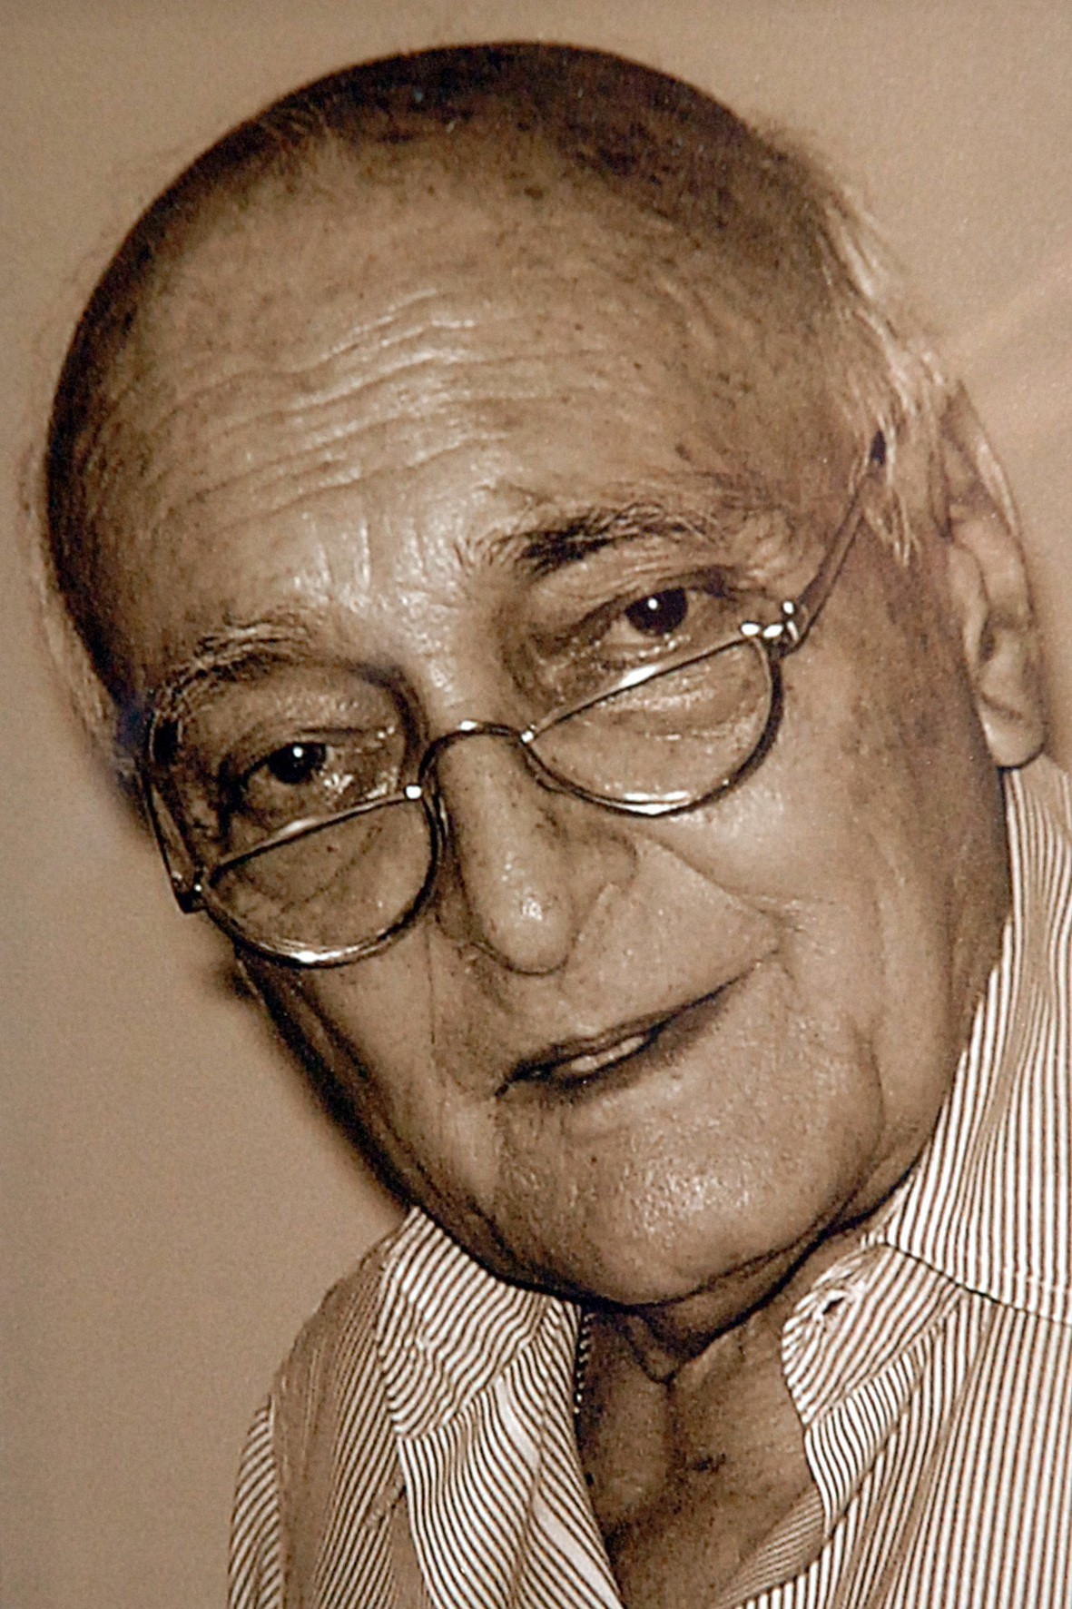
Dr. Victor de Mello Goa Lecture
and
100th Birth Anniversary
A contribution from Brazil
May, 14th, 2026
Ref: Espaço Victor de Mello na Escola Politécnica da USP. Foto: Francisco Emolo/Jornal da USP

Slide 2
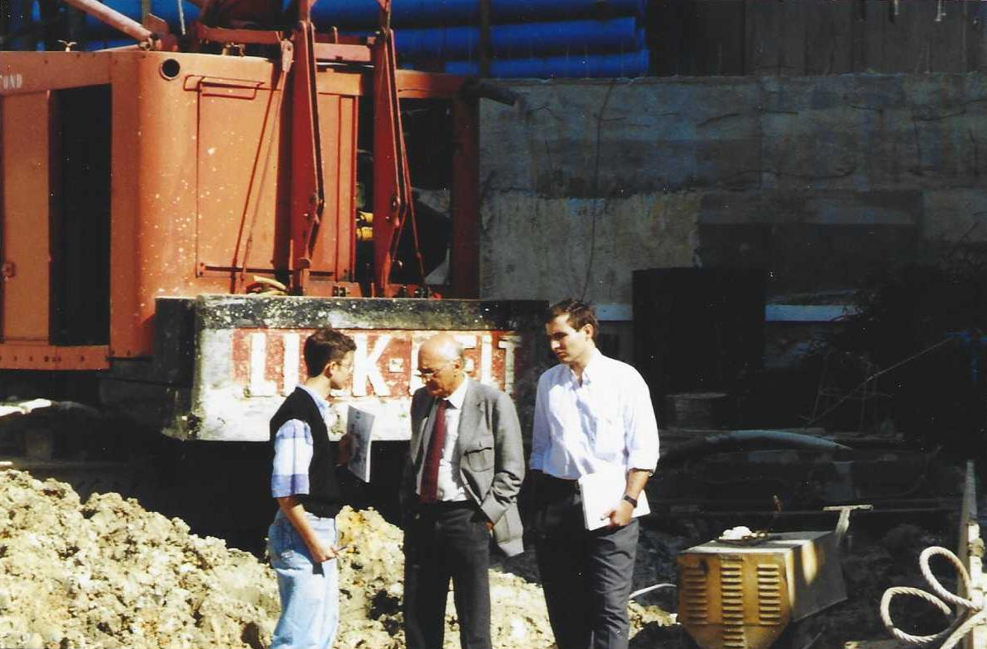
Site Visit with Prof. Victor de Mello
High Rise Building:
20 stories tall
5 basement levels in alluvium strata overlying granitic-gneiss residual soils.
Top-down construction method using diaphragm walls and foundation on bored piles.
Foundation Design by Prof. Victor de Mello & Vecttor Projetos
São Paulo, 1998

Slide 3
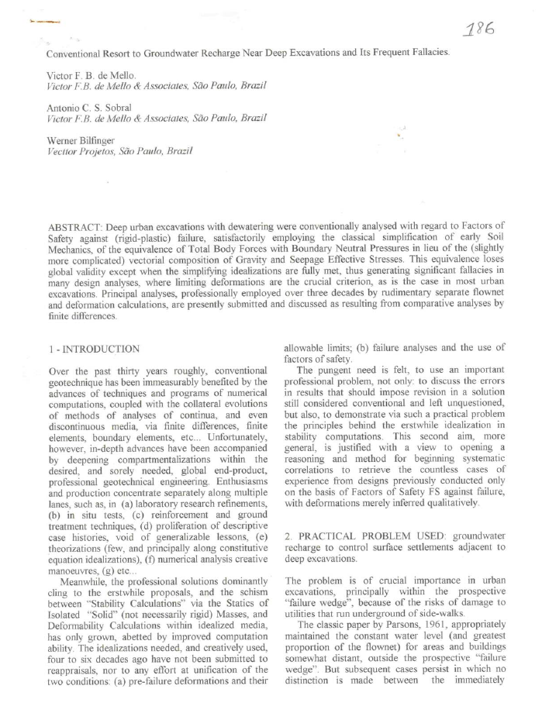
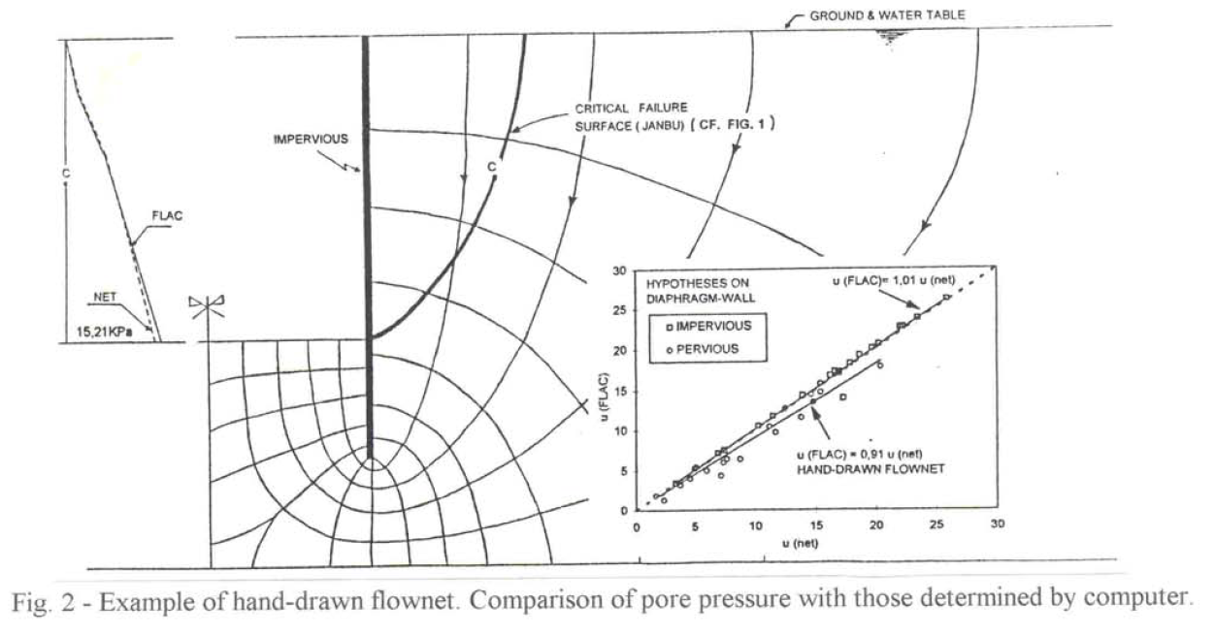
Hand drawn flownet x Numerical Model results => numerical model used to confirm intuition.
De Mello, V.F.B., Sobral, A.C.S., Bilfinger, W. (1998).
Conventional resort to groundwater recharge near deep excavations and its frequent fallacies. Proc. World Tunnel Congress., São Paulo
https://victorfbdemello.com.br/arquivos/Publicacoes/186%20-%20Conventional%20Resort%20to%20Groundwater%20Recharge%20Near%20Deep%20Excavations%20and%20its%20Frequent%20Fallacies.pdf

Slide 4
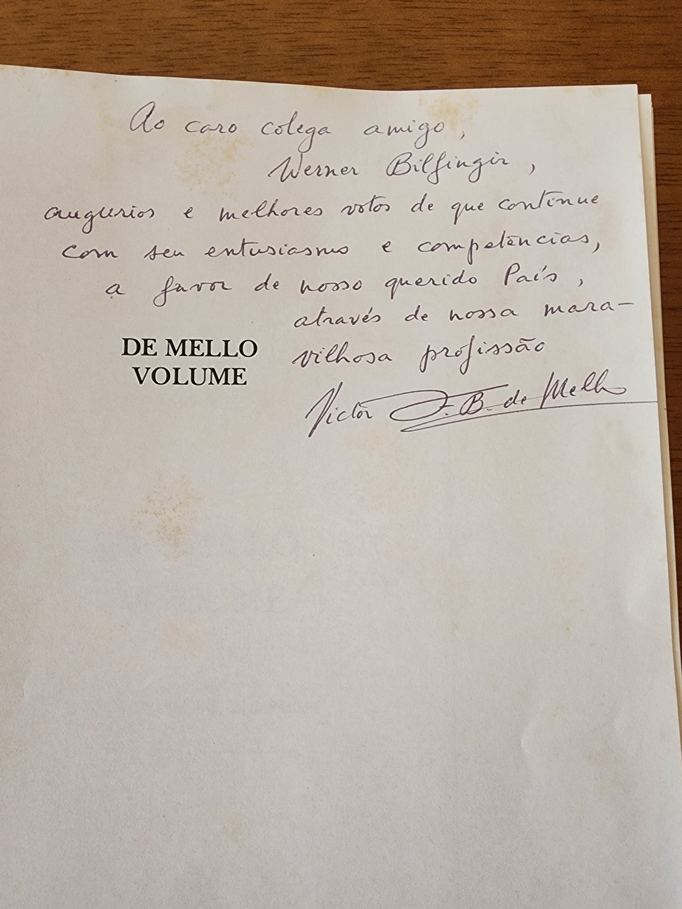
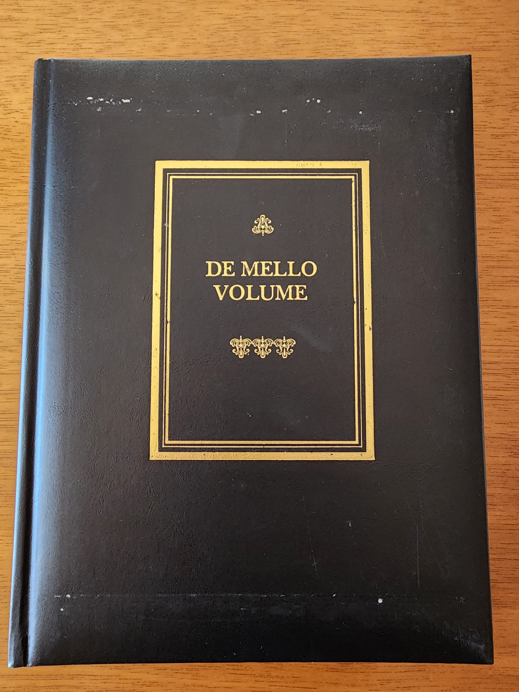
De Mello Volume, 1989
“To my dear colleague and friend Werner Bilfinger, my best wishes and sincere hopes that you continue with your enthusiasm and expertise in service of our beloved country, through our wonderful profession.”
Victor F. B. de Mello
https://victorfbdemello.com.br/arquivos/Volume/De_Mello_Volume_Compressed.pdf

Slide 5
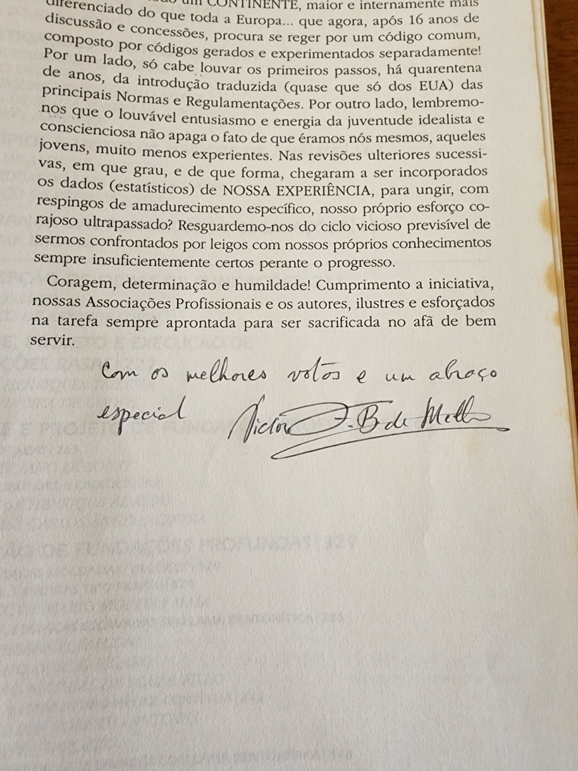
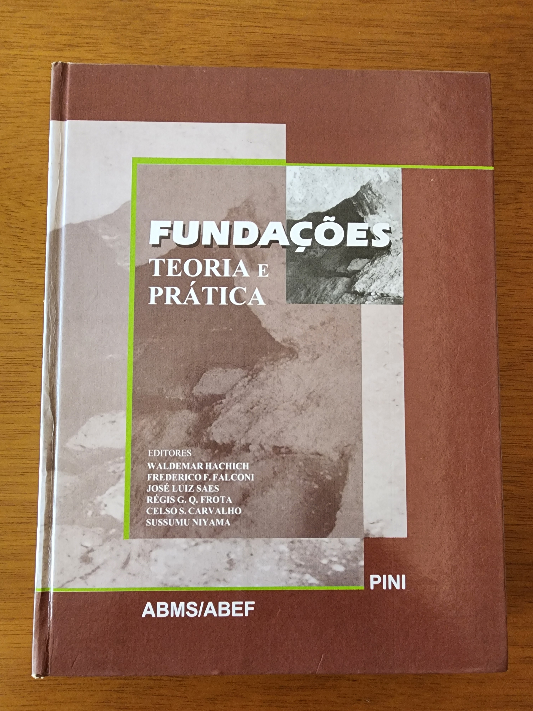
Foundations – Theory and Practice (1st ed. 1996)
(In Portuguese)
Foreword by Prof. Victor
“With best wishes and a special hug.”
Victor. F. B. de Mello

Slide 6
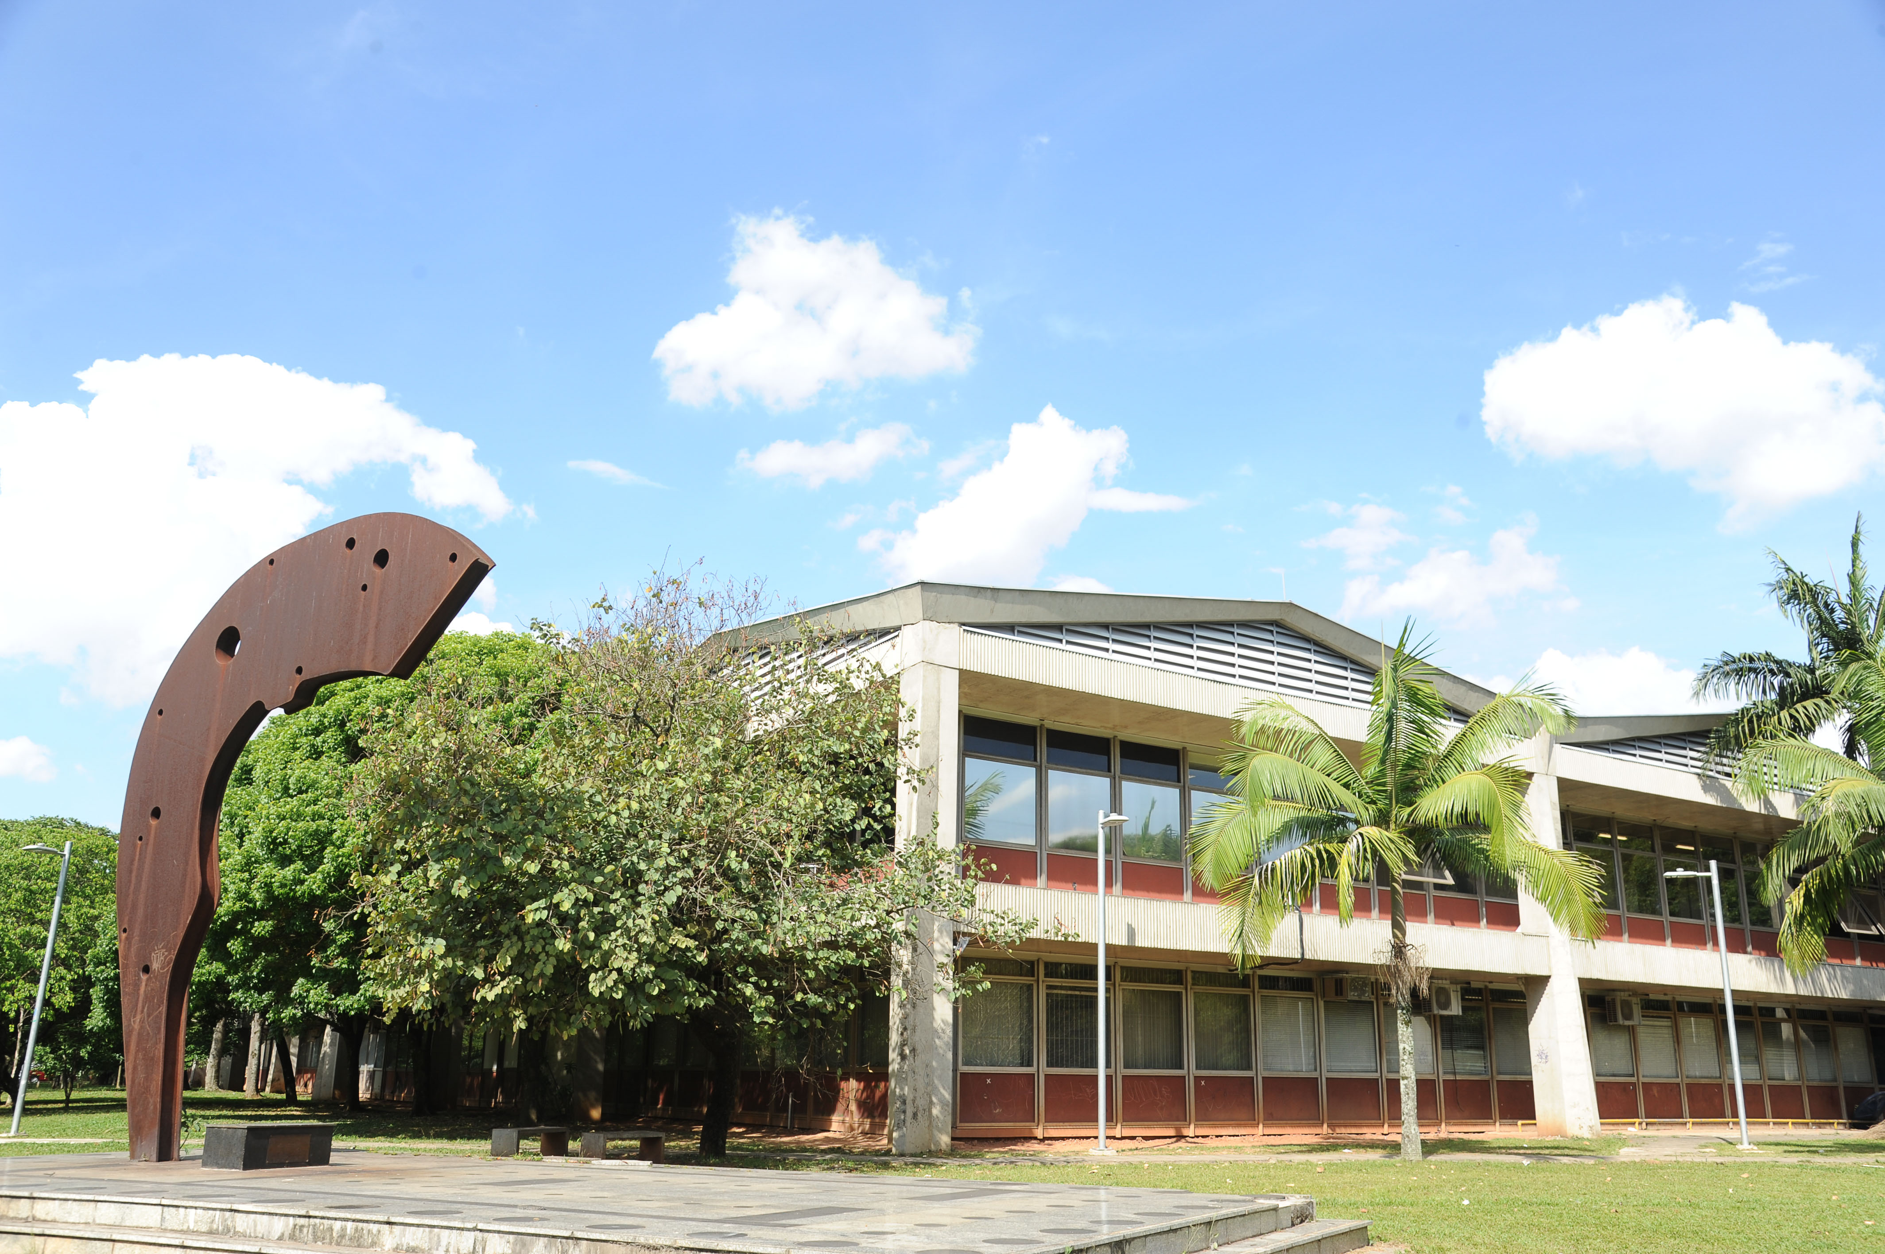
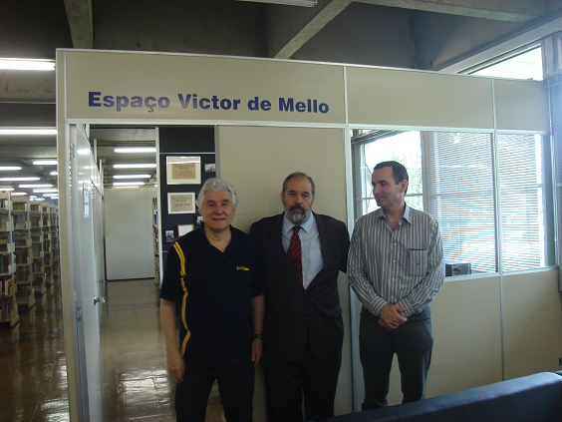
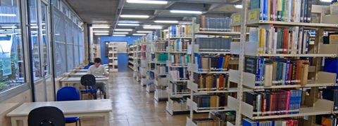
University of São Paulo – Polytechnical School – Civil Engineering Building
Section of the civil engineering library with Prof. de Mello’s private library (donated to the university)
From left to right:
Prof. Waldemar C. Hachich (former ISSMGE Vice President – South America)
Prof. Roger Frank (former ISSMGE President)
Werner Bilfinger

Slide 7
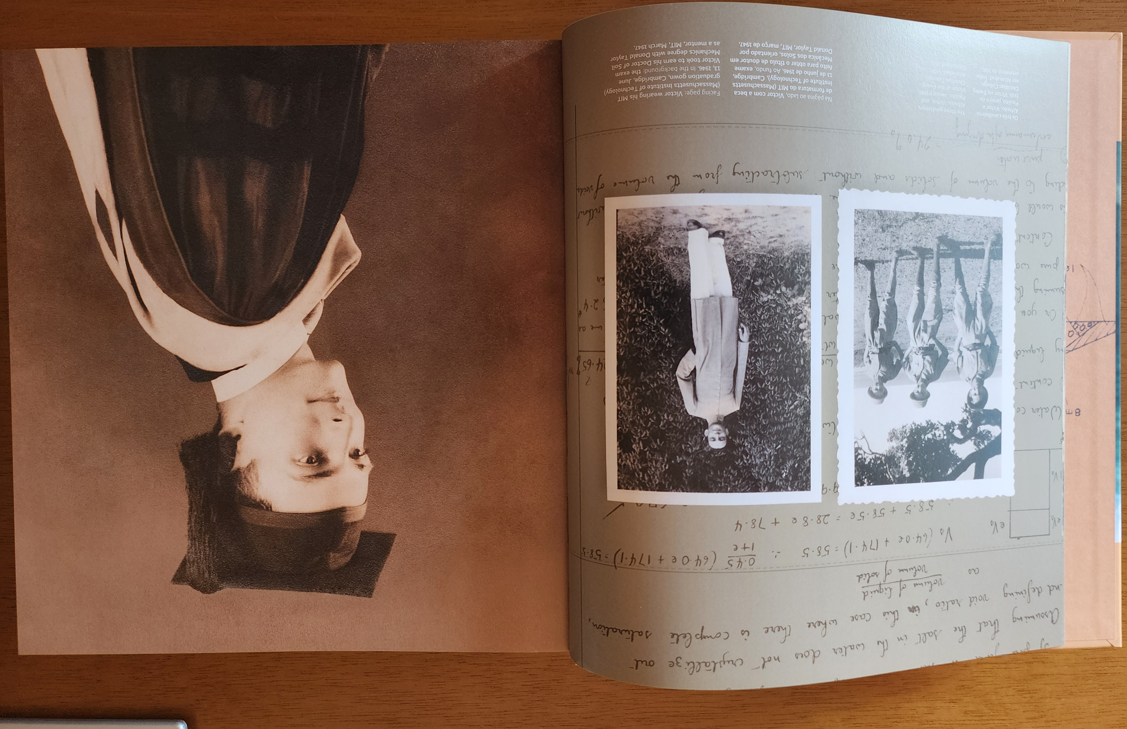

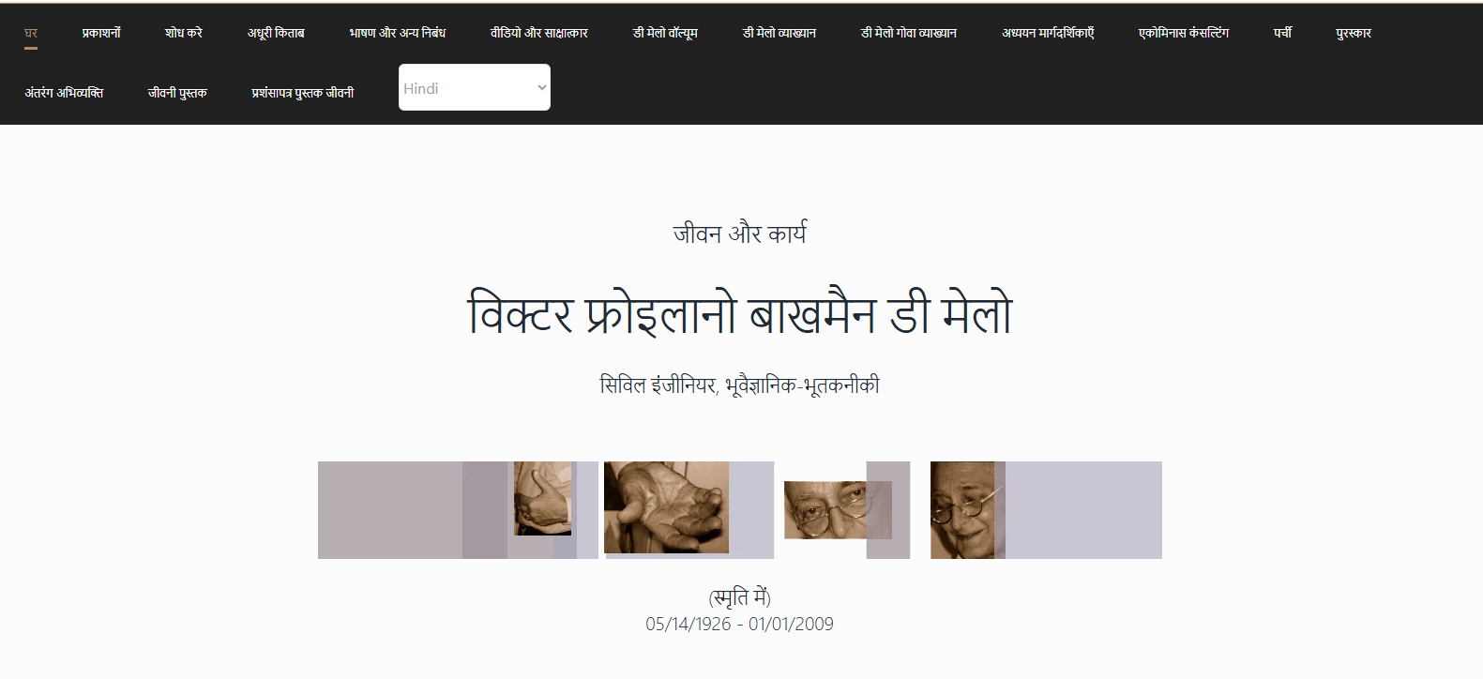
BIOGRAPHY BOOK
Free download from www.victorfbmello.com.br

Slide 8


SETTLEMENTS DUE TO BLASTING VIBRATIONS
WERNER BILFINGER
Vecttor Projetos - São Paulo - Brazil
Goa Chapter
Indian Geotechnical Society

Slide 9
PRESENTATION OUTLINE
INTRODUCTION
PROJECT DESCRIPTION
GEOLOGICAL & GEOTECHNICAL BACKGROUND
MONITORING
POSSIBLE CAUSES
CONCLUSIONS

Slide 10
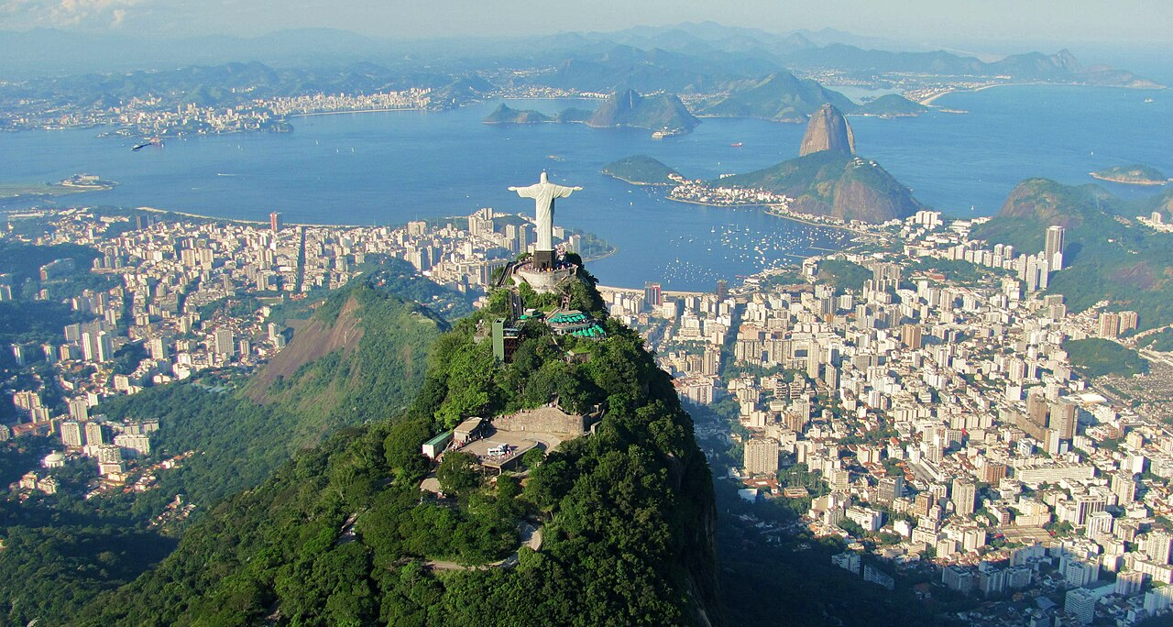
Rio de Janeiro, Brazil
Residual soil and colluvium
Granite / gneiss
Sandy and clayey recente sediments
Por Rafael Rabello de Barros - Obra do próprio, CC BY-SA 3.0, https://commons.wikimedia.org/w/index.php?curid=40647065

Slide 11
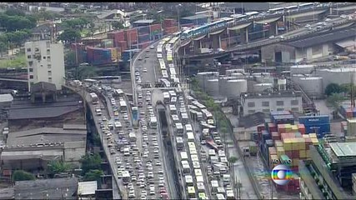

Slide 12
Introduction
THE “PORTO MARAVILHA” PROJECT
Located in Rio de Janeiro – Brazil
Part of the “Olympic Legacy”
Urban regeneration in old harbor and city center areas
Put underground part of the roads => construction of 4 tunnels

Slide 13
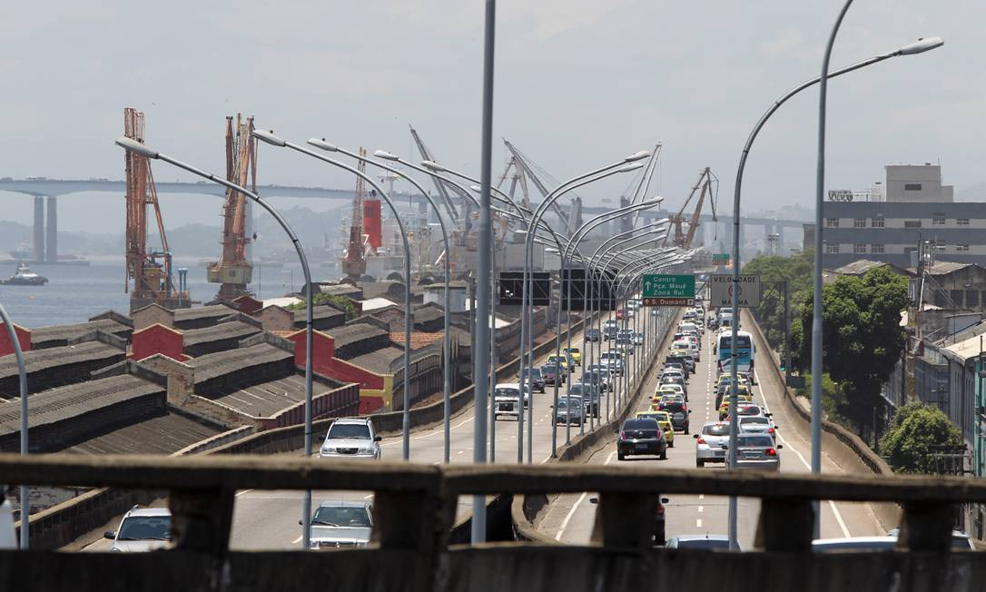
Introduction

Slide 14
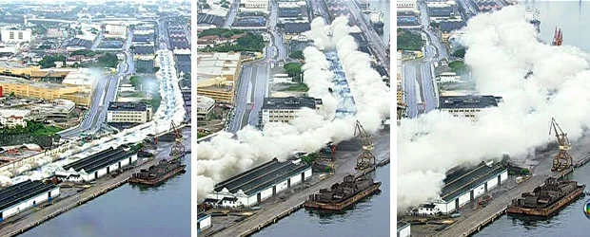
Introduction

Slide 15
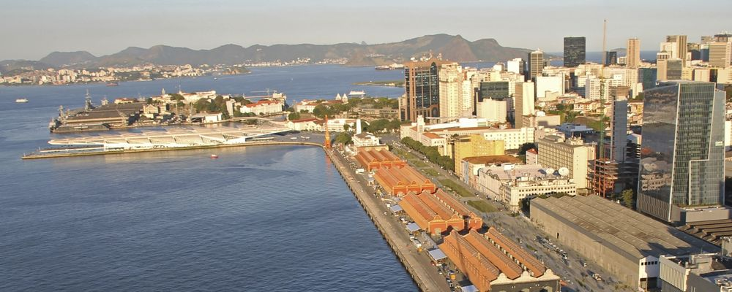
Introduction

Slide 16
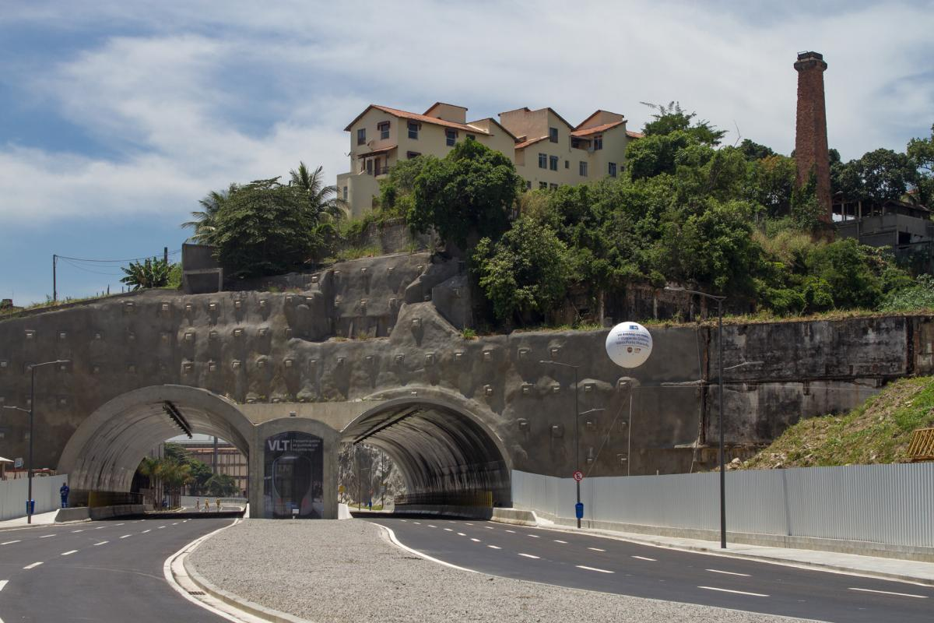
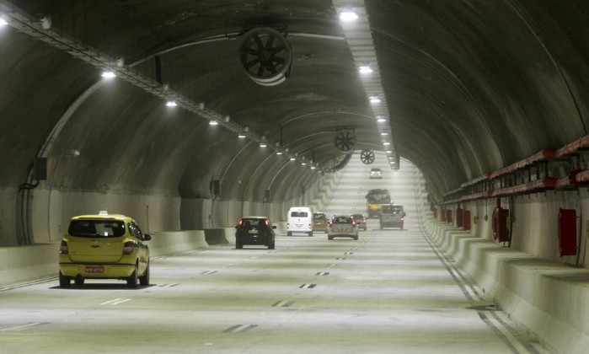
Project Description
4 Tunnels
  Saúde tunnel - 35 m long (Waimberg et al, 2014);
  “Binária tunnel” - 1012 m long;
  “Via Expressa” twin tunnels - 1850 m long each way.
Several other improvements

Slide 17
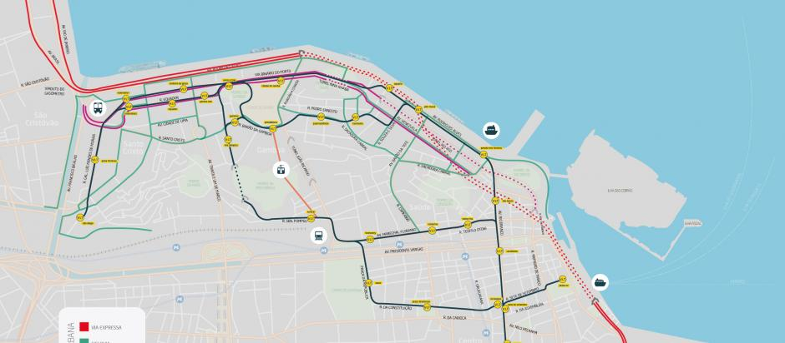
Project Description
Via Expressa tunnels

Slide 18
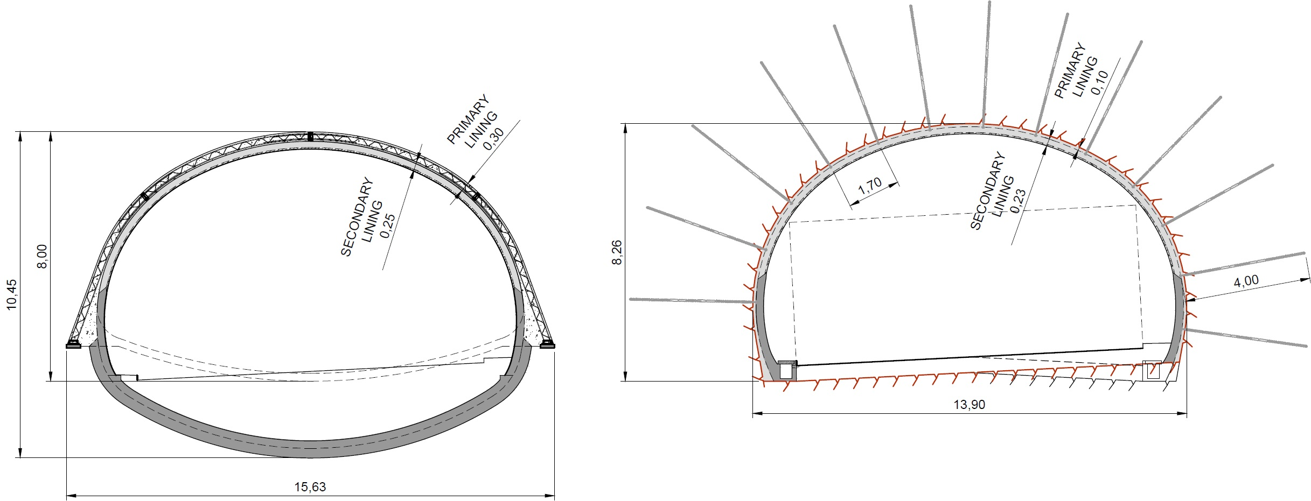
Project Description

Slide 19
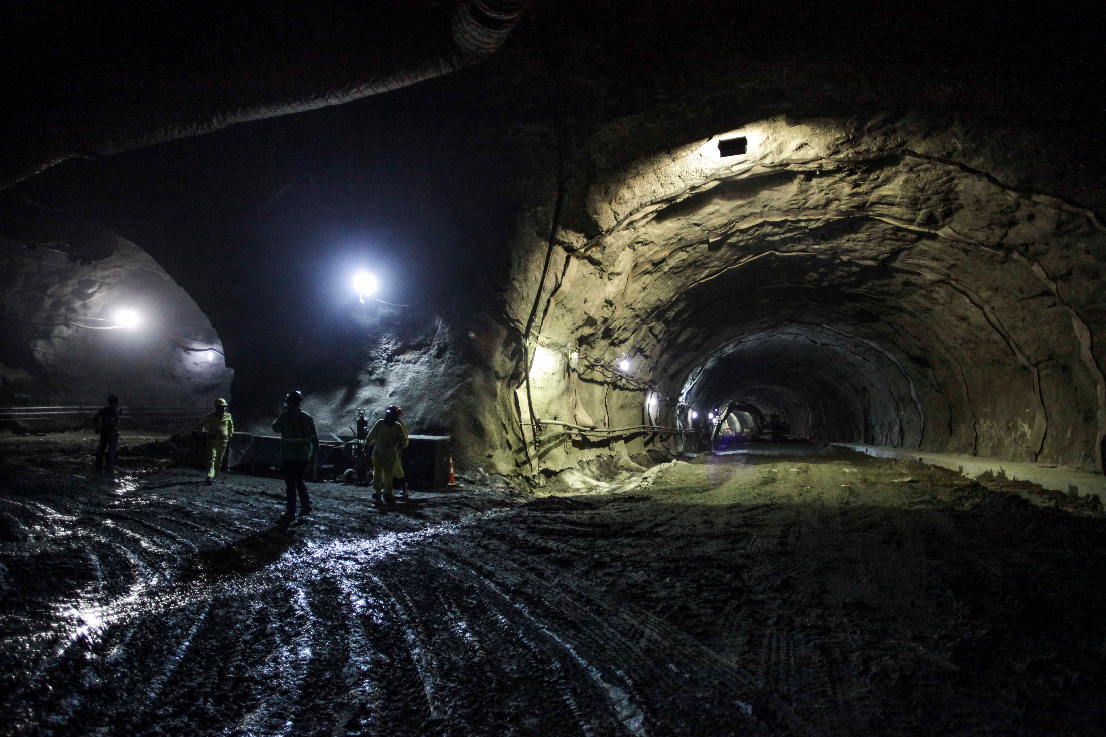
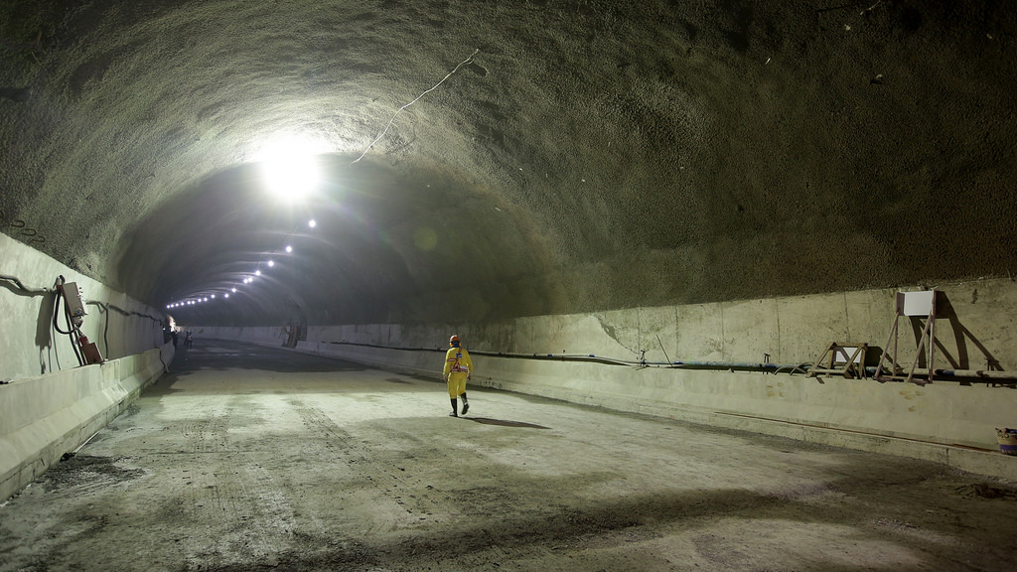
Project Description

Slide 20
Geological Background
Tunnels Excavated mainly in rock (to minimize interference with the surface)
Rock Type => Granitic Gneiss
RMR => variable I to IV
2 major fault zones crossed
Soil stretches close to tunnel portals

Slide 21
Geological Background

Slide 22
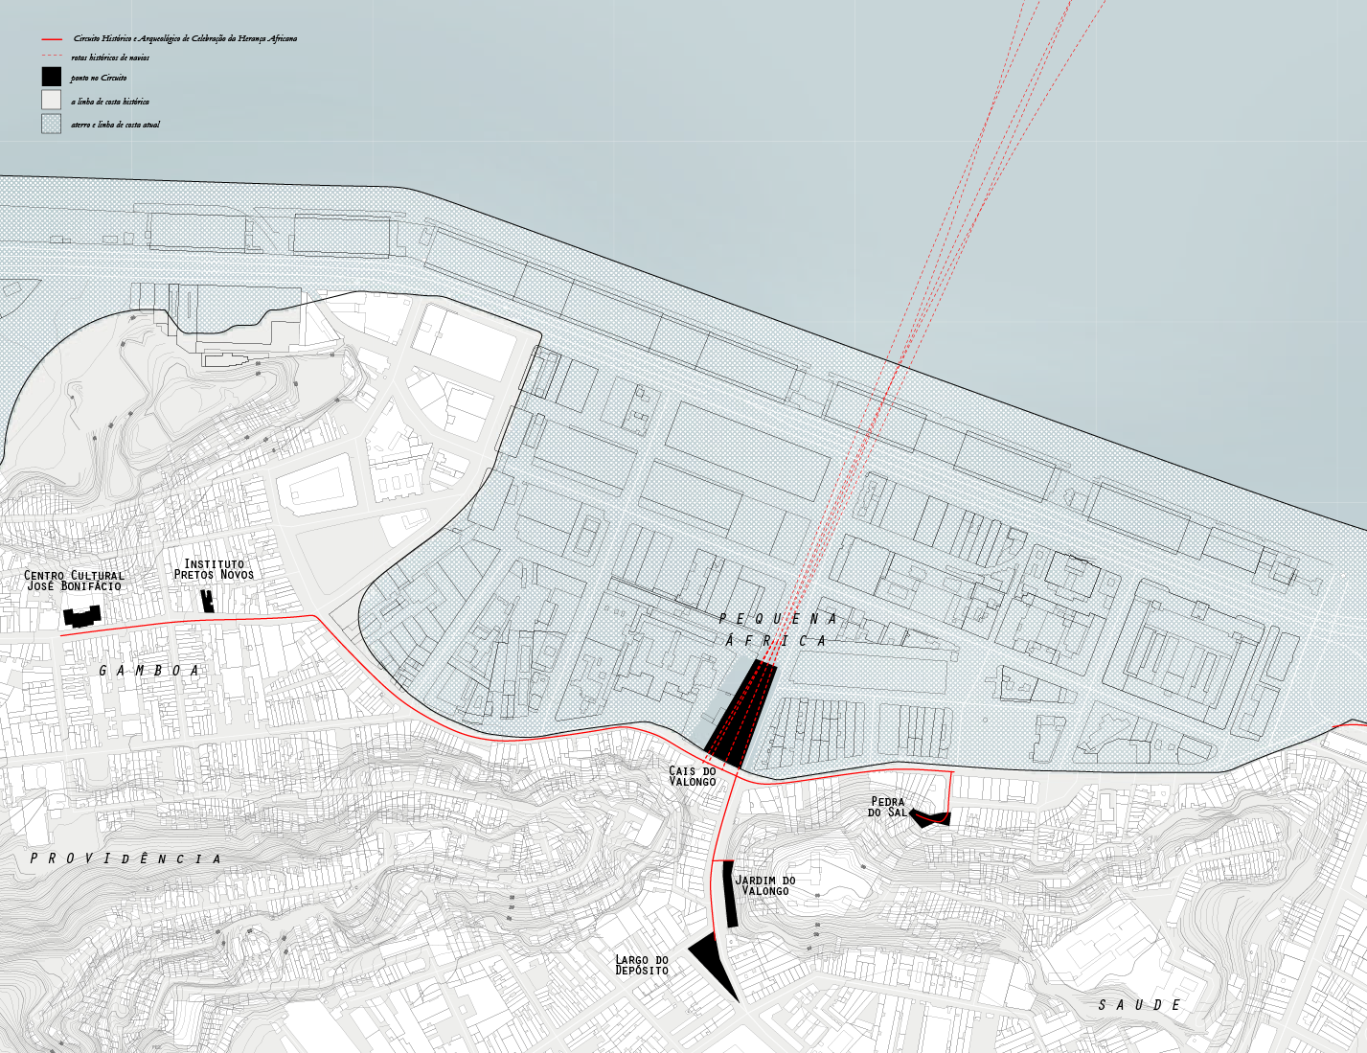
Geological Background
Reclaimed from the sea
Former pier, where slave ships arrived

Slide 23
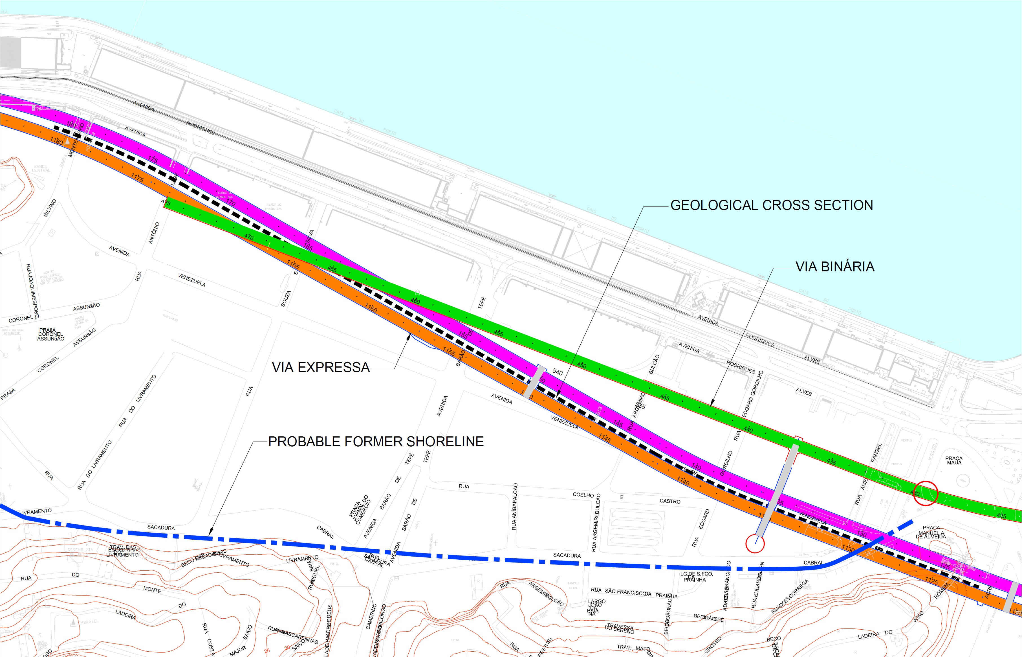
Geological Background

Slide 24
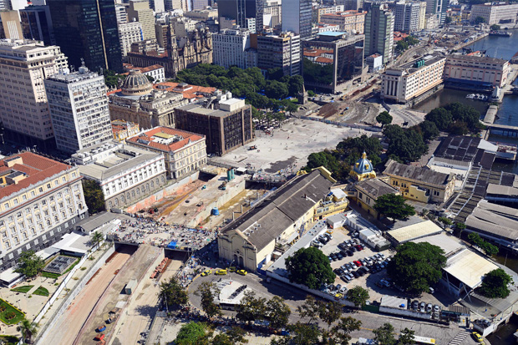
Monitoring
Densely populated area
Internal: horizontal and vertical displacements
External:
  Façade leveling points
  Surface leveling points
  Rod extensometers
  Piezometers
Seismographs

Slide 25
Monitoring
Several historic buildings => careful blasting (DIN 4150 parameters)
No significant settlements were expected
  Tunnel in “good” rock
  Sufficient rock cover
  Careful blasting
Settlement of “Rua Venezuela 45” building:

Slide 26
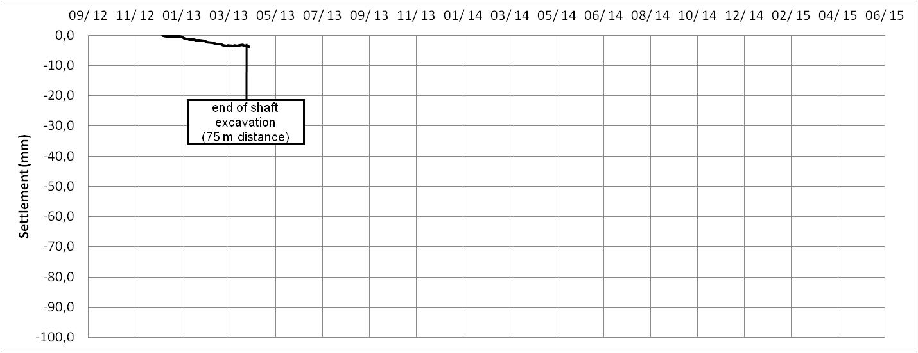
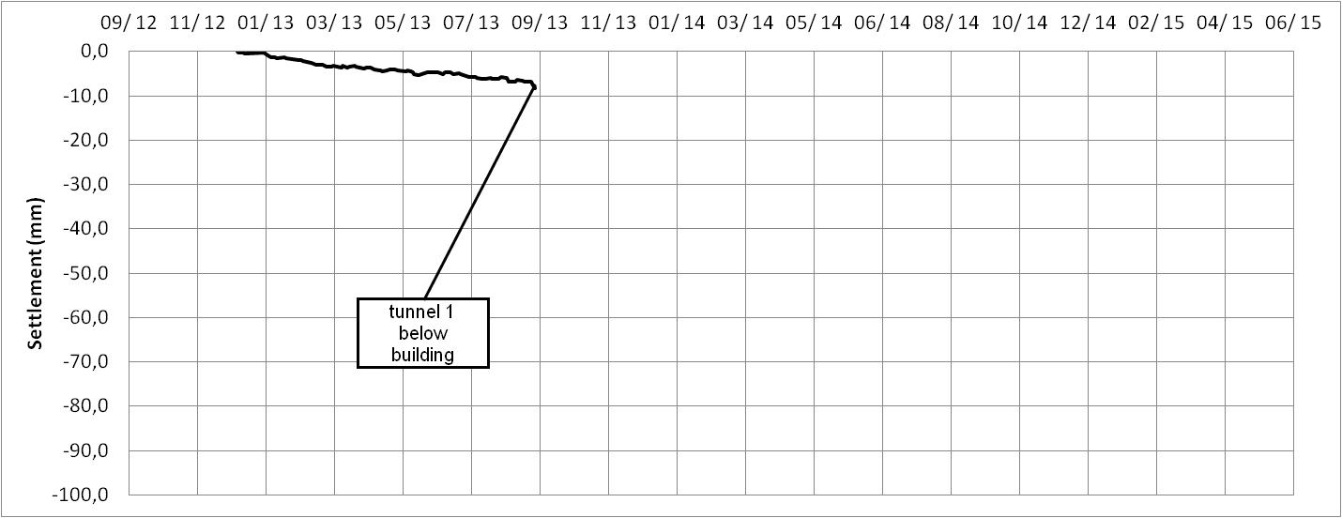
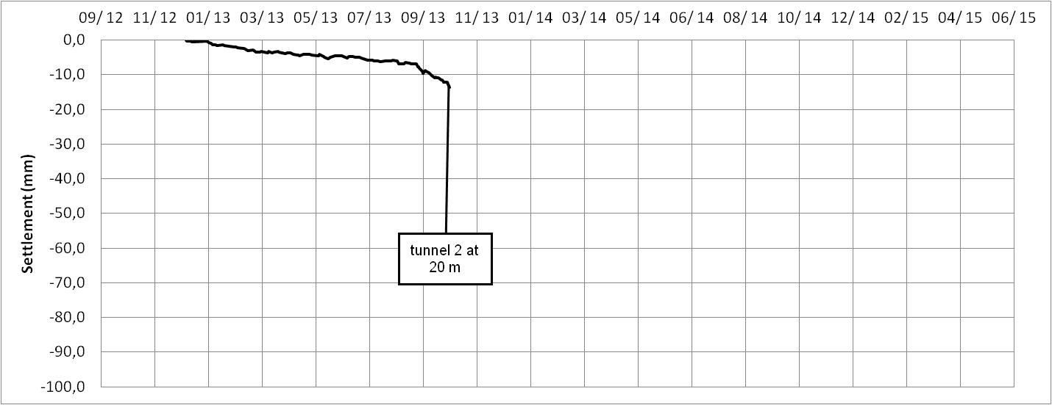
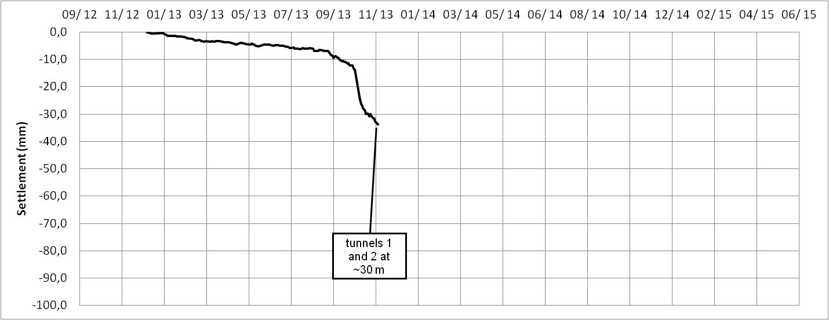
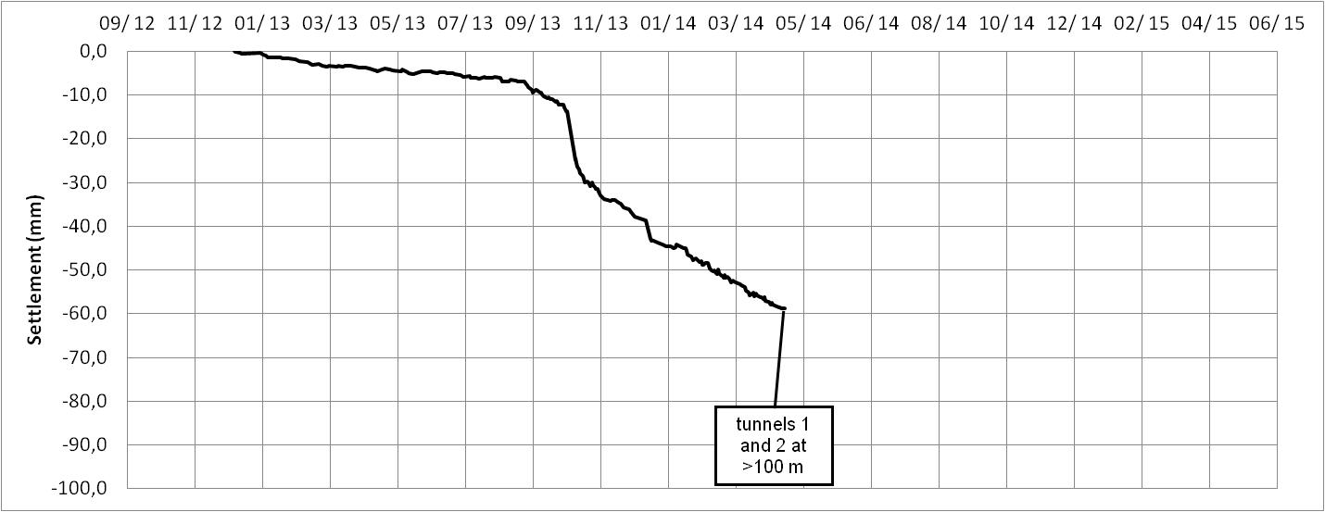
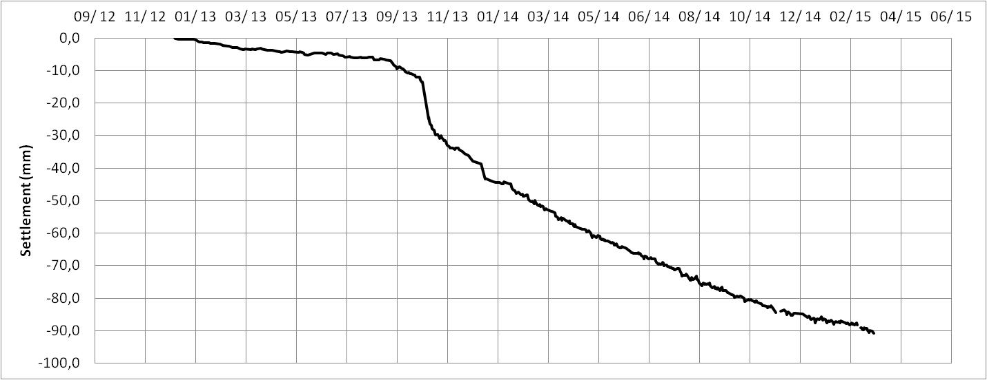
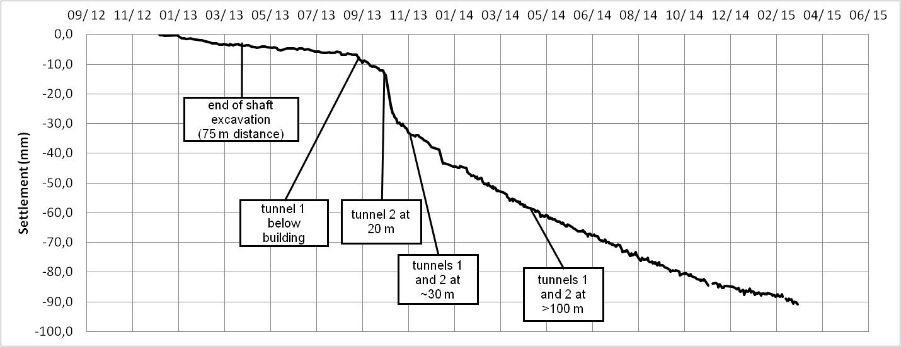
Monitoring

Slide 27
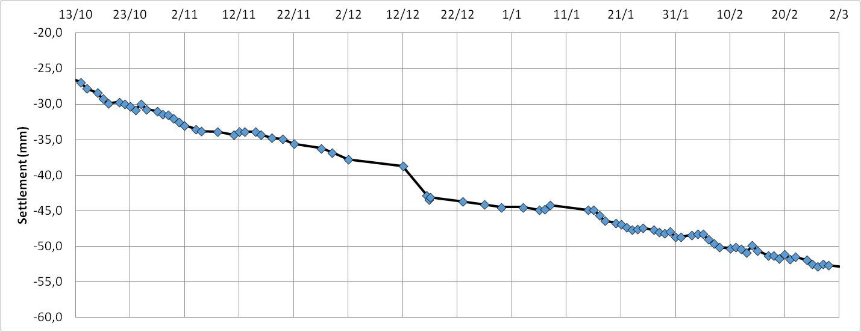
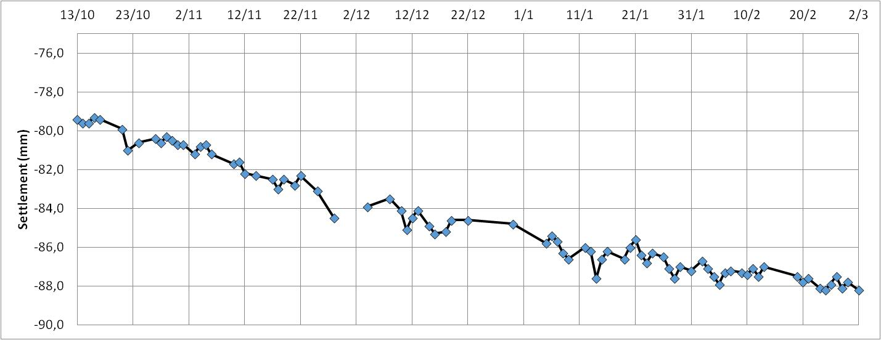
Monitoring
Constructon activities stopped for the end of the year hollidays

Slide 28
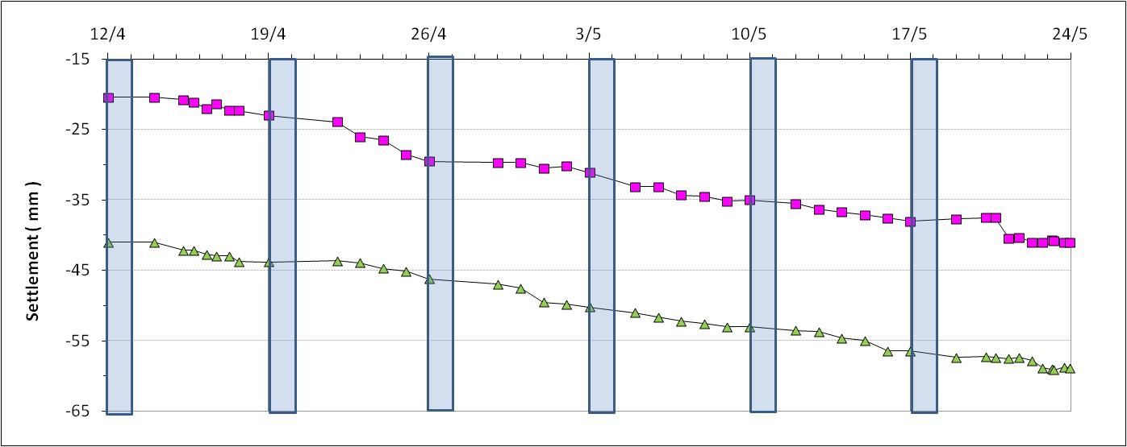
Monitoring
Apparently some relation between site activities and settlements: weekends and holidays
No “conventional” interpretation possible

Slide 29
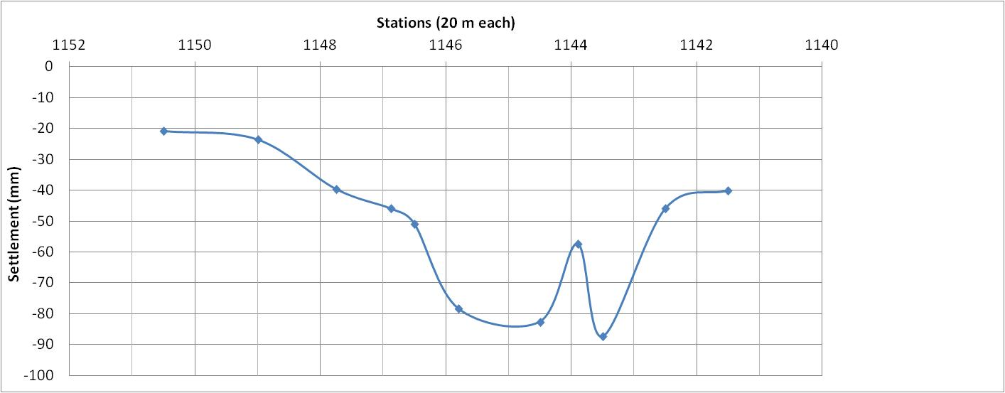
Monitoring
Settlements on the surface along tunnel alignment => very high for a tunnel in rock!

Slide 30
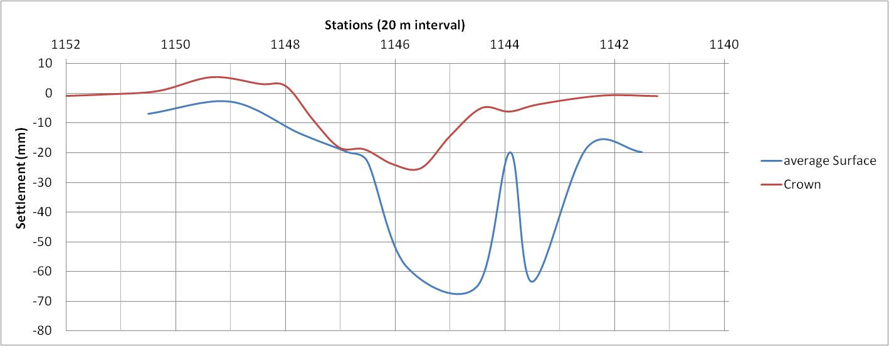
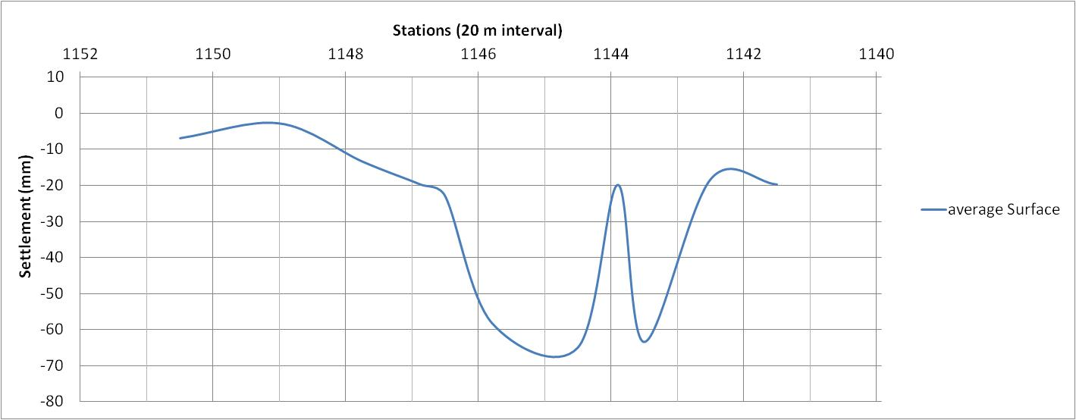
Monitoring
Same longitudinal section
Same time interval for internal and external measurements
Fault zone
Surface settlements higher than tunnel crown settlements

Slide 31
Possible Causes
“Normally” settlements due to tunneling:
  “Ground Loss”
  Groundwater lowering
Settlement at significant distances => probably not ground loss
More settlement at the surface than inside the tunnel => Groundwater lowering?
  Piezometers did not show significant water level lowering
  Apparent relation between excavation activities and settlements

Slide 32
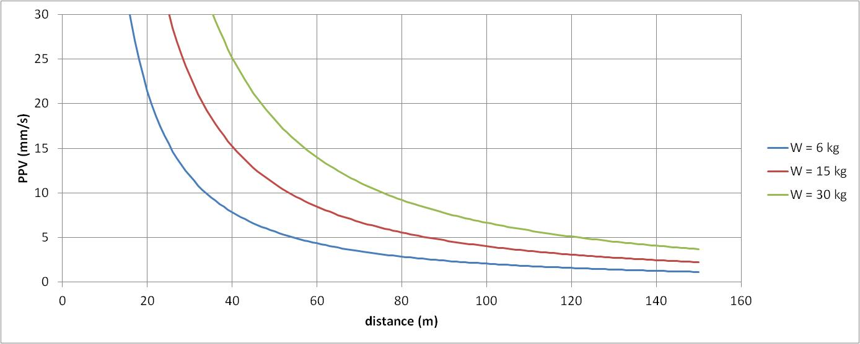

Possible Causes
Densification of loose sands due to blasting?
  Similar behavior measured by Coutinho et al (2007).
Range of blasting induced vibrations:
  Saliba et al (2014) – for Rio de Janeiro Gneiss – K = 450, α = 1,45 , β = 0,5

Slide 33
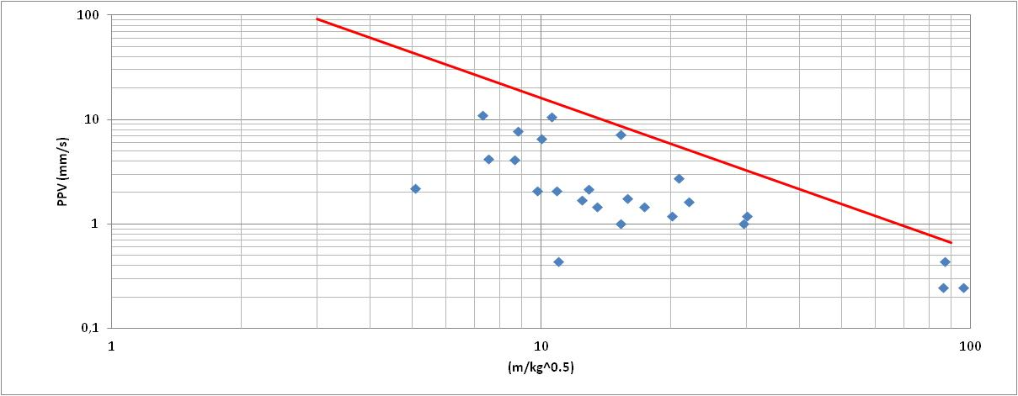
Possible Causes
Vibrations measured at the surface – buildings
Probably at the base of the soil (rock soil interface) higher
Saliba et al (2014)

Slide 34
Possible Causes
Almost 10 s vibration
ppa > 0,3 g ; ppv =7,3 mm/s
Small “earthquake”?

Slide 35
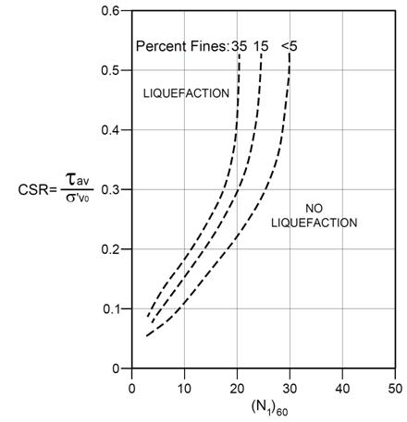
Slide Title
Soil profile => upper layer of clean, uniform, loose sand
CSR - Cyclic stress ratio (Seed & Idriss, 1971) approx. 0,15 (for 0,15 g)
Soils is potentially liquefiable!

Slide 36
Conclusions
Significant settlements at the surface occurred.
Volume loss and groundwater lowering were not the main cause.
Most probable cause: volume reduction of loose sands due to blasting induced vibrations.
Possible mitigation: very complicated => probably extensive previous activities would be necessary

Slide 37
Acknowledgements
EGT – Engecorps => Design Consortium
Odebrecht, OAS and Carioca Engenharia => Construction Consortium
THANK YOU!

