Slide 1
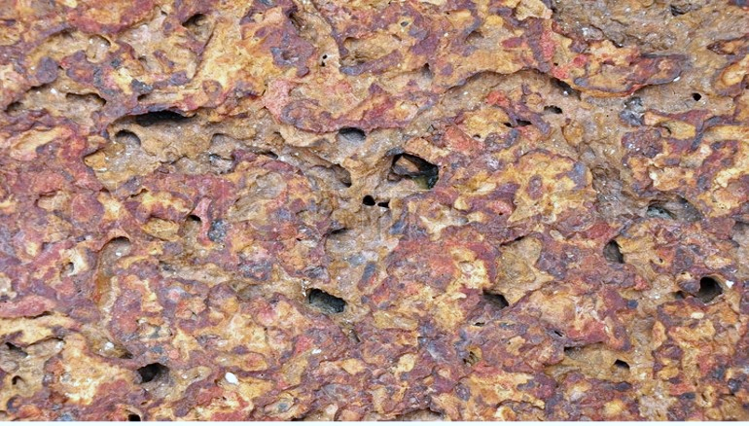
GEOTECHNICAL ENGINEERING WITH LATERITIC SOILS AND
SLOPE STABILITY IN
LATERITIC FORMATIONS
By
Dr. R. Shivashankar
Ex-Professor & HOD, Department of Civil Engineering
National Institute of Technology Karnataka, Mangalore

Slide 2
Definition and Brief Description of
Laterites and Lateritic soils of coastal peninsular india
Properties of laterites and lateritic soils vary in different regions depending on the nature of the parent rock.
Some scientists define laterites/lateritic soils based on silica-alumina ratio of the clay fraction
LATERITES are considered as soft rock or hard soil or highly compacted and cemented soils – rich in iron and aluminium
● Laterites can easily be cut into brick-shaped blocks for building.
● Laterites are products of laterization – which is a chemical weathering process

Slide 3
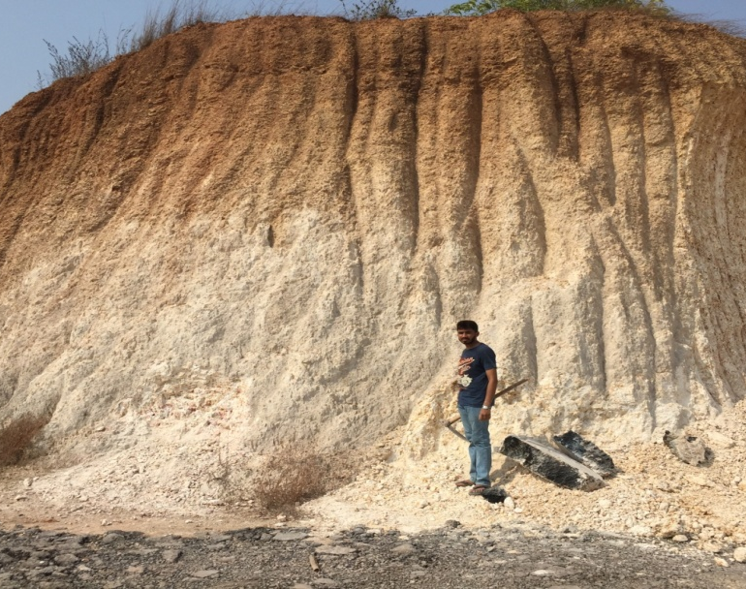
Stratification in lateritic formations
LMC is naturally available sandwiched between the weathered laterite at top and the hard parent rock granitic gneiss at bottom
LMC is locally called as the ‘shedi soil’
The top hard and porous laterites are used as bricks for construction purposes in this region, thereby exposing underlying LMC soil.
LMC are used for filling lowlying areas. The lithomargic clays are problematic soils. They behave like dispersive soils (i.e. they are weak when unconfined, lose strength on soaking/wetting, have a high erosion potential)
Lithomargic clays (lithomarges) are amorphous compounds of composition 2H₂O.Al₂O₃.2SiO₂, corresponding to the crystalline mineral kaolinite of the same composition.
LATERITE CRUST
LMC
PARENT ROCK BENEATH

Slide 4
Depth
RL 157.500
Hard Laterite
4.5 m
Bore log details at BH 1 at Vamanjoor site
Lithomargic clay
13.5 m
Weathered rock
16.8 m
Disintegrated Rock
18.4 m
Hard rock
RL 138.000
19.5 m

Slide 5
Depth
RL 158.000
Hard Laterite
5.3 m
Soft Laterite
Bore log details at BH 2
At Vamanjoor site
9.0 m
Lithomargic clay
17.0 m
Weathered Rock
18.5 m
Hard rock
RL 137.000
19.0 m

Slide 6
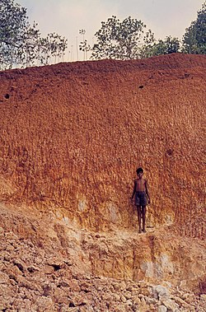
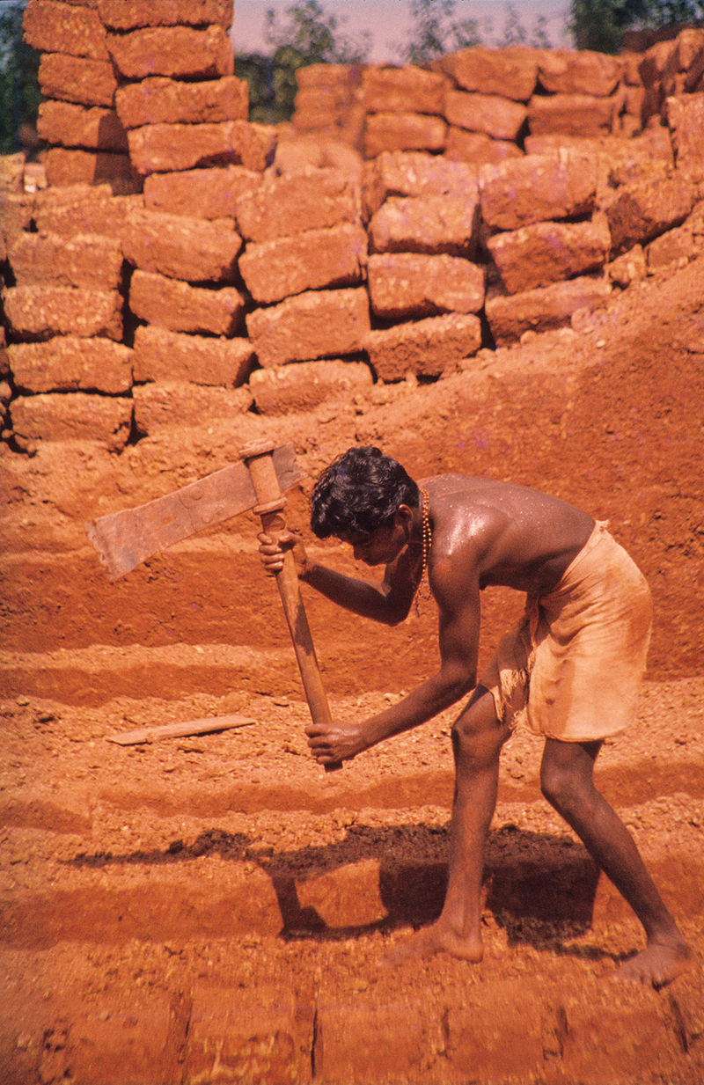
Laterites
Angadipuram (dist. Malappuram): notified as a national geo-heritage monument
Laterite formation cut into blocks for building construction
Extracted from wikipedia

Slide 7
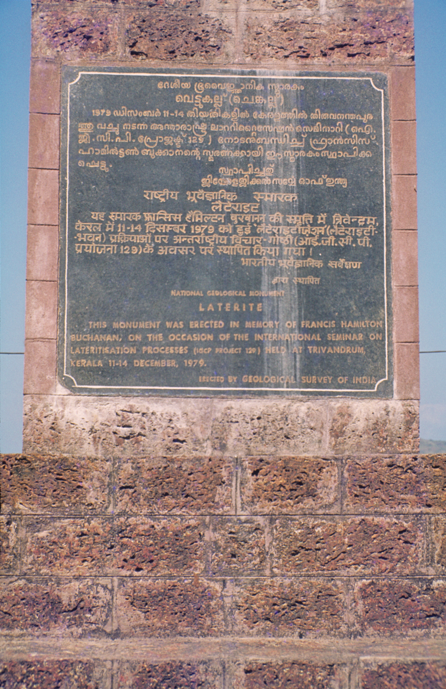
Monument of laterite brickstones at Angadipuram, Kerala India, which commemorates where laterite was first described and discussed by Francis Buchanan-Hamilton in 1807.
He was a Scottish physician who made significant contributions as a geographer, zoologist and botanist while living in India.
Extracted from Wikipedia

Slide 8
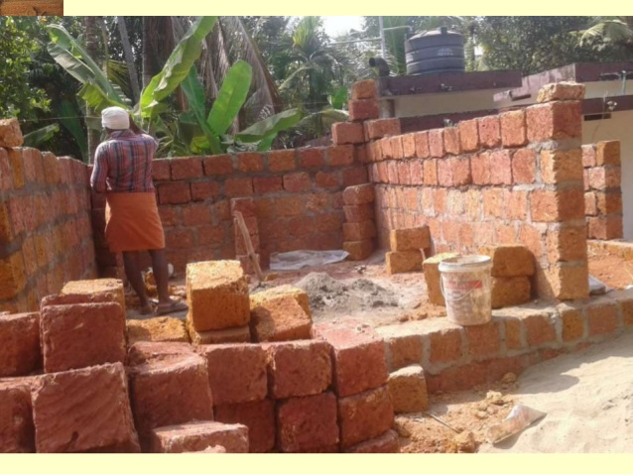
Use of Lateritic soils
Laterites can be cut into bricks (adobe) and used for construction purpose
Lithomargic clays are also for other construction purposes such as for land fills to rise lowlying areas

Slide 9
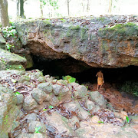
Laterites are themselves porous and will have cavities beneath
Kamalashile site
There are many caves and cave temples in lateritic formations in this coastal area

Slide 10
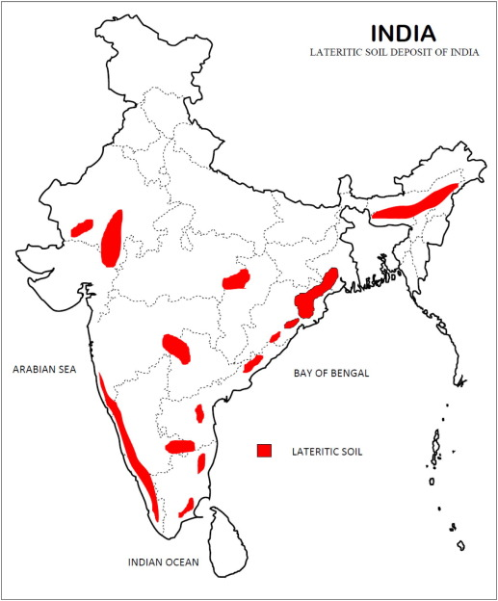
Laterites are available in South Maharashtra, parts of Karnataka, Andhra Pradesh, Orissa, West Bengal, Kerala, Assam, Meghalaya and Goa
Cover more than 2.48 lakh sq. km. of area.
World over they are found in the tropical and the sub-tropical humid regions. In parts of USA, South America, Africa, South Africa, India, Southeast Asia, Australia, China
Extracted from Biswal et al. (2016),
Transportation Geotechnics/Science Direct

Slide 11
Laterites from a
Geotechnical Engineering perspective
● Geotechnical Engineer’s perspective means use of laterites/lateritic soils for construction purposes and as a load bearing material (foundation material)
● Engineering Properties of Laterites/lateritic soils mainly vary with climate, and parent rock (laterites can be formed from igneous or sedimentary or metamorphic rocks)
●Laterites are rich in sesquioxides. A sesquioxide is an oxide with three atoms of oxygen and two metal atoms. Fe₂O₃ and Al₂O₃ . SiO₂ is the main constituent and Fe₂O₃ is significantly more in our laterites, available in this Malabar coast
● Soft and hard and ferruginous Laterites are available in India. Soft laterites harden with time. Aging is an important aspect of lateritic rocks.
● Compressive strength of laterites vary from about 5 MPa to about 40 Mpa. Laterites exhibit anisotropy.
● Laterites have very low water retention capacities. They are porous/vesicular
● Properties of laterites depend a lot on the parent rock. Laterites will have cavities

Slide 12
Climate and geology of area influencing formation of laterites/lateritic soils

Slide 13
Study Area: Geography & Climate
Coastal Karnataka and Kerala areas are adjacent to the Arabian Sea.
These coastal areas, on west coast of peninsular India, are on the windward side of the southwest monsoon. Thus, they witness heavy rainfall.
The area has only two seasons namely rainy season and summer. During monsoon season it rains almost continuously. During summer it is only moderately hot. Max temp. is 38 degree C. High humidity throughout the year (85% during south-west monsoons: June to September). Therefore environment is very conducive for the formation of laterites/ lateritic strata in the area
The area has very little or no marine clay.
On an average the study area is about 22m above sea level.
This coastal area receives copious amount of rainfall due to monsoons. Average annual rainfall of the area is about 3500mm to 4000 mm.

Slide 14
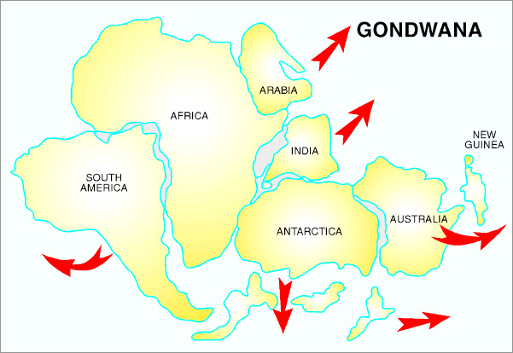
GONDWANA LAND

Slide 15
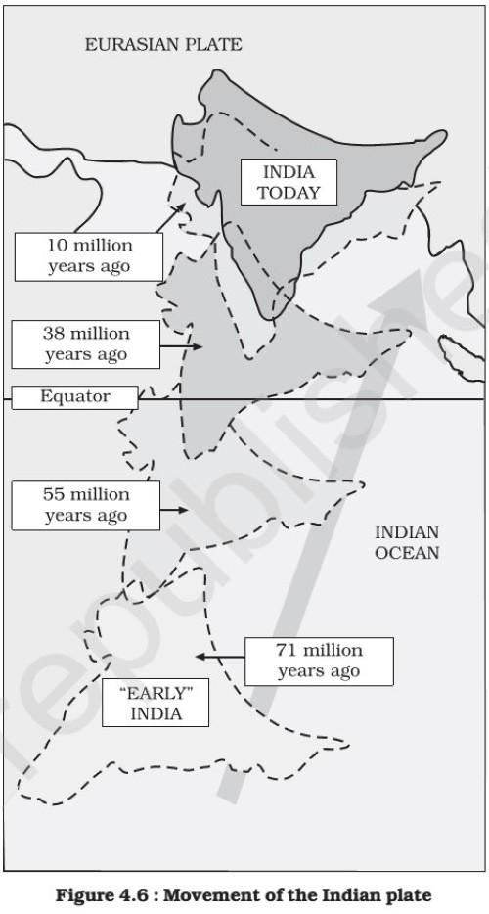

Slide 16
Tidal difference and marine clays in Coastal Karnataka
Highest tidal difference in Mangalore has been 1.86 m (6.1 feet)
Land rise due to tectonic movements i.e by the Indian plate pushing against the Asian plate is more than Sea level rise due to global warming . So there is net land rise and not sea level rise. The coast line is pushed back [There is no loss of land to sea due to sea level rise]
There is not much marine clay in this Malabar coastal belt, except in some parts of Kerala like Cochin (Cochin clay).
The height of Himalayas are increasing more than 1 cm per year

Slide 17
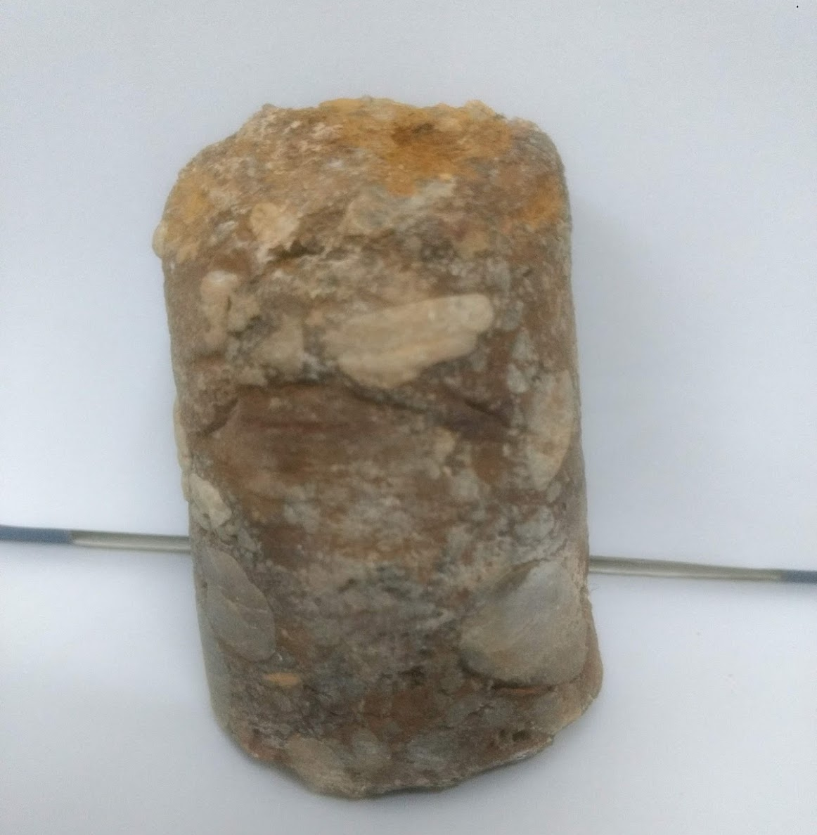
A core sample procured, from a depth of about 15m, during a geotechnical investigation for a flyover project in Hampanakarea in Mangalore. The site is some 2-3 kms from the sea.
A borehole sample procured at about 15m depth below the ground level at Hampanakatta area (which is the centre of Mangalore city)

Slide 18
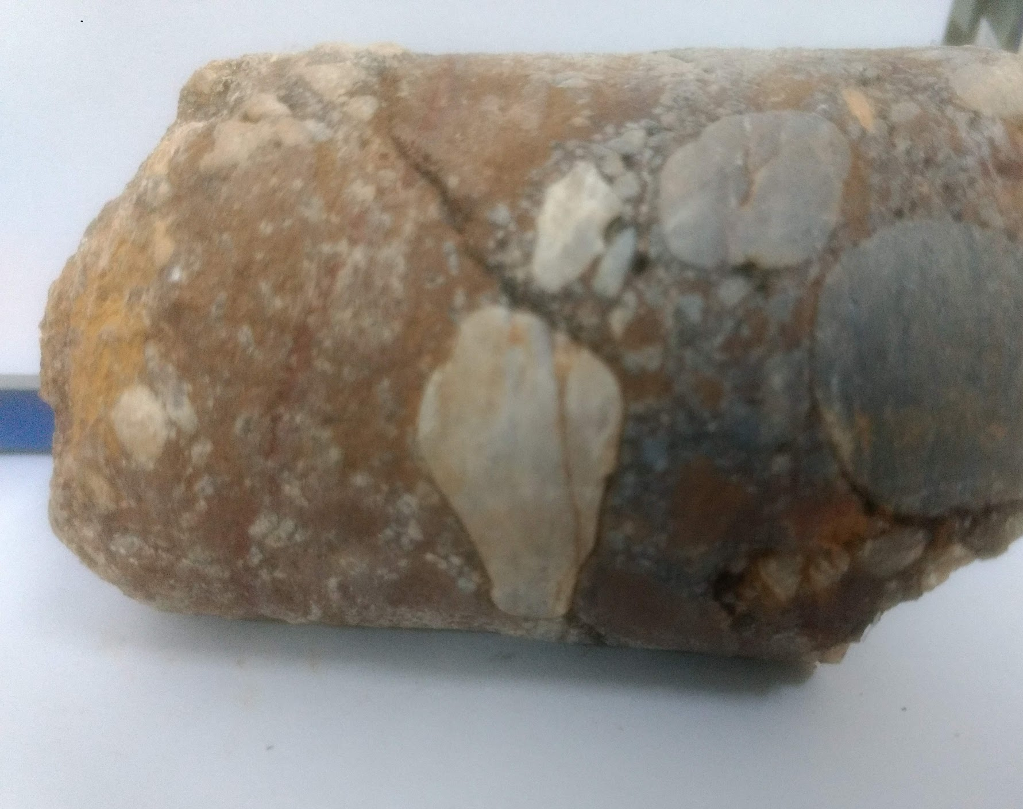
The round pebbles, fossils and peaty matter indicate that the sample was under the sea long long ago?? As of today, sea is about 1-2 kms.
What does this indicate???
It indicates that the sea has moved outwards (away from land) unlike in most coastal areas wherein the sea moves into the land

Slide 19
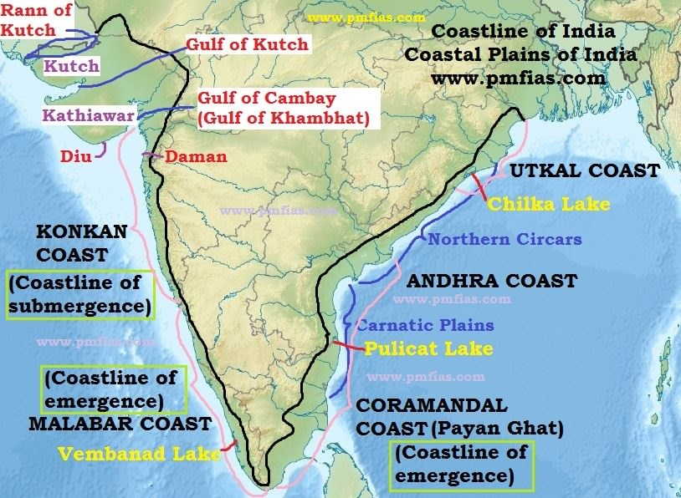

Slide 20
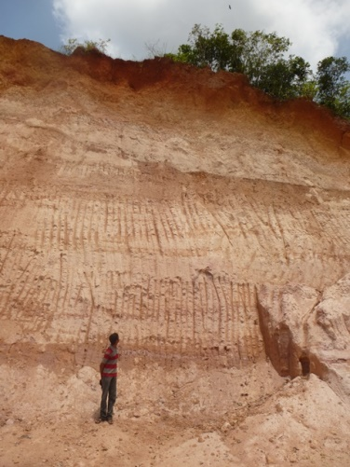
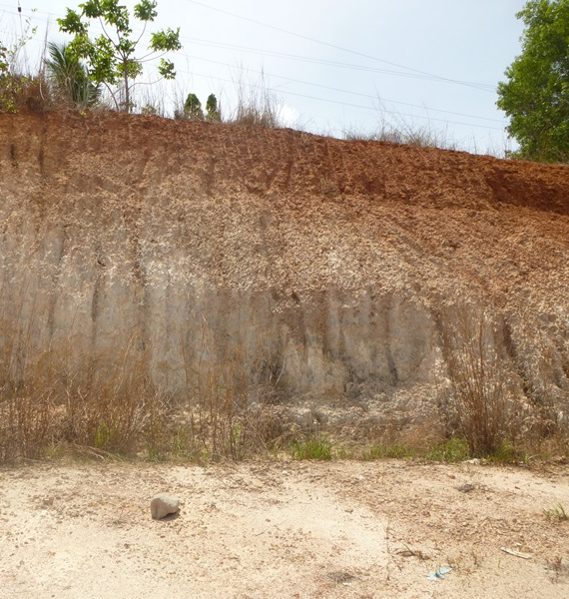


A view of lateritic formations at two sites
Top hard laterite (upto 3m thick)
Underlain by Lithomargic clay (upto 8m thick)
Below LMC is the parent rock (granitic gneiss)
Panjimoger
Padupanambur

Slide 21
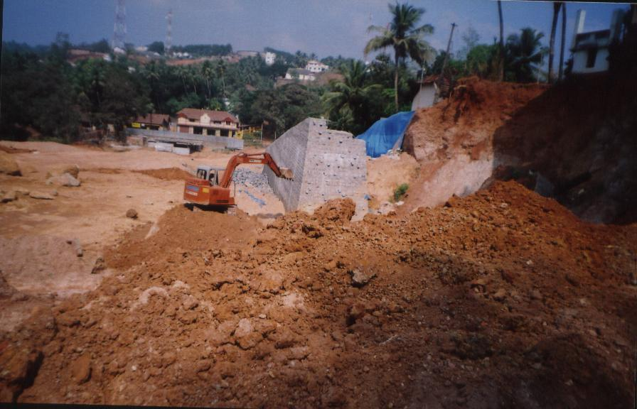
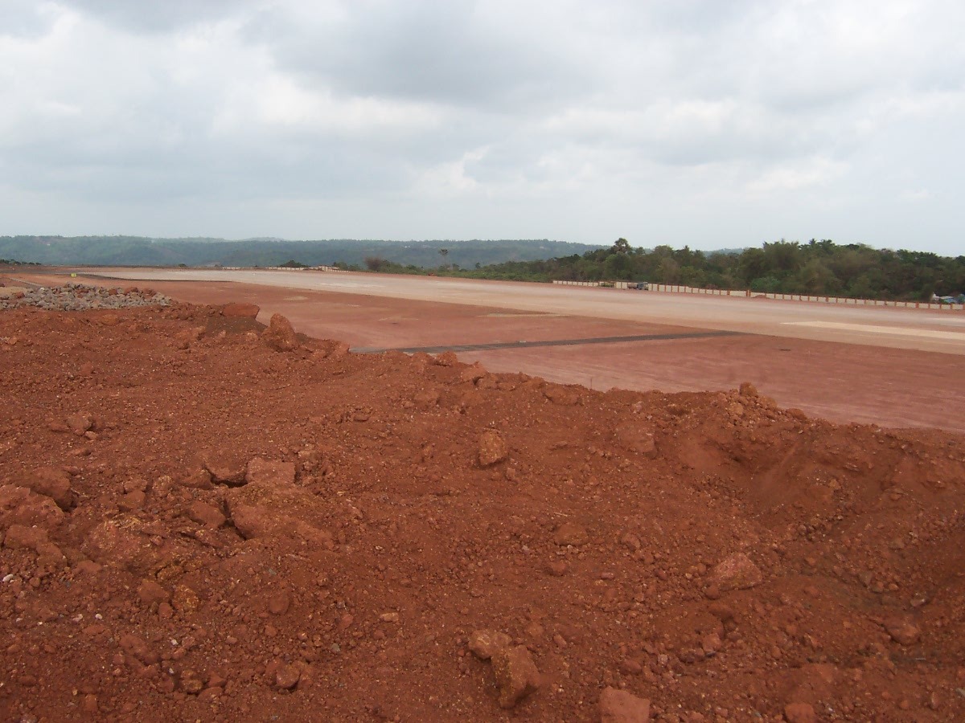
Lateritic Soils
The soils can be lateritic soils, lithomargic laterites, lateritic lithomarges and lithomargic clays
Lateritic Lithomarge
lateritic lithomarges - contain only 25 - 50 percent of lateritic constituents (reddish component).
Lithomargic Laterite
lithomargic laterites - contain 50 - 90 percent of lateritic constituents (reddish component)

Slide 22
LATERIZATION
Laterization is a chemical weathering process, of the parent rock, which is generally granitic gneiss in our area, due to intense tropical weather conditions i.e. high temperatures and rainfall, high humidity. An essential feature for the formation of laterite is the repetition of wet and dry seasons
The clay minerals present in the parent rock i.e. granites and granitic gneisses are broken down, where upon their silica are released and removed by leaching. So both laterites and LMC are residual soils.
Lateritic soils have a pH of 5 to 6.5. Lateritic soils have less humus (aided by climate) which is very suitable for growing crops like cashew nuts
Lithomargic clays (LMC) are products of laterization
LMC are used as filling material in lowlying areas and also in construction of embankments.

Slide 23
Some Typical properties of lithomargic clays/lateritic lithomarges

Slide 24
RESULTS OF SPECIFIC GRAVITY AND ATTERBERG’S LIMITS TESTS
Shedi soils usually classify as silty sands and in some cases as sandy silts
These soils are of medium to high compressibility
Lateritic soils (lithomargic clays/lateritic lithomarges) were procured from about 25 sites
The collected samples were subjected to various tests such as for their index properties, compaction characteristics, UCC strength etc.

Slide 25
SPECIFIC GRAVITY AND ATTERBERG’S LIMITS TESTS
Sample No. | Sp. Gr. | LL (%) | PL (%) | PI (%) | SL (%)
1 2 3 4 5 6 7 8 9 10 11 12 13 14 15 16 17 18 19 20 21 22 23 | 2.59 2.53 2.62 2.53 2.64 2.62 2.72 2.79 2.50 2.54 2.50 2.51 2.70 2.50 2.58 2.60 2.32 2.49 2.61 2.58 2.64 2.55 2.49 | 34.5 31.3 27.2 42.0 41.7 48.0 60.8 42.4 40.5 40.6 38.0 57.0 43.0 39.4 36.8 47.0 37.4 60.6 44.0 62.0 46.5 33.0 44.0 | 21.2 19.9 17.8 24.2 23.4 30.5 31.6 31.1 26.1 23.5 23.6 26.6 27.9 24.0 20.4 34.0 32.9 37.3 41.0 30.4 37.6 22.4 33.3 | 13.3 11.4 9.4 17.8 18.3 17.5 29.2 11.3 14.4 17.1 14.4 30.4 15.1 15.4 16.4 13.0 4.5 23.3 3.0 31.6 8.9 10.6 10.7 | 15.8 11.0 15.6 22.4 21.7 29.7 25.8 24.4 21.0 19.6 20.7 19.4 19.3 17.6 16.5 27.5 25.7 27.0 36.0 21.0 25.7 18.9 30.2

Slide 26
Grain size distribution and classification
Sample No. | Gravel Size (%) | Sand Size (%) | Silt Size (%) | Clay Size (%) | Classification
1 2 3 4 5 6 7 8 9 10 11 12 13 14 15 16 17 18 19 20 21 22 23 | 22.2 8.8 25.4 24.7 15.5 26.3 21.6 21.6 19.3 8.4 20.1 36.1 26.4 15.2 5.1 0.0 6.0 0.0 0.0 0.0 1.0 0.6 1.0 | 43.4 70.8 55.7 46.5 29.6 38.1 47.6 63.0 51.5 37.5 52.5 48.9 49.2 46.1 76.0 30.0 94.0 34.0 50.0 26.0 56.0 42.4 27.0 | 29.1 16.3 17.5 28.8 48.8 22.6 27.8 15.4 27.2 47.7 27.4 14.0 21.6 33.7 18.1 64.0 0.0 38.0 48.0 53.0 37.0 55.0 28.0 | 5.3 4.1 1.3 0.0 6.1 13.0 3.0 0.0 2.0 6.4 0.0 1.0 2.8 5.0 0.8 6.0 0.0 28.0 2.0 21.0 6.0 2.0 44.0 | SM SM SM SM MI SM SM SM SM MI SM SM SM SM SM MI SP MH SM-MI CH SM ML-MI MI

Slide 27
Results of field density, compaction and CBR tests
Sample | Field Dry Density (kN/m³) | MDD (kN/m³) | OMC (%) | CBR_{u} (%) | CBR_{s} (%)
1 2 3 4 5 6 7 8 9 10 11 12 13 14 15 16 17 18 19 20 21 22 23 | 15.1 15.6 19.7 18.1 17.4 17.8 17.2 17.4 16.1 15.7 16.7 15.3 16.5 16.6 15.9 NA NA NA NA NA NA NA NA | 18.0 20.7 21.9 20.5 18.7 17.9 19.7 19.9 19.3 17.4 20.3 20.9 20.0 20.3 21.3 14.8 14.3 14.2 15.8 15.0 (17.2*) 16.2 17.3 15.4 | 17.6 12.5 10.5 14.5 12.5 18.7 15.7 17.2 17.8 18.9 14.2 12.1 16.0 13.0 10.1 25.8 24.5 27.0 20.0 29.0 (19.0) 20.0 11.6 21.6 | 5.3 2.6 25.3 11.4 20.4 15.3 12.9 17.0 7.2 15.3 15.9 17.3 14.6 4.8 6.4 NA NA NA NA 42.2* 18.0 NA NA | 3.0 1.3 9.0 4.1 5.3 5.1 5.4 5.2 2.3 4.2 4.8 5.2 4.3 2.6 2.0 NA NA NA NA 1.5* 4.0 NA NA

Slide 28
Results of the unconfined compression strength tests
and UU triaxial shear tests
Sample No. | q_{u} (MPa) | Tangent Modulus E_{t} (MPa) | C (kPa) | ϕ (degrees) | Tangent Modulus E_{tri-UU} (MPa)
1 2 3 4 5 6 7 8 9 10 11 12 13 14 15 17 17# 19 20 21 | 0.034 0.056 0.570 0.082 0.273 0.312 0.217 0.237 0.239 0.306 0.309 0.499 0.080 0.069 0.046 0.018 0.013 NA 0.860* 0.087 | 1.81 4.73 41.36 5.24 12.38 20.49 16.04 9.81 12.49 16.31 18.58 21.16 2.67 2.64 4.47 NA NA NA NA NA | 1.9 5.8 3.1 0.1 10.0 12.0 3.5 8.3 9.2 18.0 0.0 8.7 11.0 0.6 0.5 10.0 5.5 45.0 NA 30.0 | 26.0 9.0 31.0 41.0 33.0 32.0 22.0 29.0 18.0 12.0 15.0 20.0 8.0 29.0 28.0 12.0 6.0 25.2 NA 21.0 | 6.21 8.72 70.94 23.28 34.71 27.85 15.10 21.67 16.19 15.16 28.60 22.70 15.08 8.77 20.11 NA NA NA NA NA

Slide 29
Chemical, Index and other Properties of LMC
Lithomargic clay comprises mostly of silicon dioxide and aluminium oxide.
Lithomargic clays of coastal Karnataka generally classify, based on grain size distribution, as silty sands or sandy silts, with very little clay size particles. The soil has very little or no cohesion. Its behaviour is of silty or of non-plastic nature. So the term 'clay' in 'lithomargic clay' is a misnomer.
LL is about 40%. PI about 10-25%. Maximum dry density is 16-18 kN/cu.m. OMC is about 15%. Undrained Cohesion is about 15 to 30 kPa and angle of internal friction is about 10-20 degrees, depending on the soil moisture content
The lithomargic clays are problematic soils. They behave like dispersive soils (i.e. they are weak when unconfined, lose strength on soaking/wetting, have a high erosion potential with erosion index of 2-5)

Slide 30
Composition of typical laterite & lithomargic clay
CHEMICAL COMPOUND | COMPOSITION IN PERCENTAGE Laterite/LMC
SiO₂ | 64.27 | 76.00
Fe₂O₃ | 20.54 | 0.81
Al₂O₃ | 7.04 | 19.00
K₂O | 4.07 | -
TiO₂ | 1.6 | -
MgO | 1.55 | -
CaO | 0.23 | 2.19
TiO₅ | 0.17 | -

Slide 31
UCC and CBR TEST RESULTS
Lithomargic clay has UCC strength of 0.27 Mpa (light compaction) and 0.38 Mpa (Heavy compaction)
Lithomargic clay + 40% sand gave 0.34 Mpa (light compaction) and 0.48 Mpa (Heavy compaction)
CBR value of LMC with light compaction was 12% (unsoaked) and 3% (soaked)
CBR value of LMC + 40% sand with light compaction was 21% (unsoaked) and 5% (soaked)
CBR value of LMC with heavy compaction was 16% (unsoaked) and 4% (soaked)
CBR value of LMC + 40% sand with heavy compaction was 25% (unsoaked) and 11% (soaked)
Thus the properties of shedi soil subgrades can be substantially improved by blending it with suitable stabilizers.

Slide 32
Geotechnical practices:
Engineering Problems while dealing with laterites and lmc
& some case studies

Slide 33
Engineering Problems with Laterites and LMC
Good quality laterites are becoming scarce (as also good clay for manufacture of Mangalore tiles)
Low water retention capacity (water problem in summer months)
Bearing Capacity problems
Land filling
Foundations
Pavements
Slope failures
Slope stability Problems (excavated slopes, embankment slopes, land slides)
Railway Constructions
Erosion problems (pertaining to slopes)[Erosion studies on LMC through Hole Erosion Tests (HET)]

Slide 34
Study Area (DK district area)
Lowlying areas are filled up with LMC/shedi soil.
Most of these lowlying areas are adjacent to water bodies (lowlands)
Geotechnical and Transportation Engg. problems faced in this study area are of low bearing capacity, large settlements, steep and high vertical cuts (w/o berms), improperly compacted embankments, unimproved soft grounds, poor drainage (especially in excavated slopes and in highways leading to surface erosion and internal erosion), slope failures, poor roads etc.

Slide 35
Mangalore airport
Mangalore is an important city on western coast of peninsular India. It connects to all important cities in the gulf.
Mangalore airport is a table top airport
It is a critical airport. Not much margin for pilot error.
Runway length got by filling (upto 20-30m thickness) between hillocks by lateritic soils.

Slide 36
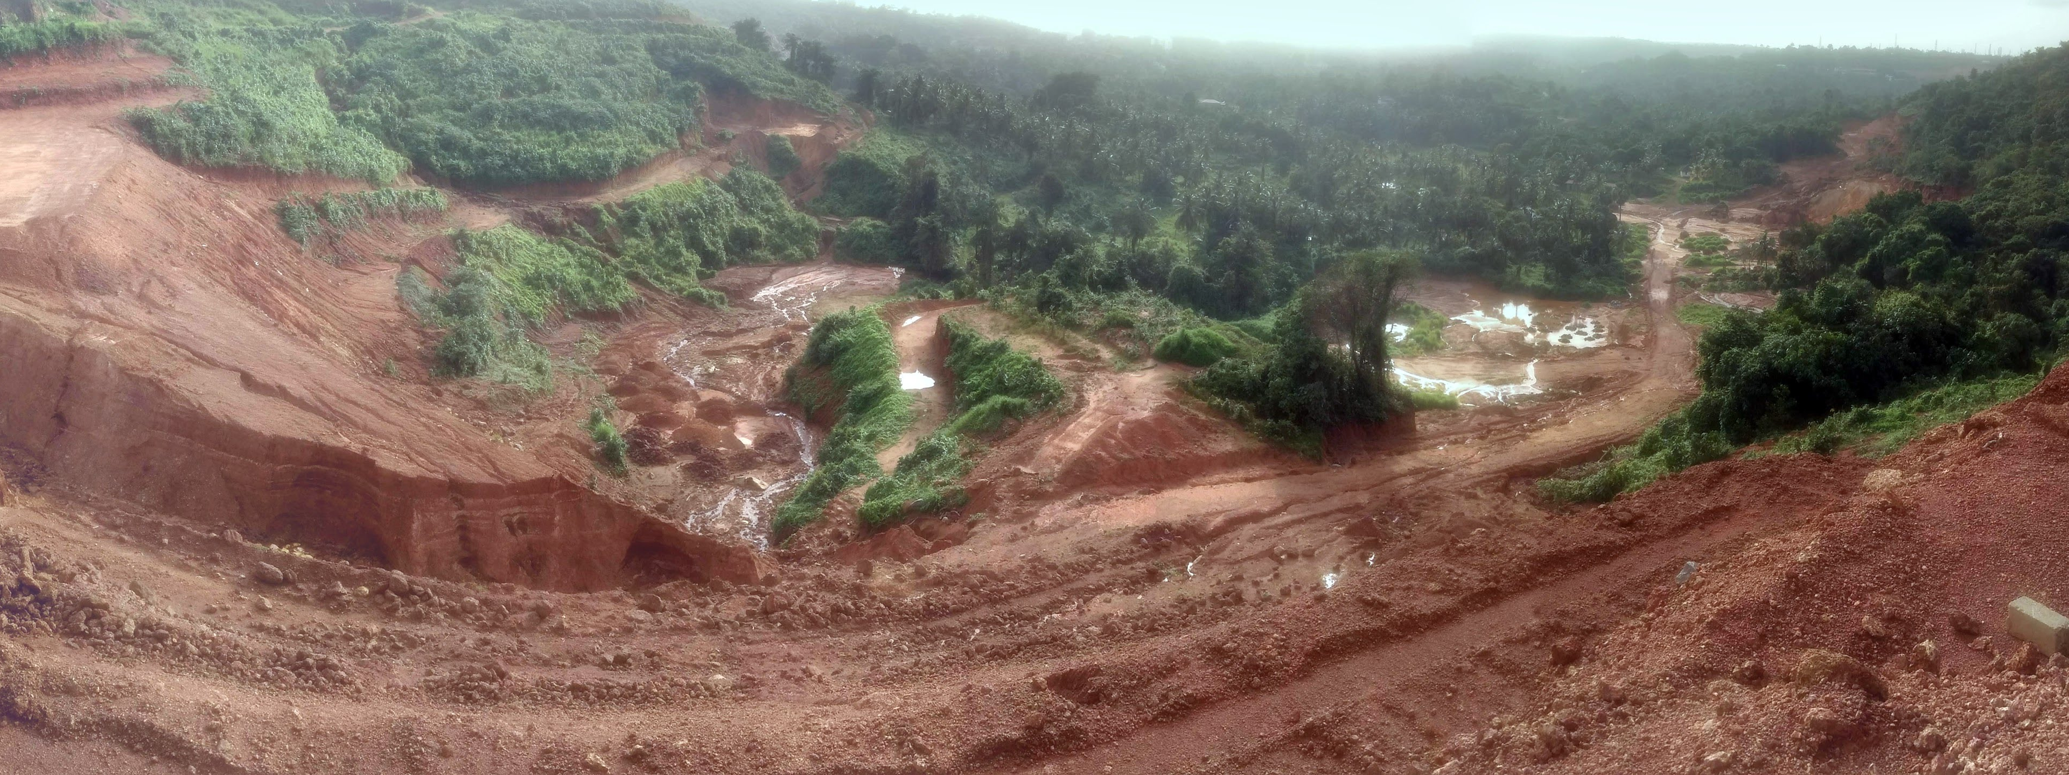
Lowlying areas are filled up with lateritic soil for developmental projects such as Highway, Railway and Airport projects

Slide 37
An Airport Runway project with lateritic soil subgrade

Slide 38
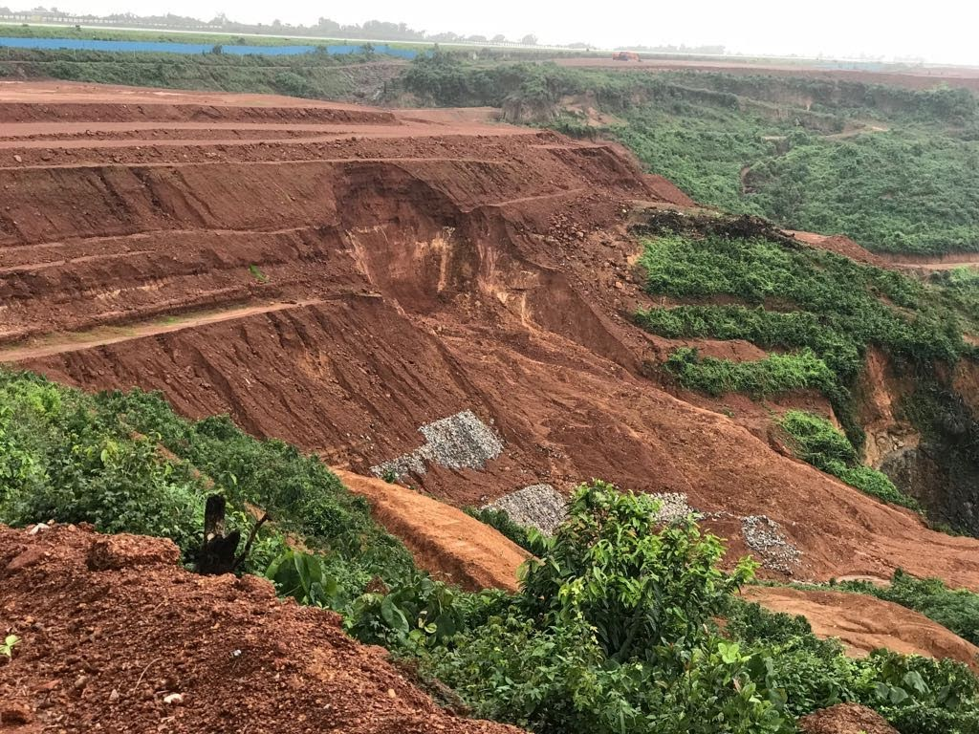
Mangalore airport new runway construction, lateritic soil filling was done between two existing hillocks.
Mangalore airport is a table top airport
Some Slope failure due to heavy rainfall
Very good quality lateritic soil was used for filling the valley
Compaction was very good
Slopes are to be engineered, and most importantly provided with proper drainage facilities and erosion control measures at site, for good performance

Slide 39
Land Filling with Lateritic soil
Lateritic soils (or lithomargic laterites) [gravelly sand with some clay binder perhaps] are good materials for land filling purposes when properly compacted in layers
Lateritic soils used for filling can be lateritic soils/lithomargic clays (LMC)/ lithomargic laterites/lateritic lithomarges
LMC soils are very sensitive to moisture variations, especially when there is no confinement and no proper compaction.

Slide 40
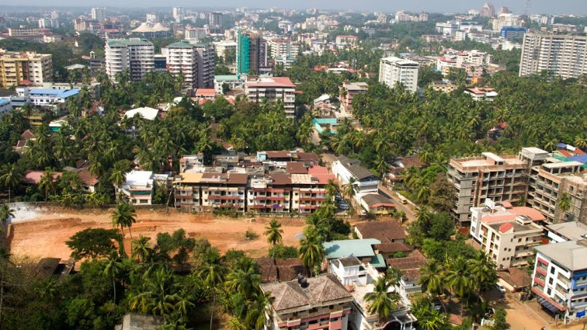
Soil filling with lateritic soils in midst of city
Courtesy ‘Google Maps’

Slide 41
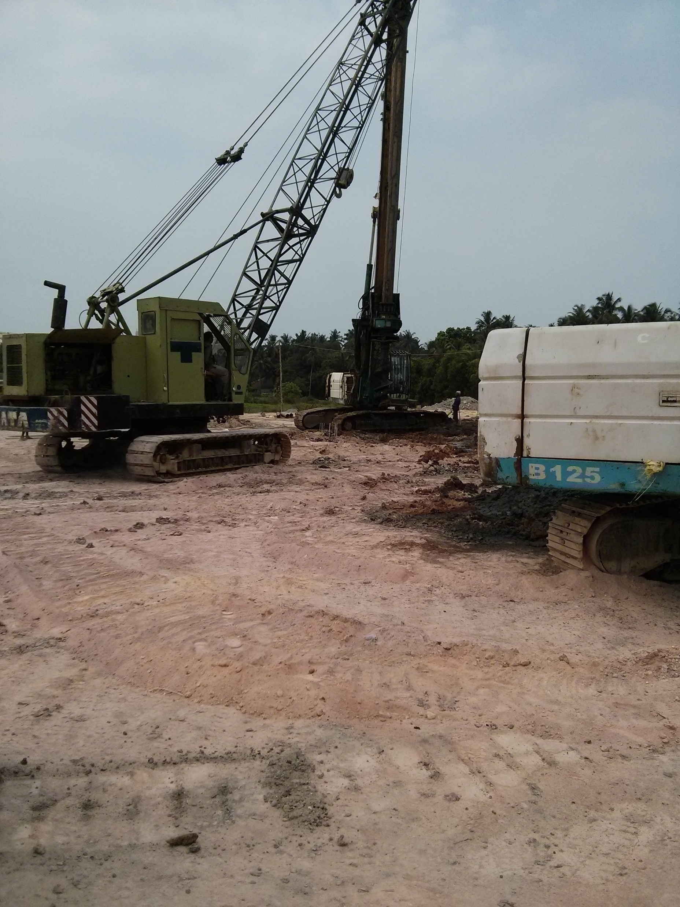
Lands adjacent to water bodies are filled up for construction of big buildings

Slide 42
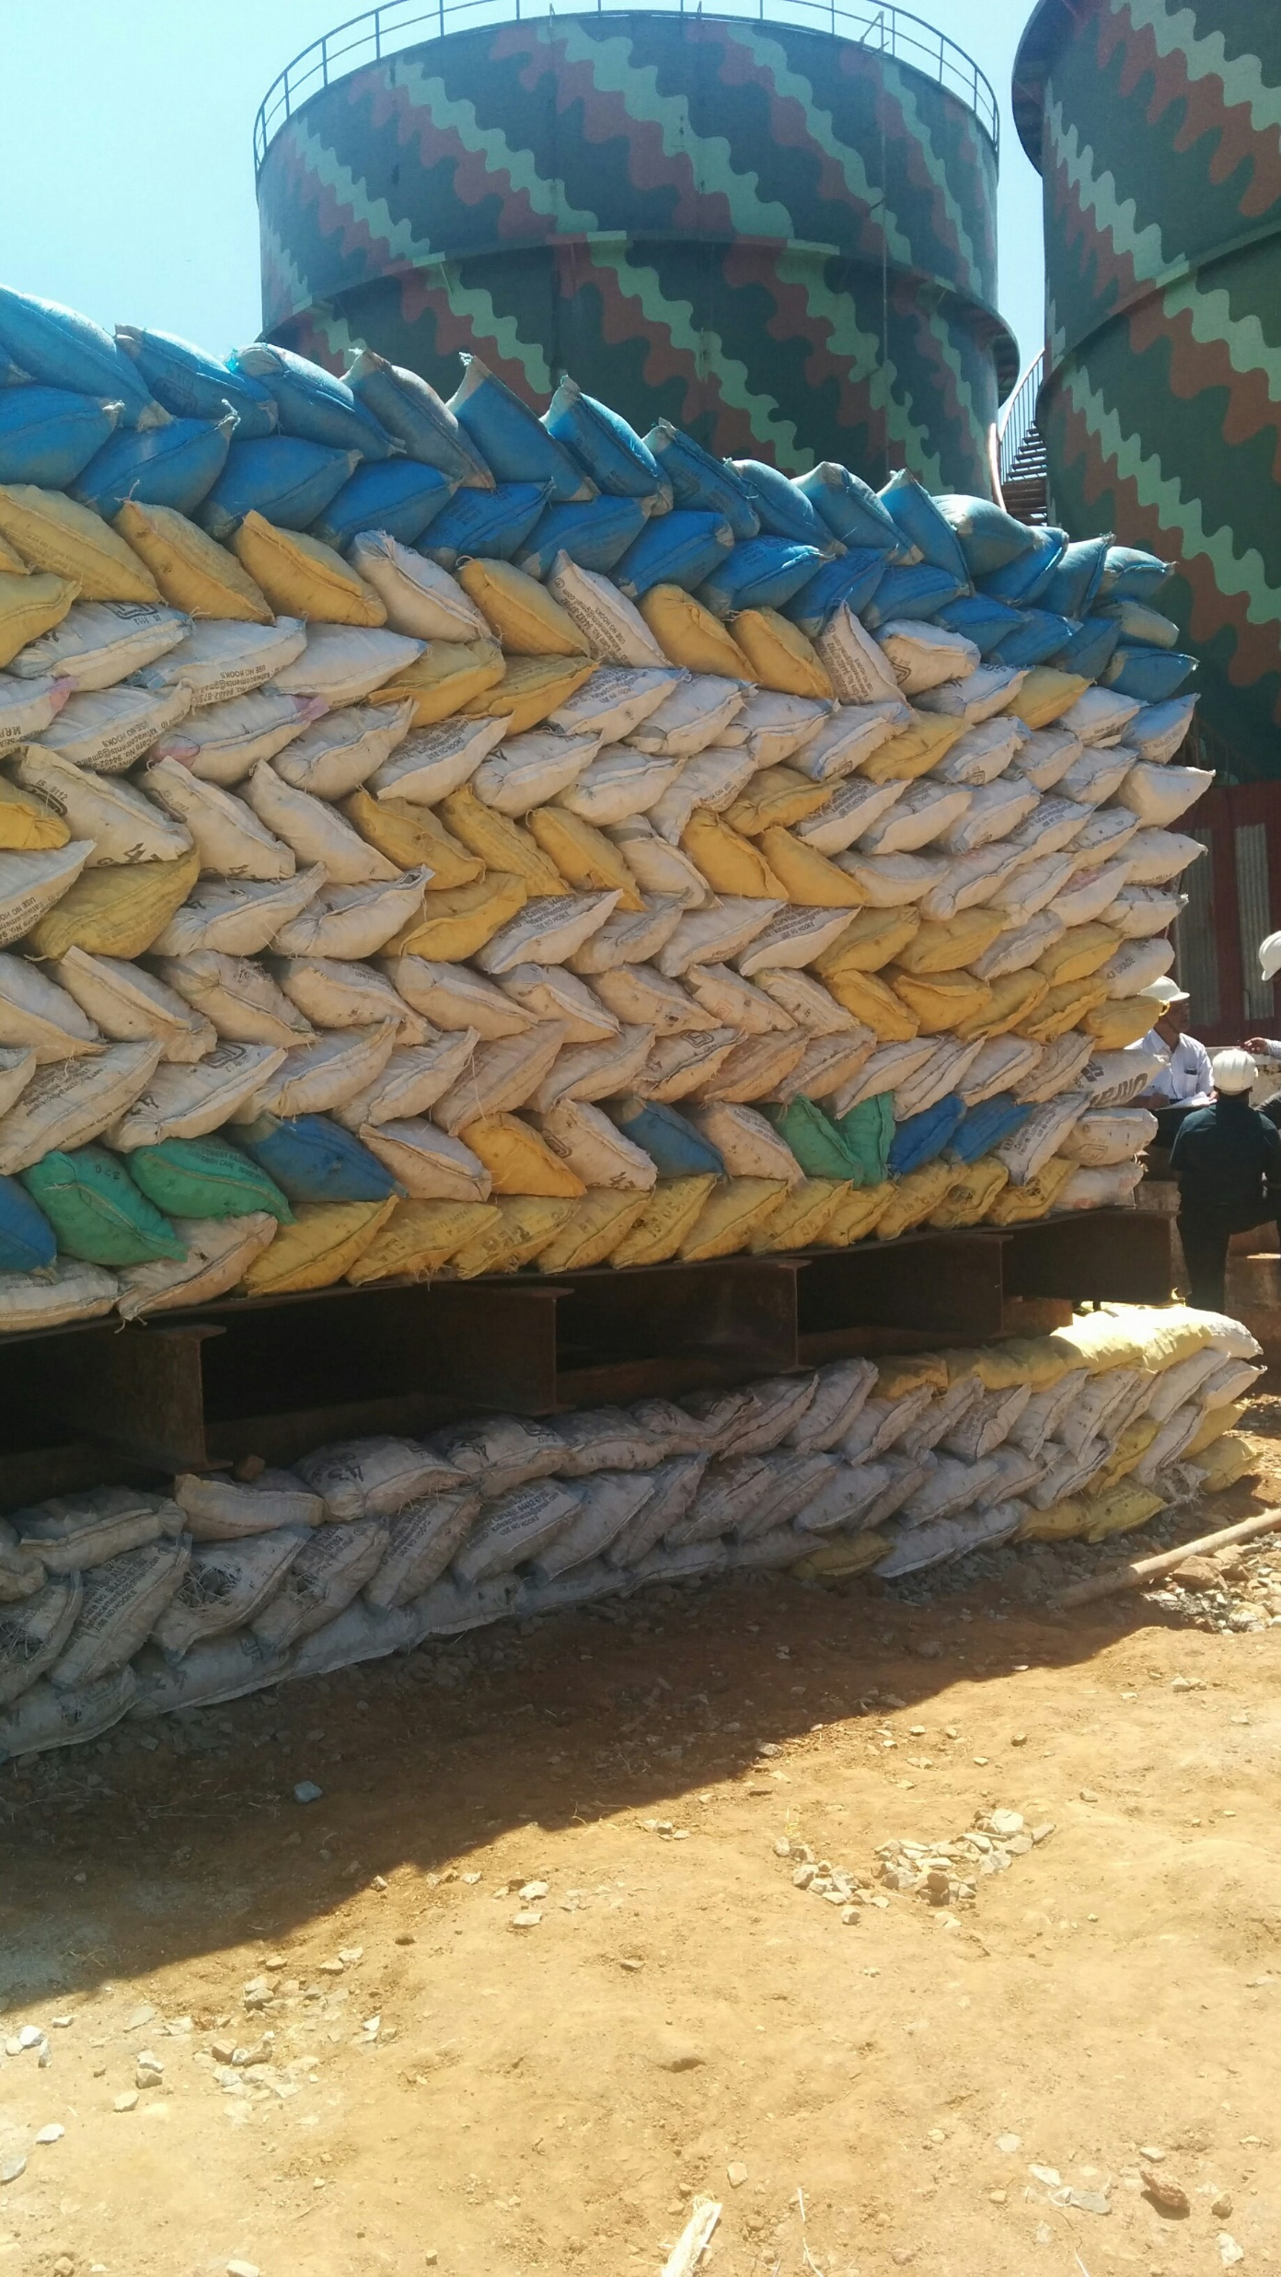
Storage tanks in refinery area on filled up ground, in industrial area
Plate load tests are conducted on unimproved filled-up ground as well as on stone column improved ground
Storage tanks are very often supported on stone columns/ granular piles

Slide 43
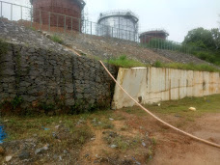
SLOPE FAILURE, GABION WALL FAILURE AND RC RETAINING WALL FAILURE AT REFINERY AREA

Slide 44
BRIDGE APPROACHES

Slide 45
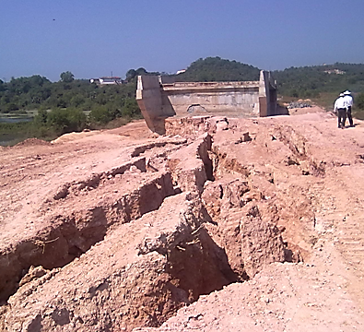
A Bridge approach embankment being filled up with lithomargic clay [shedi soil] on soft marshy ground
-Poor compaction
-No Ground improvement for foundation soil

Slide 46
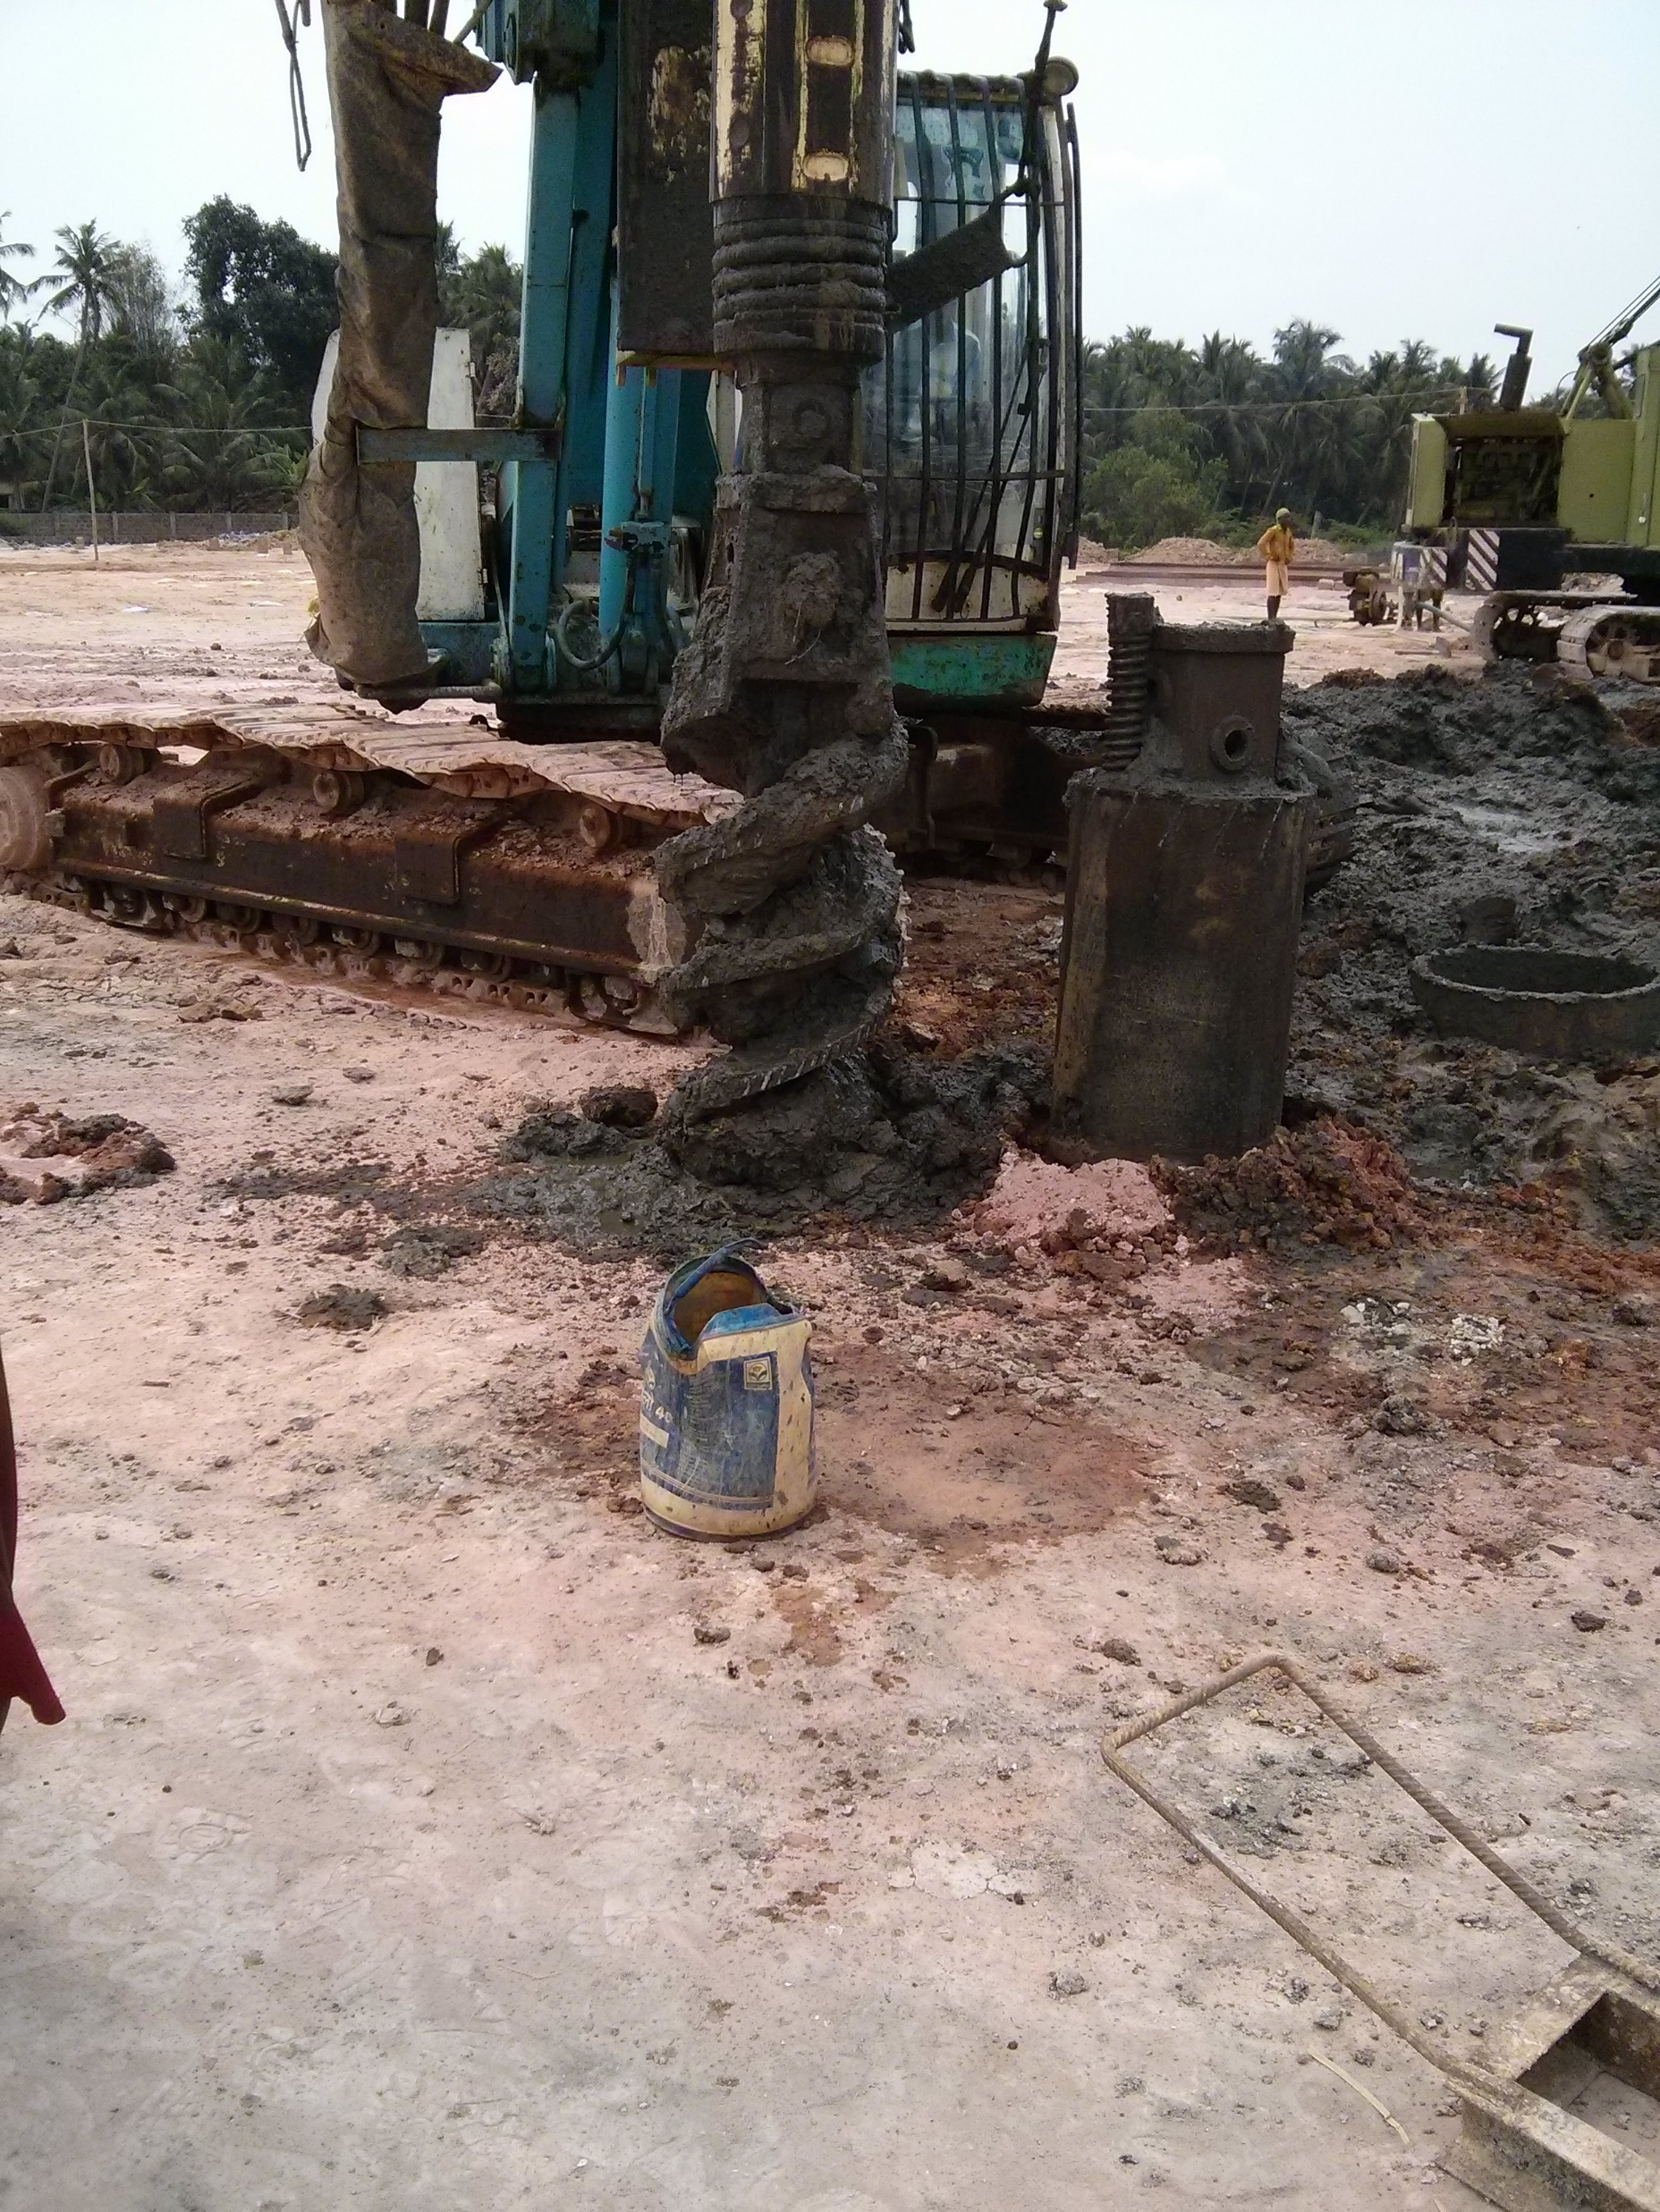
Big buildings on LMC filled up grounds, adjacent to water bodies, are recommended to be supported on pile foundations.
Problems of dealing with LMCs for highway engineers and foundation engineers, are loss of shear strength on wetting and removal of confinement, erosion problems, landslides, slope stability problems etc.

Slide 47
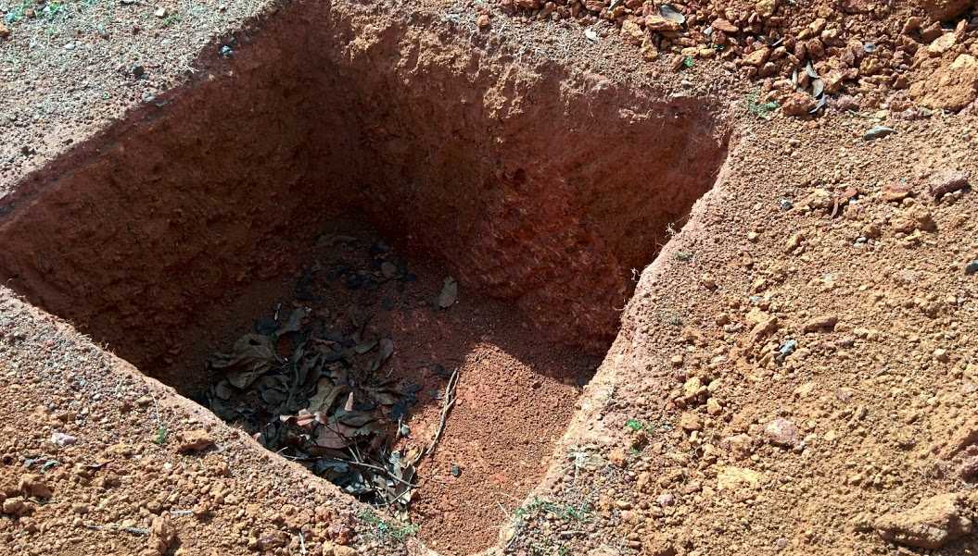
Shallow foundations for lightly loaded structures on hard laterite over LMC.
Depth of foundation is not to be very deep.
It is important to do a good and detailed geotechnical investigation to ascertain the depth of top lateritic crust and depth of hard rock

Slide 48
EXCAVATED SLOPES

Slide 49
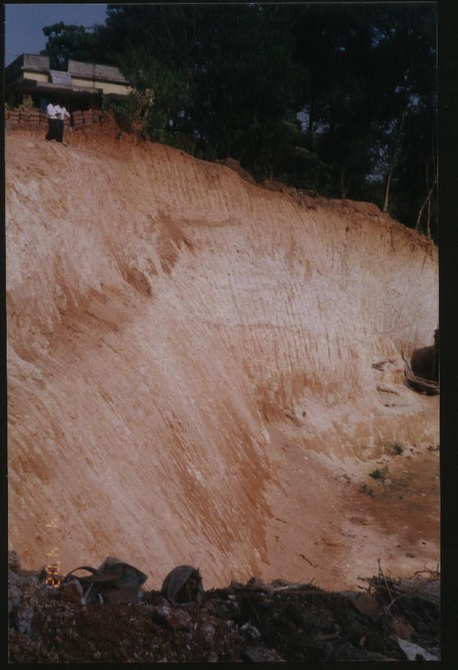
A very high vertical cut made close and adjacent to existing buildings

Slide 50
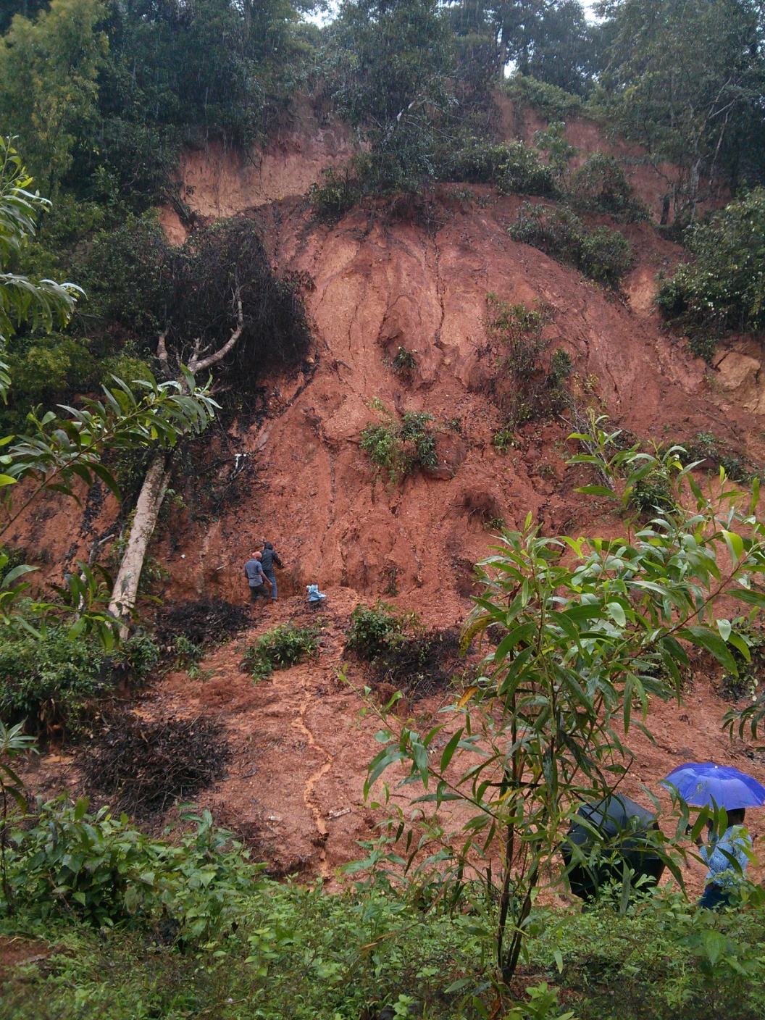
Steep Slope failure
Imagine there is a road (a state highway) at top

Slide 51
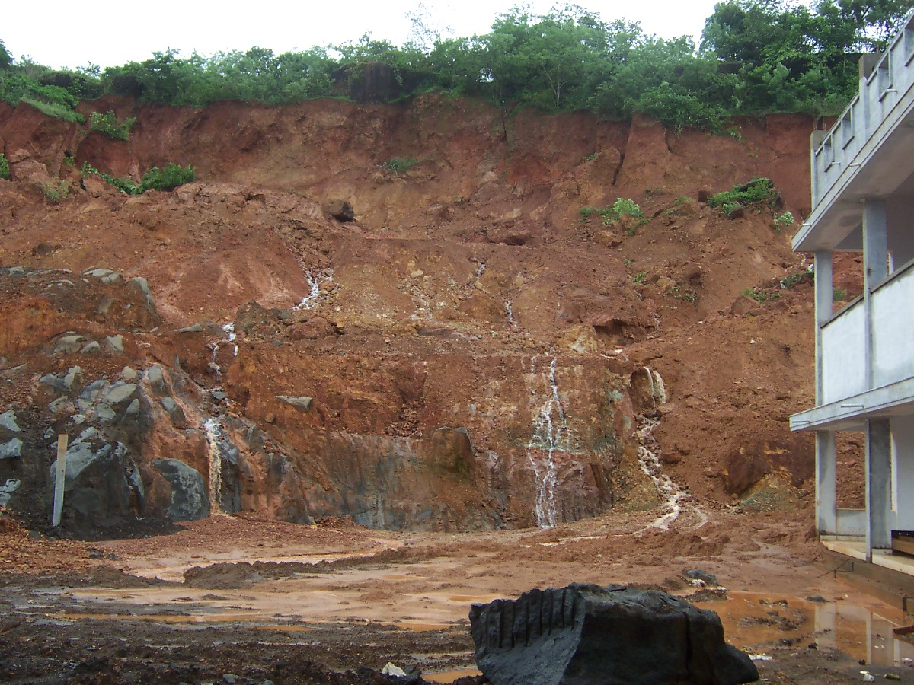
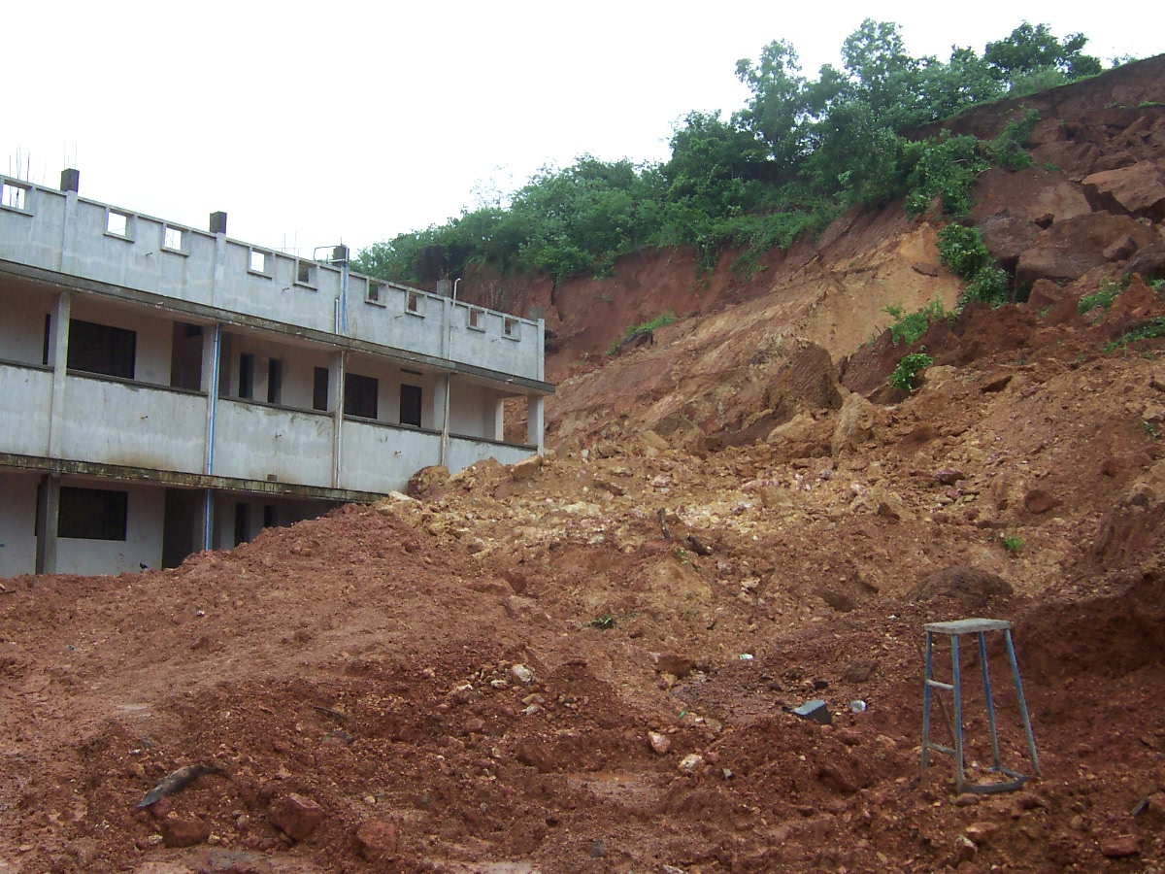
POOR SOIL, LACK OF DRAINAGE CONTROL AND STEEP SLOPES CAUSE SLOPE FAILURES

Slide 52
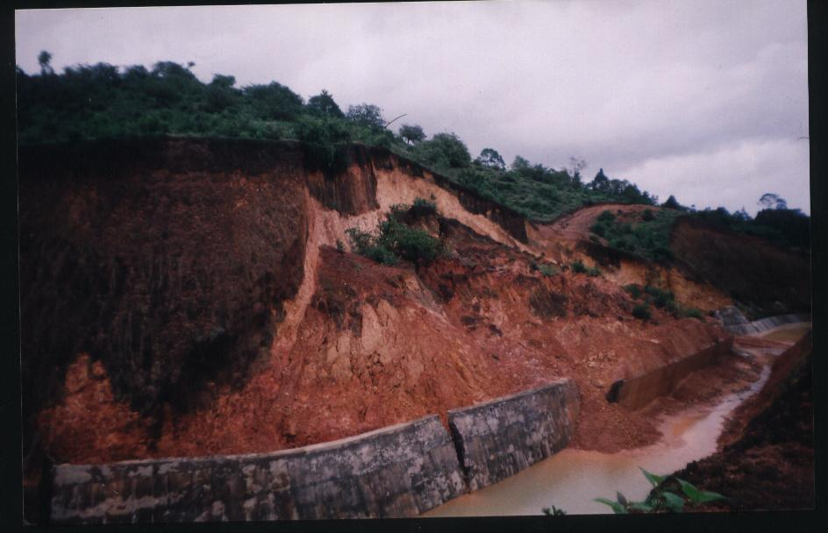
Slope failure of a high and steep slope adjacent to a canal
Shedi soil (LMC)
Toe (retaining) wall that failed

Slide 53
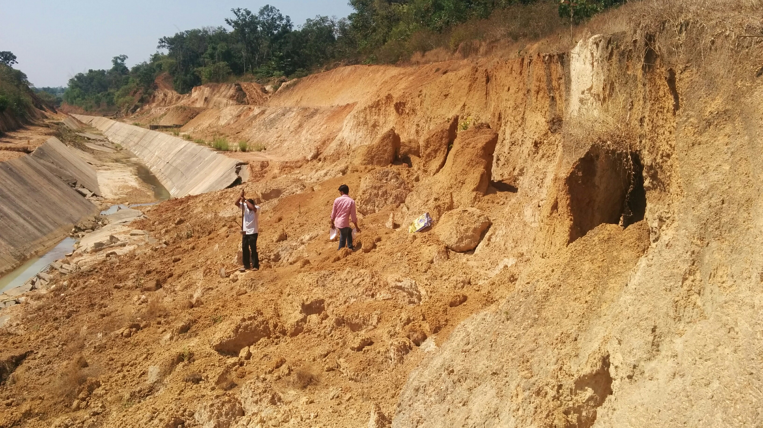
Slope failure adjacent to a canal

Slide 54
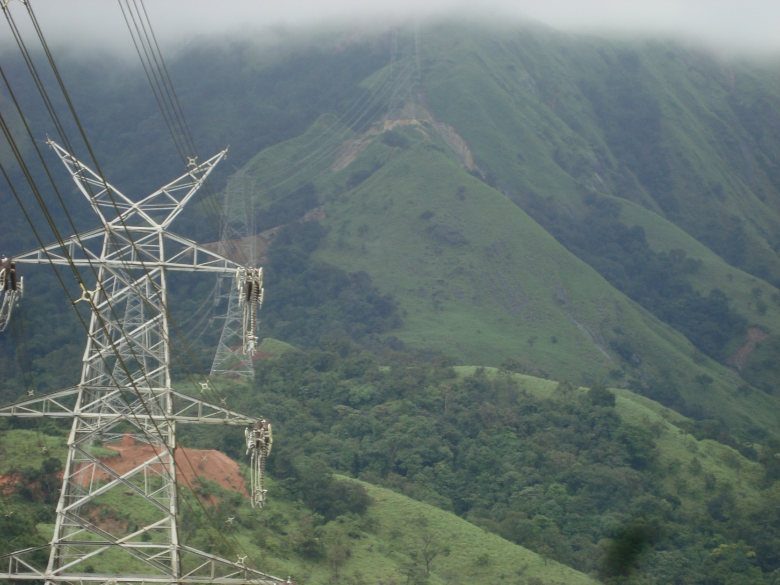
Power Transmission line through the dense forests (western ghats)

Slide 55
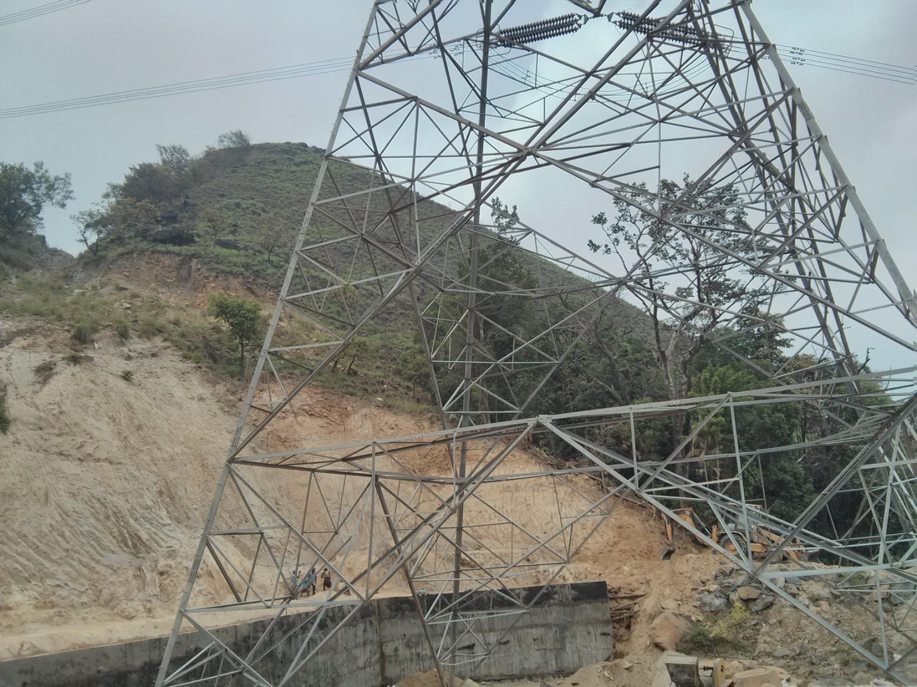
Erection of power transmission towers in the Western Ghats

Slide 56
Power Transmission line through the dense forests (western ghats)
Every one hour of power disruption will cause loss of crores of rupees to the electricity board and cause inconvenience to the public and industries
Maintaining access to such vital installations is very important for maintenance and supervision works, and some sort of kutcha roads (if not pucca roads) are a must

Slide 57
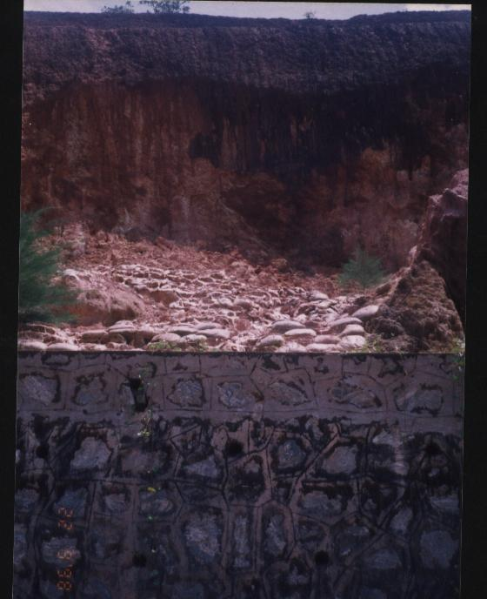
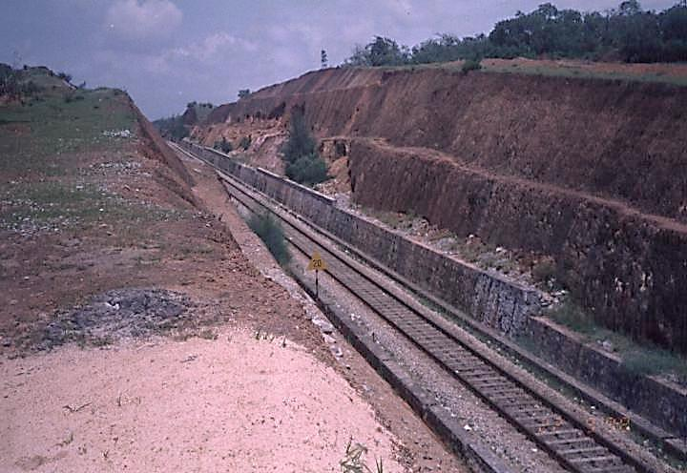
Problems of slope stability in lateritic formations along railway tracks
Slope failures along Konkan railway route in early stages of the project, due to change in drainage pattern. There were also problems of mud pumping
Caving seen in shedi soil portion adjacent to a railway track in cutting

Slide 58
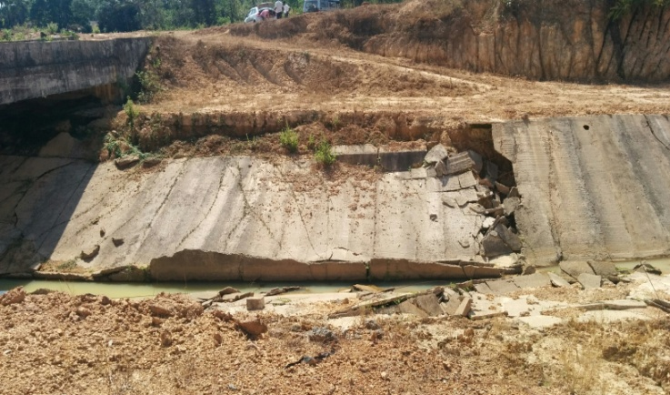
Major Irrigation Canal
Slope Failures due to erosion in lithomargic clay
Piping erosion

Slide 59
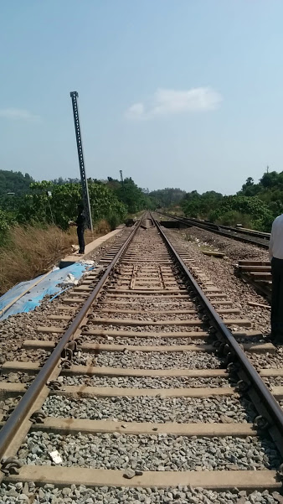
Railway Track on top of embankment

Slide 60
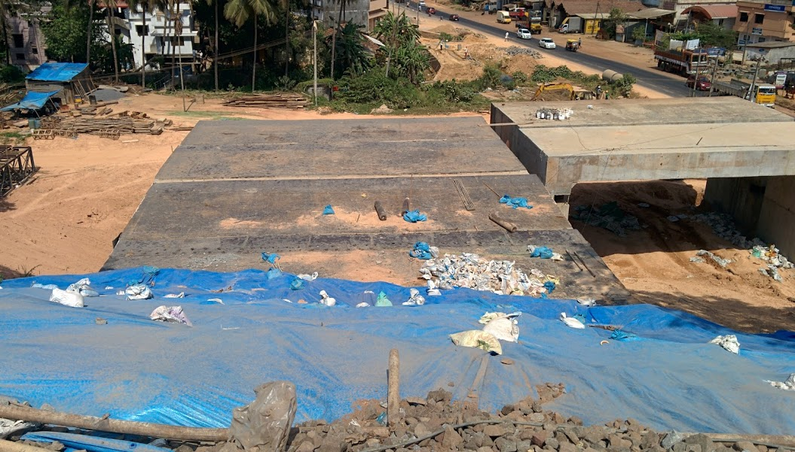
Precast box being pushed ( as viewed from top)

Slide 61
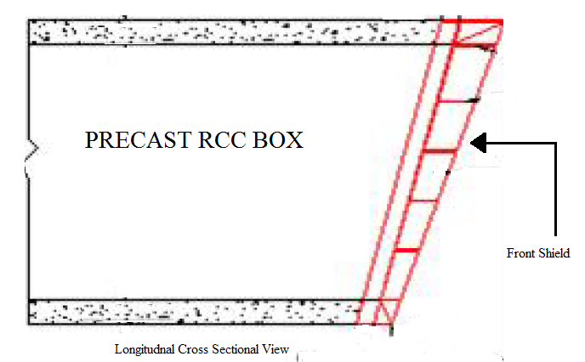
Push box

Slide 62
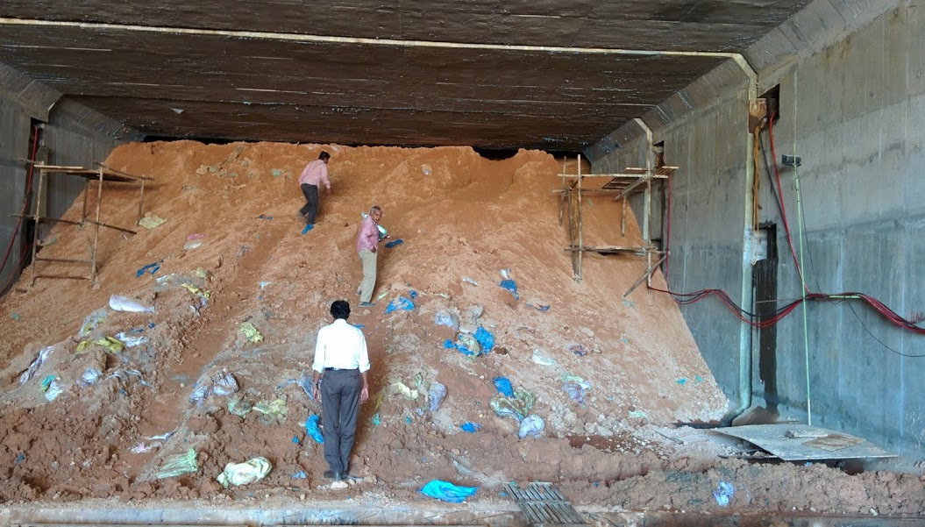
Push box technology adopted beneath a Railway embankment made of lateritic soil

Slide 63
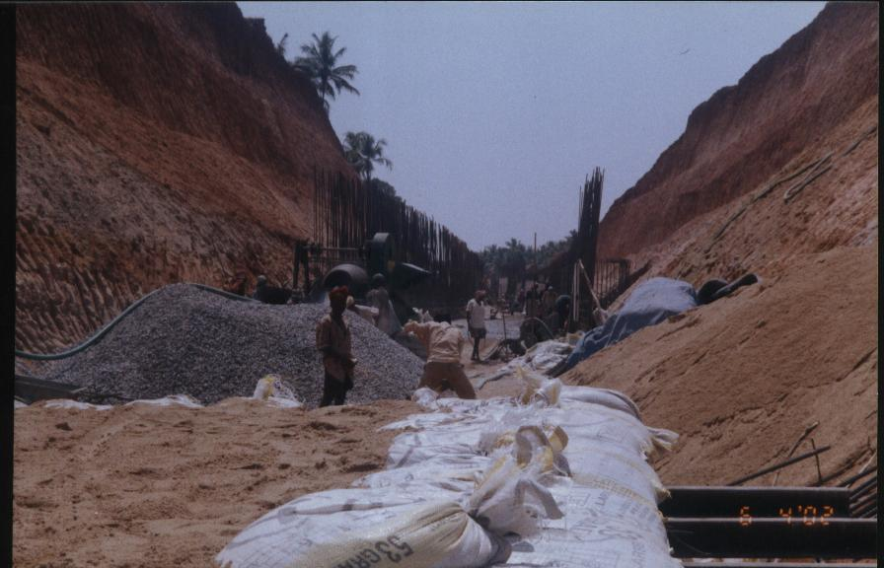
Cut and cover method of construction of railway tunnels is a better option in lateritic formations

Slide 64
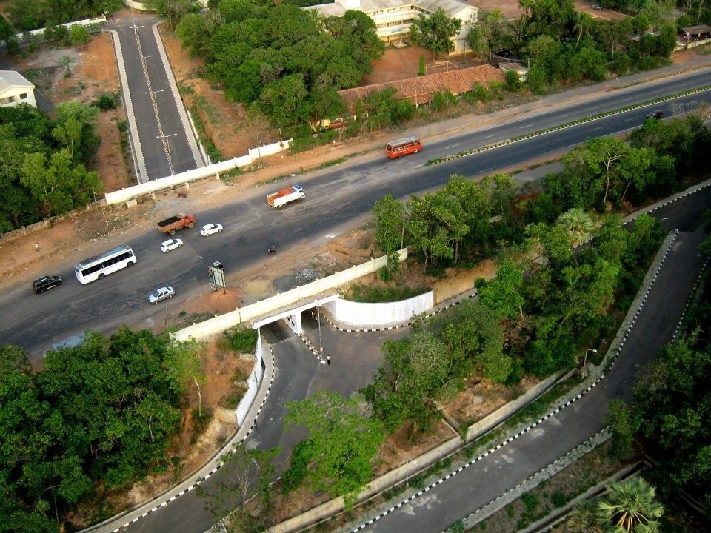
Cut and cover method was adopted for construction of underpass in NITK Campus
www.nitk.ac.in

Slide 65
SLOPES AND RETAINING WALLS

Slide 66
How is stability of slopes in lateritic formations different?
Steep decrease in shear strength as depth increases.
Increase in strength with time (mostly confined to the top hard crust)
Short term failure happens through distressing at the bottom due to loss of confinement.
The dispersive kaolinite or bauxite is present is unable to prevent fracture.
This may also be aggravated by the erosion caused by any slight ground water seepage.
This may progress and leave the top unsupported till the overhang breaks and shears off.
Effect of vegetation (especially turfing on slopes) is very significant in excavated lateritic formations
Slope stability analysis should be a combination of geotechnical engineering, hydrological engineering and bio-engineering

Slide 67
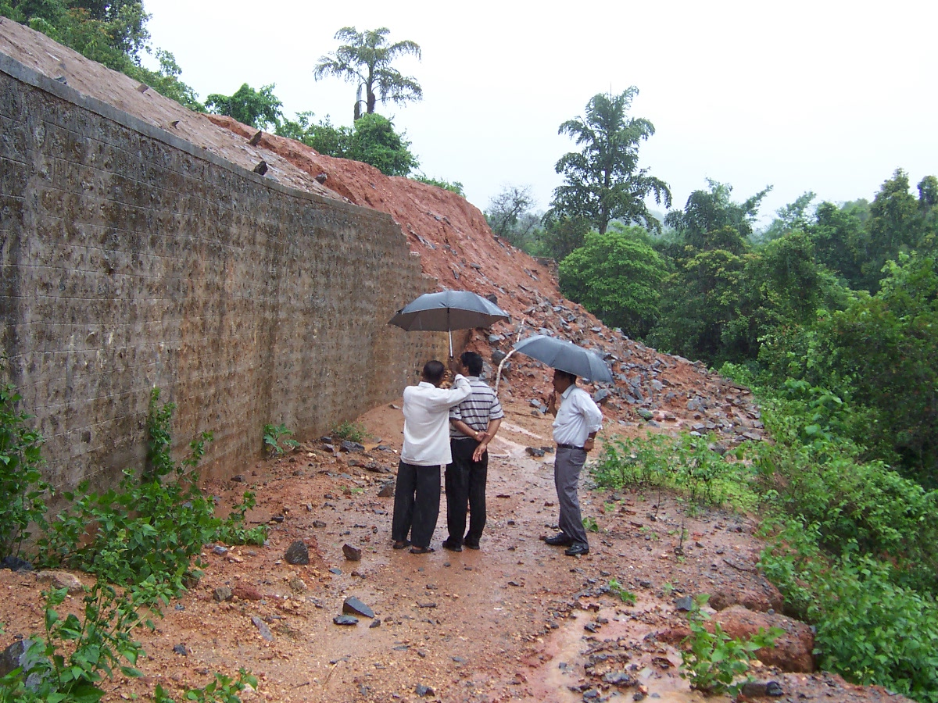
AN UNDERDESIGNED AND NO DRAINAGE CONTROL RETAINING WALL (COSMETIC WALL). NO WEEP HOLES IN THE WALL

Slide 68
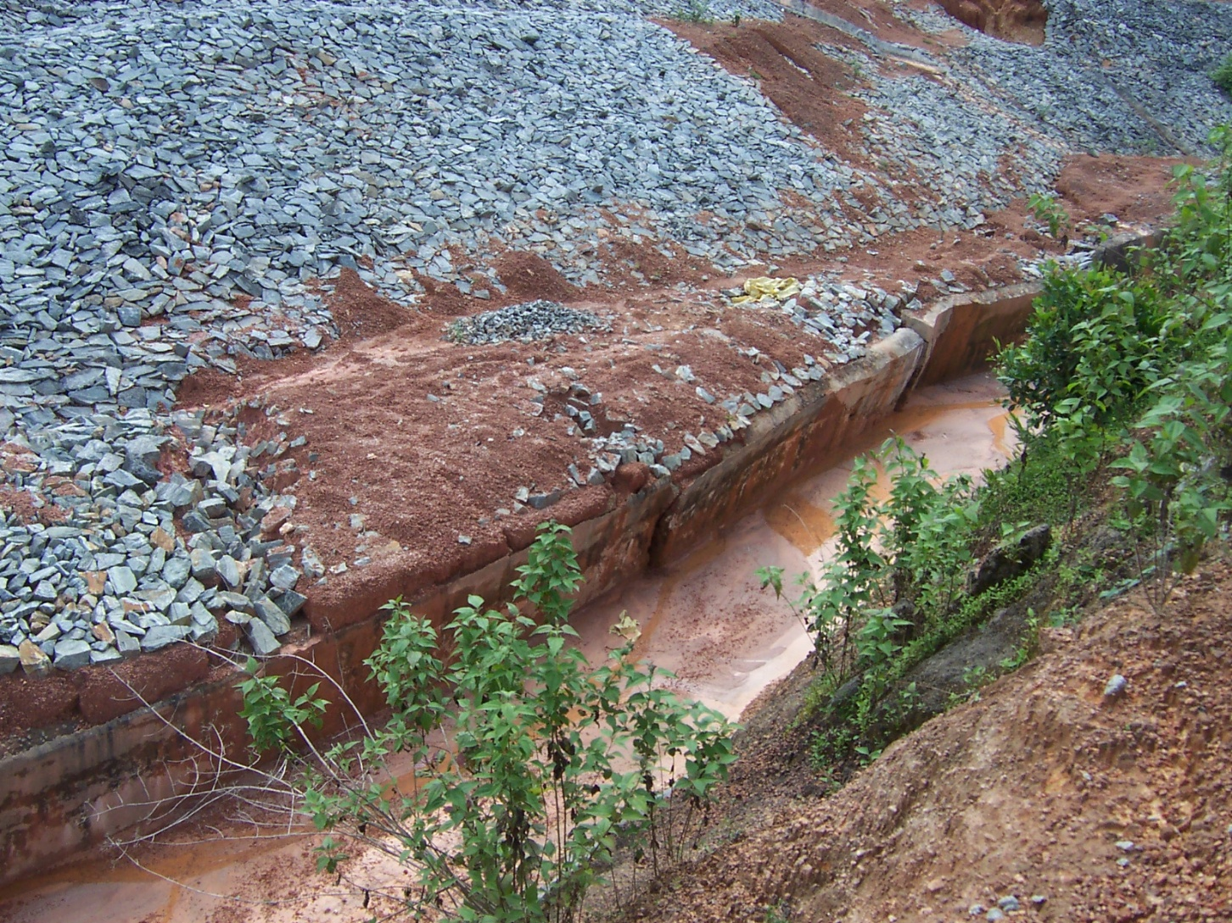
An underdesigned Retaining wall

Slide 69
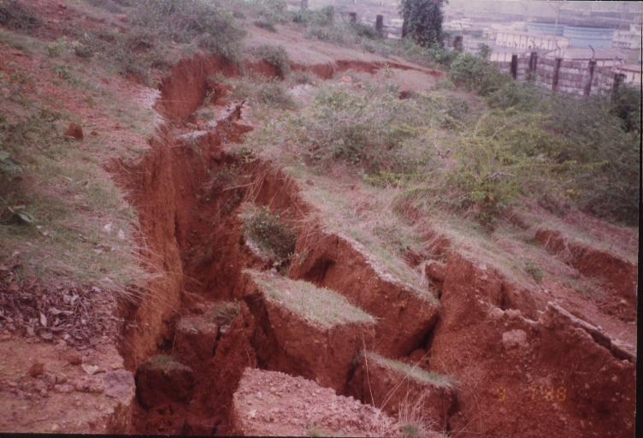
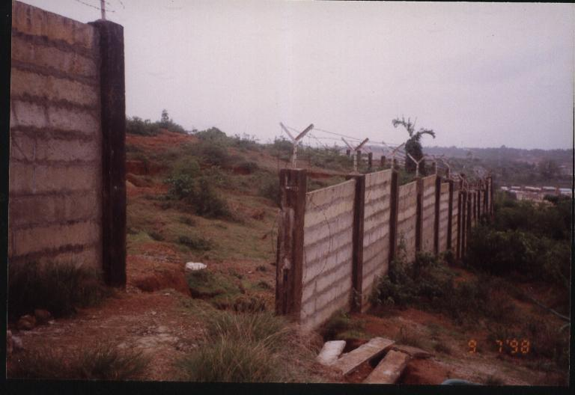
LAND SLIDE

Slide 70
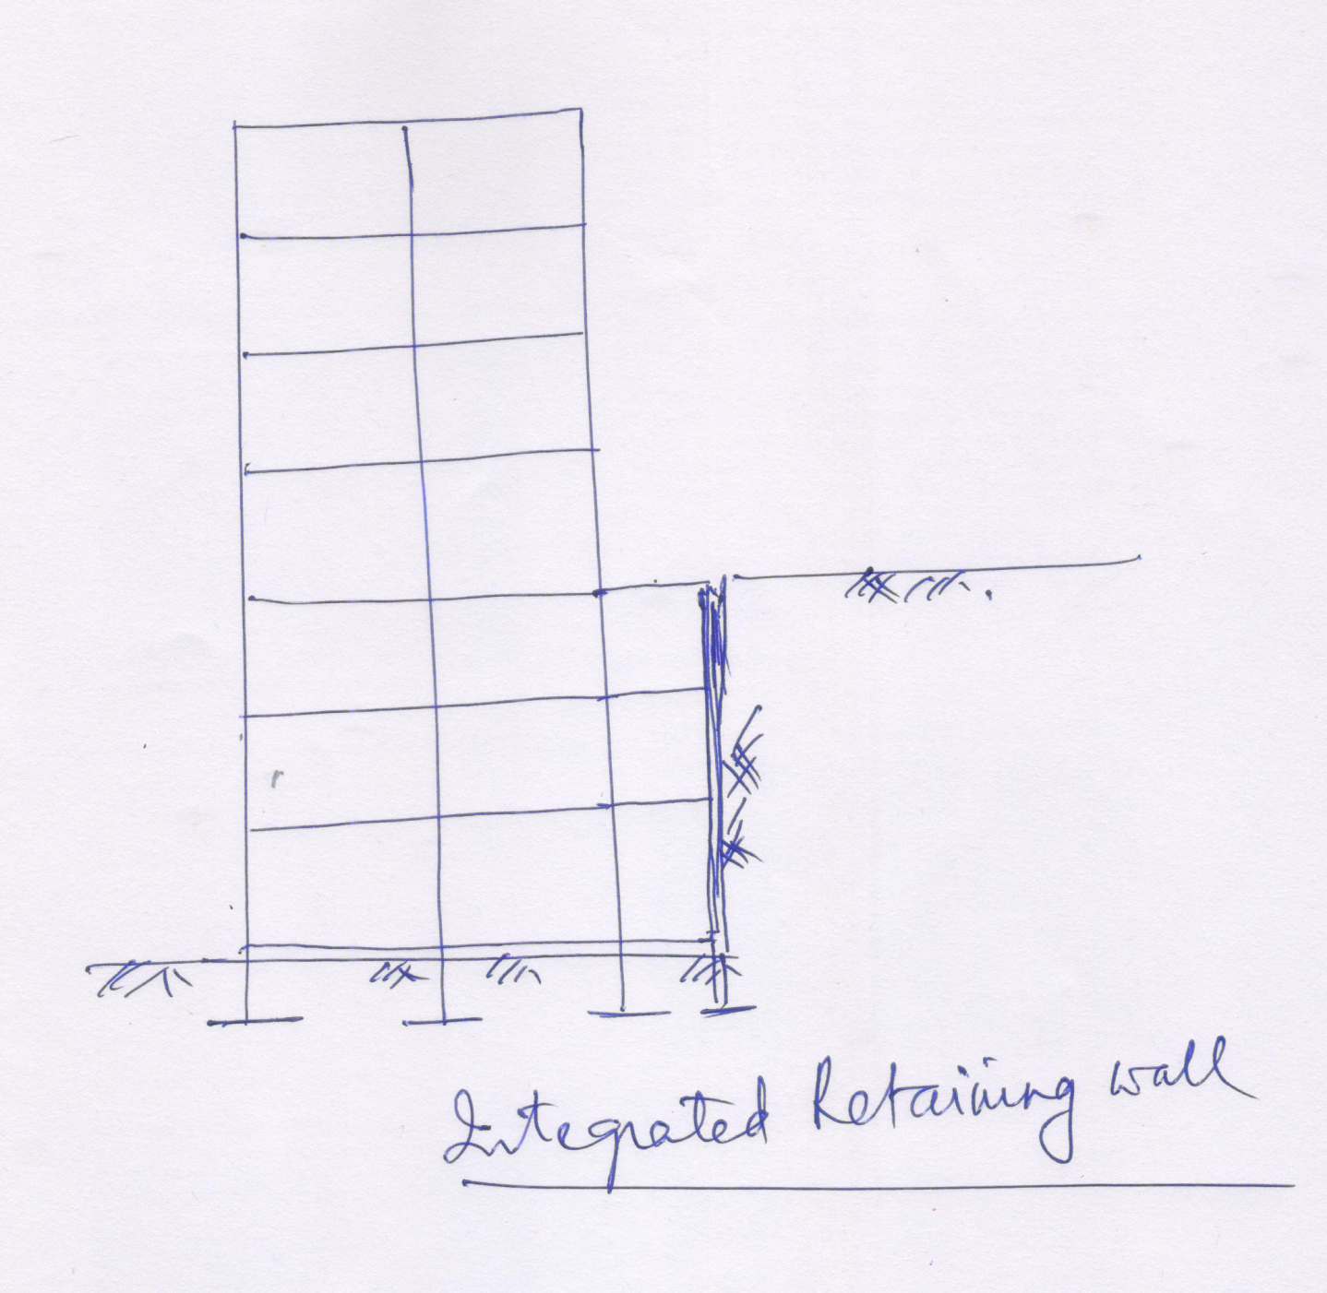

Slide 71
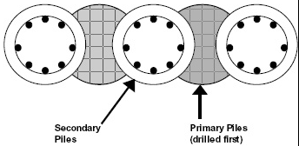
Secant Piles
Secant Piles are drilled shafts constructed in such a way that the shafts overlap each other to form a wall.
They are very stiff retaining walls often used when there are sensitive structures behind the wall.
A secant pile wall uses interlocking male and female cast in situ piles to produce a retaining structure.

Slide 72
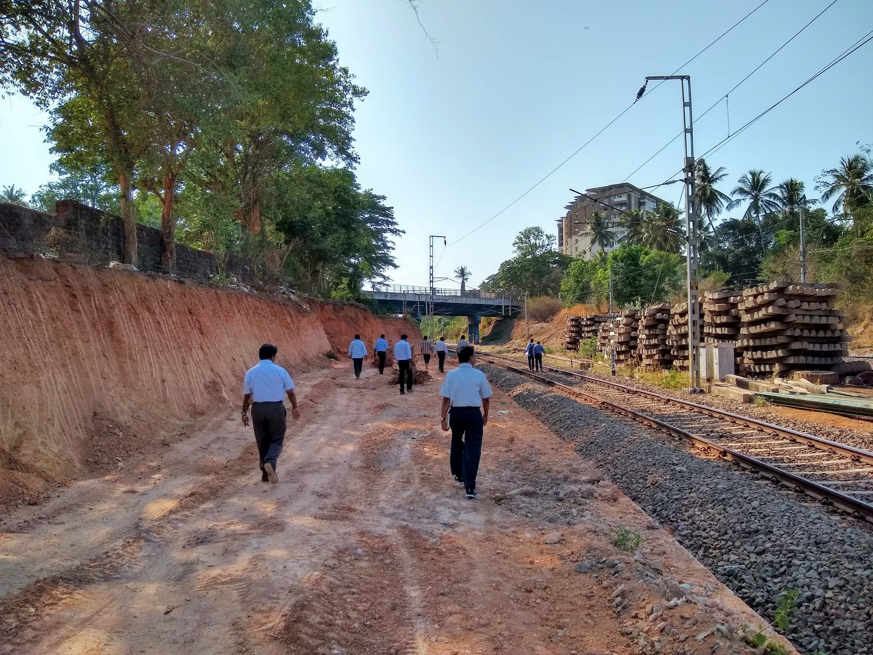
Railway track widening project, Mangalore

Slide 73

Engineered slope
Gentle, not very steep slopes
Checked for stability and all Factor of safeties are as per standard practice
Height of slope is not unduly high (not more than typically 6m ht)
Berms of atleast 1-2m width are provided inbetween slopes, if height of slope is more than 6m
Provided with drainage facilities (such as bench drains, chute drains, collection sumps etc.)
Provided with erosion protection measures such as stone pitching, gabions, turfing (vetiver), geosynthetics, stabilizing soil with chemicals like lignosulfonate etc.

Slide 74

Engineered slopes

Slide 75

A GABION WALL ON KONKAN RAILWAY STRETCH BETWEEN MURDESHWAR AND HONNAVAR
SLOPE WAS TURFED WITH VETIVER GRASS

Slide 76
Turfing
To prevent soil erosion (surface erosion and also internal erosion)
Vetiver grass is very well suited.
It can withstand severe drought, cattle don’t feed on it, it does not spread like a weed, roots grow deep and hold the soil mass, lots of vetiver nurseries are coming up in this part of world.
Roots of vetiver have good tensile strength. Our tests showed that these roots can have tensile strength upto 1/16th that of steel

Slide 77


Slide 78

GROWING GRASS ON SLOPES [TURFING] WILL PREVENT SOIL EROSION AND ALSO GIVES SOME REINFORCEMENT EFFECT
A well grown Vetiver root

Slide 79

SLOPE EROSION IS PREVENTED BY PLANTING SUCH GRASS (VETIVER). THEIR ROOTS ARE VERY STRONG AND HAVE TENSILE STRENGTH OF ONE-SIXTH OF STEEL.

Slide 80

A CLOSER VIEW OF VETIVER PLANT. THEIR ROOTS OVERLAP AND FORM A STRONG NET TO PROTECT AGAINST EROSION.

Slide 81



Use of Geocoir and Geojute with grass for erosion control on slopes
8 mm opening size
12 mm opening size
Soil only

Slide 82


Coir Geotextile or Geo-coir
(bhoovasthra) for erosion control on slopes
coirboard.gov.in

Slide 83


Slide 84
VEGETATION ON SLOPES
Turfing will help to prevent erosion and adds to stability
Trees on slopes at appropriate places (especially at toe and beyond) will add to stability

Slide 85
Case Study 1: Kethikal land slide
Cross section of slope
16 to 18 degrees
12 m in height
65 to 70˚
Road 12 m in width
15 m in height
55 to 60 degrees
Cross section of slope at Kethikal before failure

Slide 86

Case study 1: Kethikal slope failure
Laterite quarries such as these will be discarded after their utility – causing changes in drainage pattern and disasters in the form of land slides and/or flooding
Google

Slide 88

View of movements at the carp of Landslide

Slide 89
Kethikal slope failure Case study
105 m in length
55 m in width
Plan of failure wedge in Kethikal

Slide 90

Case Study 1: Kethikal land slide Cross section of slope
View of Road that had sunk upto 5m due to a Landslide
This road was part of an important State Highway

Slide 91

Plate 1: Another View of Road at Landslide

Slide 92

Case Study 1: Field investigations
N
Bore log details of Kethikal (at the road level)

Slide 93
EROSION STUDIES ON LITHOMARGIC CLAYS

Slide 94


Slide 95

Typical Results of HET

Slide 96
Typical Results of HET
Plot of Erosion rate v/s Hydraulic Shear stress

Slide 97
The rate of erosion of a soil can be represented by an erosion rate Index, I_{h}
I_{h} = -log( C_{e})
Notes:
Lower the Ih higher is the erosion taking place

Slide 98
Variation of Erosion Index (I_{h}) with Plasticity Index (PI) at Saturation
M samples are those lateritic soils (LMC) with higher silt size fraction (50 to 80%), in a fines content of about 60 to 95%
C samples are those lateritic soils (LMC) with higher clay size fraction (33 to 55%), in a fines content of 60 to 98%
Biji Chinnamma Thomas,
R. Shivashankar, Sarah Jacob and Meera Susan Varghese
“Erosion studies on Lithomargic clays”,
Indian Geotechnical Journal, 50, 142–156 (2020)
Variation of erosion index (I_{h}) with plasticity index (PI) at critical head (samples prepared at saturation condition) [Critical head is for progressive erosion)

Slide 99
CONCLUSIONS
Laterites are products of laterization and their properties depend on the nature of parent rock
LATERITES are considered as soft rock or hard soil or highly compacted and cemented soils – rich in iron and aluminium
Lateritic soils are of different grain size compositions. They are liable to be crushed under load. They behave somewhat like dispersive soils. They are highly erosive.
Their properties (strength and plasticity characteristics) can change due to contamination
As for any soils, good compaction and good drainage (good geotechnical practices) can ensure good performance of earth structures built using lateritic soils.

Slide 100



Slide 101


