Slide 1
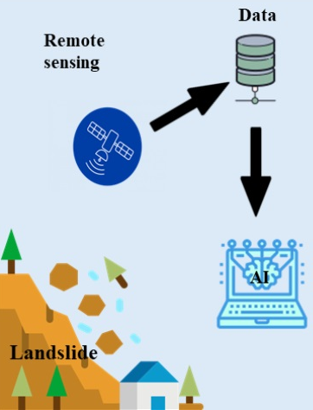
APPLICATIONS OF AI IN LANDSLIDES AND SLOPE STABILITY
Dr. Purnanand P. Savoikar
Professor in Civil Engineering Goa Engineering College, Farmagudi

Slide 2
Introduction
Globally, the landslides, a prominent natural disaster, are estimated to cause approximately 1000 deaths annually apart from damaging property worth millions of dollars.
Between 1998 and 2017, landslides killed 18 thousand people and affected 4.8 million lives (Gemmo Ai).
The landslides account for considerable loss of life and cause damage to human settlements, civil structures, hydro projects, communication routes, and agricultural and forest land.
The secondary effects of landslides could also be disastrous:
- Impact of waves generated by landslides entering water bodies,
- Formation of landslide dams resulting from blockade of drainage
courses and consequent floods due to breaching/overtopping.

Slide 3
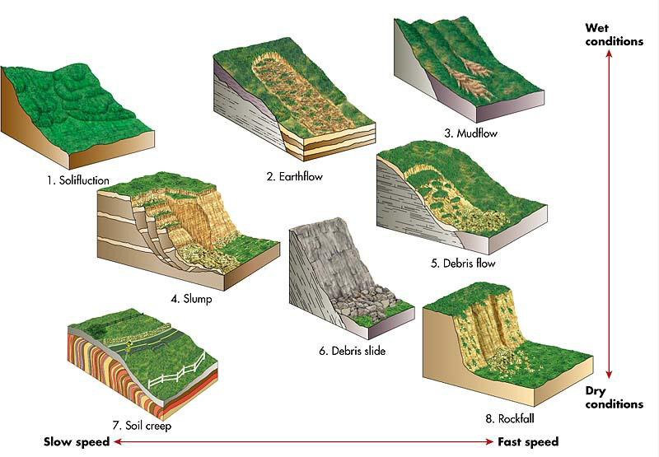
Landslides - Types

Slide 4
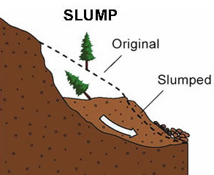
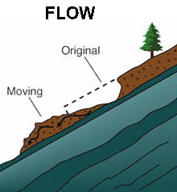
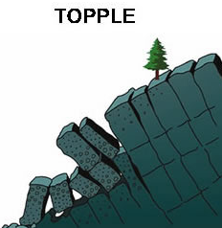
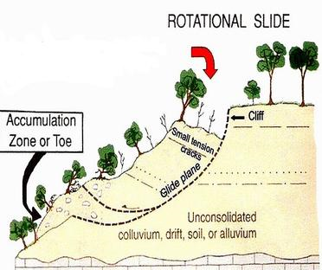
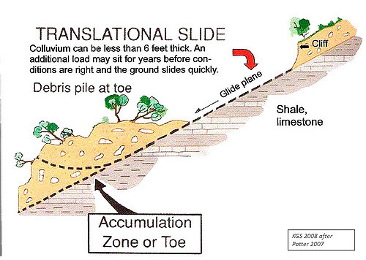
Landslides - Types

Slide 5
Landslides - Classification & causes
Causes: rainfall, snowmelt, water level changes, ground water depletion, stream erosion, earthquakes, volcanic activity, disturbance by human activities or a combination of these.
Geological causes: weak or sensitive materials, weathered materials, sheared, jointed or fissured materials. Other geological factors range from bedding to schistosity, fault, unconformity, contact and contrast in permeability/ stiffness of material.
Type | Max. Depth of slide
1. Surface slide | < 1.5m
2. Shallow slide | 1.5 – 5m
3. Deep slide | 5 – 20m
4. Very deep slide | > 20m

Slide 6
Landslides - Causes
Morphological causes:
Tectonic or volcanic uplift, wind and water erosion, deposition on slope or its crest, vegetation removal, steep slopes, soil moisture
Human causes:
Water leakage from utilities, excavation of slope or its
toe, loading of slope or its crest, drawdown of reservoirs,
irrigation, mining, artificial vibration and deforestation.
Slope saturation by water:
Flooding, rainfall, snowmelt, ground water depletion,
water level changes across dams, lakes, reservoirs,
canals and rivers.

Slide 7
Landslides - Causes
Human
activities
Deforestations
Heavy
rainfall
Mining
Nature of the soil
Slope
Modification
Snow
melts
Construction
Change
in
ground
water
Lateritic soil - Gravelly sand
Human factors – cutting of slopes
Heavy rainfall
Deforestation

Slide 8
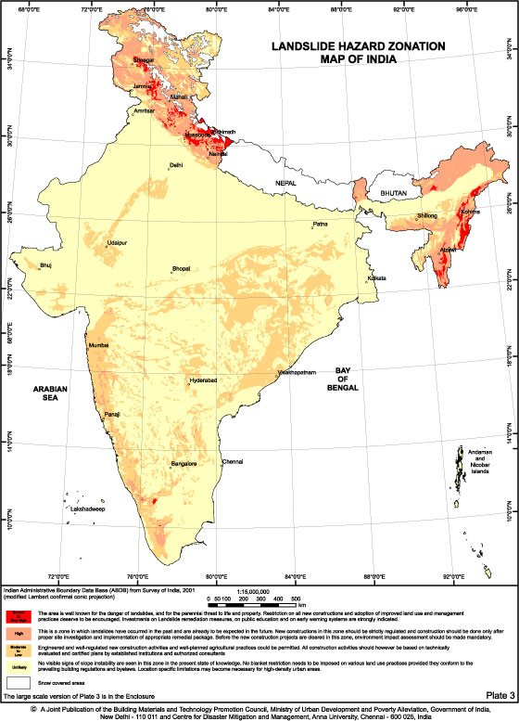
Landslides - Hazard zones in India
Landslide Hazard Zonation map of India:
The Western Himalayas ( Uttar Pradesh, Uttaranchal, Himachal Pradesh and Jammu & Kashmir)
The Eastern & North-eastern Himalayas (West Bengal, Sikkim and Arunachal Pradesh)
The Naga-Arakkan Mountain belt (Nagaland, Manipur, Mizoram and Tripura)
The Western Ghats region & Nilgiris (Maharashtra, Goa, Karnataka, Kerala & Tamil Nadu)
Meghalaya Plateau comprising the Peninsular India (North-east India).

Slide 9
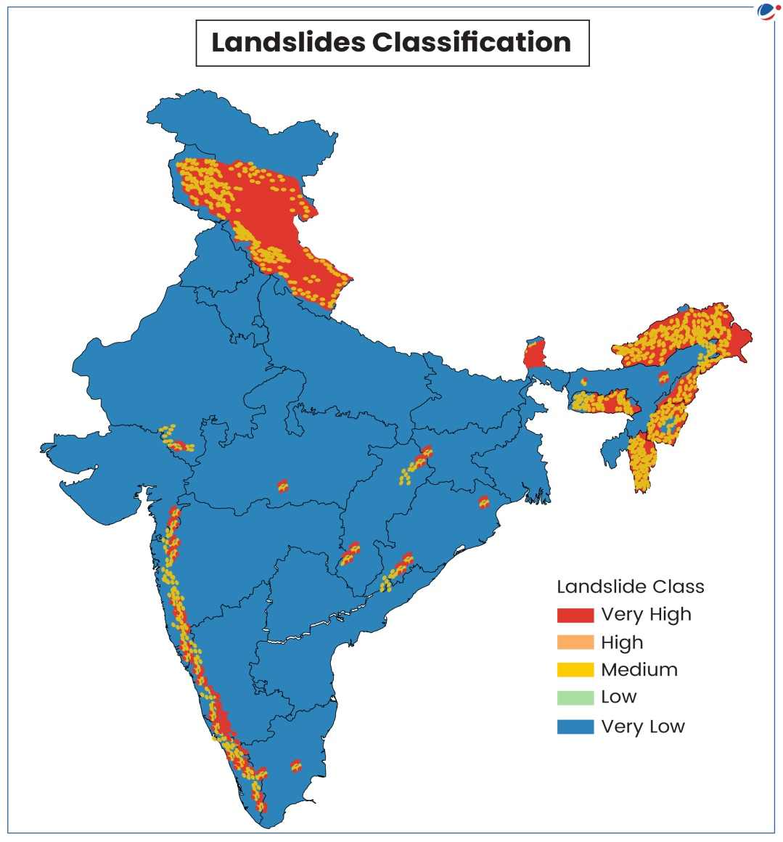
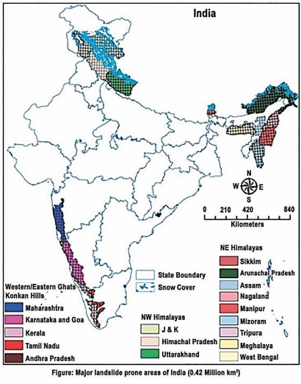
Landslides - Classification

Slide 10
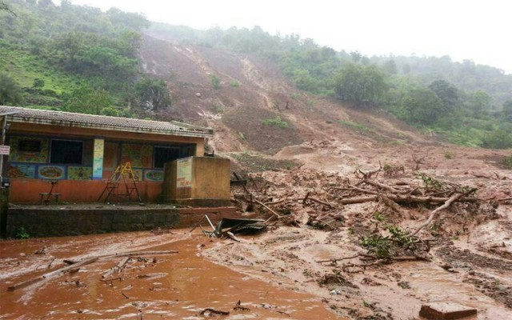
Landslides in India
Malin landslide in Pune (30th July 2014)
151 deaths

Slide 11
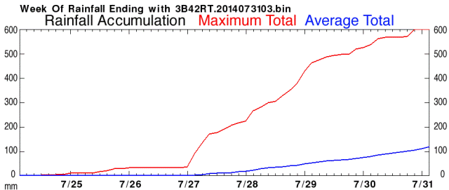
Malin landslide – Pune, Maharashtra
Heavy rainfall of 60cm two days prior to landslide
role of development and deforestation
landslide appears to be a mudslide in deeply weathered soils
no evidence of involvement of large amounts of bedrock
NASA TRMM landslide warning: slope would be highly susceptible to disturbance.

Slide 12
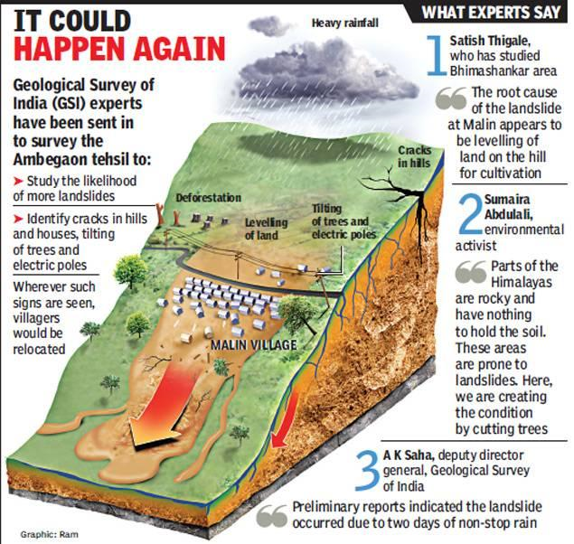
Malin landslide – Pune, Maharashtra

Slide 13
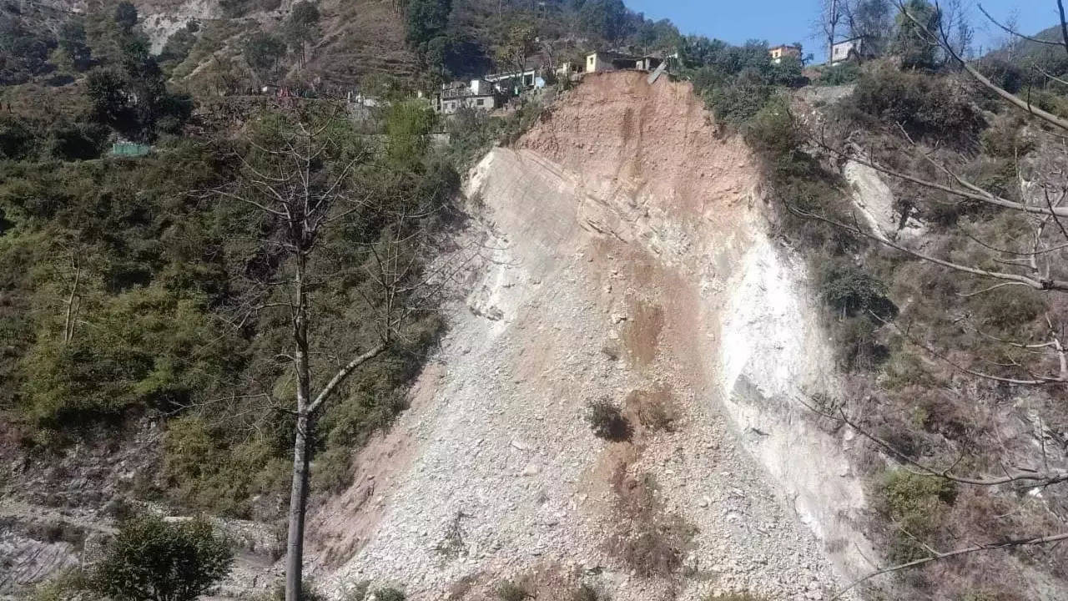
Landslide – Rudraprayag
Between 2018 and 2021,
Uttarakhand reported 253 landslides resulted in 127 deaths.
The two hill districts of Rudraprayag and Tehri in Uttarakhand
have maximum exposure to landslide risk in India (NSRC, ISRO)

Slide 14
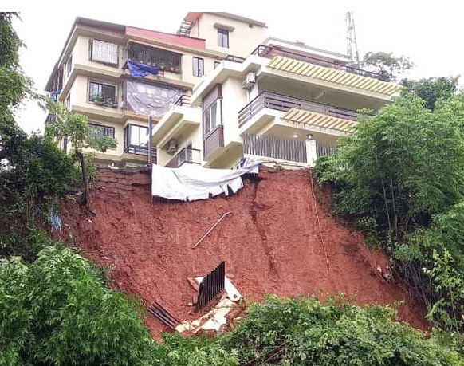
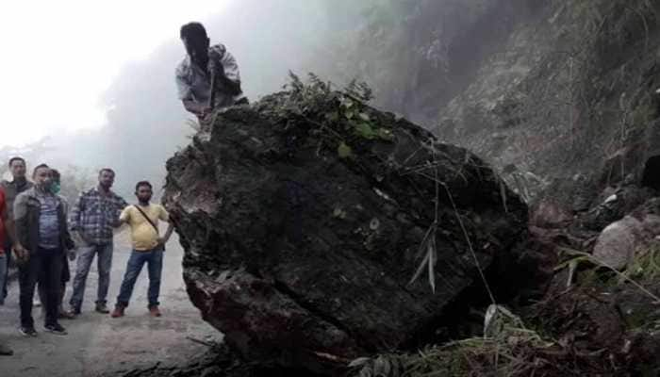
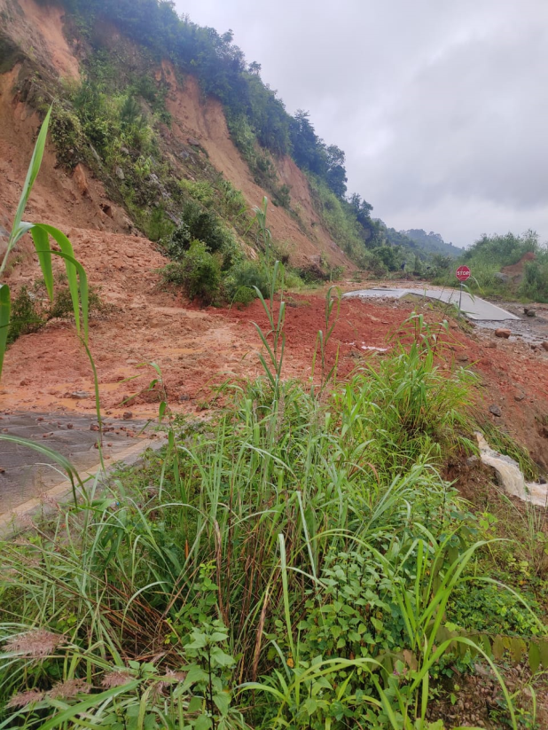
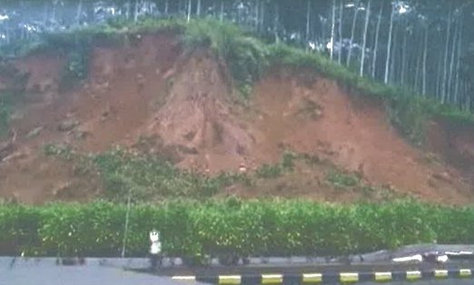
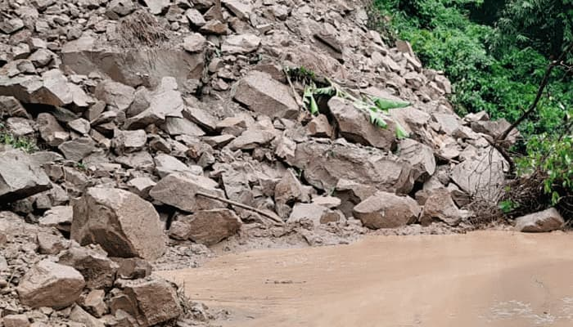
Landslides in recent past
August 2020, Goa
Sept. 2020, Meghalaya
July., 2020, Darjeeling
April 2020, Indonesia
Sept., 2020, Nepal

Slide 15
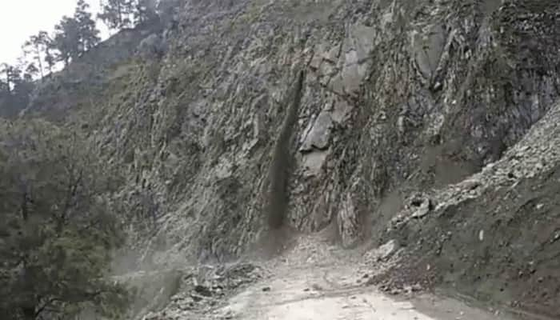
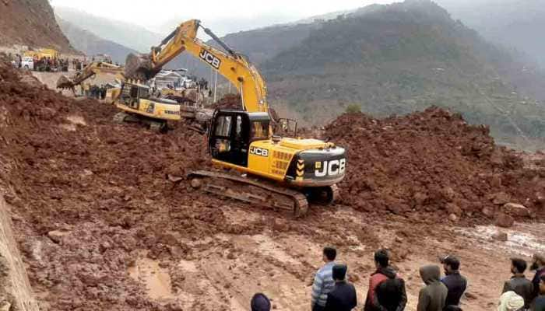
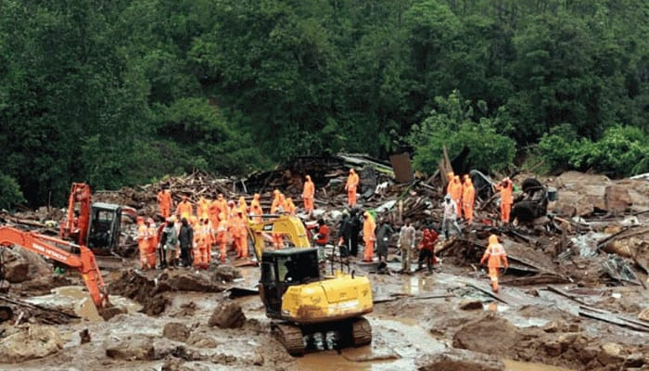
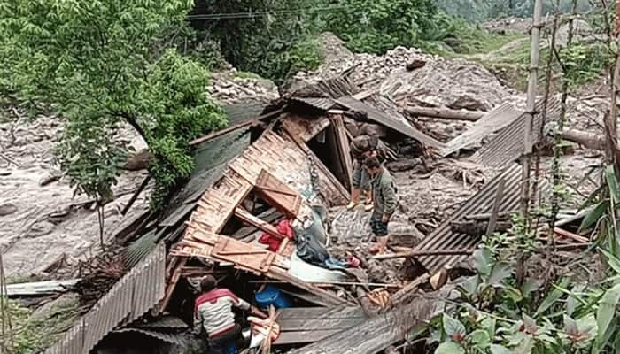
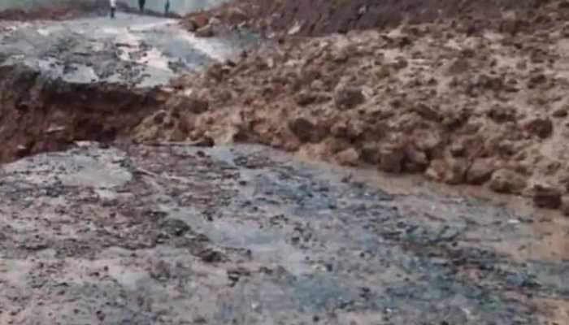
Landslides in recent past
Aug 2020, Kerala
March 2020, J & K
Sept 2020, Mandi
Aug 2020, Sikkim
Aug 2020, J & K
LBSITW FDP 22-26 NON 2021

Slide 16
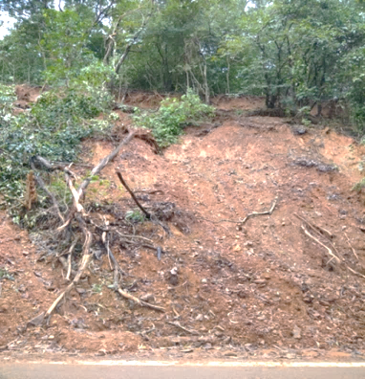
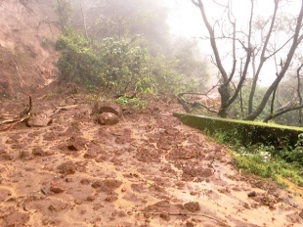
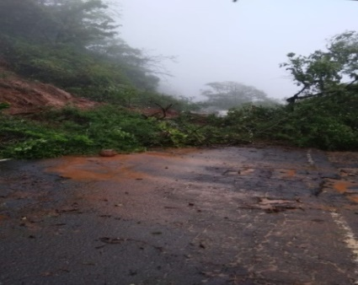
Landslides in recent past in Goa
Landslides in Chorla Ghat in 2017, 2019, 2020

Slide 17
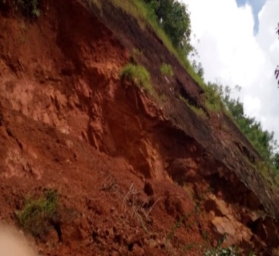
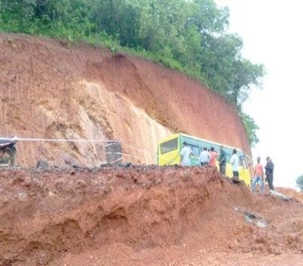
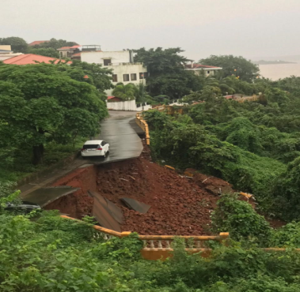
Landslides in recent past in Goa
Mardol - Goa 2016 Khandepar – Goa 2018 Dona Paula, 2019

Slide 18
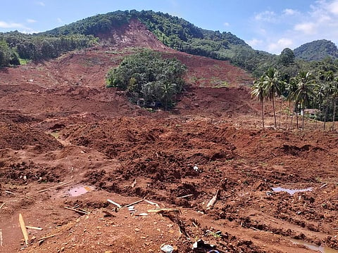
Some major recent landslides - Manipur
Landslide on June 30, 2022 at Tupul Railway station building site Makhuam village in Noney district, Manipur.
61 killed and 18 injured.
Causes: Extreme rains, long-term exposure to hill slopes cut for development projects, debris obstructing the flow of Ijei river and shifting land use patterns, such as deforestation

Slide 19
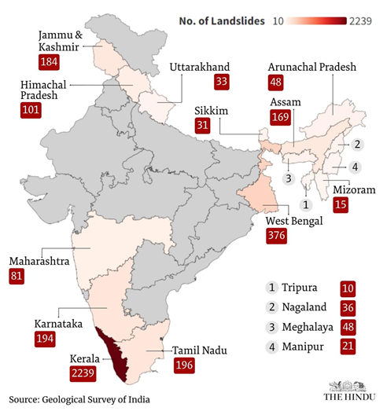
Some major recent landslides – Wayanad, Kerala
2015 to 2022, about 3,782 significant landslides occurred in India of which 2,239 (60%) occurred in Kerala as per GSI.
On July 30, 2024, Chooralmala and Mundakkai in Wayanad were hit by devastating landslides triggered by torrential downpour (570mm in 2 days), claiming over 392 lives, 273 injuries and 150 people missing.
Debris travelled about 8 km along the Iruvaniphuza river, altering its course, causing breaches in the banks, and destroying buildings and homes along the riverbanks.

Slide 20
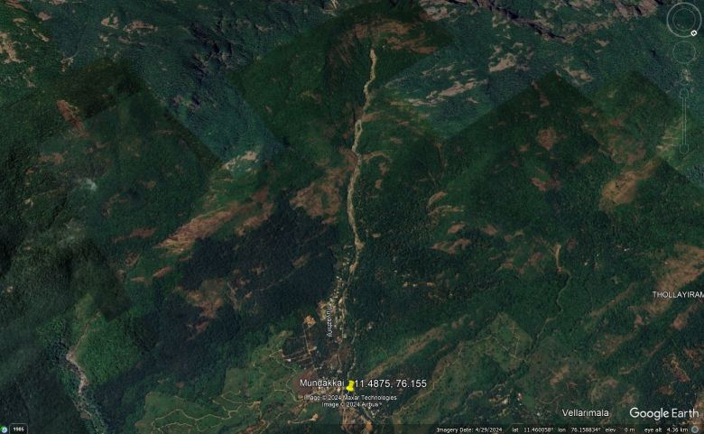
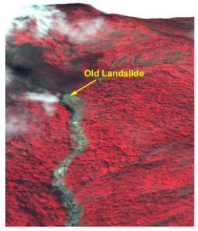
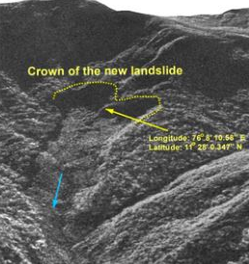
Some major recent landslides – Wayanad, Kerala
Pre-landslide (NASA)
Google Earth Image April 2024
Post-landslide satellite images (NASA)

Slide 21
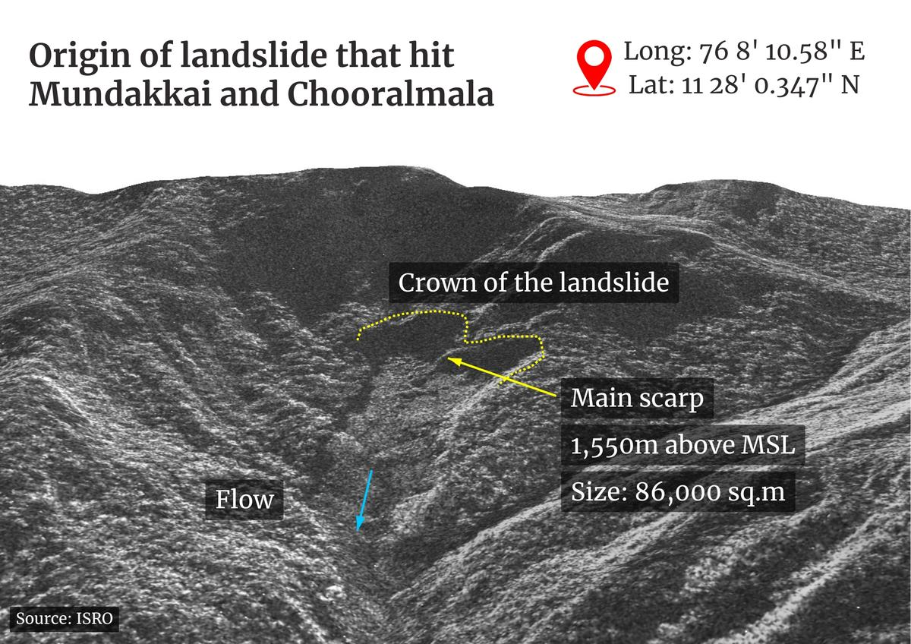
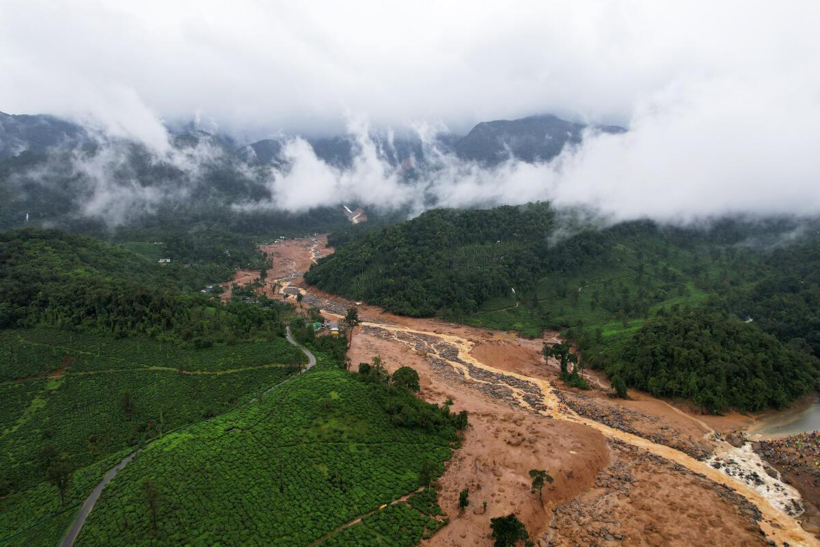
Some major recent landslides – Wayanad, Kerala
Landslide hit Mundakkai-Chooralmala region
July 30, 2024
Over 31% of Wayanad’s land is classified as very highly susceptible to landslides (IITD).

Slide 22
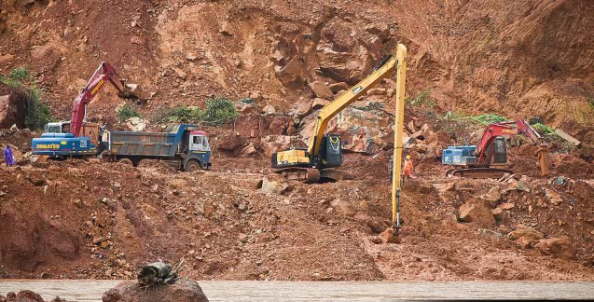
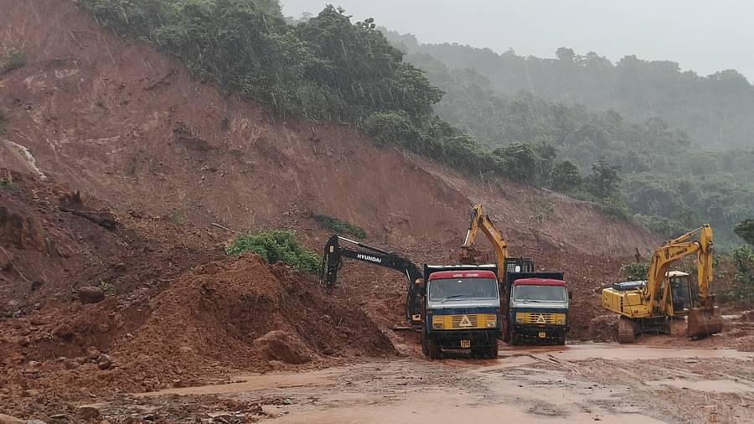
Some major recent landslides – Shirur, Karnataka
Landslide at Shirur, Ankola
(Karnataka) on 16 July 2024.
Landslide caused by construction work and heavy rains. Nine deaths and two missing.
Unscientific construction of NH-66 and heavy rainfall (GSI)

Slide 23
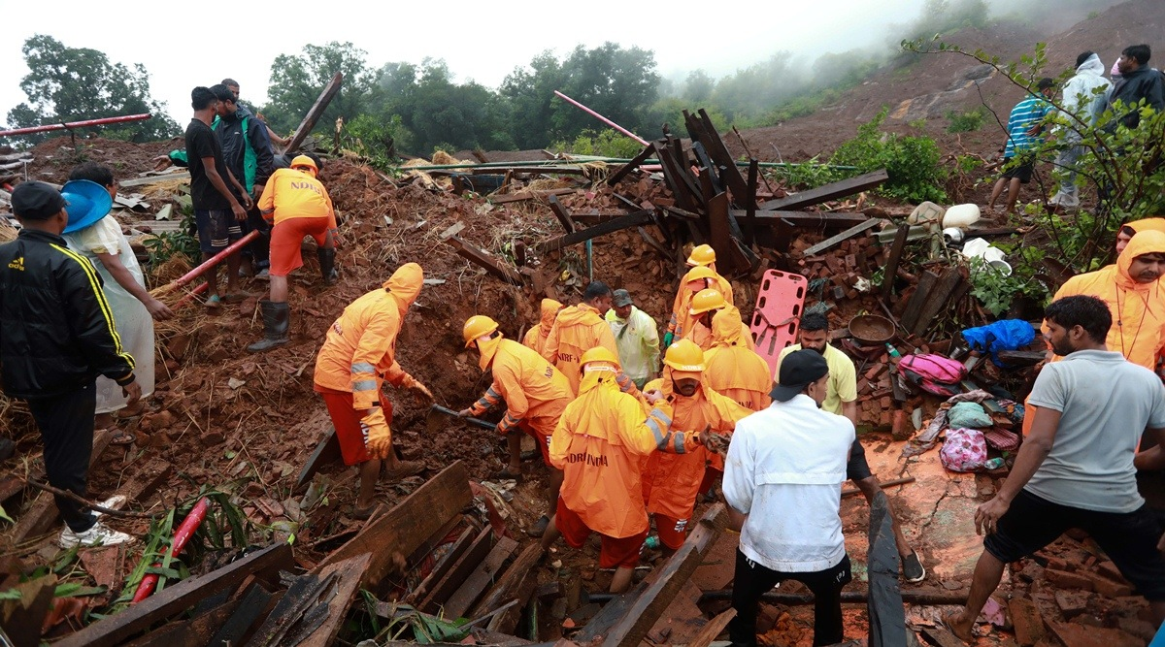
Some major recent landslides – Raigad, Maharashtra
On 19 July 2023 landslide occurred in Irshalwadi, Raigad, Maharashtra.
The landslide was caused by torrential rains, and resulted in at least 26 deaths

Slide 24
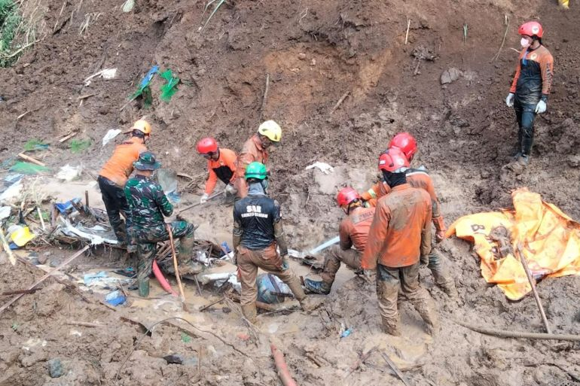
Some major recent landslides – Sulewasi, Indonesia
About 79 villagers were digging for grains of gold in a pit at the small traditional gold mine when tonnes of mud plunged down the surrounding hills and buried them.
11 people killed and 45 missing after heavy rains caused a landslide near an illegal gold mine at Sulawesi, Indonesia.

Slide 25
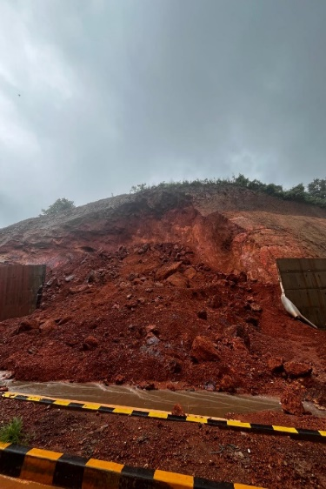
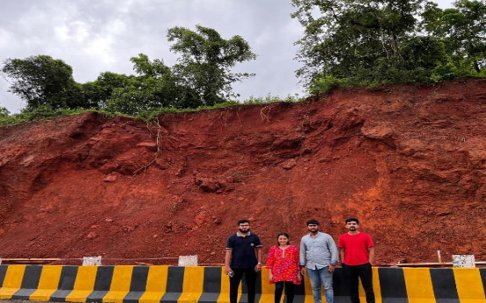
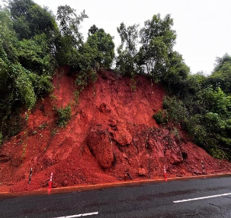
Some major recent landslides – Goa
Pernem – Goa Bicholim – Goa Konem- Priol
July 2024 July 2024 July 2024

Slide 26
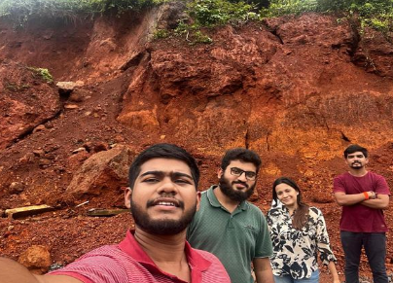
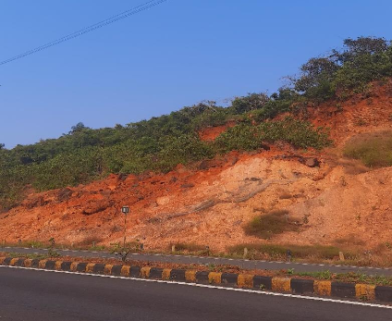
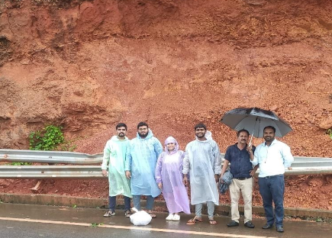
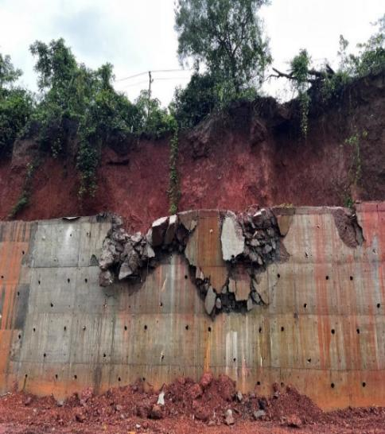
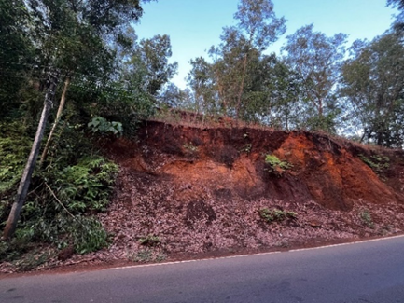
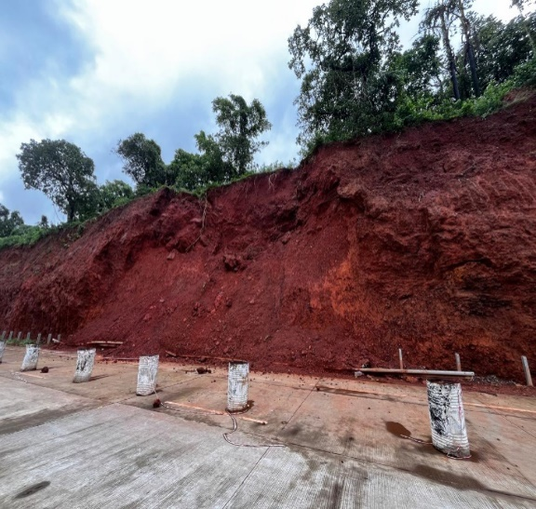
Some major recent landslides – Goa
Kundai – Goa Verna highway – Goa Vasco-da-gama
Aug 2024 July 2024 July 2024
Dhargal
Malpe
Virdi
Bicholim

Slide 27


Mapping of recent landslides – Goa
Faldessai and Savoikar, 2019
Naik et al., 2024

Slide 28
Lessons learnt from recent landslides
Role of the climate crisis and change in land-use patterns over the years as trigger to the landslide
Extreme rainfall pattern
Rampant cutting of hills for roads & other development projects
Deforestation
Changing the drainage pattern
Nature of the soil/rock

Slide 29
Landslide hazard mitigation
Mitigation – reducing the effect or impact of disaster.
1. Landslide hazard mapping - assessment of the susceptibility of the terrain for a slope failure; determining soil-water characteristic curves (SWCC), rainfall threshold.
2. Land use - afforestation, proper study before development activity, no blockage of existing drainage, relocation of settlements, etc.
3. Increase vegetation cover - to arrest landslides by binding top layer of soil with layers below.
4. Implementation of surface drainage - control works, use of geotextiles
5. Construction of retaining structures - use of micropiles, soil nailing, grouting to improve shear strength of soil and decrease permeability, protection or rockfall (nets), providing mudflow barriers, slope stability measures.

Slide 30


Soil-Water Characteristic Curves (SWCC)
SWCC are used to illustrate the engineering behaviour of unsaturated soils, their strength, flow and volume change.
Matric suction influences the behaviour of unsaturated soils in both terms of shear strength and permeability.
Determine the hydraulic and mechanical behaviour of unsaturated soils and to predict soil water storage
Different zones of de-saturation in SWCC (Fredlund, 2006)
van Genuchten-Mualen (1980)

Slide 31




Soil-Water Characteristic Curves (SWCC)
Pressure Plate Apparatus
Neutron probes measure the amount of water present within soil and is widely used across geologging and related industries. A neutron probe contains a pellet containing americium and beryllium.
Dew Point Potentiometer

Slide 32


Analysis of Malin (Pune) landslide
First rainfall event
Factor of Safety = 1.46
Rainfall infiltration in soil slopes increased saturation and decrease matric suction or negative pore. Positive pore pressures in the soil layers. SWCC were determined for soil and used in analysis.
Ering and Babu (2016)
Second rainfall event
Factor of Safety = 1.00

Slide 33

Critical Rainfall Threshold (CRT)
Simplest method to determine CRT is to use hourly rainfall intensity and accumulated precipitation which is total sum of rainfall amount for 7 days including that day of rainstorm occurrence for the consideration of antecedent effective rainfall (Huang et al., 2015).

Slide 34


Critical Rainfall Threshold (CRT)

Slide 35

Artificial Intelligence (AI)
AI - Advanced technology aiming to automate intellectual tasks that are normally performed by humans.
Ability to characterize the inherent non-linear relationships between big data.
Components like machine learning, natural language processing, cloud computing.
Primary focus of AI applications in landslide risk assessment is machine learning (ML) containing deep learning (DL)
He et al. (2024)

Slide 36

Machine Learning (ML) Models
ML is a data-driven method combining statistics with optimization theory.
Widely used ML models include Linear Regression, Logistic Regression (LR), Support Vector Machine (SVM), K-nearest Neighbors (KNN), Clustering, Decision Tree (DT), Random Forest (RF), Naive Bayes (NB), etc.
ANFIS - Adaptive Neuro-Fuzzy Inference System
ANN - Artificial Neural Network
ELM - Extreme Learning Machine
FN - Functional Network
GP - Genetic Programming
GPR - Gaussian Process Regression
LSSVM - Least-Square Support Vector Machine
MARS - Multivariate Adaptive Regression Spline
MPMR - Minimax Probability Machine Regression
RVM - Relevance Vector Machine
SVR - Support Vector Regression

Slide 37


Deep Learning (DL) Models
DL is an advanced ML approach that requires a larger amount of data. DL framework is established with neural networks and there are always more than three neuron layers .
Hybrid model
DL mainly has three steps :
All the input data are subjected to a linear regression operation to obtain a series of results.
Linear regression results are substituted into an activation function to obtain the outputs.
The outputs are used as inputs in the next layer of neurons. The calculation process is repeated to eliminate the invalid features, and then the final outputs can be obtained.
deep feed forward network; (b) long short-term memory; (c) recurrent neural network;
(d) convolutional neural network.
He et al. (2024)

Slide 38
Popular AI tools
ML - Random Forest (RF) robustness in handling large datasets and multiple conditioning factors
Algeria - RF, SVM, and Boosted Regression Tree (BRT)
ML - Support Vector Machine (SVM) high precision in binary classification
China - Analytic Hierarchy Process (AHP), Binary Logistic Regression (BLR), MLP, etc.
DL - Convolutional Neural Networks (CNN) - spatial data processing through layered feature extraction.
Norway - RF and Gradient Boosted Regression Tree (GBRT)
DL - Multi Layer Perception (MLP) - provide flexibility in capturing complex, non-linear relationships between factors.
Sikkim Himalayas – CNN,
Kashmir - Deep Multilayer perceptron for LSM (DMLP-LSM)
Kudaibergenov et al. (2025)
ANN - tabular data flows forward from input to output
CNN - process grid-like data such as images or videos
RNN - designed for sequential data
DNN – ANN with multiple hidden layers
Iran- RNN, CNN, CNN–DNN

Slide 39

Mapping landslides in South Korea
DL - CNN

Slide 40

Mapping landslides in Vietnam
Radial Basis Function Neural Networks (RBFN)

Slide 41

Mapping of Landslides in Goa
Babitha et al., 2023

Slide 42
Satelite, Airborne and Ground-based remote sensing techniques
Shuttle Radar Topography Mission (SRTM)
Advanced Spaceborne Thermal Emission and Reflection Radiometer (ASTER)
Light Detection And Ranging (LiDAR) instruments that characterize terrain morphology.
Synthetic Aperture Radar (SAR) and Interferometric SAR (InSAR) using Google Earth Engine (GEE), the United States Geological Survey (USGS) Earth Explorer and Copernicus.

Slide 43


NASA – Global Precipitation Mission (GPM) & Tropical Rainfall Measuring Mission (TRMM)
TRMM (1997-2015)
GPM (2014 -)
TRMM - critical precipitation measurements, storm structure and intensification in the tropical and subtropical regions using Precipitation Radar. TRMM provided critical inputs to tropical cyclone forecasting, numerical weather prediction, and precipitation climatology for 17 years.
GPM - Accuracy, coverage and dynamic range of precipitation characteristics (heavy, moderate and light precipitation) using conically-scanning multi-channel microwave radiometer covering a swath of 885 km with frequency from 10 GHz to 183 GHz.

Slide 44

Landslide monitoring set-up

Slide 45




Field measurements of ground movements
Inclinometer sensor Tiltmeter
Tiltmeters: measure degrees of rotation, and are useful on extremely slow moving rotational failures.
Inclinometers : measures the curving of originally straight boreholes, thus identifying any modification in inclination of the borehole casing. It helps in the determination of slip surfaces or zones of movement.
Vibrating wire piezometer
Piezometers: measure the pore pressure of groundwater within a geological structure and gives an indication of the build-up stresses and strains. Here, water pressure is converted to a frequency signal via a diaphragm and a tensioned steel wire.
Geophones: measure vibration associated with movement. They can detect landslides on the basis of frequency composition

Slide 46



Field measurements of ground movements
Borehole extensometer
Tape extensometer
Extensometers: measures stress-strains, compaction or upheaval of soil, strain in rocks, and split between rock layers around driven tunnels, slope stability.
Crack meter: measures the displacement between two points, inspects movement across surface cracks and joints in rock, and soil.

Slide 47


Automatic Weather Stations (AWS)
Solar powered AWS
AWS measures, records and transmits weather data such as temperature, wind speed and direction, solar radiation and precipitation.

Slide 48
Parameters affecting landslides
Topo-geomorphological factors:
Slope angle (Sl) factor
Altitude (Al) factor
Distance to drainage network (Dtd) factor
Topographic roughness index (TRI) factor
Geomorphology (Gm) factor
Lithological parameters:
Lithology (Li) factor
Soil (Si) factor
Gravity anomaly (Ga) factor
Distance to faults (Dtf) factor
Hydrological parameters:
Stream transport index (STI) factor
Topographic wetness index (TWI) factor
Stream power index (SPI) factor
Human caused parameters:
Distance to roads (Dtr) factor
Land use/land cover (LULC) factor
Vegetation parameter:
Growth of vegetation and soil characteristics. Normalized Difference Vegetation Index (NDVI) factor

Slide 49


Parameters affecting landslides
Topo-geomorphological factors
Rainfall Erosivity Map of Goa

Slide 50

Parameters affecting landslides

Slide 51

Landslide hazard mapping

Slide 52

Typical AI landslide model

Slide 53

Landslide detection
A pixel (a) classified as ”landslide” or ”non-landslide”.
2. Segmenting images based on shape, colour (b), and scale (c).
3. Classifying objects (e) and (d).
4. CNN extracts the contextual features of an image dataset and learn to identify landslide features (f) by looking at R, G, B channels (g).
He et al. (2024)

Slide 54





Applications of AI in landslides
Landslide
displacement
Baishuihe
Landslide
Susceptibility
mapping
Algeria
Landslide
Detection
Italy
He et al. (2024)

Slide 55

Los Angeles Landslide 2024
Data from NASA's UAVSAR was used to map the slow-moving landslides on Los Angeles County's Palos Verdes Peninsula
Moved 10 cm/week due to record rainfall.

Slide 56

Application of AI for monitoring 3000 landslides in UK
BGS has used Interferometric Synthetic Aperture Radar (InSAR)
Involves large data processing.
A semi-automated method - Machine Learning with Clustering Tools

Slide 57



Landslide Hazard – Microzonation (ISRO)

Slide 58

Database of fatal landslides (NASA)
https://svs.gsfc.nasa.gov/4710

Slide 59

AI in Landslides – Current practices
He et al. (2024)

Slide 60

AI in Landslides – Future scope
He et al. (2024)

Slide 61
LANDSLIDE CONTROL METHODS

Slide 62


Landslide control measures
Benching
Gabion wall with
nailing

Slide 63




Landslide control measures
Soil Nailing &
shotcreting
Precast Retaining Walls

Slide 64


Landslide control measures
Multi-step cantilever retaining wall
Reinforced Earth walls

Slide 65



Landslide control measures
Cantilever retaining wall with relief shelves

Slide 66




Landslide control measures
Graviloft – patented technology
by M/s. Saavi Infrastructures, Pune
3 m to 18 m high, 2.2 km long
Graviloft retaining wall –
Chandani Chowk, Pune
Savi Infrastructures, Pune
15m wall at Dhayari, Pune

Slide 67
Conclusions
Landslides are major cause of concern in developing countries.
The triggering factor like rainfall, high level of development activities, cutting of vegetation, etc.
Man-made landslides are quite alarming. The land use policies and regulations should also be in place.
Landslide hazard mitigation which aims at reducing the effect or impact of disaster is the need of the hour to minimize the loss of human lives, property, etc.

Slide 68
Conclusions
Landslide hazard mitigation involves Landslide hazard mapping, proper land use, increasing the vegetal cover, implementation of surface drainage and construction of retaining structure.
Various slope protection measures like RCC retaining walls, reinforced earth walls, soil nailed walls, gabion walls, tie back wall, etc. can be implemented considering height of the slope, type of the soil, availability of space for construction, cost, long term durability, etc.
Artificial Intelligence has helped mapping landslide prone areas, detecting landslides and issuing sufficient prior warning so that the loss to the human life is minimized.
More advanced Hybrid models will ensure better accuracy and detection of landslides

Slide 69
Thank you !!!

Slide 70



My Published books
As Co-author:
Published by CRC Press,
UK 2022
Published by Creative
Books, New Delhi 2024
Published by Creative
Books, New Delhi 2021
As Editor:
Excel Publishers, New Delhi:
Proceedings of International Conference Concrete Technology, Materials & Construction Practices 2016, Goa
Proceedings of National Conference on Laterites & Lateritic Soils, Goa 2018
Springer Publishers, Netherlands:
1. Proceedings of 13th Deep Foundations of India Conference, Goa 2024 Vol. 1 & 2 (In press)

