Slide 1

Numerical Modelling of Rainfall Induced Landslides: Insights from FEM, LEM and Integrated Geotechnical Workflow
Dr. Rohan Deshmukh
PhD Geotechnical (S V NIT Surat), Geotech Consultant Bentley System, Life Member Indian Geotechnical Society, Life Member Indian Society for Rock Mechanics and Tunnelling Technology

Slide 2
Outline of Presentation
Introduction
Causes of slope instability
Types and Examples of slope failure
Landslides from India
Guidelines for Slope Stability in Hydro Power Projects
Methods of Slope Stability Analysis
Limit Equilibrium Analysis
Finite Element Analysis
Advantages of the Finite Element Analysis
Limitations of FEA
Conclusions
References
Demonstration
Case Study

Slide 3
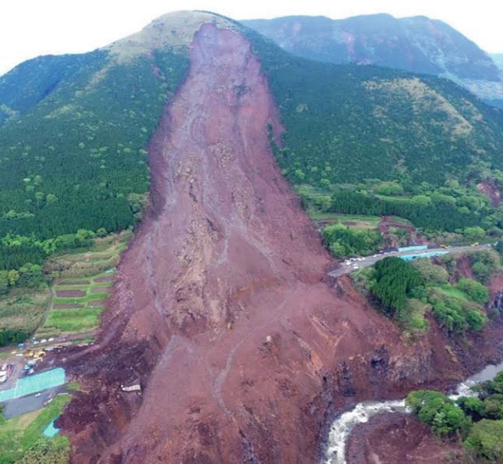
Introduction
Slopes are typically categorized in two types: natural and artificially-made slopes. Natural slopes are formed due to physical processes that include plate tectonics and weathering/erosion of rock masses that result in material deposition. Artificially-made slopes are established to facilitate infrastructure projects, ex., embankments, earth dams, road cuttings etc.
The stability of a slope is of critical importance in Geotechnical Engineering applications. A slope movement (also referred as a landslide) can lead to severe issues including infrastructure damage or/and casualties.
Slope stability depends on the capability of the soil mass to withstand its gravitational forces, the additional loads acting on the slope, as well as potential dynamic loads (such as that of an earthquake).
Translational landslide in Japan

Slide 4
Causes of Slope Instability
Increased unit weight of soil by wetting
Added external loads
Steepened slopes either by excavation or by erosion
Shock loads
Vibration and earthquakes
Increase in moisture content
Freezing and thawing action

Slide 5
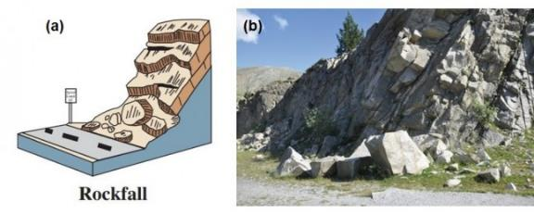
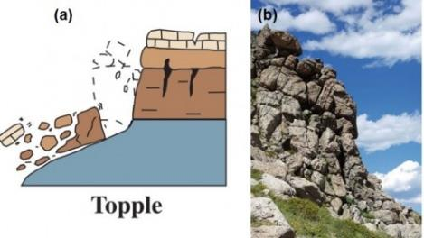
Types and Examples of Slope Failure
The most common and complete classification system of landslides is that provided by Varnes (1978), who introduces a system that requires the definition of the landslide material and the type of the movement induced.
Topples
Topples are also failures that occur in rocky materials and resemble falls. However, this type of failure is associated with a rotational movement that occurs around a certain point located in a relatively low position.
Falls
Falls are downward movements that progress rapidly and may not be preceded by initial movements or warnings.
Figure 1: a) Illustration of a rockfall (USGS, 2004), b) Rockfall in Central Pyrenees, Spain
Figure 2: a) Illustration of a topple failure (USGS, 2004), b) Topple failures in granite boulders, Mount Evans, Arapaho National Forest, Colorado, U.S.A.

Slide 6
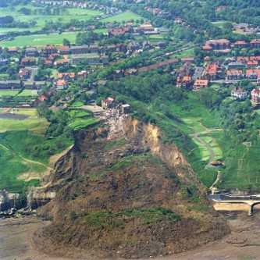
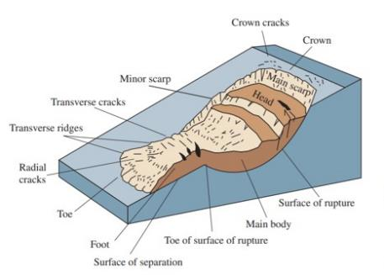
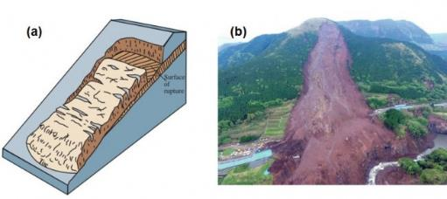
Slides
Slides refer to ground movements along a specified surface or zone of weakness. A slide occurs when the shear stress applied along a surface overcomes its shear strength. The failure may propagate progressively initiating from a local failure zone. The main body of the slide will move downwards separating the stable from the unstable ground.
There are two main types of slides: rotational and translational slides.
Figure 4: The rotational Holbeck Hall landslide landslide, in Scarborough North Yorkshire, England (June 1993)
Figure 5. a) Illustration of a translational landslide (USGS, 2004) and b) Co-seismic translational landslide triggered in Japan in 2016
Figure 3: Main features of a rotational landslide (USGS, 2004)

Slide 7
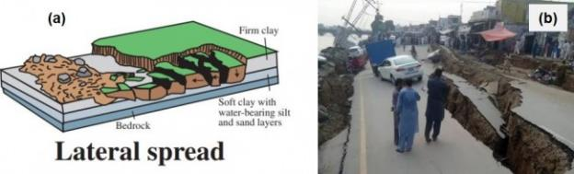
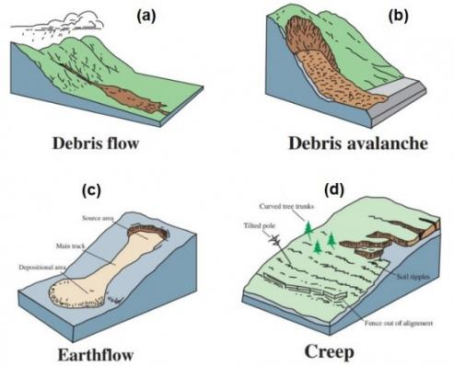
Lateral Spreads
Lateral spreads are deformational phenomena caused by liquefaction, the process during which a saturated soil (usually sands) experiences loss of strength after a sudden change in its initial stress conditions. Therefore, the soil tends to behave more like a liquid than a solid.
Figure 5. a) An illustration of a translational landslide (USGS, 2004) and b) Lateral spreading example caused by an earthquake in Pakistan
Flows
According to Varnes (1978), not all types of slope movements can be categorized in the aforementioned categories. There are certain landslide phenomena that take the form of slow or fast-moving flows. In rocks, there are types of slow movements that result in folding or bending. Due to the fact that these displacements resemble viscous fluids, they can be characterized as rock flows. Regarding flows in soil materials, Varnes (1978) distinguished 4 main categories:
Figure 6: Illustration of a) debris flow, b) debris avalanche, c) earthflow and d) creeping flow (USGS, 2004)

Slide 8
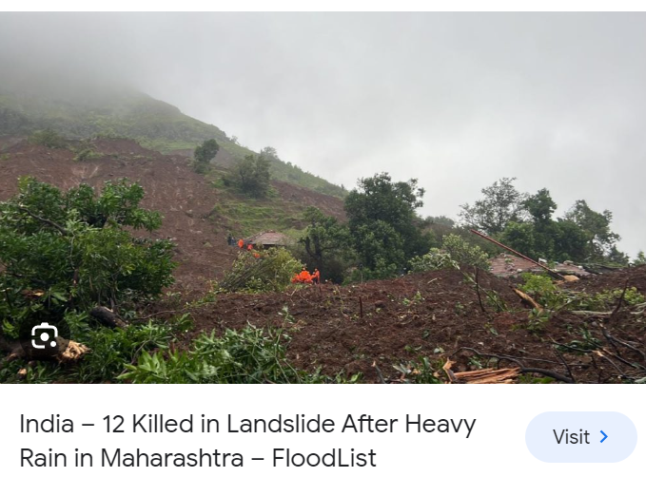
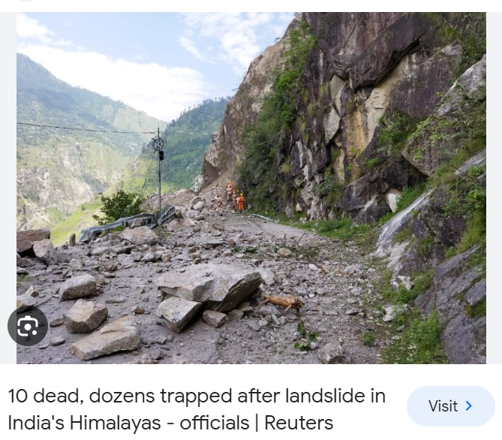
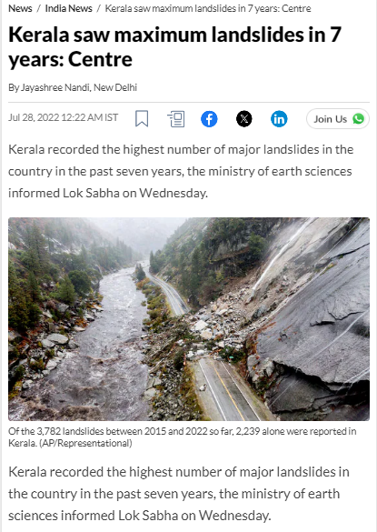
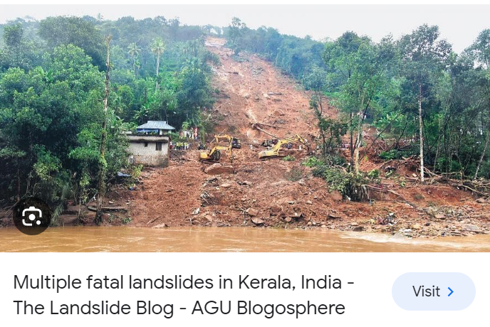
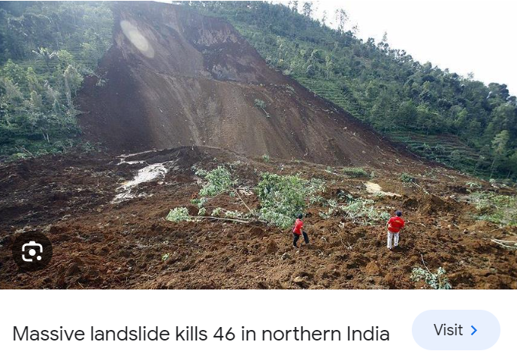

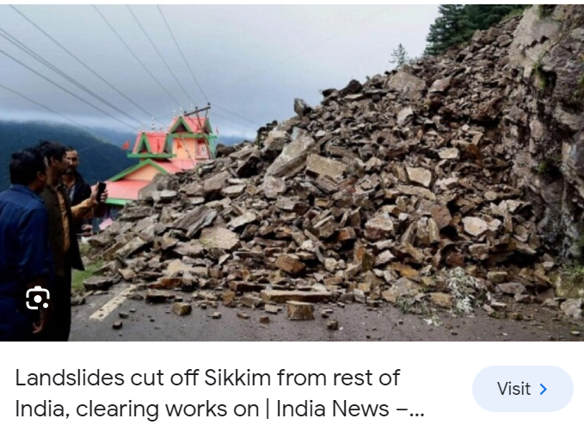
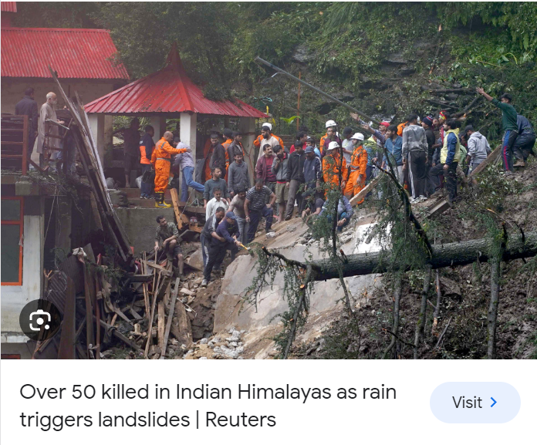
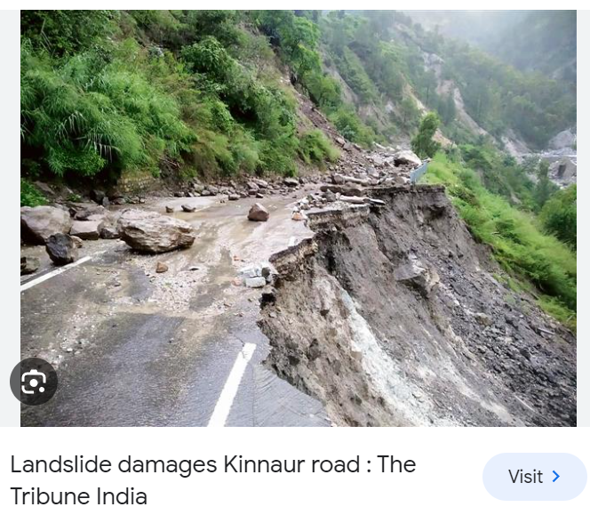
Landslides from India

Slide 9
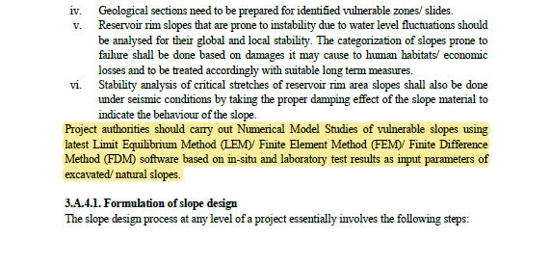
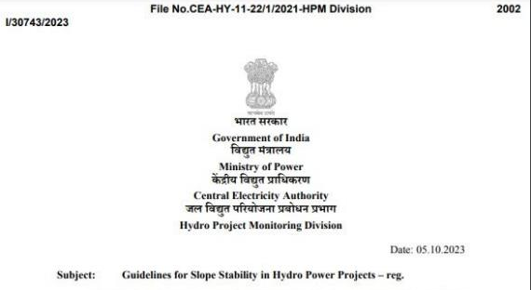
𝐆𝐮𝐢𝐝𝐞𝐥𝐢𝐧𝐞𝐬 𝐟𝐨𝐫 𝐒𝐥𝐨𝐩𝐞 𝐒𝐭𝐚𝐛𝐢𝐥𝐢𝐭𝐲 𝐢𝐧 𝐇𝐲𝐝𝐫𝐨 𝐏𝐨𝐰𝐞𝐫 𝐏𝐫𝐨𝐣𝐞𝐜𝐭𝐬

Slide 10
Methods of Slope Stability Analysis
Slope Stability Analysis
Limit Equilibrium Analysis
Numerical Method of Analysis
Swedish Slip Circle Method of Analysis
Ordinary Method of Slices
Modified Bishop’s Method of Analysis
Lorimer's method
Spencer’s Method
Sarma method
Continuum modelling
Discontinuum modelling
Hybrid/coupled modelling

Slide 11
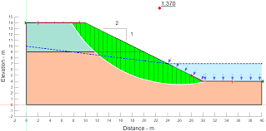
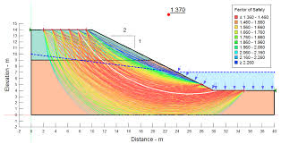
Limit Equilibrium Analysis
Limit equilibrium methods are the most common and widely used slope stability analysis methods.
They are based on the assumption that the slope is on the verge of failure and that the forces acting on the potential failure surface are in equilibrium.
You can use different methods of slices, such as Fellenius, Bishop, Spencer, or Morgenstern-Price, to divide the slope into vertical or horizontal slices and calculate the factor of safety for each slice.
Limit equilibrium methods are relatively simple, fast, and compatible with most geotechnical software. However, they also have some limitations, such as neglecting the effects of pore water pressure, soil deformation, and stress distribution.

Slide 12
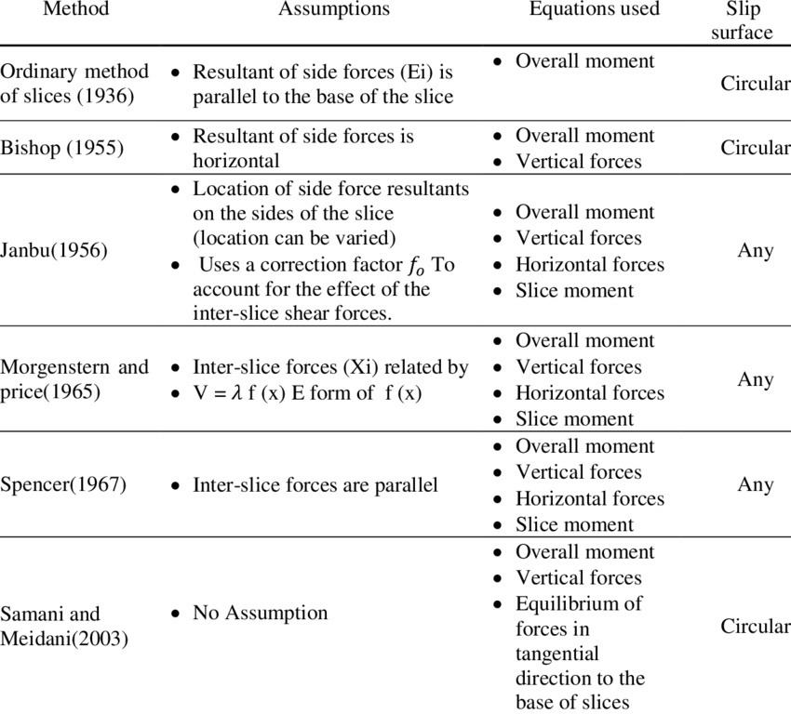
Limit Equilibrium Analysis

Slide 13
Limit Equilibrium Analysis
Method | Assumption
Ordinary method of slices | Interslice forces are neglected
Bishop's simplified/modified | Resultant interslice forces are horizontal. There are no interslice shear forces.
Janbu's simplified | Resultant interslice forces are horizontal. An empirical correction factor is used to account for interslice shear forces.
Janbu's generalized | An assumed line of thrust is used to define the location of the interslice normal force.
Spencer | The resultant interslice forces have constant slope throughout the sliding mass. The line of thrust is a degree of freedom.
Chugh | Same as Spencer's method but with a constant acceleration force on each slice.
Morgenstern-Price | The direction of the resultant interslice forces is defined using an arbitrary function. The fractions of the function value needed for force and moment balance is computed.
Fredlund-Krahn (GLE) | Similar to Morgenstern-Price.
Corps of Engineers | The resultant interslice force is either parallel to the ground surface or equal to the average slope from the beginning to the end of the slip surface..
Lowe and Karafiath | The direction of the resultant interslice force is equal to the average of the ground surface and the slope of the base of each slice.
Sarma | The shear strength criterion is applied to the shears on the sides and bottom of each slice. The inclinations of the slice interfaces are varied until a critical criterion is met.

Slide 14
Finite Element Analysis
Finite element methods are more advanced and sophisticated slope stability analysis methods.
They are based on the numerical solution of the equations of equilibrium and constitutive laws for the soil material.
You can use different types of finite elements, such as plane strain, axisymmetric, or three-dimensional, to model the slope geometry and boundary conditions.
Finite element methods can account for the effects of pore water pressure, soil deformation, and stress distribution.
They can also simulate different stages of loading, unloading, or consolidation. However, they also require more input data, computational time, and expertise.

Slide 15
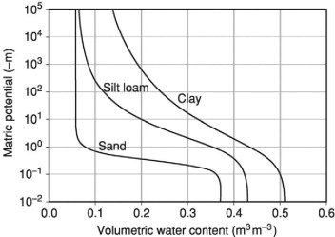
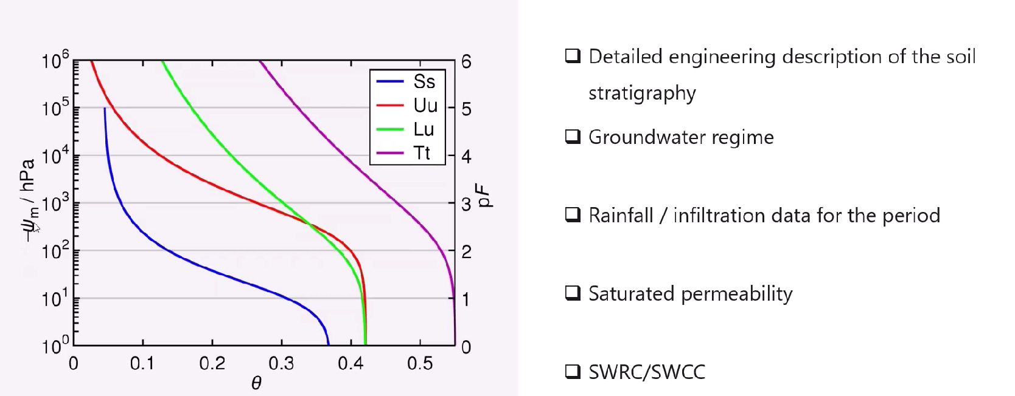
Pre-Requirements of FE Modelling
A Soil Water Characteristic Curve (SWCC) is introduced to describe hydraulic parameters of the groundwater flow in unsaturated zones (usually above the phreatic surface). The SWCC describes the capacity of the soil to keep water at different stresses.

Slide 16
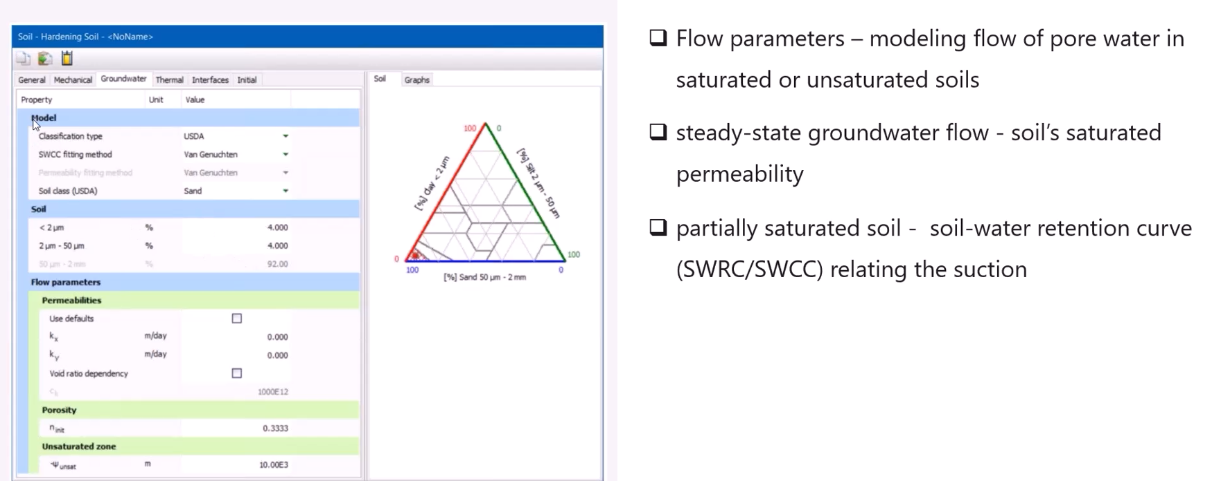
Flow Model
There are many hydraulic models which describe the hydraulic behaviour of unsaturated soils. The most common in the groundwater literature is the model proposed by van Genuchten (1980), which is used in PLAXIS.

Slide 17
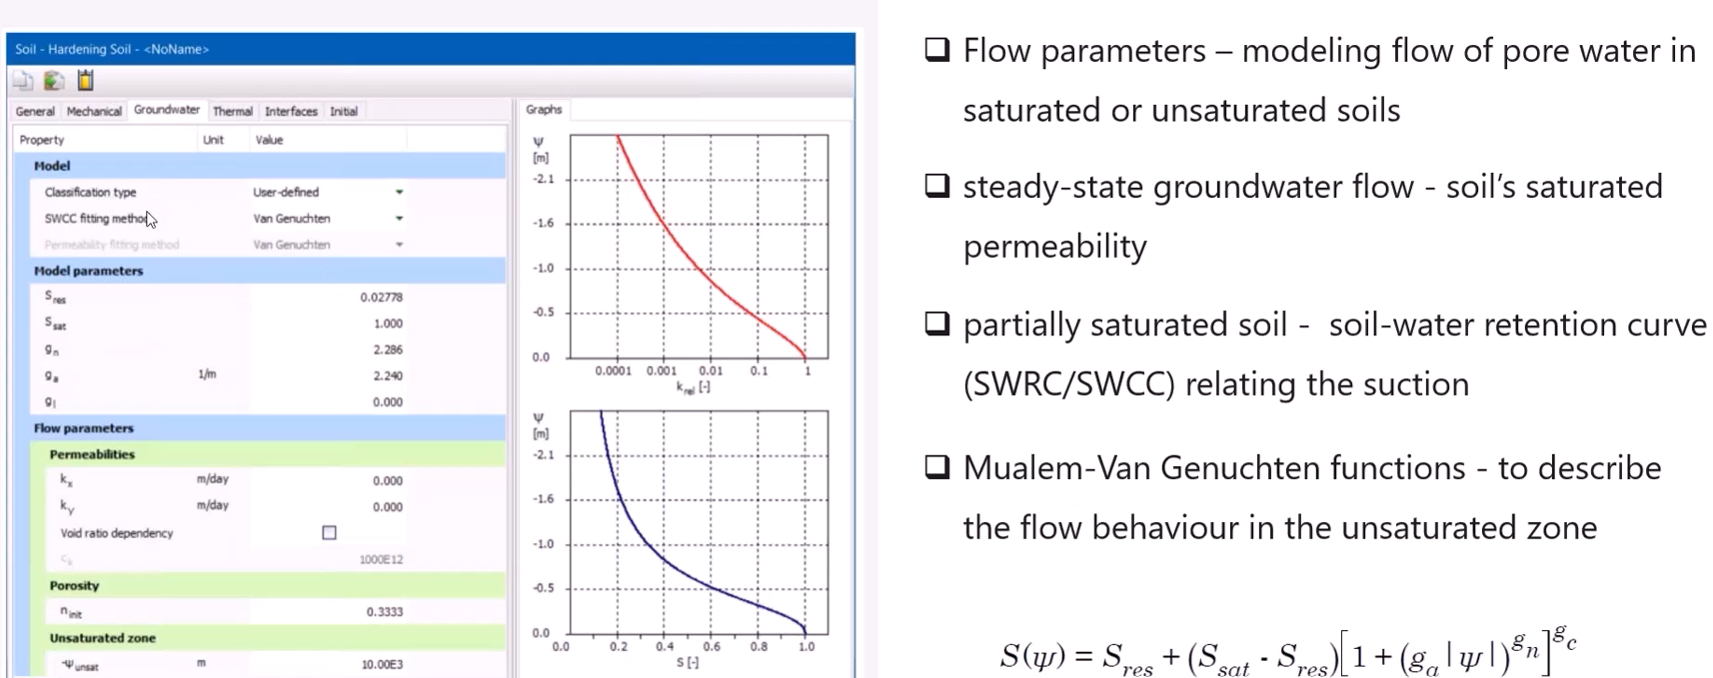
Flow Model
The Van Genuchten function is a three-parameter equation and relates the saturation to the pressure head ψ.
Sres the residual degree of saturation
Ssat the saturated degree of saturation

Slide 18
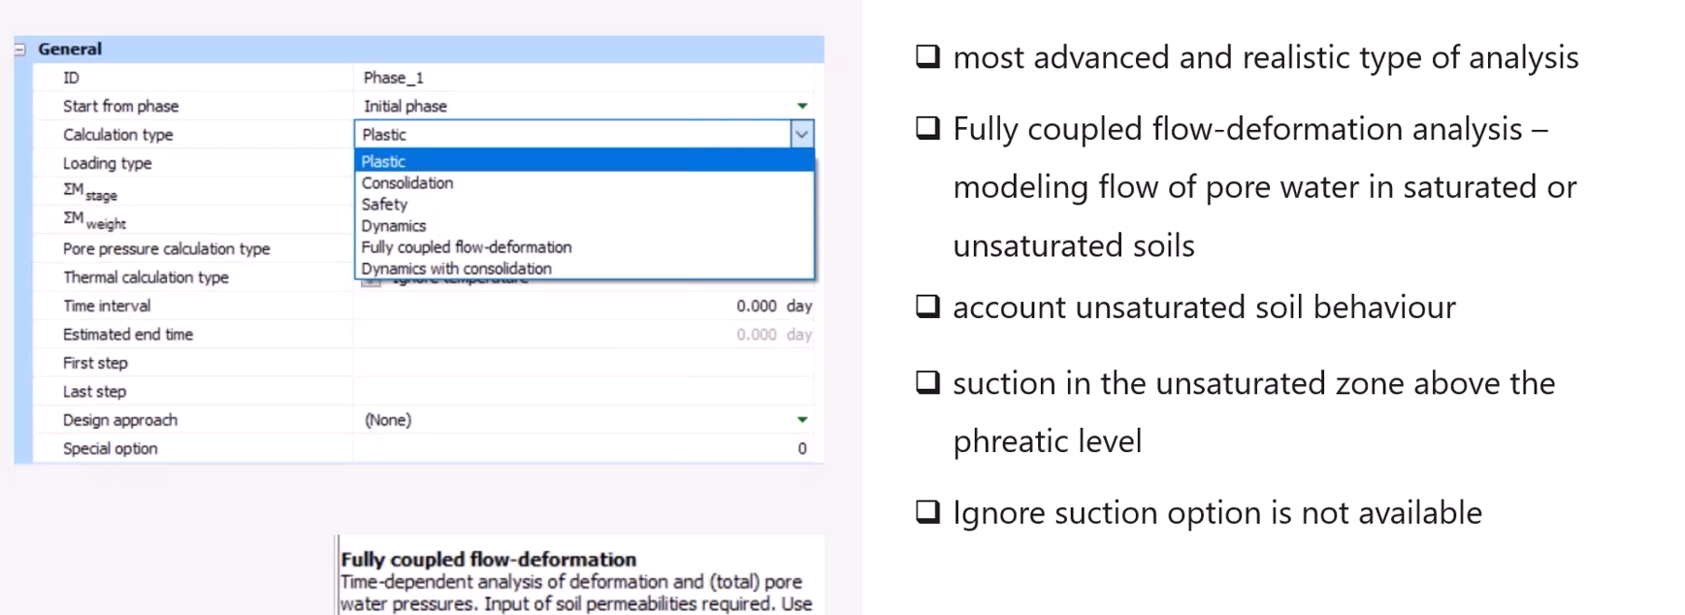
Modelling Rainfall in PLAXIS

Slide 19
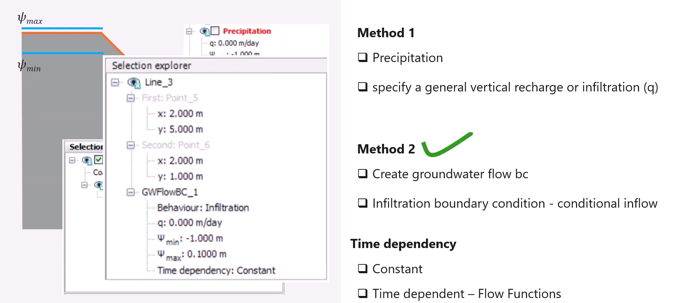
Modelling Rainfall in PLAXIS
q | Recharge (infiltration)
ψ_{max} | Maximum pore pressure head
ψ_{min} | Minimum pore pressure head

Slide 20
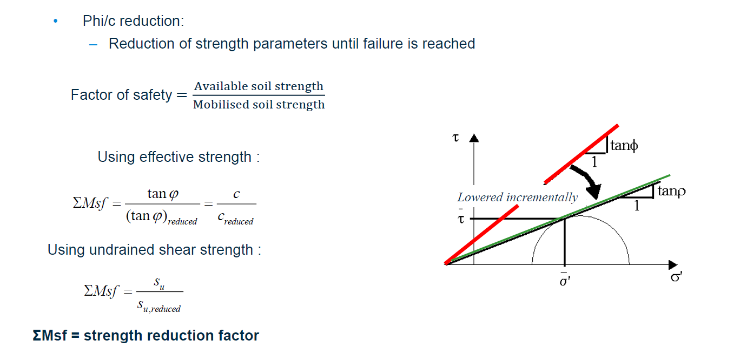
Slope Stability Analysis in FE
We can recognize whether failure occurs based on the idea that when a small reduction of strength is applied this leads to a large change of strains and displacements.
Note that this relationship is different for models that do not have the Mohr-Coulomb failure criterion, like the Hoek-Brown model. See the Calculations chapter in the PLAXIS Reference Manual for more details.

Slide 21
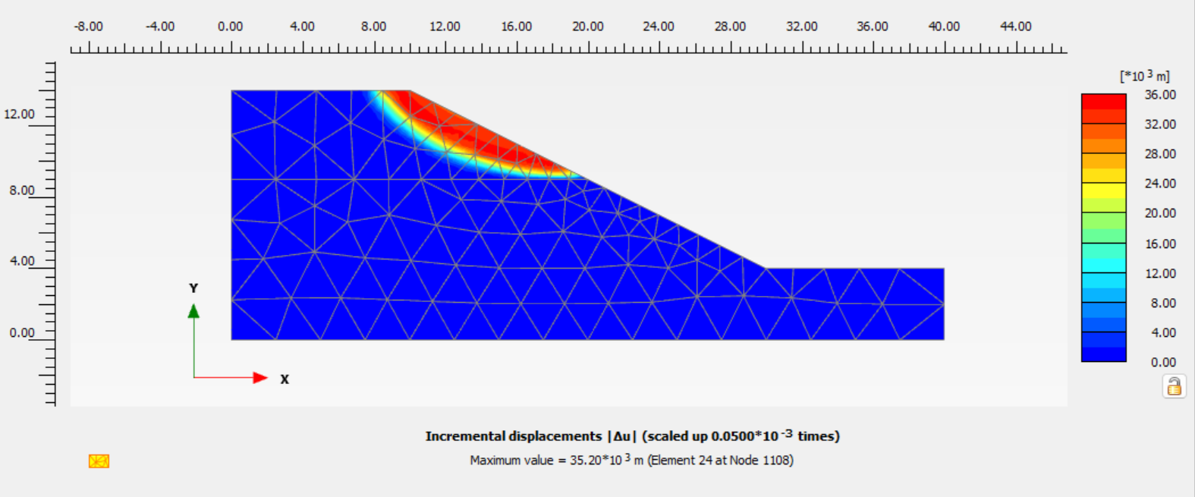
Finite Element Analysis
Due to this ('artificial') strength reduction, you will introduce out-of-balance forces in the model. This out-of-balance will be solved by the calculation kernel, which will result in deformations. These additional displacements that are generated do not have a physical meaning, but the incremental displacements and/or incremental shear strains in the final step (once a stable solution for ΣMsf is reached), give an indication of the likely failure mechanism. Note that the displacements júst before the maximum ΣMsf is reached may be used to get an order of magnitude of the displacements at the moment of failure.

Slide 22
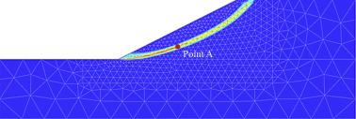
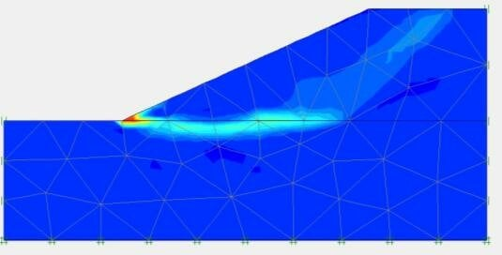
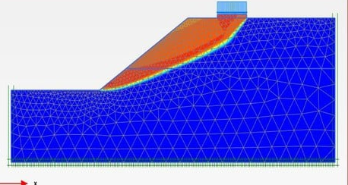
Advantages of the Finite Element Analysis
No assumption needs to be made in advance about the shape or location of the failure surface.
Failure occurs naturally through the zones within the soil mass in which the soil shear strength is unable to sustain the applied shear stresses.
Since there is no concept of slices in the FE approach, there is no need for assumptions about slice side forces.
The FEM preserves global equilibrium until failure is reached.
If realistic soil compressibility data are available, the FE solutions will give information about deformations at working stress levels.
The FEM is able to monitor progressive failure up to and including overall shear failure.

Slide 23
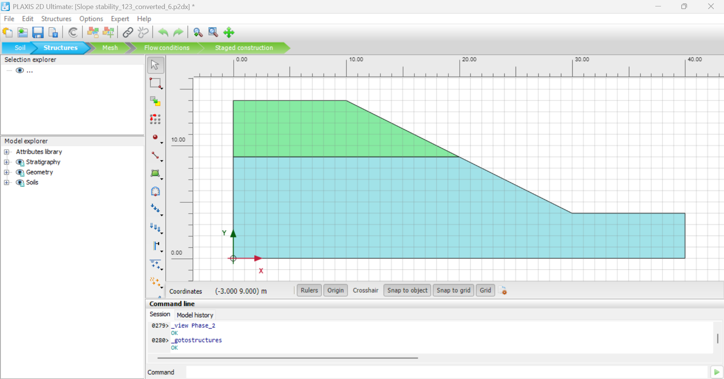
Sample Problem
Determine the FoS before the Rainfall
Simulate the Rainfall with Intensity of 5 mm/hr for 24 hr and 120 hr duration
Determine the FoS after 24 hr Rainfall
Determine the FoS after 120 hr Rainfall

Slide 24
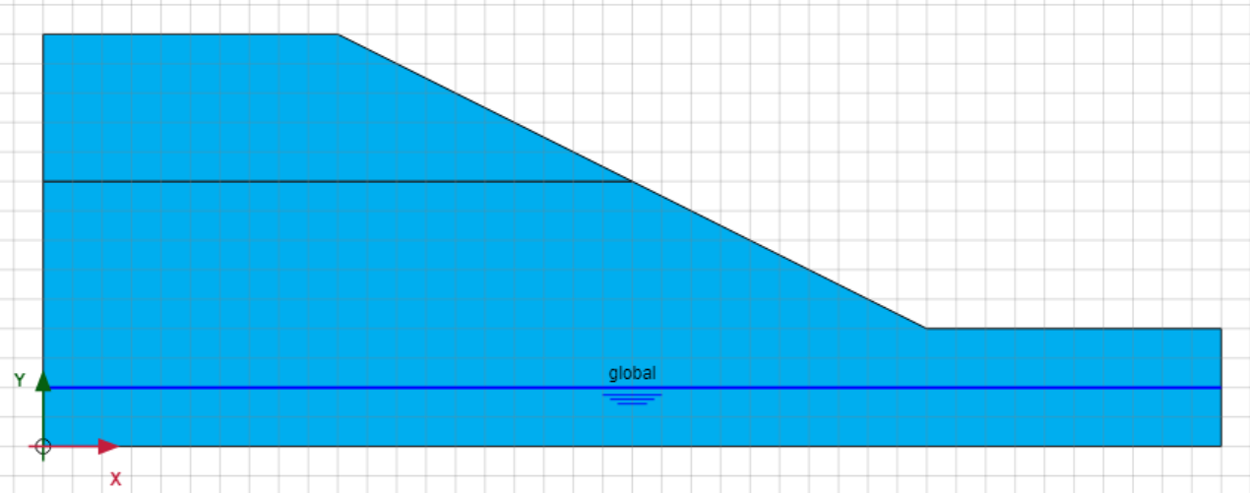
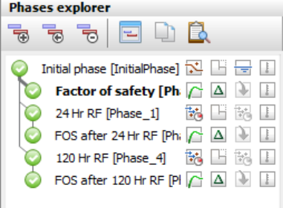
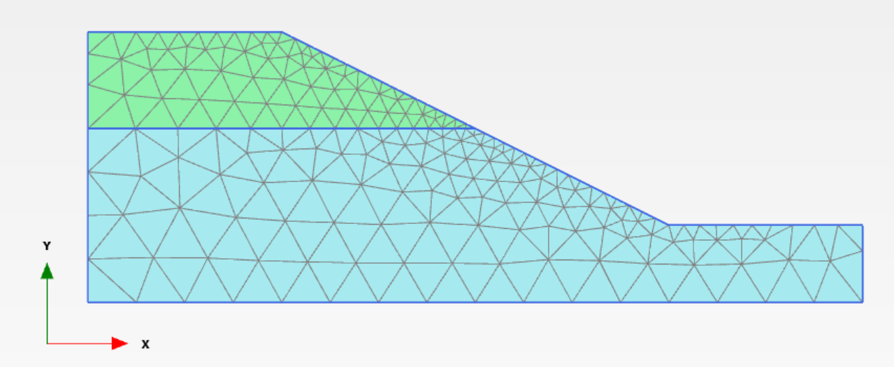

Slide 25
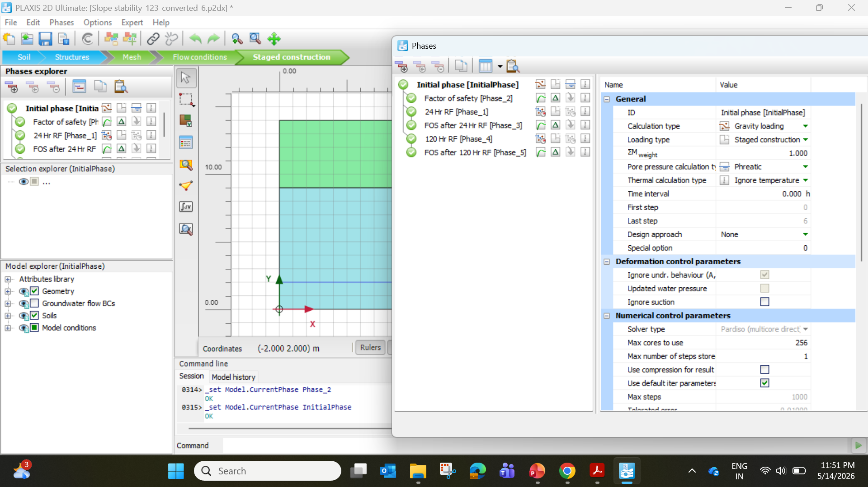

Slide 26
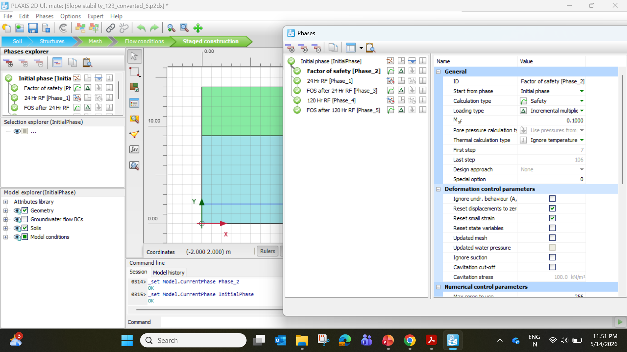

Slide 27
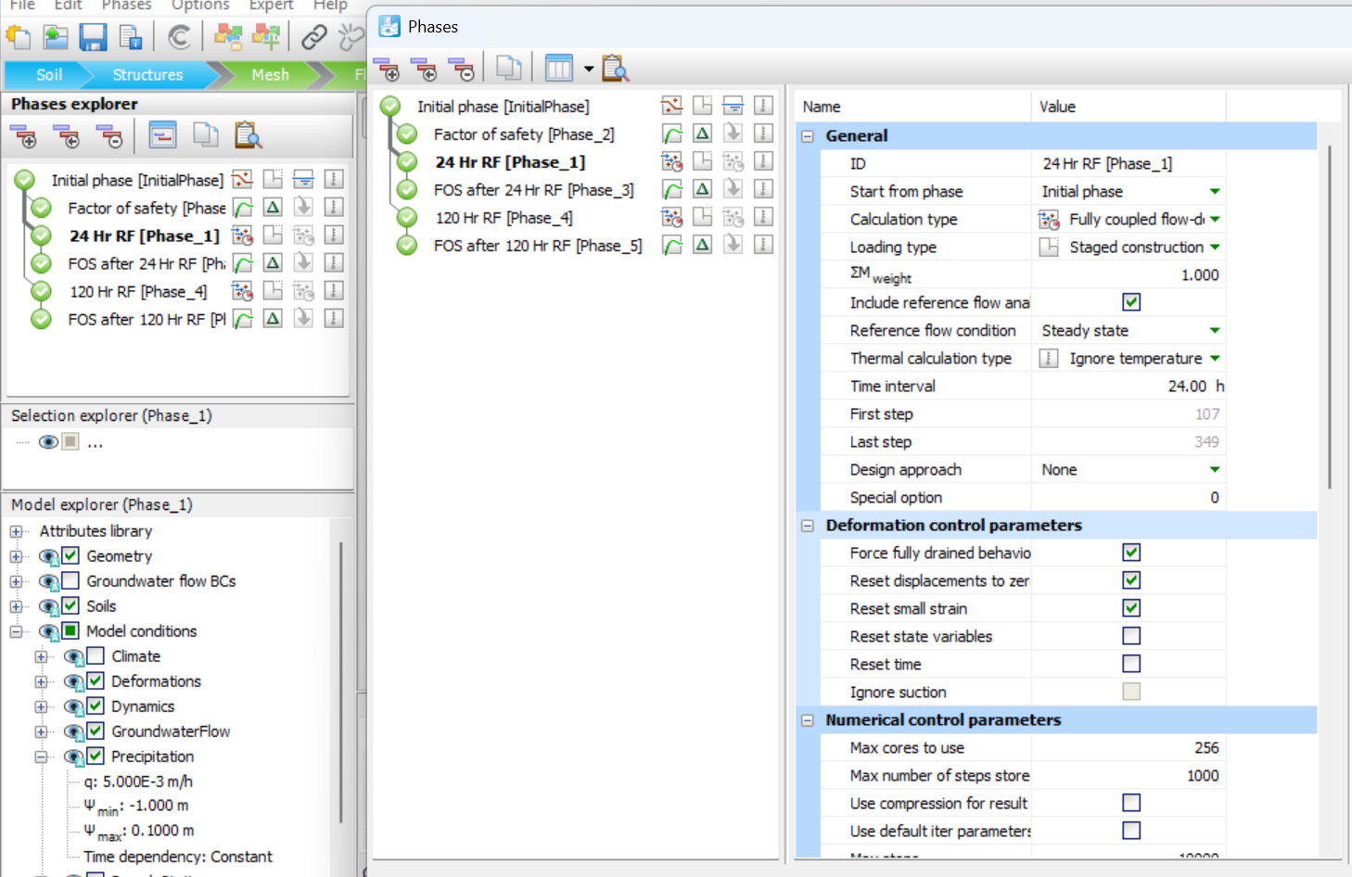

Slide 28
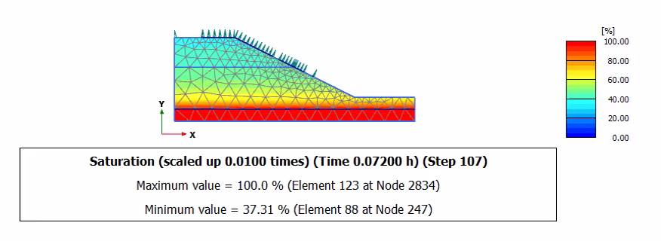
24 Hr Rainfall

Slide 29
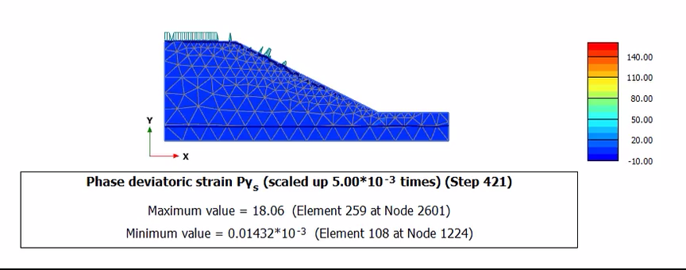
After 24 Hr Rainfall, FoS = 1.44

Slide 30
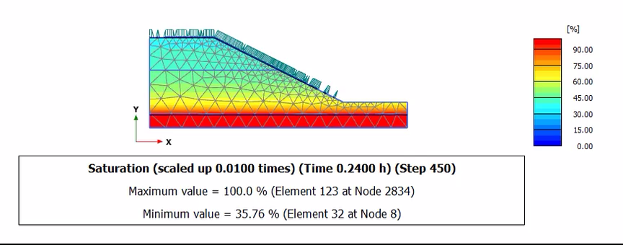
120 Hr Rainfall

Slide 31
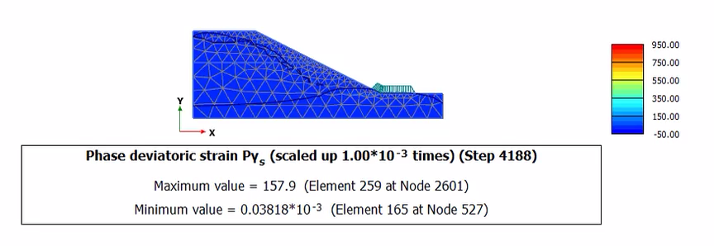
After 120 Hr Rainfall, FoS = 1.09

Slide 32
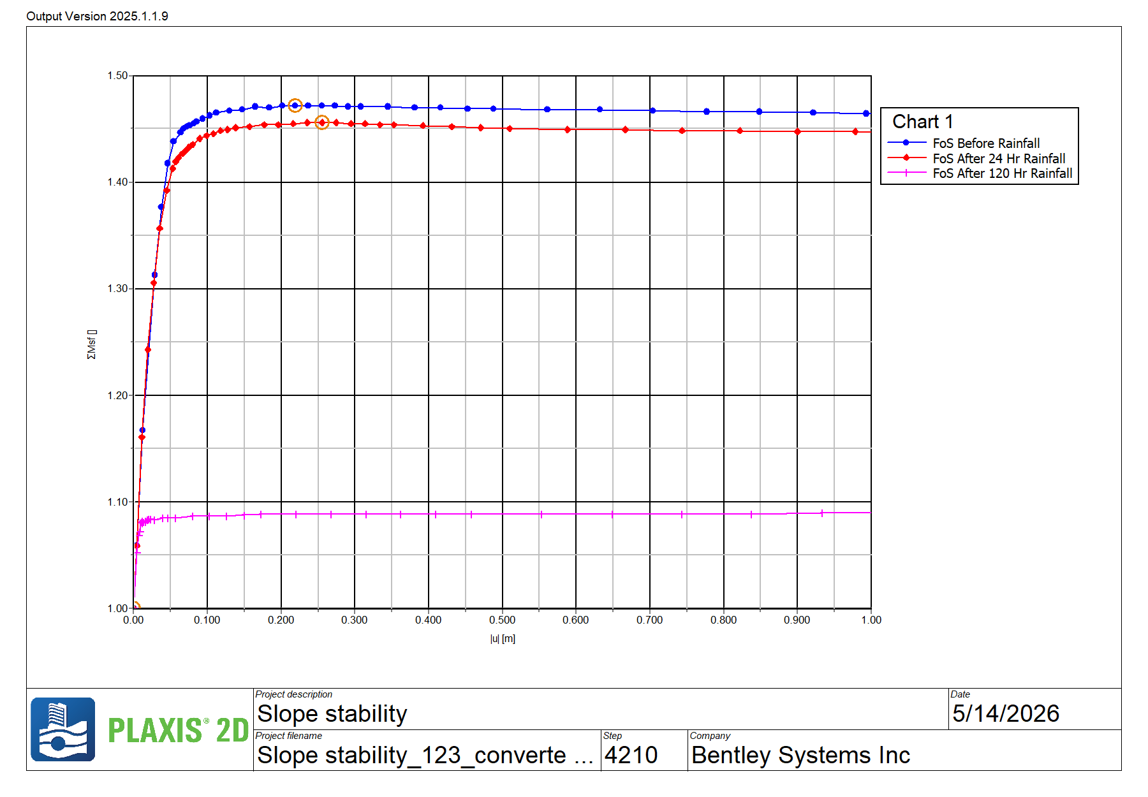

Slide 33
Limitations of FEA
For the determination of a Factor of Safety, the strength reduction method is a very powerful tool to obtain the most critical slip surface, a slip surface that may be circular but can also have any other form. However, there may be circumstances in which more information is required than just the most critical slip surface or when the critical slip surface is of minor importance from an engineering point of view. For instance:
For a large dam, both the global stability as well as the stability of the sloped sections in between berms must be determined.
For a road project in the mountains, both the stability of the hillside above and below the road must be determined, as failure below the road would lead to a loss of the road whereas a failure above the road would only lead to rockfall and temporary loss of service.
The critical slip surface is very small, for instance, just the corner of the crown of an embankment. This is not important from an engineering point of view, and the global stability would be of greater interest.

Slide 34
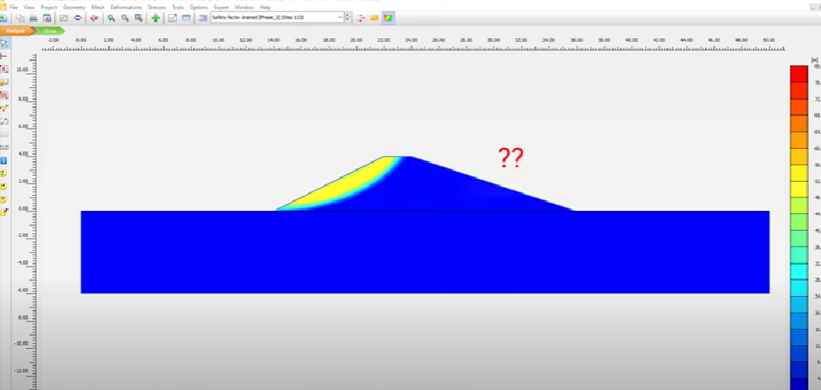
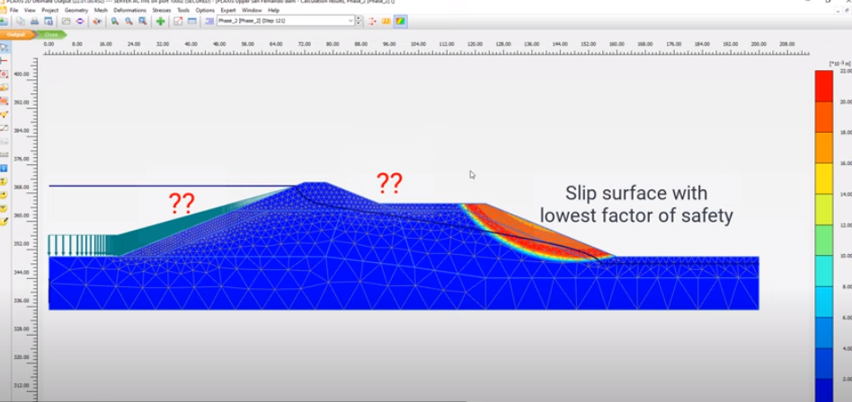
Limitations of FEA
In these cases, determining a Factor of Safety using the Limit Equilibrium Method would be the solution. With Limit Equilibrium, it is possible to specify exactly what part of the model the Factor of Safety must be determined while the method would still have the benefit of determining the most critical, possible non-circular, slip surface in that area. It would also allow within one model to determine different factors of safety for different parts of the model.

Slide 35
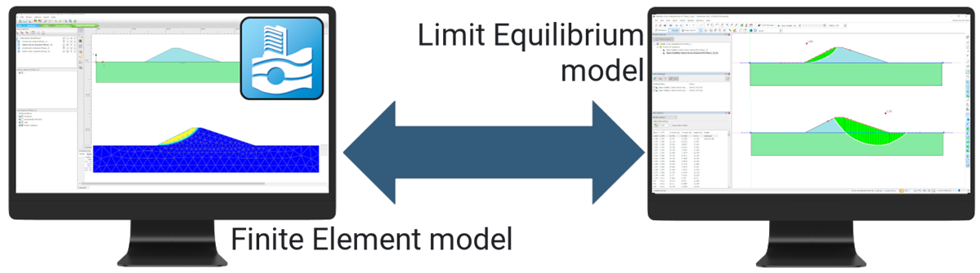
PLAXIS and GeoStudio – bi-directional data sharing
Export any PLAXIS 2D phase configuration to GeoStudio 2D
Import GeoStudio 2D stratification into PLAXIS 2D
Limit Equilibrium Model
Finite Element Model

Slide 36
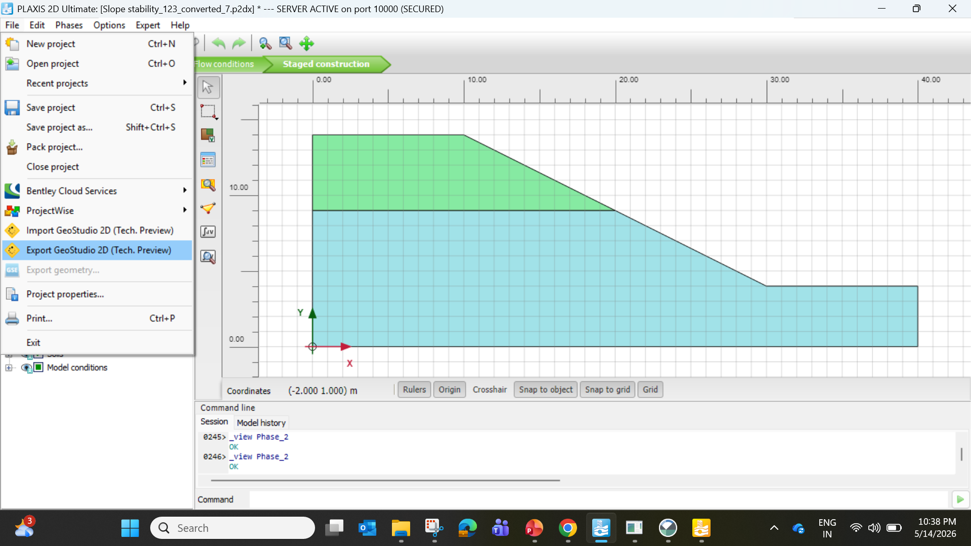

Slide 37
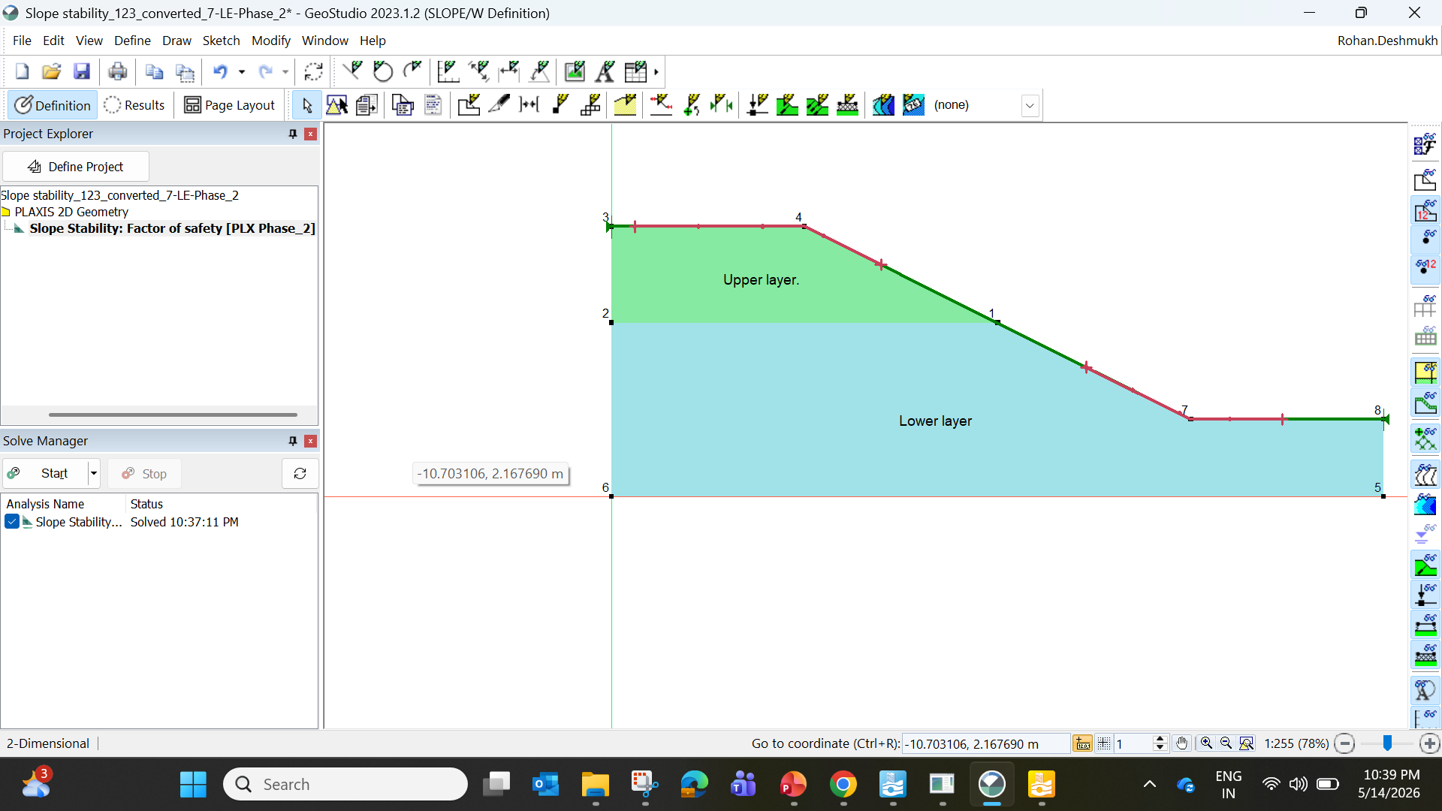

Slide 38
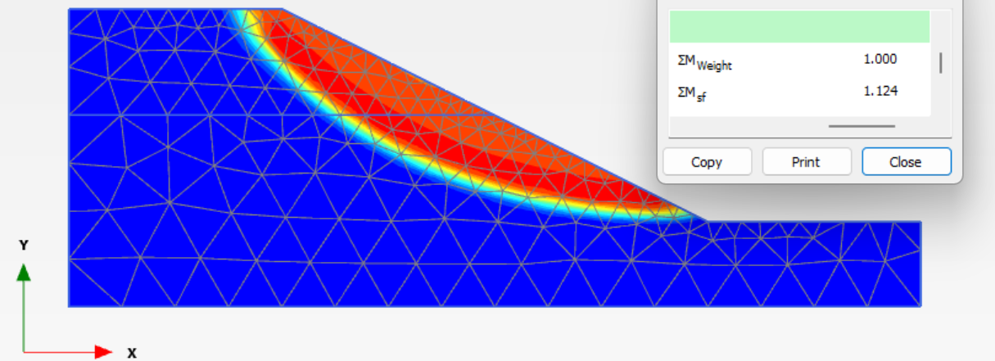

PLAXIS – FEM – FoS = 1.12
GeoStudio – LEM – FoS = 1.17

Slide 39
Conclusions
Following conclusions are drawn from the review of research papers of slope stability analysis:
FEM has been shown to be a reliable and robust method for assessing the factor of safety of slopes. One of the main advantages of the FEM is that the factor of safety emerges naturally from the analysis without the user having to commit to any particular form of the mechanism a priori. The FE approach for determining the factor of safety of slopes has satisfied the criteria for effective computer-aided analysis.
The factor of safety differences between the finite element method and limit equilibrium method results are small. Any failure mode develops naturally there is no need to specify a range of trail surfaces in advance. Multiple failure surfaces evolve naturally. LEM has been the primary method used in estimating the stability of slope for decades.
However, due to some of the shortcomings of LEM, the FEM is a great tool to model the non-linear stress-strain behavior of materials and understand the stability based on deformations. There is no concept of slices in the FE approach, there is no need for assumptions about slice side forces. No assumption needs to be made in advance about the shape or location of the failure surface.

Slide 40
References
Vinod B R, P Shivananda, Swathivarma R, Bhaskar MB, "Some of Limit Equilibrium Method and Finite Element Method based Software is used in Slope Stability Analysis", International Journal of Application or Innovation in Engineering & Management (IJAIEM), Volume 6, Issue 9, September 2017, pp. 006-010, ISSN 2319 - 4847.
Michael Duncan, Stephen G. Wright, “Soil Strength and Slope Stability” ISBN 0-471-69163-1, 2005, Published by John Wiley & Sons, Inc., Hoboken, New Jersey.
Krishna Prasad Aryal, Doctoral Thesis, “Slope Stability Evaluations by Limit Equilibrium and Finite Element Methods”, Norwegian University of Science and Technology, April 2006.
D. V. Griffiths, P. A. Lane, “Slope stability analysis by finite elements”, Geotechnique, Volume-3 (1999), pp. 387-403
John Krahn. The 2001 R.M. Hardy Lecture: The limits of limit equilibrium analyses. Canadian Geotechnical Journal. 40(3): 643-660. https://doi.org/10.1139/t03-024
Petterson, K.E. 1955. The early History of circular sliding surfaces. Geotechnique, 5: 275-296
M. Rabie, “Comparison study between traditional and finite element method for slope under heavy rainfall”, HBRC, 2014
Zienkiewicz, O. C., Humpheson, C. and Lewis, R. W. (1975) Associated and nonassociated visco-plasticity and plasticity in soil mechanics. Geotechnique 1975; 25(4): 671–89.
Lane, P.A., and Griffiths, D.V. (2000) Assessment of stability of slopes under drawdown conditions. J Geotech Geoenviron Eng, ASCE 2000; 126(5): 443–50.
Cai, F. and Ugai, K. (2004) Numerical analysis of rainfall effects on slope stability. Int J Geomech, ASCE 2004; 4(2): 69–78.
Huang, M., and Jia, C. Q. (2008) Strength reduction FEM in stability analysis of soil slopes subjected to transient unsaturated seepage. Computers and Geotechnics, 36 (2009): 93–101.

Slide 41



Thanks for you attention
Dr. Rohan Deshmukh
rohan.deshmukh@bentley.com
+91- 8793534397

