Slide 1
Third Alternative - GRGB
Madhav Madhira
Academic, Researcher & Consultant

Slide 2

Shallow Foundations
ground
firm ground
bed rock

Slide 3
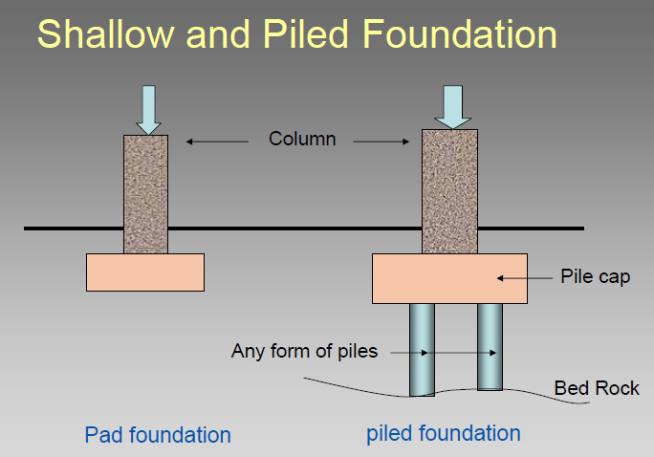

Slide 4
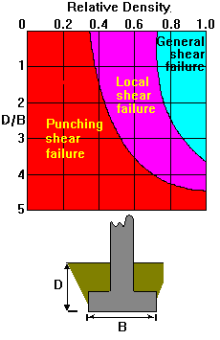
Failure Modes

Slide 5
Deep Foundations
~ For transferring building loads to underlying ground
~ Mostly for weak soils or heavy loads
weak soil
bed rock

Slide 6
Deep Foundations
Q
Q
End Bearing
Friction
Unsuitable
Soil
Side
Resistance
Bearing Layer
Tip Resistance
Tip Resistance (small)

Slide 7
The Third Alternative
GI/GRGB
Structure Ground | Light | Medium | Heavy
Soft | Shallow Found./G.I | Gr. Impr. (G.I.) | Deep Found.
Medium Stiff | Shallow Found. | Gr. Impr. (G.I.) | Deep Found./ (G.I.)
Hard | Shallow Found. | Shallow Found./G.I. | Shallow Found./G.I

Slide 8
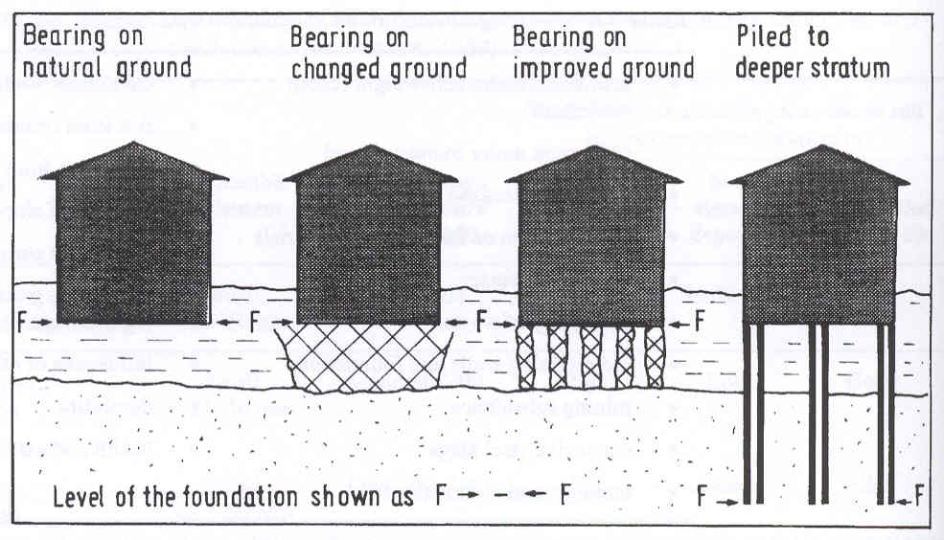
Foundation Options

Slide 9
Engineering of Ground
Dynamic compaction
Preloading
Vibro- methods/Stone Columns
Dewatering
Grouting
Micropiling
Reinforced foundation beds

Slide 10
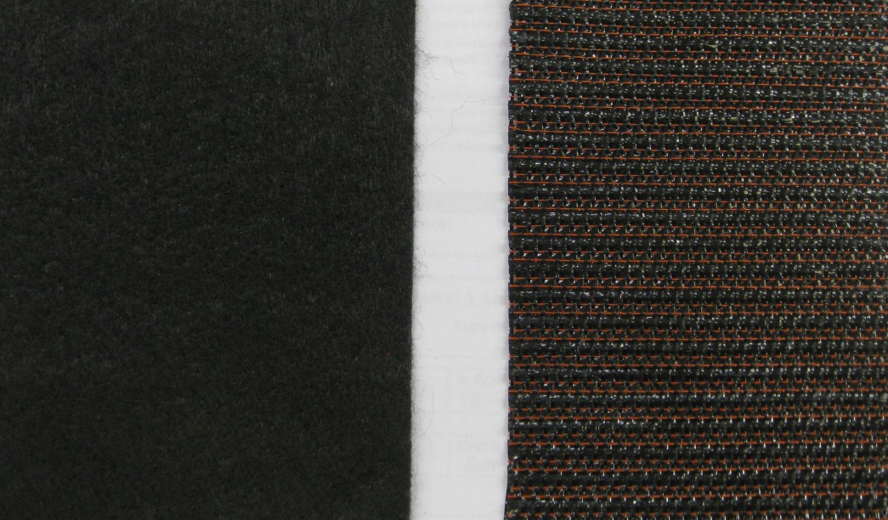
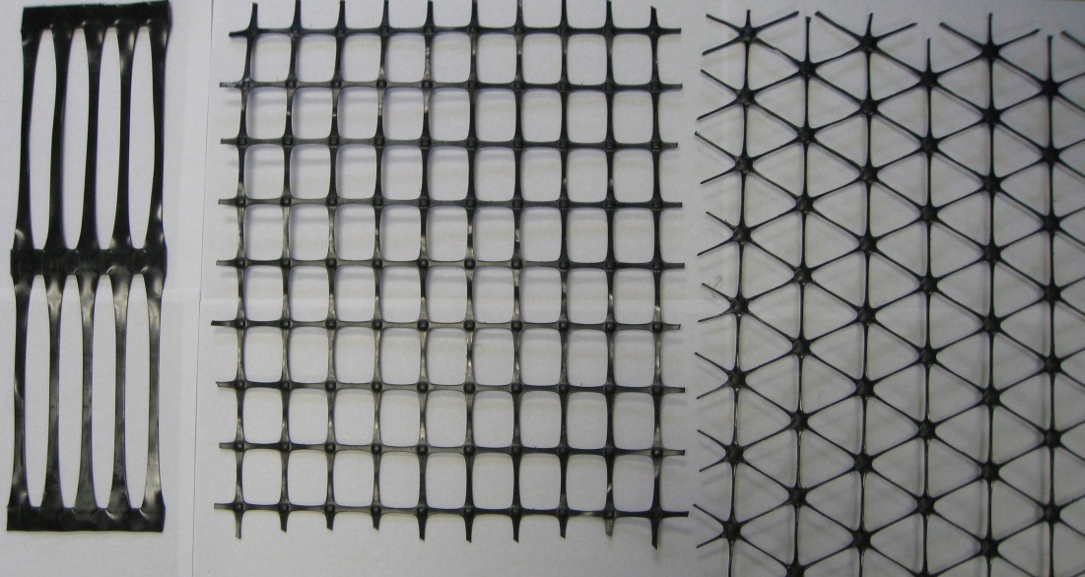
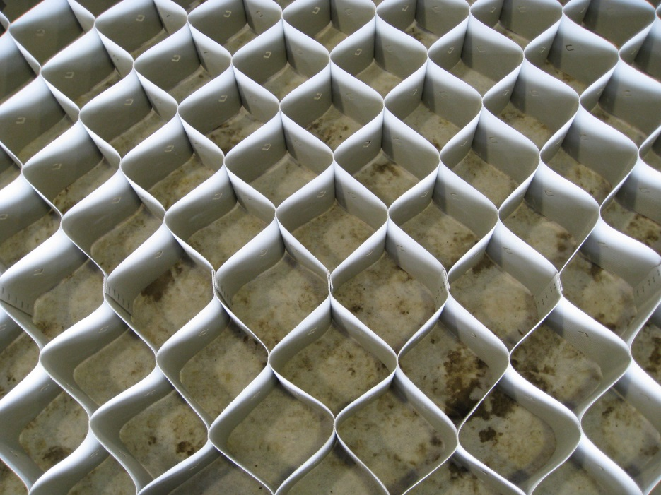
Commonly Used Geosynthetics
Geotextile (GT)
Geogrid (GG)
Geocell (GC)

Slide 11
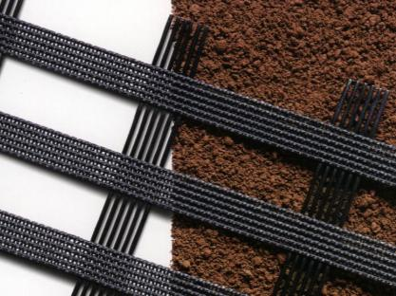
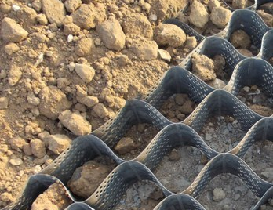
Geogrid & Geocell

Slide 12
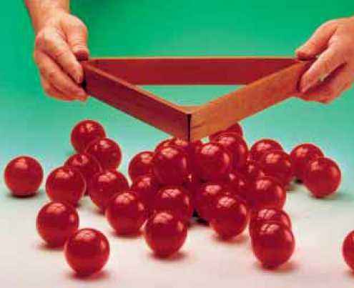
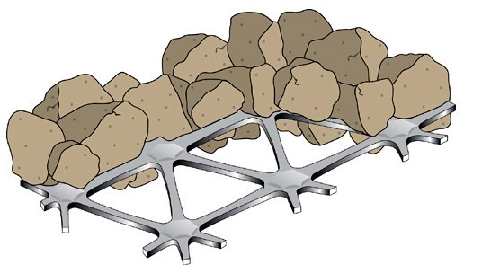
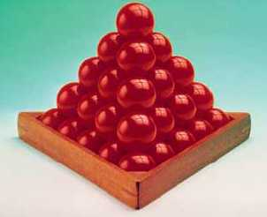
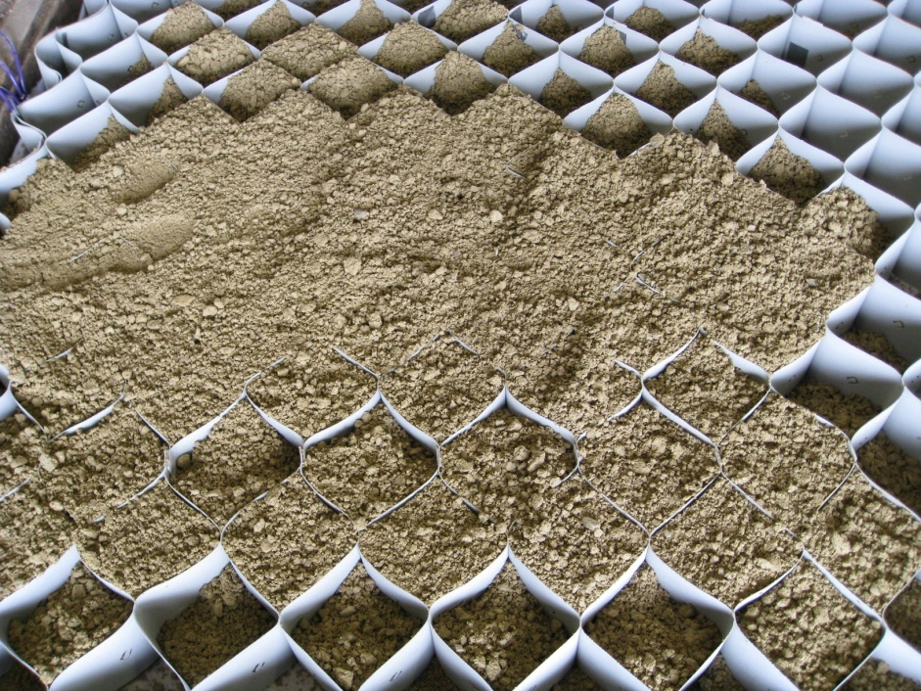
Confinement
Interlocking
Confinement

Slide 13
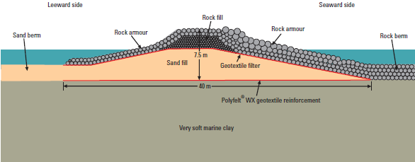
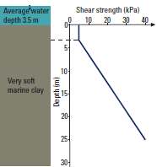
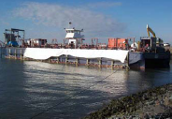
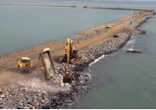
Basal reinforcement

Slide 14
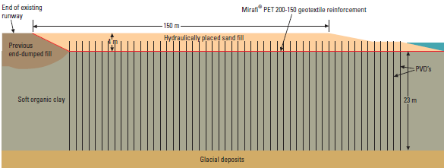
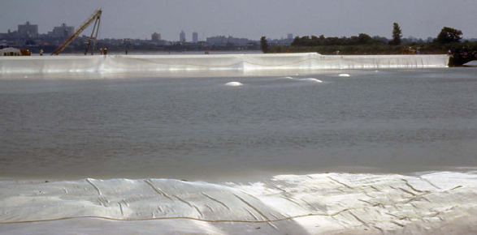
Airport Runway

Slide 15
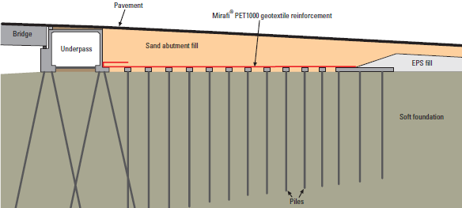
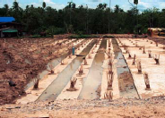
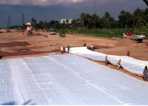
Load Transfer on to Piles

Slide 16
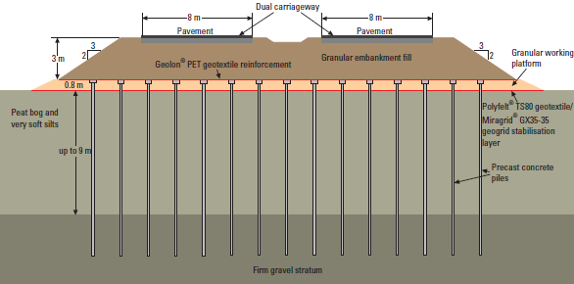
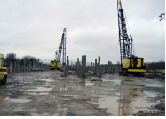
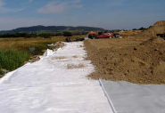

Load Transfer Platform

Slide 17
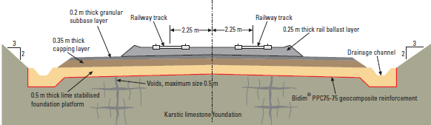
High Speed Railway Track

Slide 18
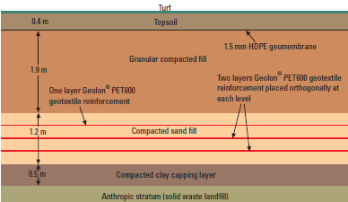
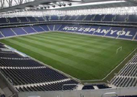
Sports Field over Landfill

Slide 19
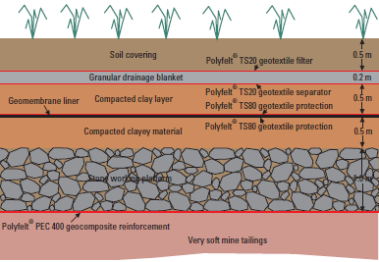
Mine Tailing Pond Closure

Slide 20
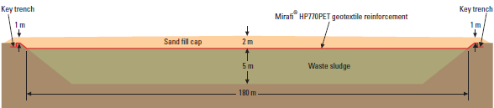
Sludge Lagoon Closure

Slide 21
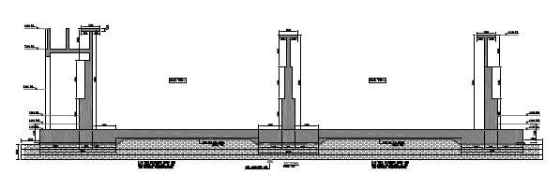
Reinf. Found. Bed for Waste Treatment Plant

Slide 22
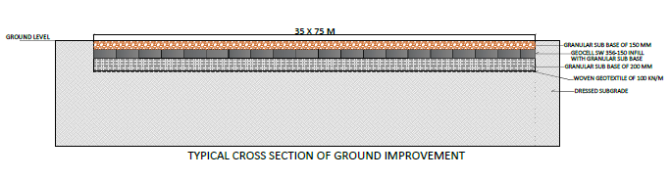
RFB for Industrial Structure

Slide 23
Borelogs STP

Slide 25
STP

Slide 26
GRFB for STP

Slide 27
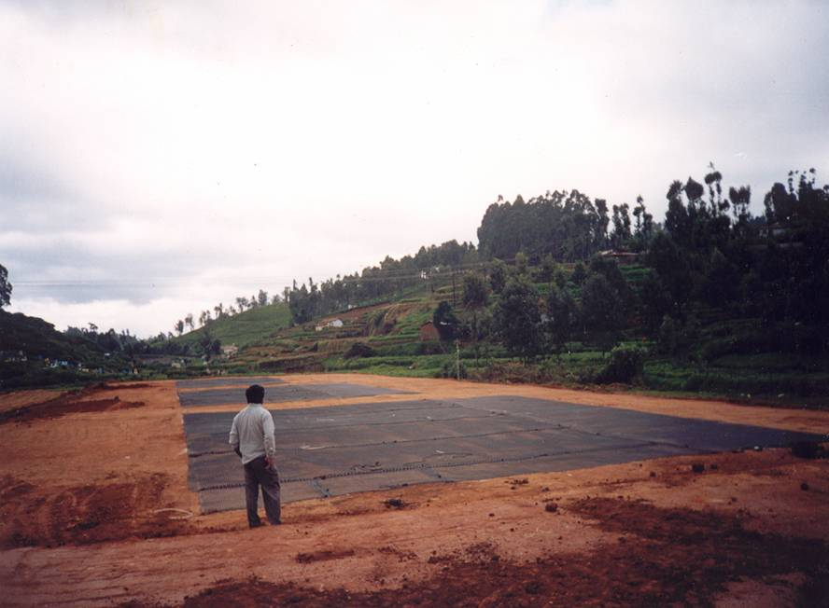

Slide 28
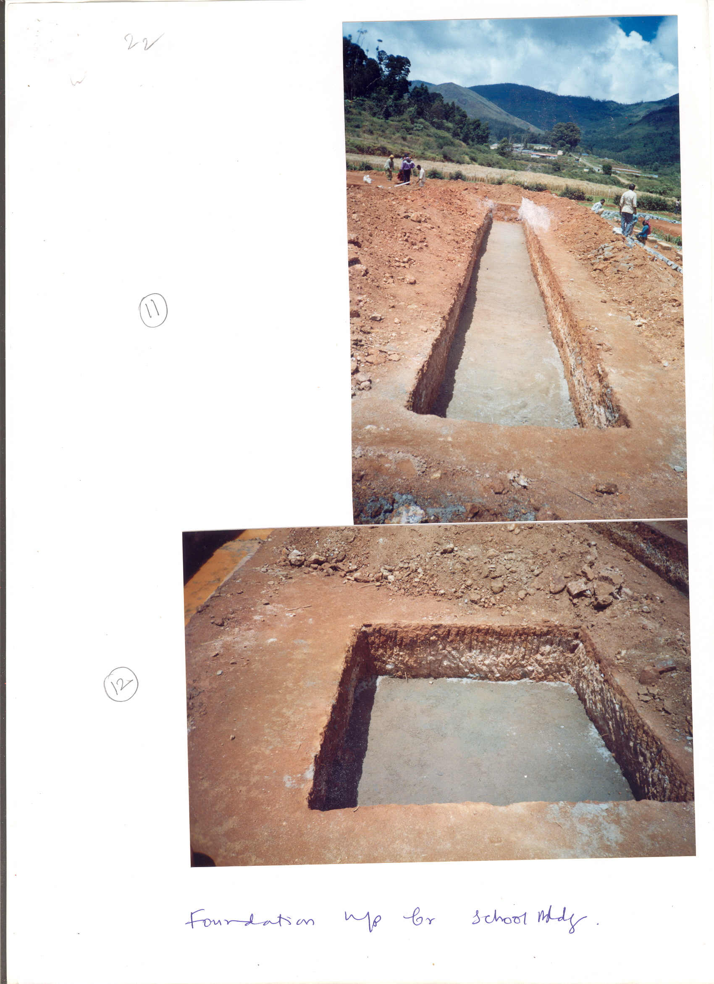

Slide 29
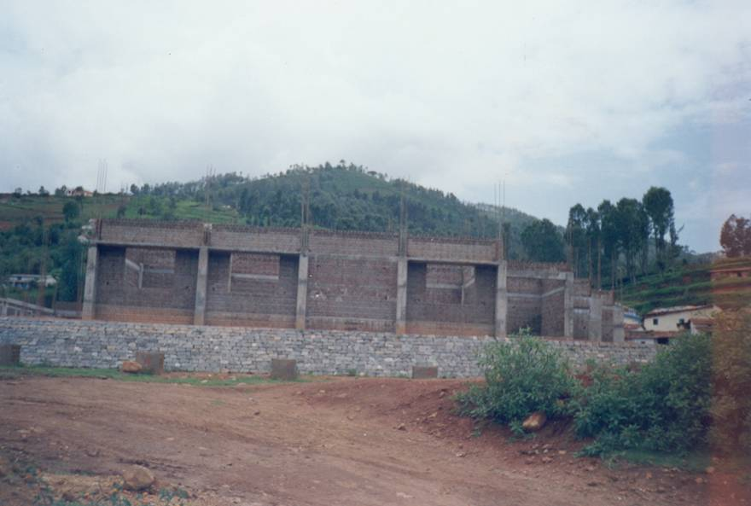
Central school complex

Slide 30
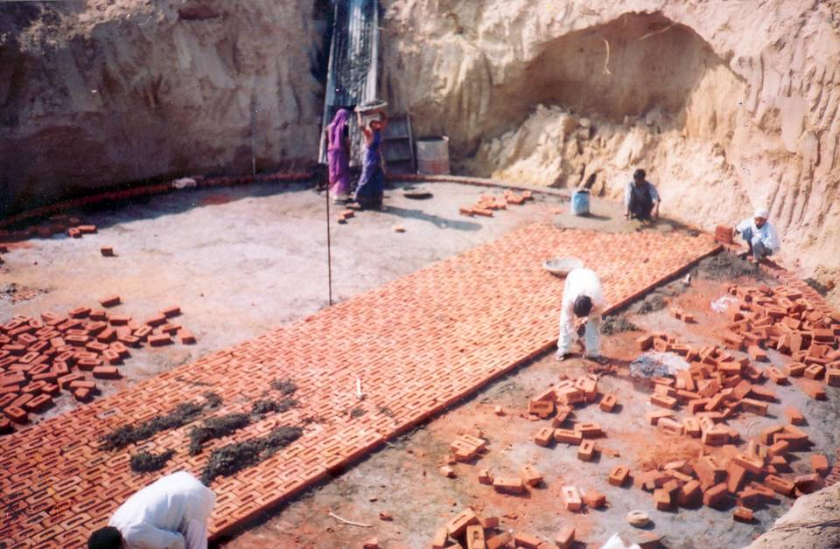
Antenna Foundation

Slide 31
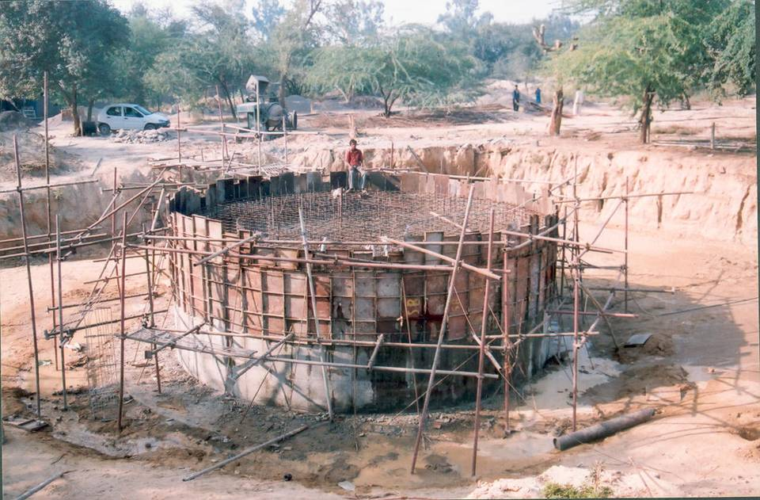

Slide 32
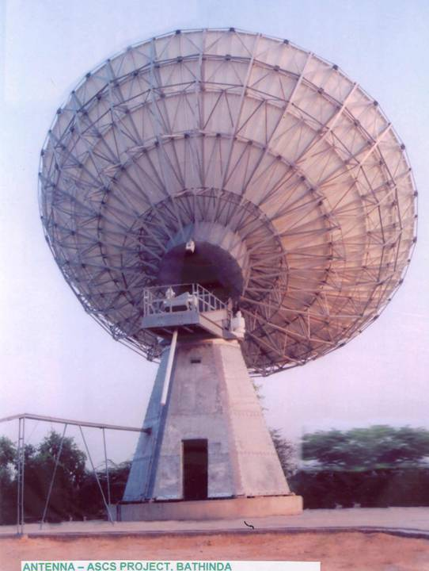

Slide 33
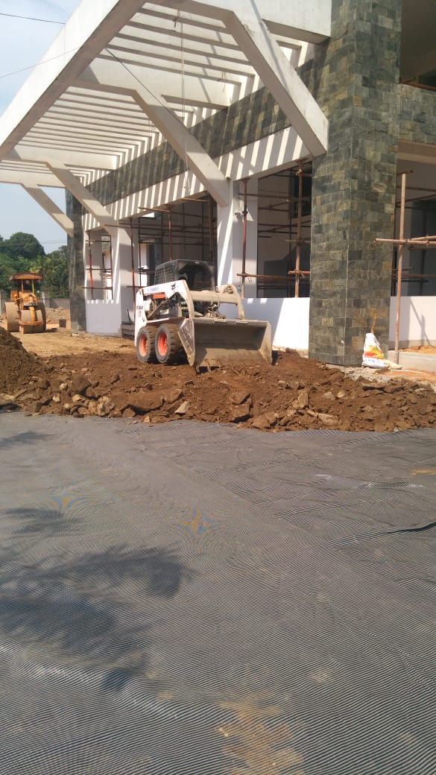
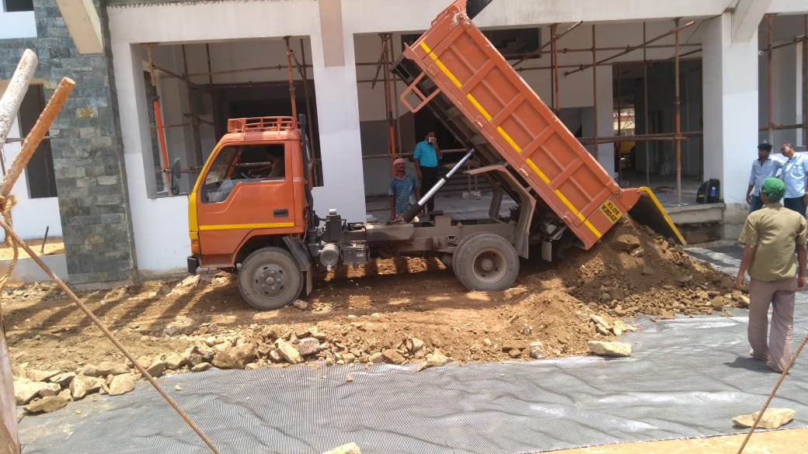
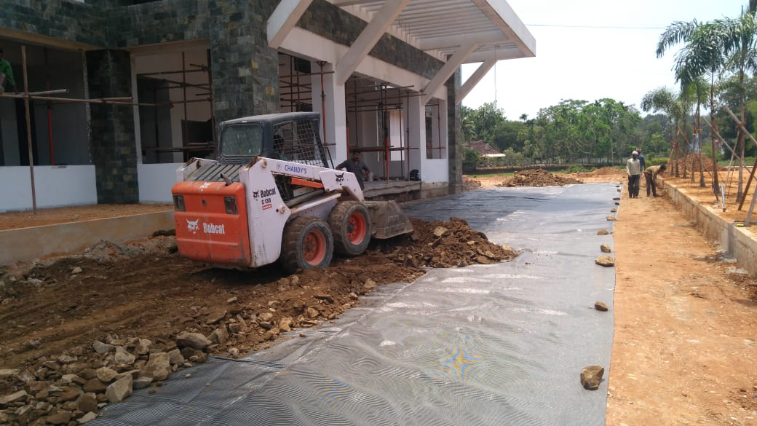

Slide 35
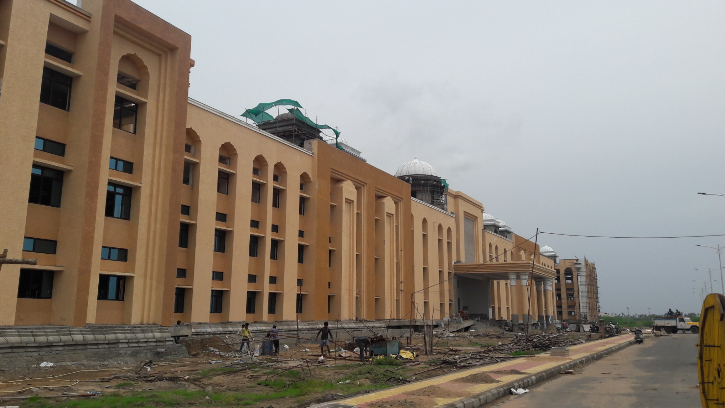
Krishna University, Machilipatnam

Slide 36
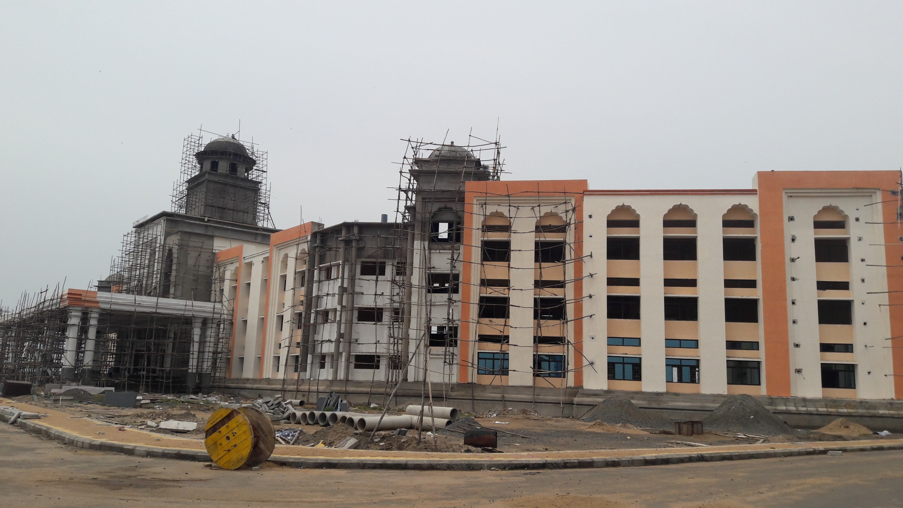
KU 2

Slide 37
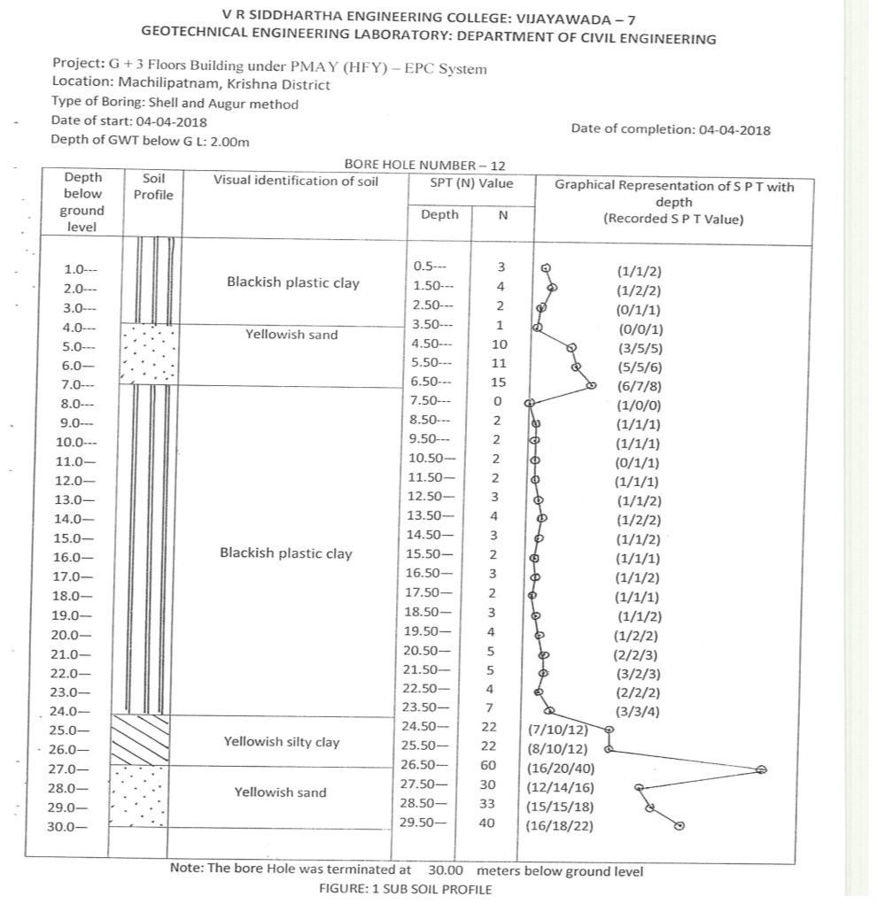
Soft Ground

Slide 38
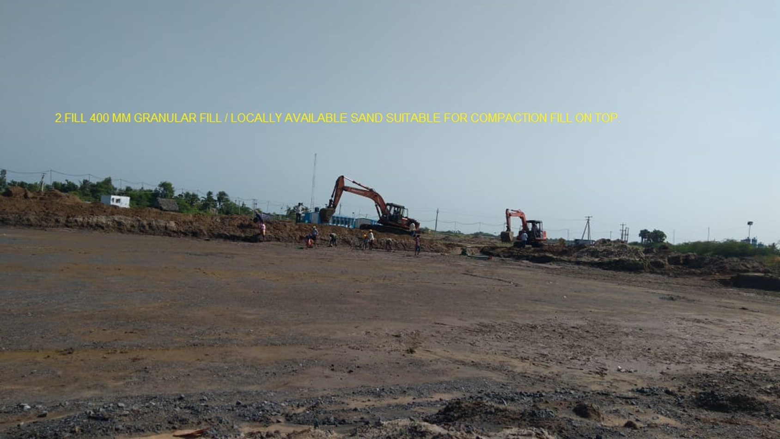
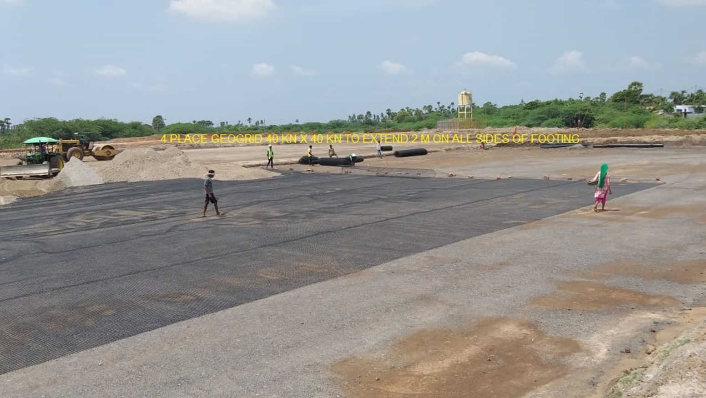
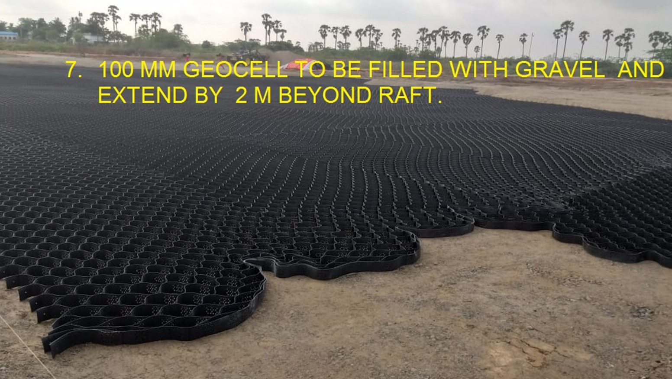
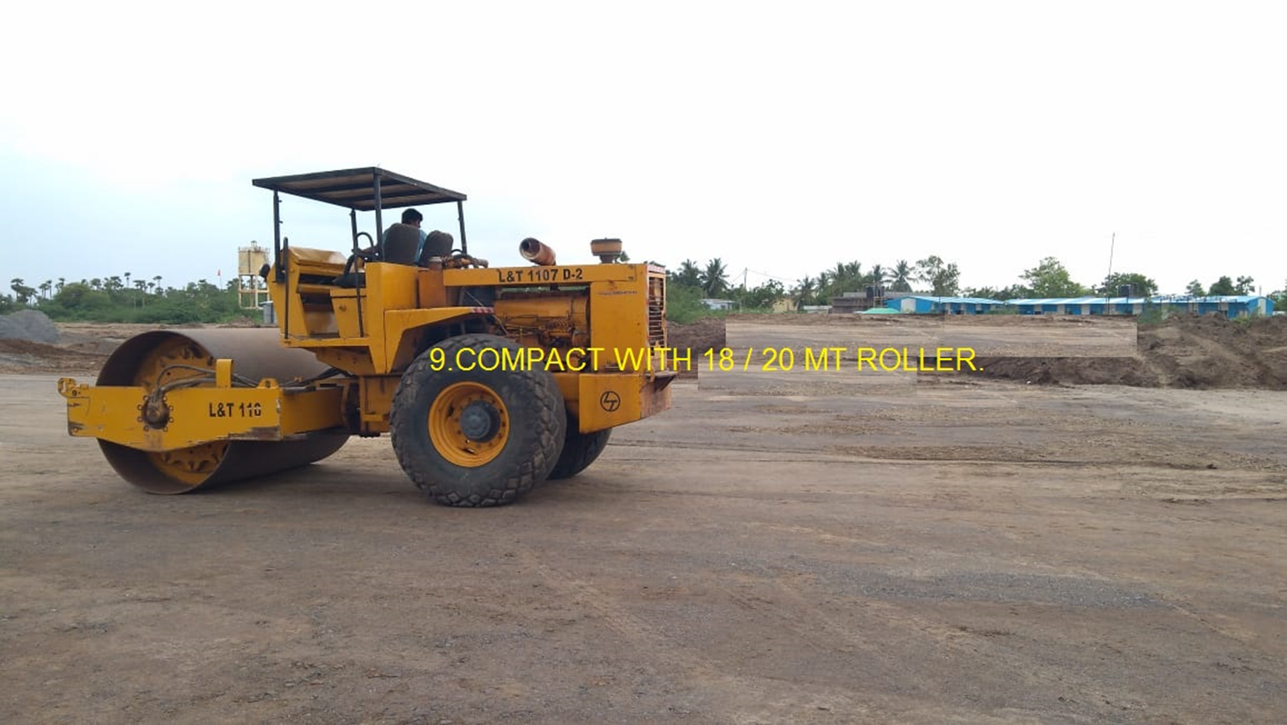

Slide 39
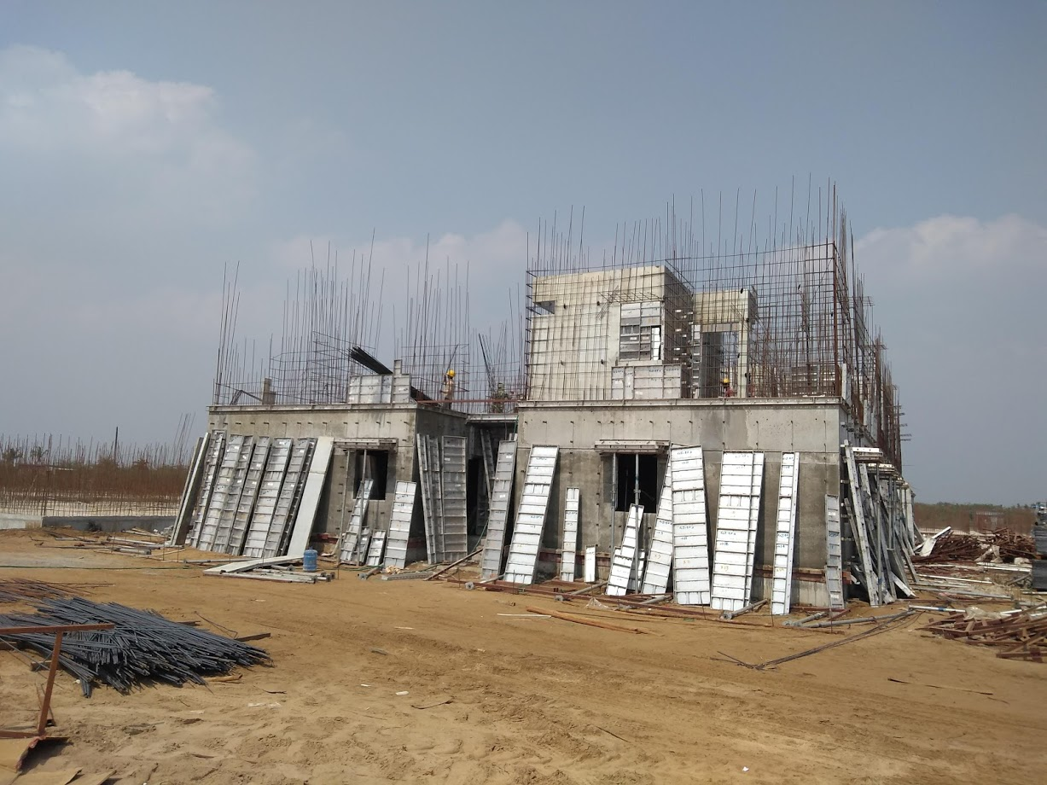
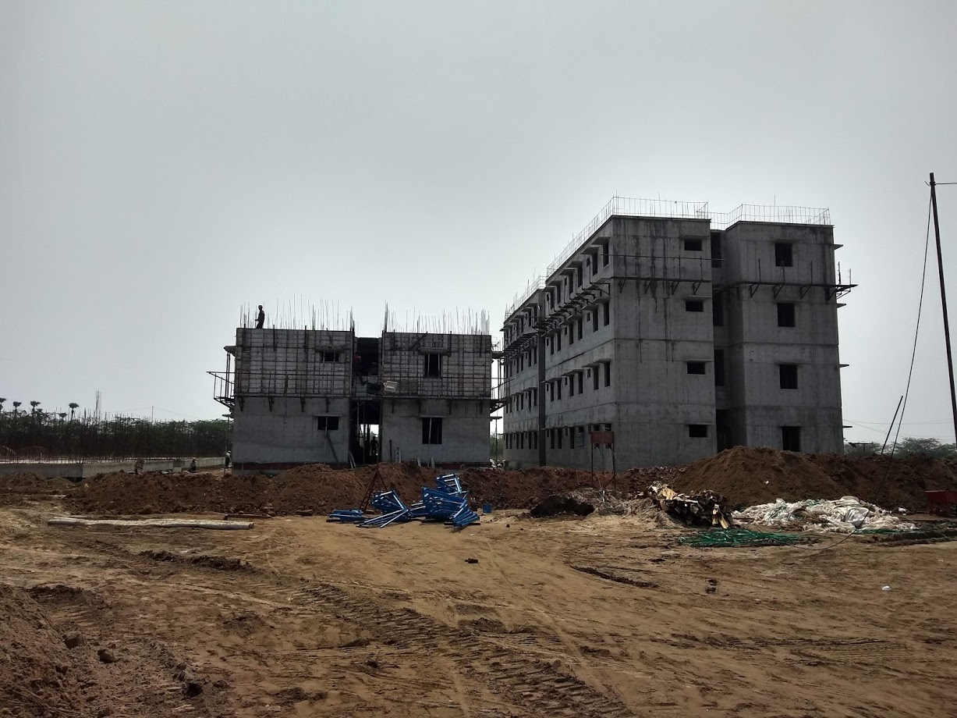
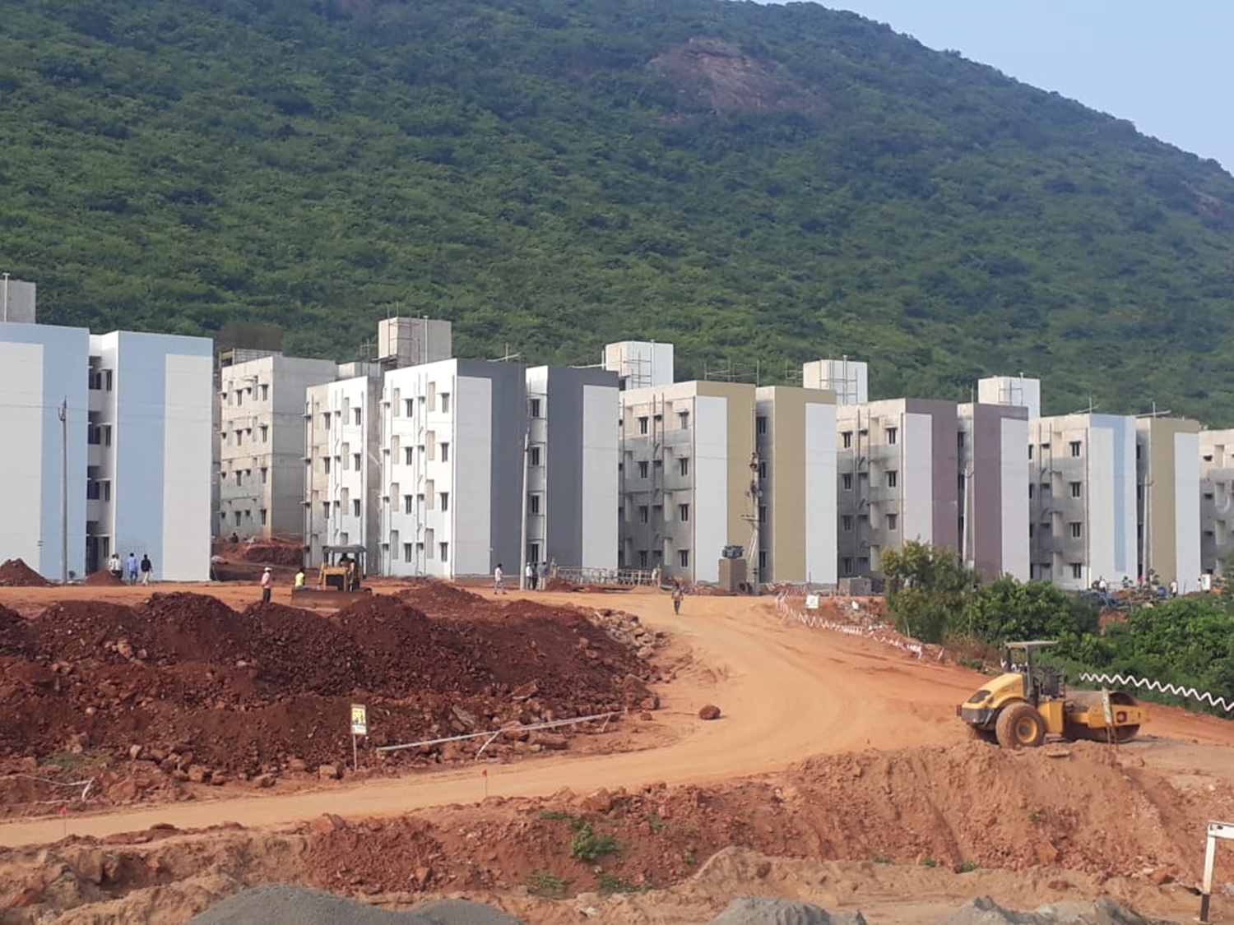

Slide 40


Geocell
Lightweight but strong three dimensional honeycomb-like cellular confinement system
Honeycomb structure - strongest structural systems
Fabricated from ultrasonically-welded HDPE strips that are expandable at site
Confinement of non-cohesive material within provides rigidity
Perforated for porewater pressure relief
Textured within for better soil-cell wall interaction

Slide 41



applications of Geocell

Slide 42

Principle of Geocells
Geocells filled with cohesionless material - semi-rigid raft/mat
p

Slide 43

Geogrid Reinforced Granular Foundations

Slide 44


Slide 45
PLT with 750 mm dia Plate of GRFB

Slide 46
PLT with 300 mm square Plate on GRFB

Slide 47
Plate Load Tests

Slide 48
Degrees of improvement:
Bearing capacity ratio, BCR = ratio of bearing capacities of reinforced to unreinforced cases
Sub-grade stiffness improvement factor, I_{k} = ratio of moduli of subgrade reactions of reinforced to unreinforced cases
Settlement reduction factor, SRF = ratio of settlements of reinforced to unreinforced cases at different percentages of normalized settlements

Slide 49
Bearing Capacity of Found. On Strong Soil over Weak One

Slide 50



Lateral Confinement, Load Spread & Membrane Mechanisms

Slide 51


Slide 52
Bearing Capacity of Embedded Circular Footings
on Reinforced Foundation Beds over Soft Compressible Ground

Slide 53


Slide 54
Effect of Reinforcement on Critical Granular layer thickness

Slide 55
(BCR)_{ax}* versus D/H- Effect of G/s_{u} and γB /s_{u}

Slide 56
(BCR)_{ug}, (BCR)_{ax} versus ϕ - Effect of G/s_{u}

Slide 57
N_{cg} versus H/B- Effect of γB /s_{u} and G /s_{u}

Slide 58
Effect of Stiff Layer over Softer One

Slide 59

Ueshita and Meyerhof (1967)

Slide 60


Slide 61

Case study 1: (Hegde and Sitharam - 2013)
Homogenous sand bed reinforced with geocell and geogrid underlying square footing

Slide 62


Slide 63


Slide 64


Slide 65


Slide 66
h/B effect: d/B=1.2; b/B=12; u/B=0.1
h/B | E_{eq}/E₂ | E_{r}/E₂
0.8 | 1.23 | 4.16
1.6 | 2.04 | 8.6
2 | 2.12 | 4
2.75 | 2.12 | 2.6
3.14 | 2.16 | 2.38

Slide 67


Slide 68

b/B effect: d/B=0.8; h/B=1.2; u/B=0
Governing equations:
$$E=\frac{q∙B}{2.δ}\left(1.25\right)$$
$$\frac{E_{eq}}{E_{2}}=\frac{2.6}{\frac{0.994}{p}+0.256}$$
b/B | E_{eq}/E₂ | E_{r}/E₂
1 | 2.12 | 2.98
2 | 2.12 | 2.98
4 | 2.22 | 3.24
6 | 2.27 | 3.27
8 | 2.48 | 4
10 | 2.79 | 5.18
12 | 3 | 6.19

Slide 69
h/B effect: d/B=0.8; u/B=0; b/B=4.9
h/B | E_{eq}/E₂ | E_{r}/E₂
0.6 | 1.63 | 4.28
1.2 | 2.1 | 2.63
1.8 | 2.19 | 2.22
2.4 | 2.32 | 2.32

Slide 70
Estimation of Modular Ratio of Reinforced Beds

Slide 71
Two-Layered Soils
a
p
/ Unit area
•
r
Layer 1 E₁
h
ν₁
1
t
Perfectly adhesive interface
Layer 2
E₂
z

Slide 72

Normalized Stresses at Interface h/a = 1.0 (Fox 1948)

Slide 73



Settlement Influence Factors for n₁/n₂ (a) 0.2/0.4; (b) 0.5/0.5 and © 0.35/0.35

Slide 74
Normalized Vertical Stress Profiles – Homogeneous Ground, h/a = 0.2, 0.75 & 1.0

Slide 75
Normalized Vertical Stress Profiles at Interface h/a =1.25 & 2.0

Slide 76


Fitting Bell Curve

Slide 77


Integration for Partial Load
λ_{α}= P_{a}/P₀

Slide 78
Radial Extent vs h/a

Slide 79
h/a = 0.2, 0.75, 1.0 & 1.25

Slide 80
h/a = 2.0

Slide 81
Effect of Modular ratio

Slide 82

Case study 1- (Murad et al., 2008).
Reinforcement | Tensile modulus(kN/m)
GG1 | 182
GG2 | 274
GG3 | 425

Slide 83


Measured vertical stress distributions at depth (Murad et al., 2008).
(a) 457 mm
(b) 610 mm

Slide 84

Measured vertical stress distributions at depth of 762 mm (Murad et al., 2008).
(c) 762 mm

Slide 85


Schematic a)Reinforced soil bed and
b)Two-layered system for h = 457 mm
Reinforcement layer 1
E_{1 ,} ν₁
2
E_{2 ,} ν₂
Pressure cells
(a)
(b)

Slide 86


Schematic a)Reinforced soil bed and b)Two-layered system for h = 610 mm
Reinforcement layer 1
E_{1 ,} ν₁
2
Pressure cells
E_{2 ,} ν₂
3
(a)
(b)

Slide 87


Schematic - a)Reinforced soil bed and
b) Two layered system for h = 762 mm.
Reinforcement layer 1
2
E_{1 ,} ν₁
3
E_{2 ,} ν₂
4
Pressure cells
(a)
(b)

Slide 88
Load distribution angle (θ) vs λ_{α} (Murad et al., 2008)
h/a = 2.0 h/a = 2.66

Slide 89
(θ) vs λ_{α} for h/a = 3.34 (Murad et al., 2008)

Slide 90

Interpolation for modular ratio for 90% load (Murad et al., 2008)

Slide 91
Modular ratios for RFB: thickness 457 mm, h/a = 2.0
h/a=2.0 | Reinforcement | µ
 | GG14 | 3.9
 | GG23 | 3.8
 | GG24 | 4.4
 | GG25 | 6.1
 | GG34 | 5.4
Average for geogrids |  | 4.7

Slide 92
Modular ratios for RFB: thickness 610 mm, h/a = 2.66
h/a = 2.66 | Reinforcement | μ
 | GG14 | 8.9
 | GG23 | 8.2
 | GG24 | 9.4
 | GG25 | 10.2
 | GG34 | 9.6
 | Average for geogrids | 9.3

Slide 93
Modular ratios for RFB:
Thickness 762 mm, h/a = 3.34
h/a = 3.34 | Reinforcement | μ
 | GG14 | 9.6
 | GG23 | 9.5
 | GG24 | 10.3
 | GG25 | 12.0
 | GG34 | 11.1
Average for geogrids |  | 10.5

Slide 94

Case study 2 - (Chen et al., 2007)
Reinforcement | Tensile modulus(kN/m)
GG1 | 365
GG2 | 182
GG3 | 274
GT1 | 700

Slide 95

Stress distributions: depth of 254 mm Surface pressure (a) 47 kPa and (b) 468 kPa, (Chen et al., 2007)
(a)
(b)

Slide 96


Schematic – h = 254 mm
E_{1 ,} ν₁
h = 254
mm
E_{2 ,} ν₂
(a)
(b)

Slide 97

(θ) vs λ_{α} (Chen et al., 2007)

Slide 98
Modular ratios for RFB:
Thickness 254 mm, h/a = 3.34 (Chen et al., 2007)
h/a = 3.34 | Reinforcement | μ
 | GG1 | 10.2
 | GG2 | 10.4
 | GG3 | 8.1
 | Average for geogrids | 9.6
 | GT1 | 10.7

Slide 99

Case study 3 (Murad et al, 2013).
Reinforcement | Tensile modulus (kN/m)
GG1 | 365
GT1 | 700

Slide 100

Stress distribution at depth of 254 mm for surface pressure (a) 94 kPa and (b) 750 kPa, (Murad et al, 2013)

Slide 101

Schematic
h= 254
mm
E_{1 ,} ν₁
E_{2 ,} ν₂
(a)
(b)

Slide 102

(θ) vs λ_{α} (Murad et al, 2013)

Slide 103
Modular ratios for RFB
Thickness 254 mm, h/a = 3.34 (Murad et al, 2013)
h/a = 3.34 | Reinforcement | µ
 | GG1 | 11.2
 | GT1 | 12.4
Average for reinforcement |  | 11.8

Slide 104
Moral – Do Not Prescribe Pile Foundations unless Essential.
Think of The Third Alternative - GRGB

Slide 105
There is Life in the Ground: it goes into the seed and it also, when stirred up, goes into the man who stirs it.
C. D. Warner
13/05/2026
105

