Slide 1
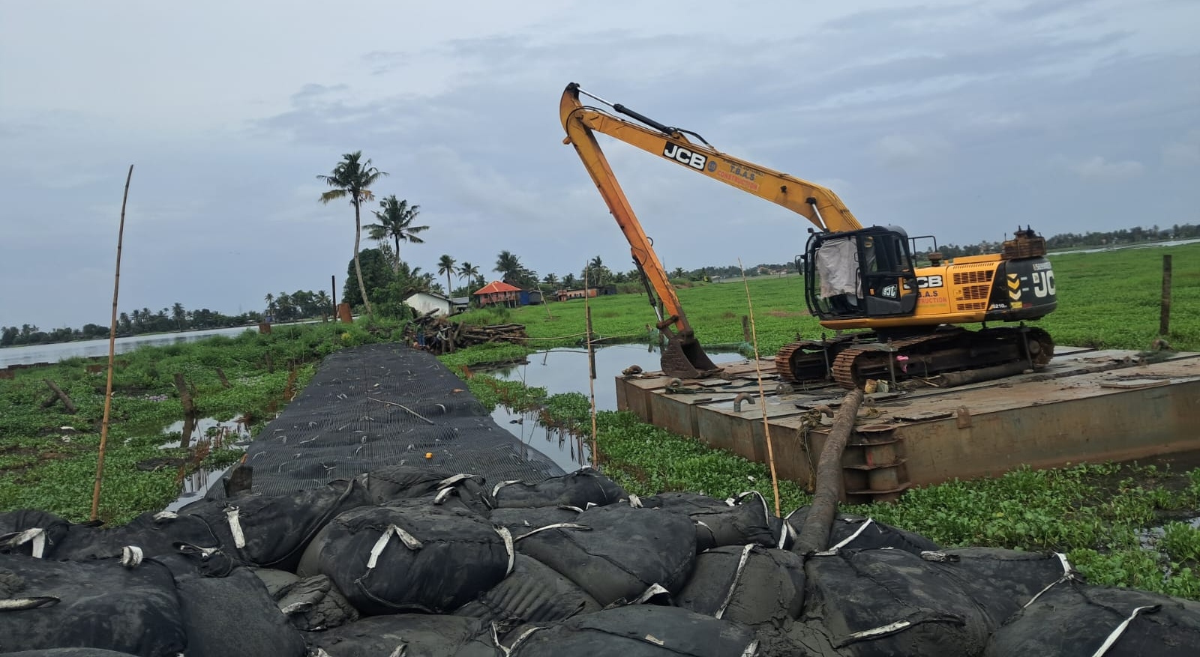

Reconstruction of
Failed Embankment resting on Soft Soil
– A Case Study
Dr. Jayamohan.J
Joint Director
Lal Bahadur Shastri Centre for Science & Technology
Thiruvananthapuram

Slide 2
Introduction
Kuttanad – Alapuzha & Kottayam
Major Rice Producer of the State
Vast Paddy Fields
Farming is carried around 1.2 to 3.0 metres below sea level
Kuttanad clay is a soft soil with associated problems of low shear strength and high compressibility

Slide 3
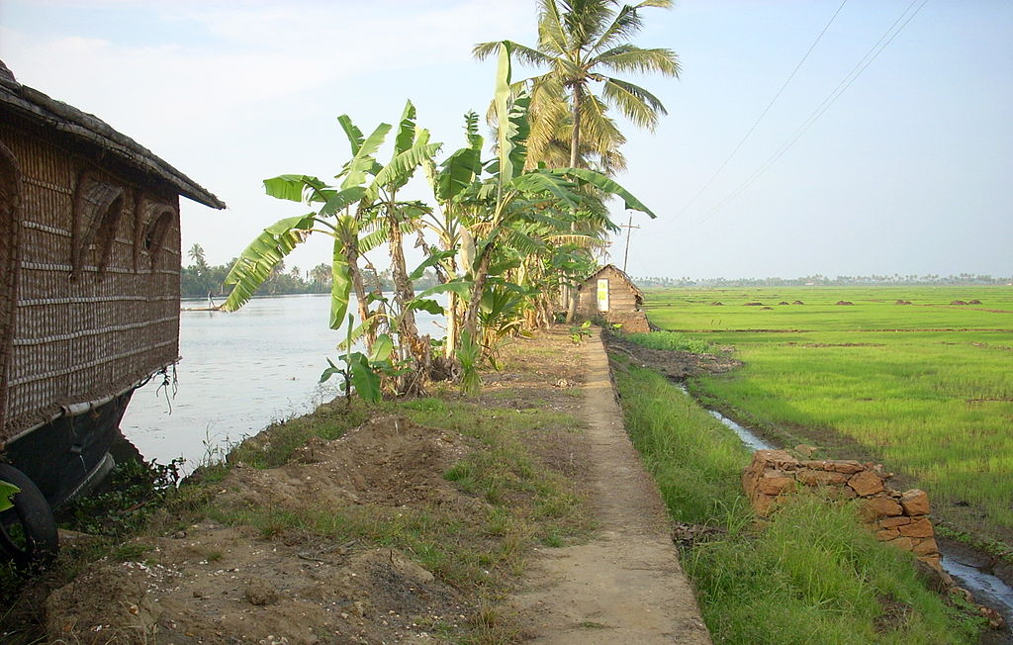
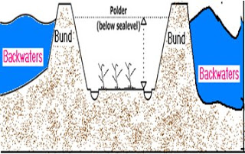
Introduction

Slide 4
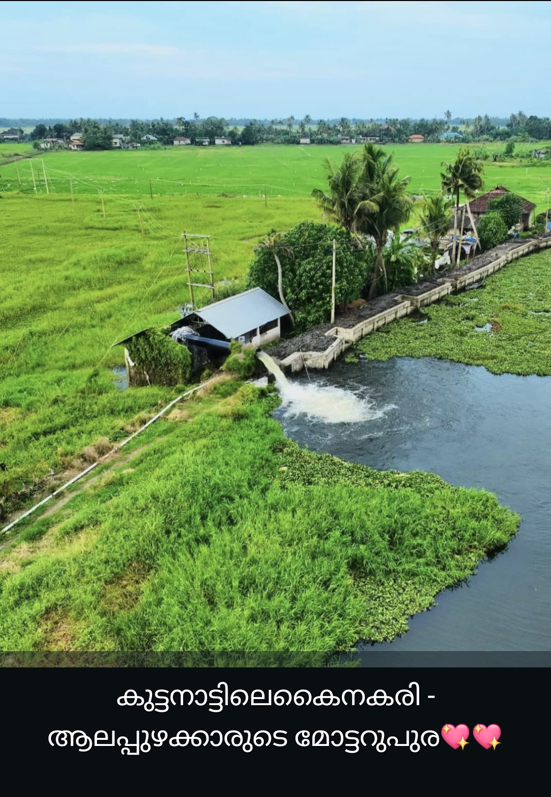

Slide 5
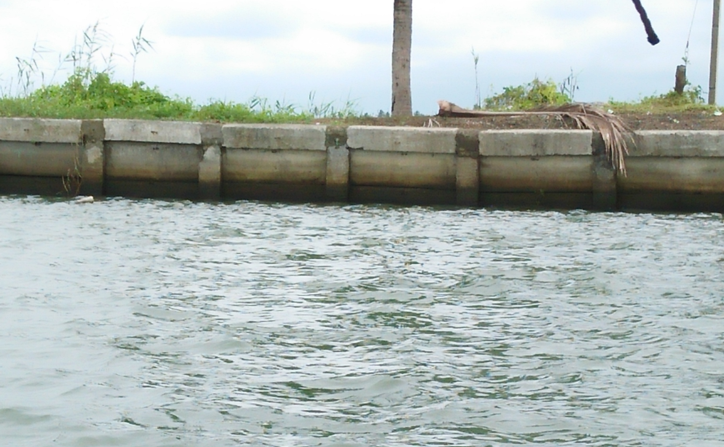
Embankments – Pile and Slab System

Slide 6
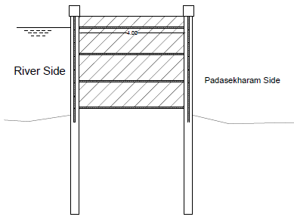
Embankments – Pile and Slab System

Slide 7
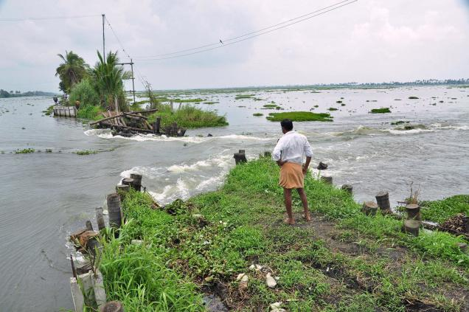
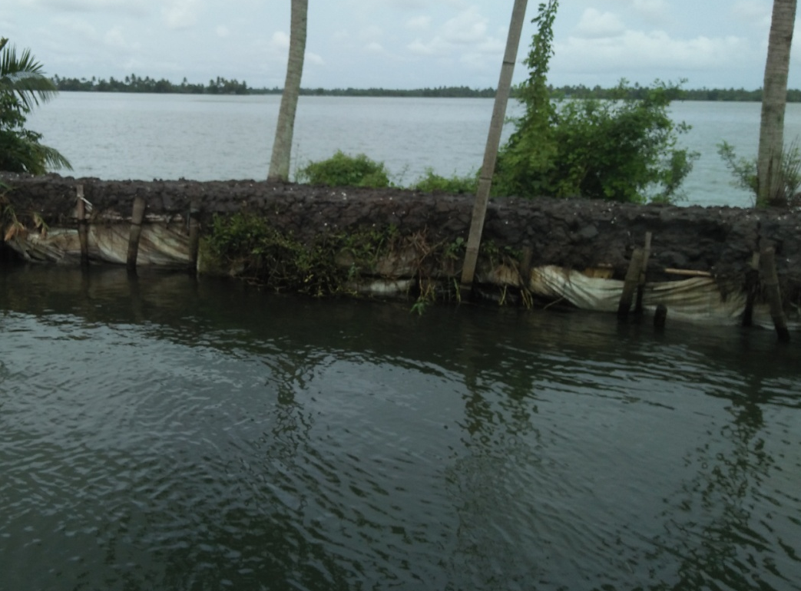
Failure of Embankment

Slide 8
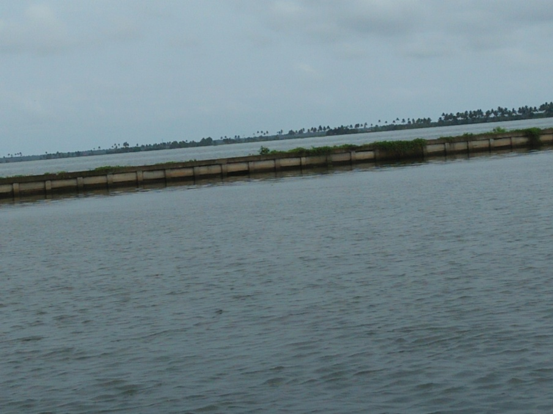
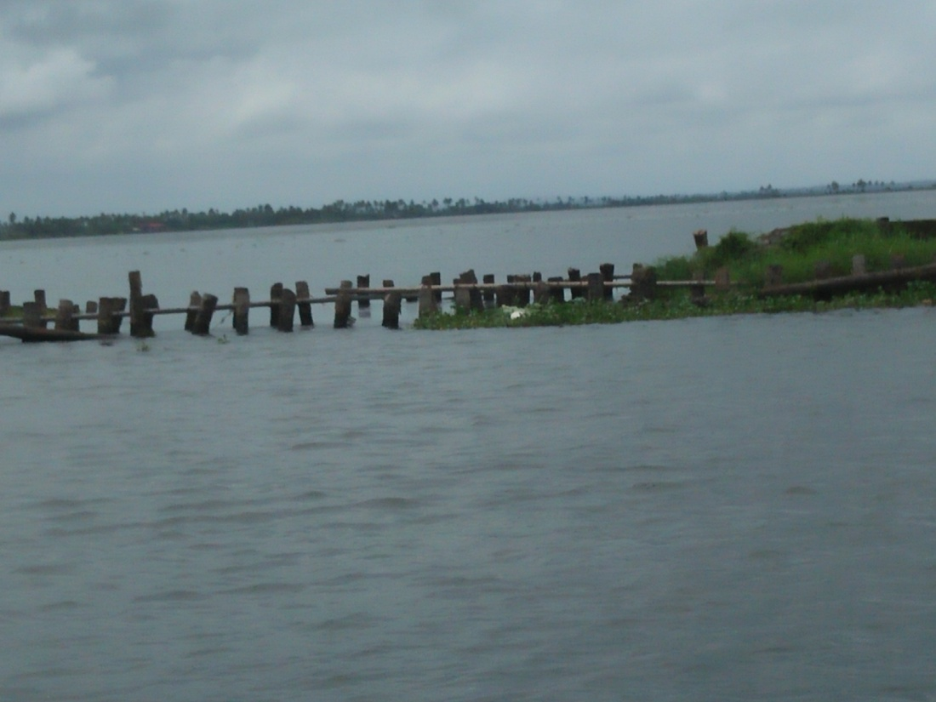
Failure of Embankment

Slide 9
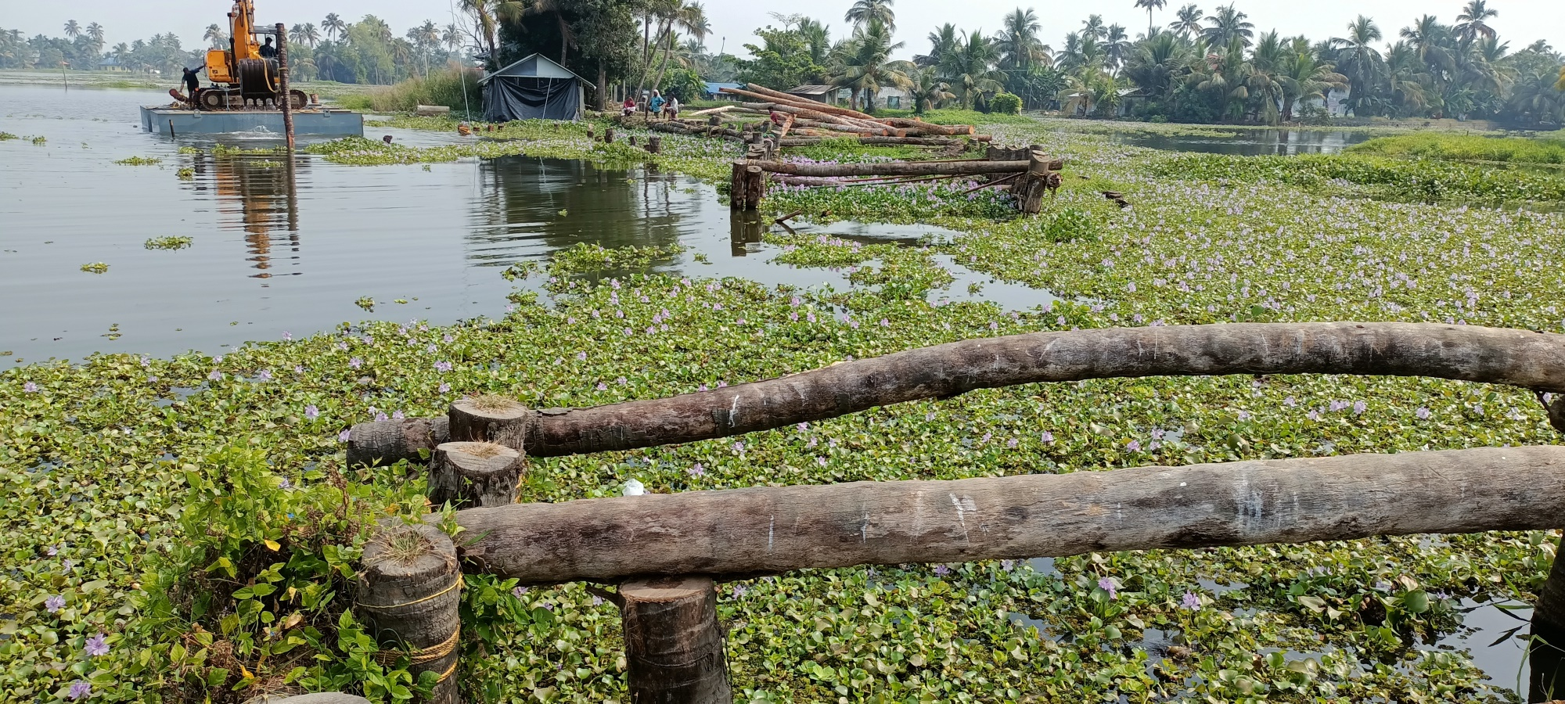
Failure of Embankment at Kanakassery Padasekharam,
Kainakary Panchayath, Kuttanad

Slide 10
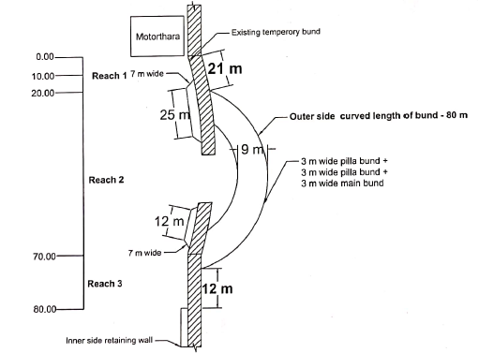
Breach of Embankment and Temporary Bund

Slide 11
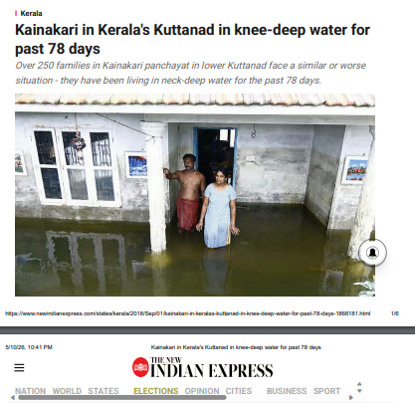

Slide 12
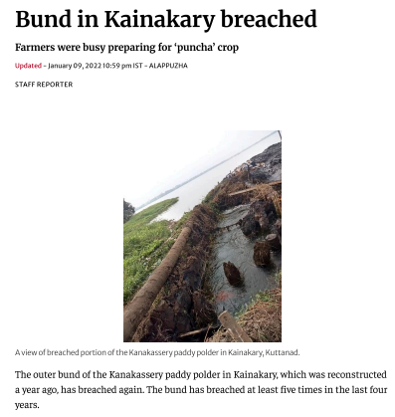

Slide 13
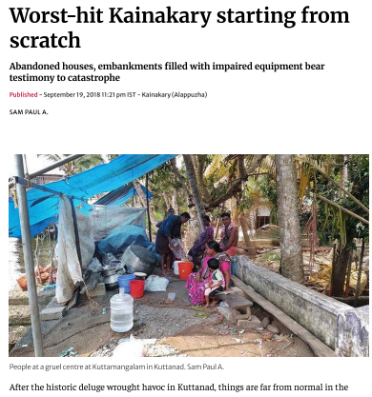

Slide 14
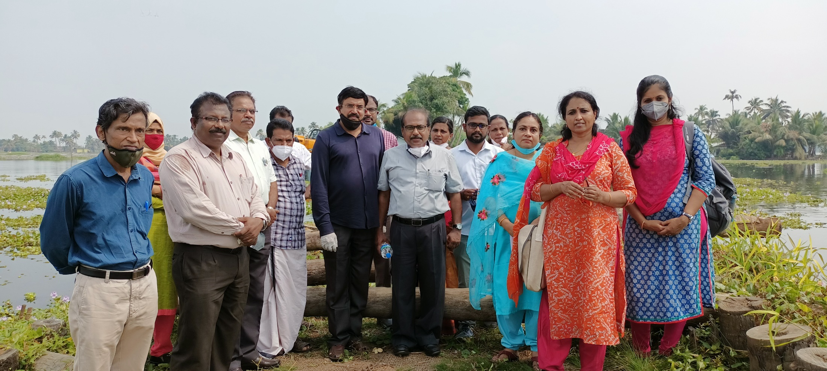
Inspection at Site

Slide 15
Details of Failure
At Kanakassery Padasekharam in Kainakari Panchayath of Alappuzha District, the portion of embankment near the water pump breaches regularly
Recurring breaches in this location
09-08-2019 – 30 m wide
27-08-2019 – 30 m wide
05-12-2019 – 30 m wide
11-12-2020 – 20 m wide

Slide 16
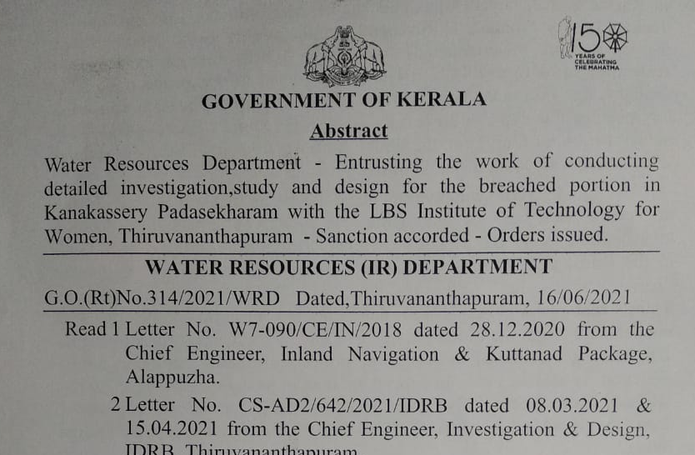

Slide 17
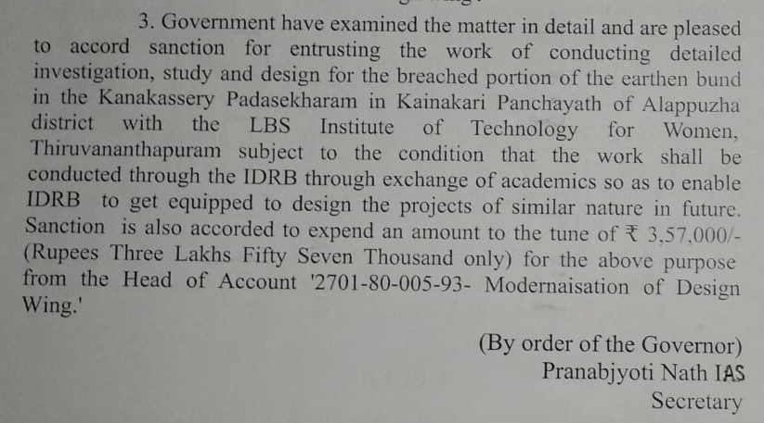

Slide 18
Data from Department
To have a detailed sounding to measure the depth of water in the Backwater and also in Padasekharam.
The sounding has to be taken in a grid of 5 m for a width of 20 m on either side of the breached bund.
Collect the soil sample from backwater area from surface and also from a depth of 1 m.
Sample of soil used for bund construction.

Slide 19
Data from Department
To provide detailed sketches or drawings of the following:
Present condition of bund along with pump house and the drainage channel.
Proposed temporary bund (construction of which is in progress),
Data on pumping of water, like the time required to empty the padasekharam and the extent of area covered under one pump.
The MFL and drawdown level of water during pumping.
Details of past breaches in the area.

Slide 20
Details of previous breaches at this location
09-08-2019 – 30 m wide
27-08-2019 – 30 m wide
05-12-2019 – 30 m wide
11-12-2020 – 20 m wide

Slide 21
Chainages and Reaches

Slide 22
Embankment – Chainage 0.00

Slide 23
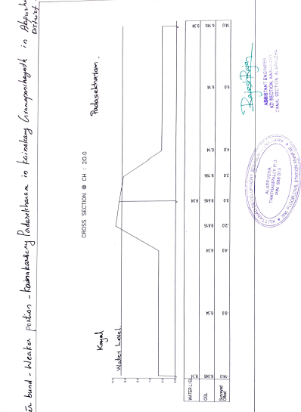
Embankment – Chainage 20.00

Slide 24
Embankment – Chainage 30.00

Slide 25
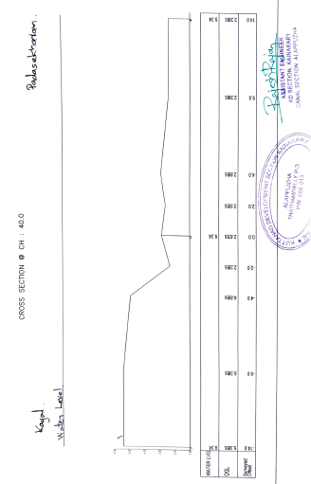
Embankment – Chainage 40.00

Slide 26
Embankment – Chainage 50.00

Slide 27
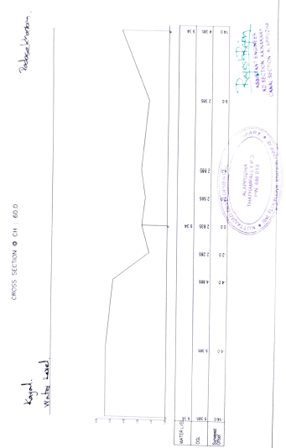
Embankment – Chainage 60.00

Slide 28
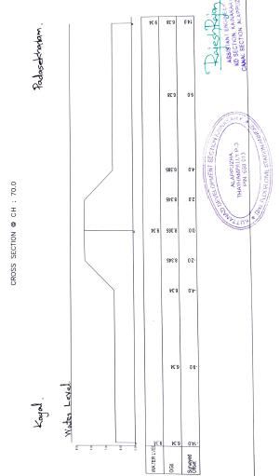
Embankment – Chainage 70.00

Slide 29
Embankment – Chainage 80.00

Slide 30
Soil Properties
Properties | Clay
Classification | MH-OH
Specific Gravity | 2.4
Natural moisture content (%) | 116
Bulk Density (g/cc) | 1.35
Void Ratio | 2.36
Liquid Limit (%) | 71
Plastic Limit (%) | 38
Plasticity Index (%) | 33
Cohesion (kPa) | 0.088
% Clay & Silt | 94.3
% Sand | 5.7

Slide 31
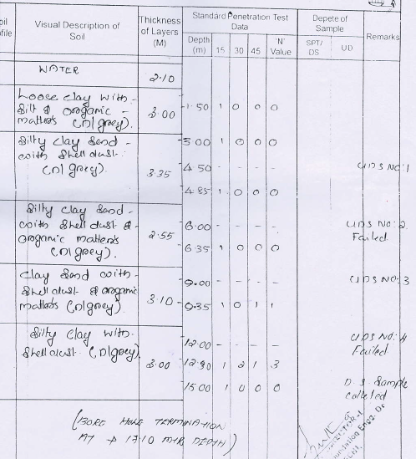
Bore Log

Slide 32
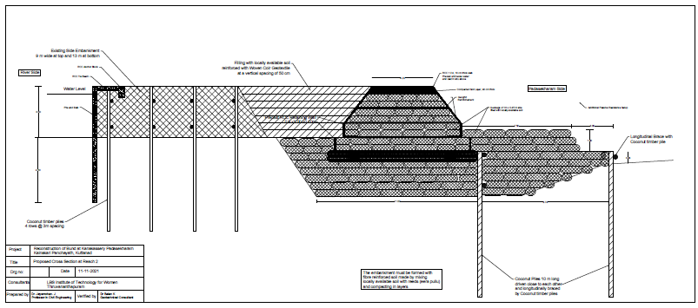
Designed Embankment Section in Reach 2

Slide 33
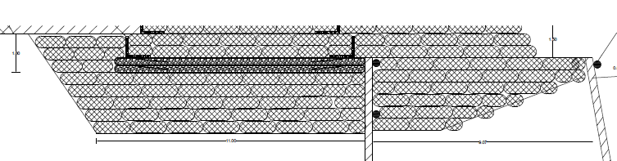
Designed Embankment Section in Reach 2
Filling the depression using Geobags filled with local soil

Slide 34
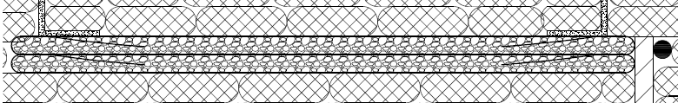
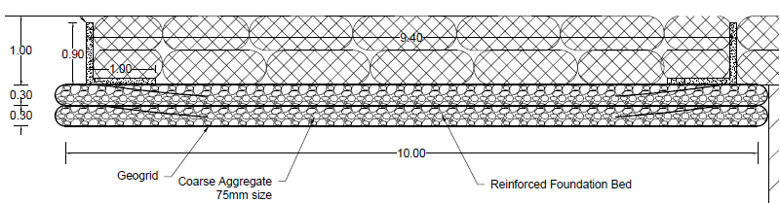
Designed Embankment Section in Reach 2
Reinforced Foundation Bed

Slide 35
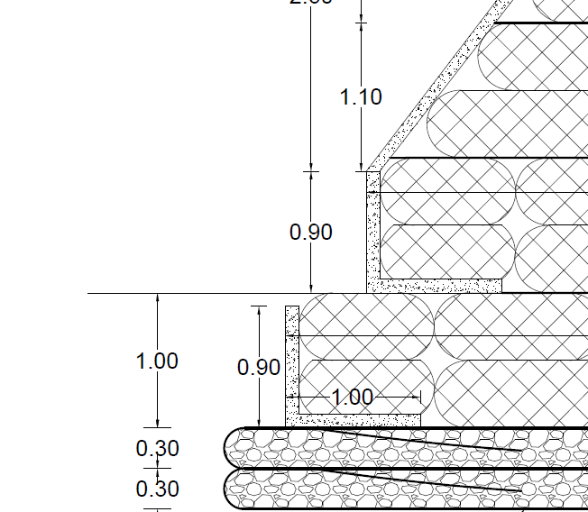
Designed Embankment Section in Reach 2
Precast RCC Retaining Walls

Slide 36
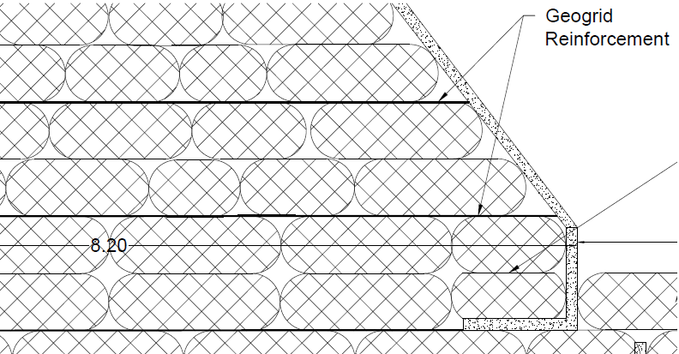
Designed Embankment Section in Reach 2

Slide 37
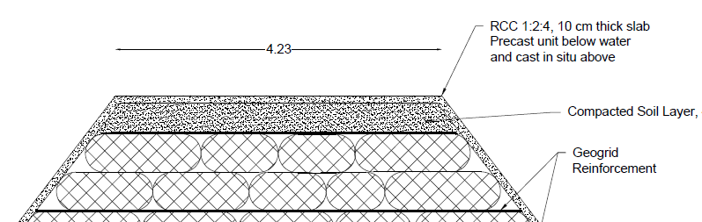
Designed Embankment Section in Reach 2

Slide 38
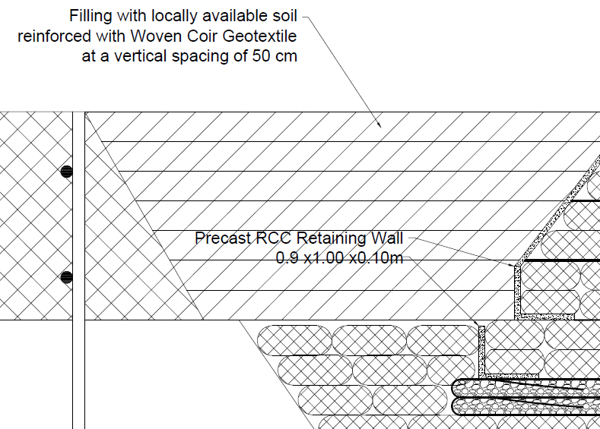
The space between the existing temporary bund and the reconstructed bund is filled up with locally available soil mixed with locally available reeds (Eerapullu). This soil must be reinforced with Coir Geotextile at a vertical spacing of 50 cm

Slide 39
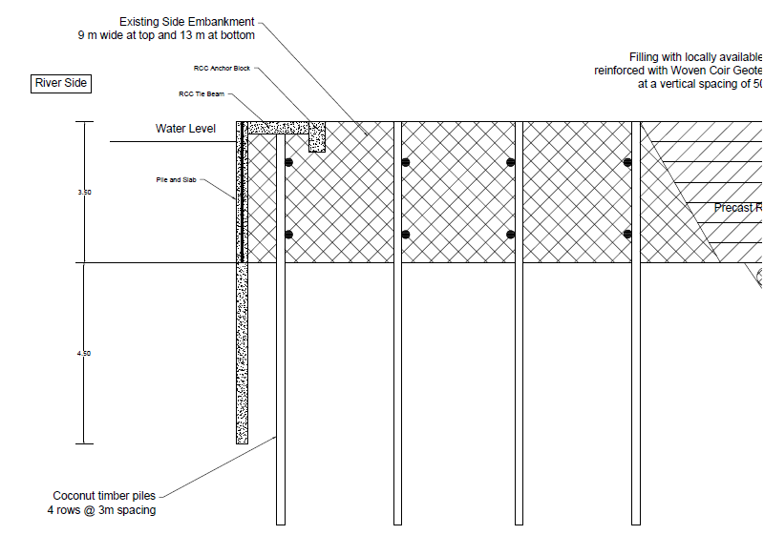
Existing Embankment (Ring Bund)

Slide 40
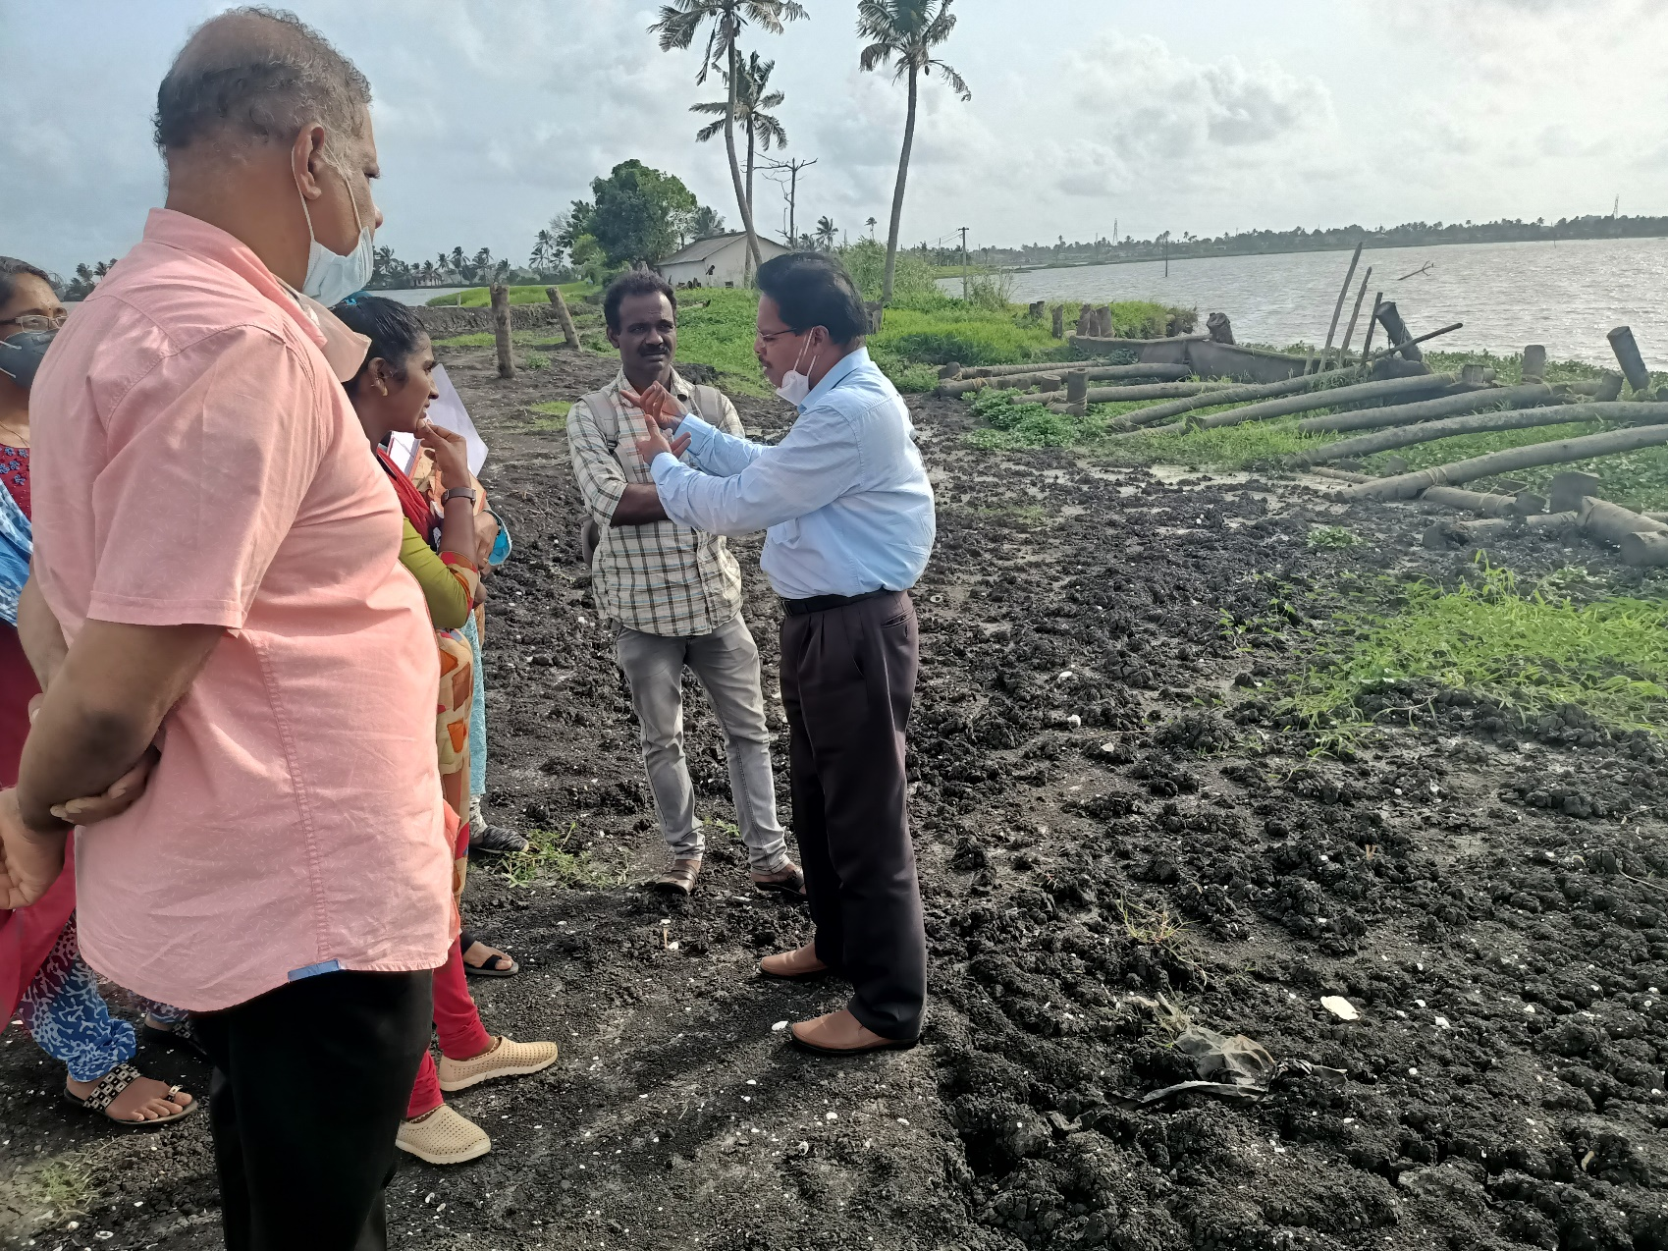
Temporary Construction

Slide 41
Finite Element Analysis
The global stability of the design section has been determined by carrying out finite element analyses with the software PLAXIS 2D.
Soil properties presented in table 1 has been adopted in the analyses.
The elastic axial stiffness and flexural rigidity of Contigous piles and Soldier Piles are determined from the dimensions of section and material properties.
The depth and rate of drawdown has been adopted as reported by the Engineers at site.

Slide 42
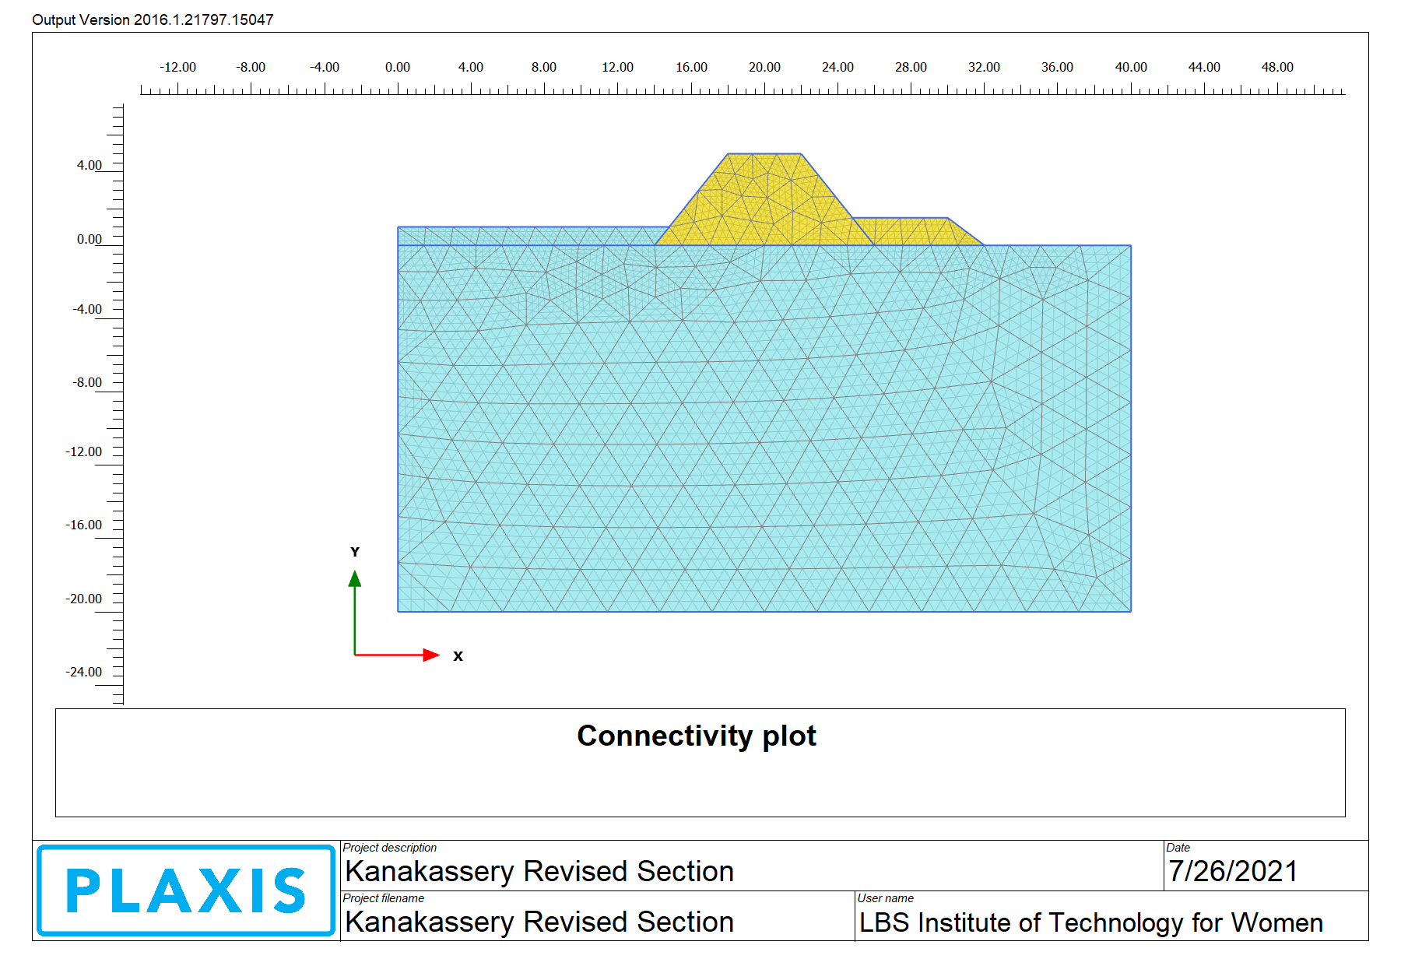
Finite Element Analysis

Slide 43
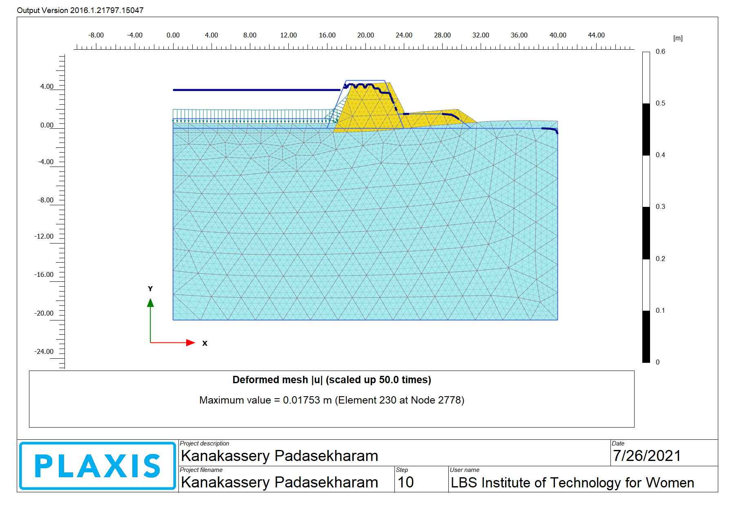
Finite Element Analysis

Slide 44
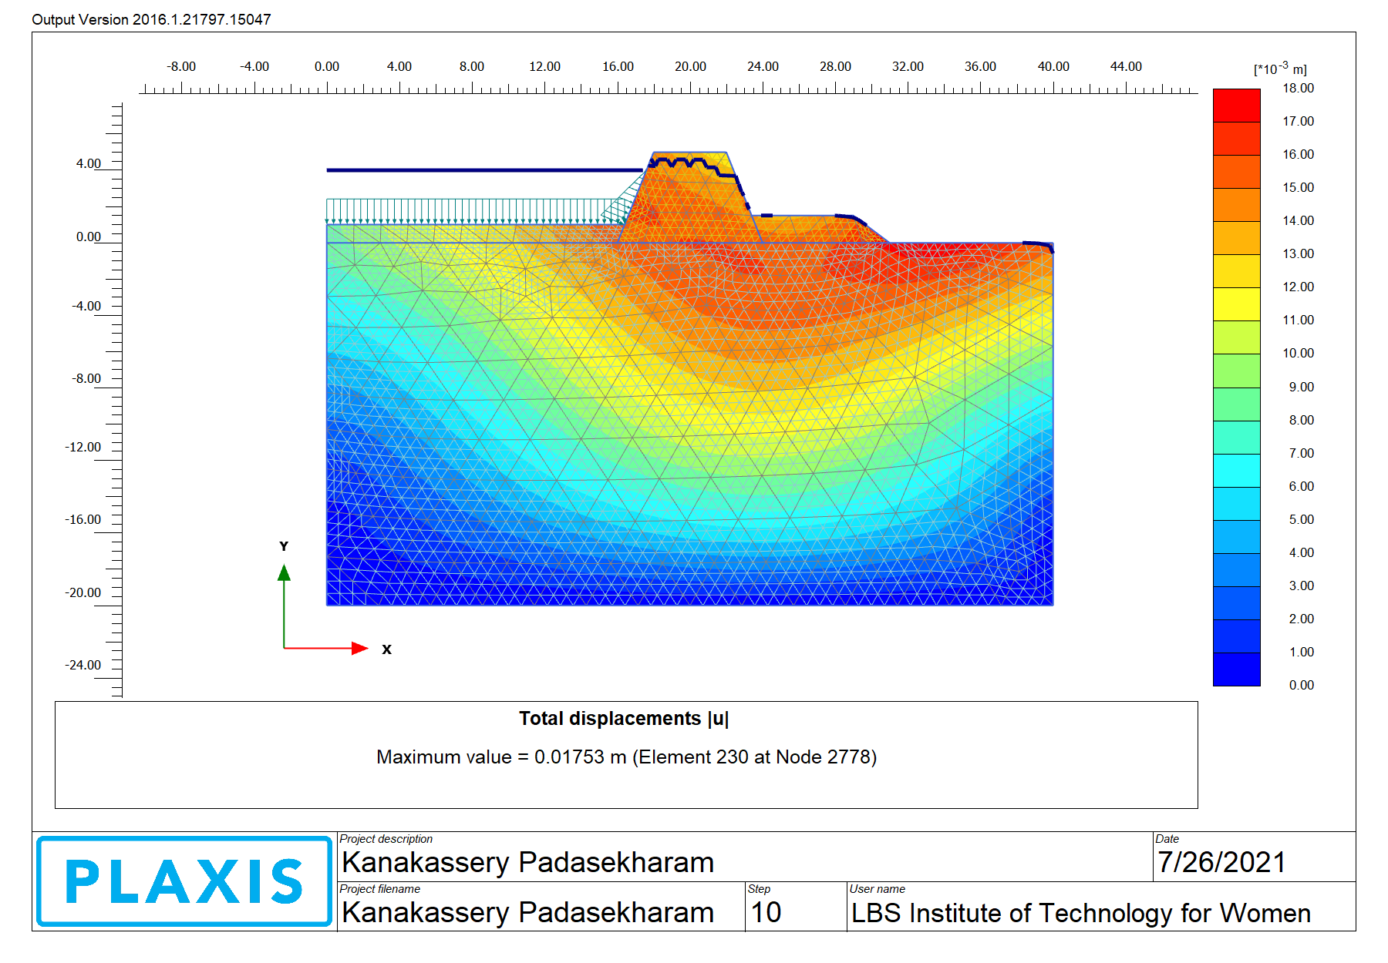
Finite Element Analysis

Slide 45
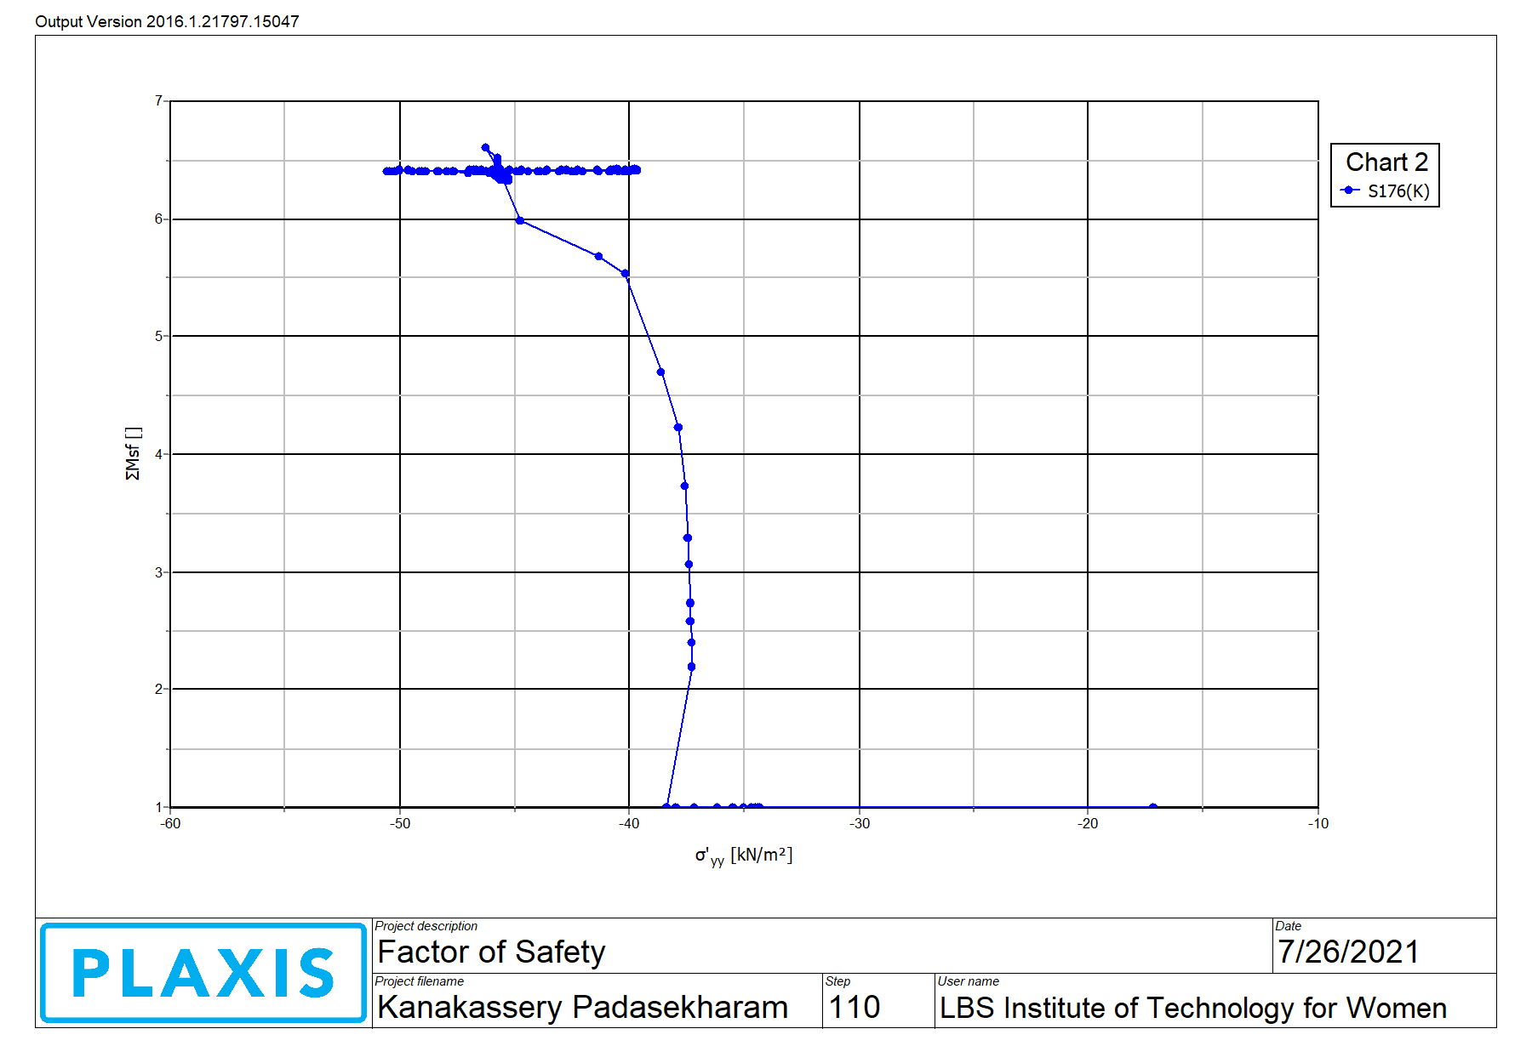
Finite Element Analysis

Slide 46
Reaches 1, 2 & 3

Slide 47
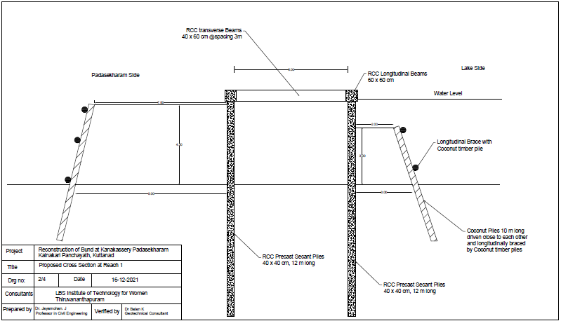
Designed Embankment Section in Reach 1

Slide 48
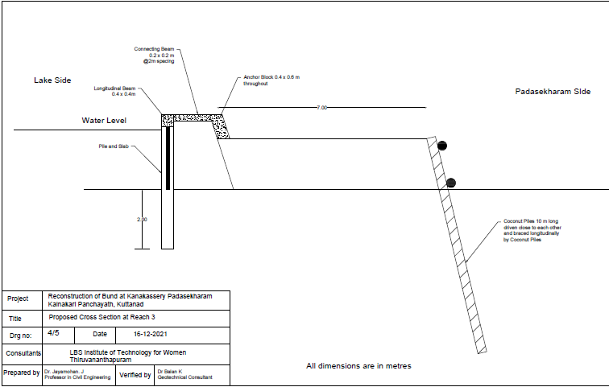
Designed Embankment Section in Reach 3

Slide 49
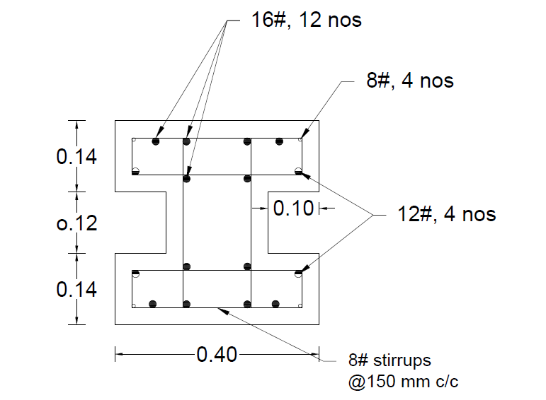
Cross Section of Soldier Pile in Reach 1 & 3

Slide 50
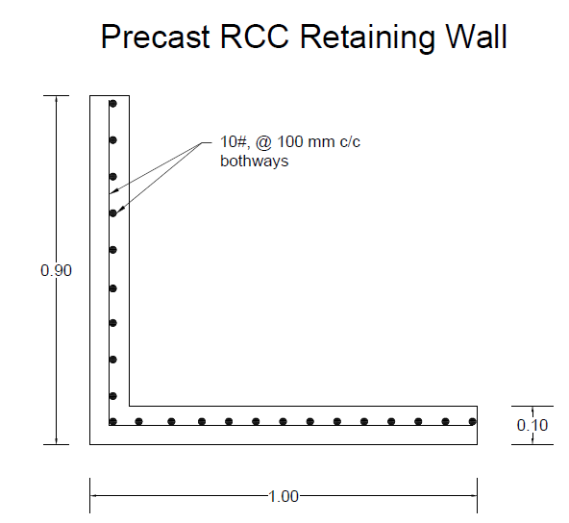
Designed Embankment Section in Reach 2

Slide 51
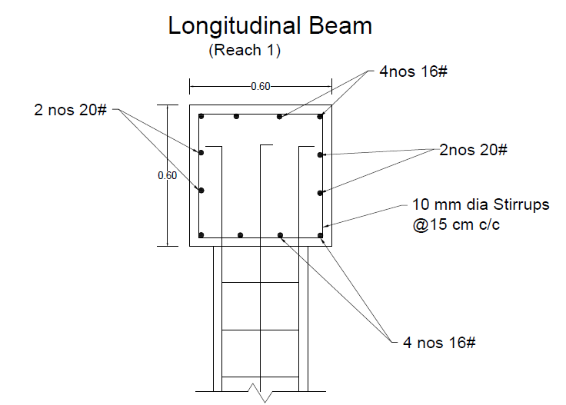
Designed Embankment Section in Reach 1 & 3

Slide 52

Breached Portion

Slide 53
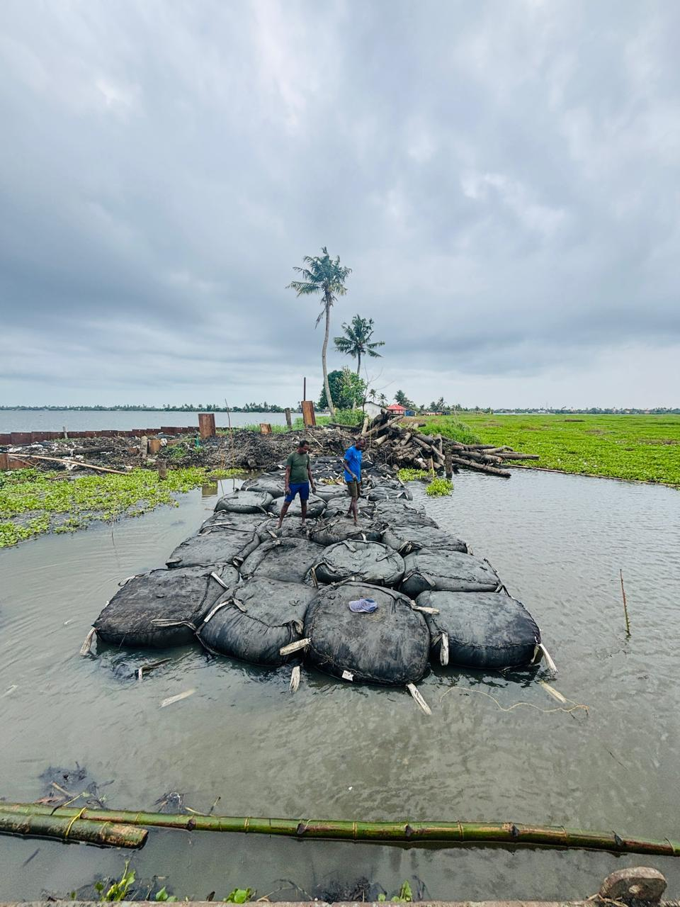
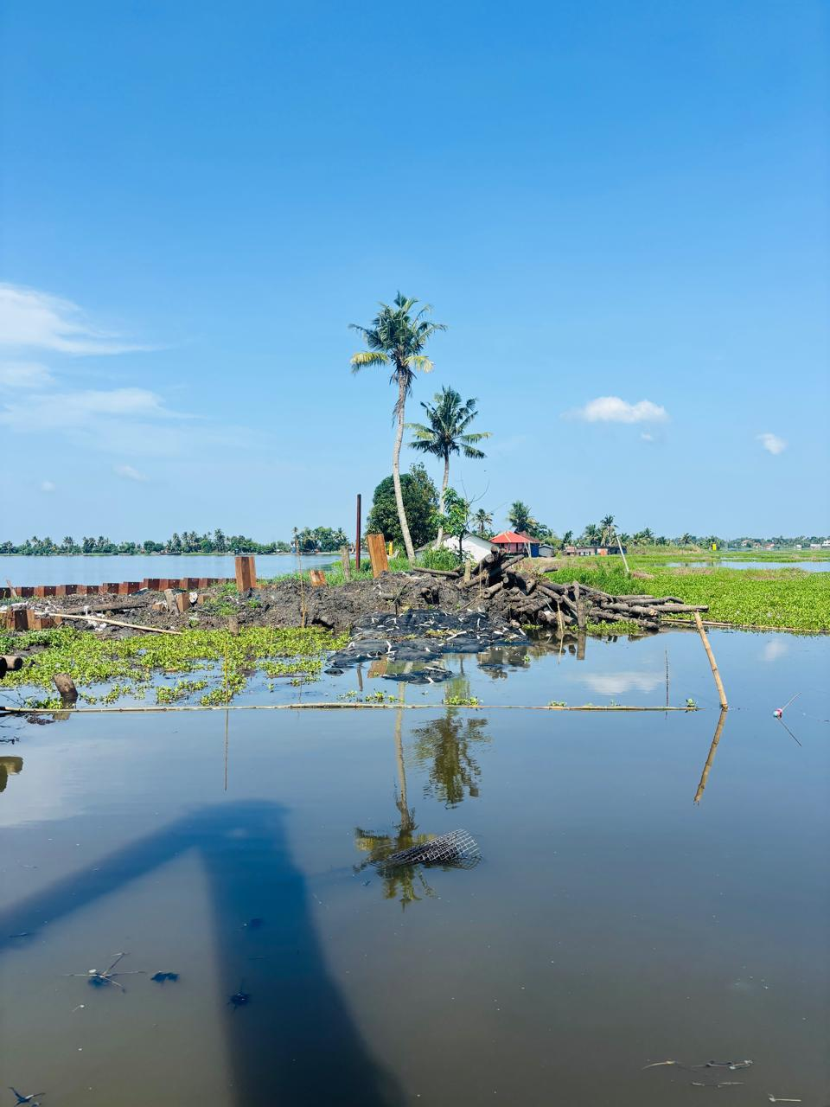

Slide 54
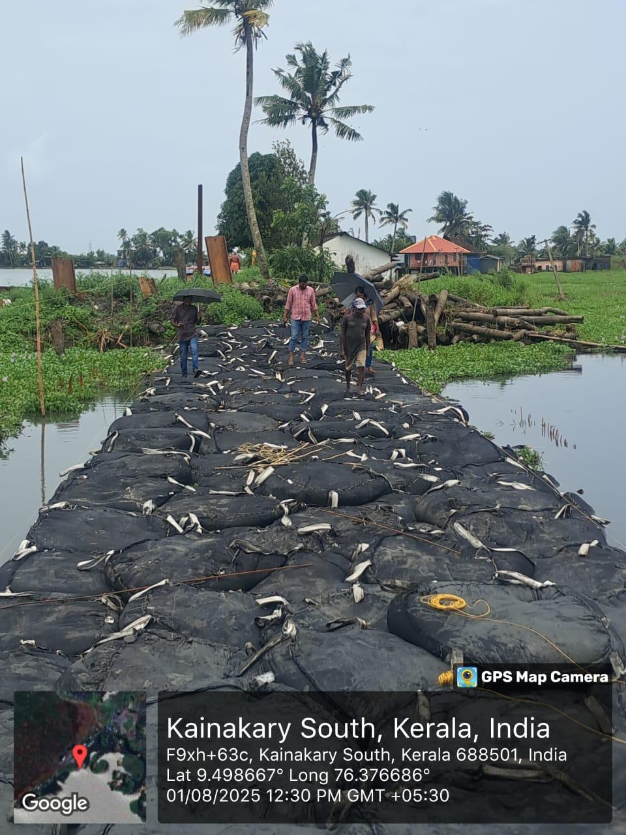
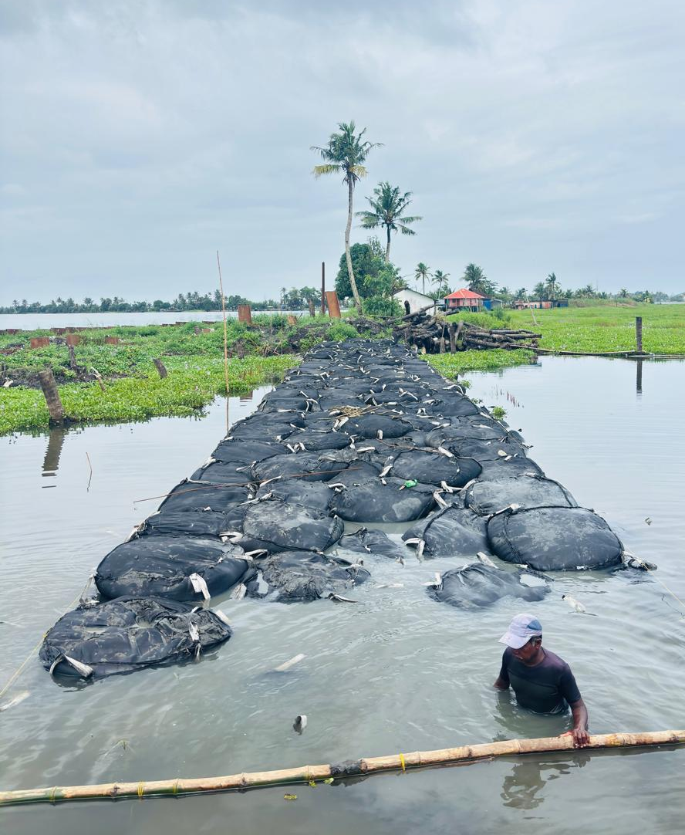

Slide 55
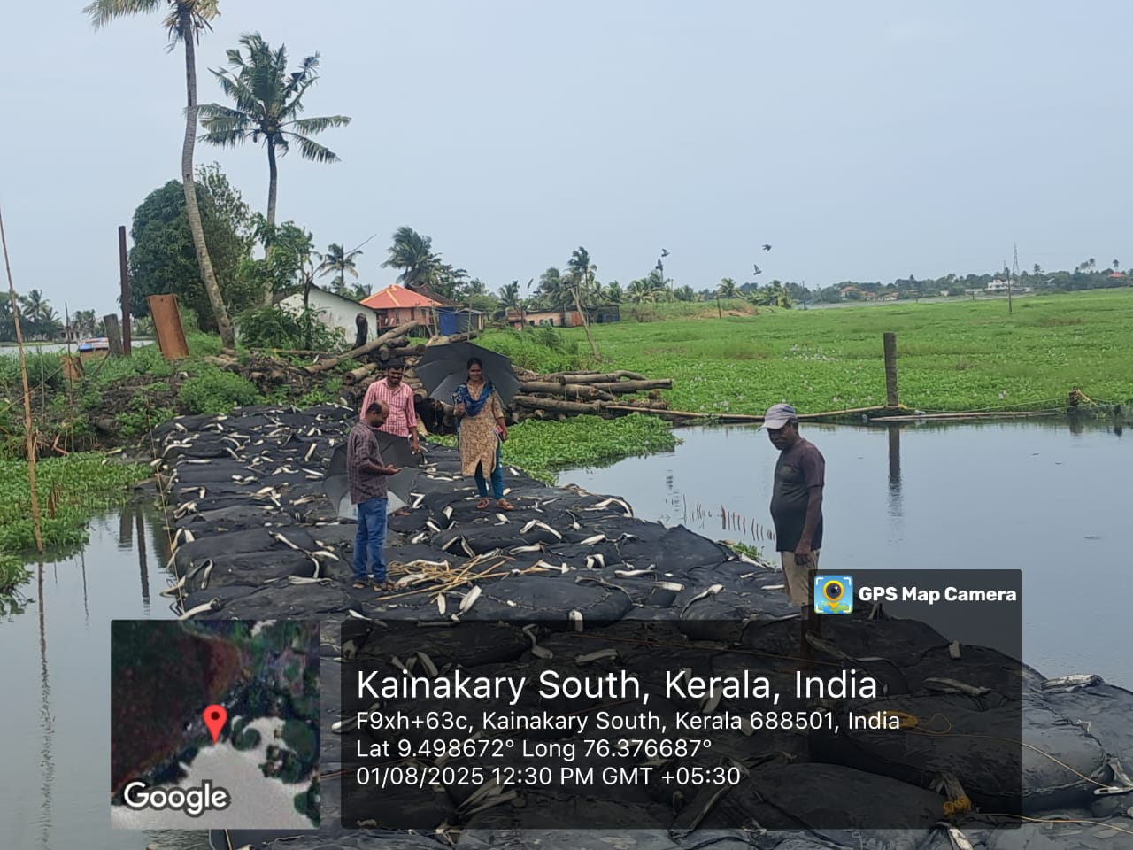

Slide 57
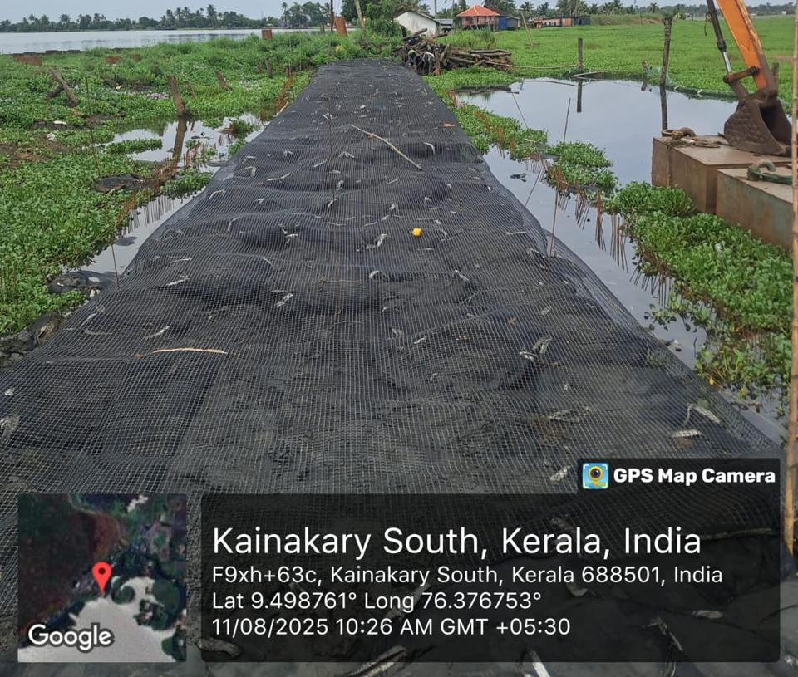
Construction in progress
Biaxial Geogrid Reinforcement

Slide 58
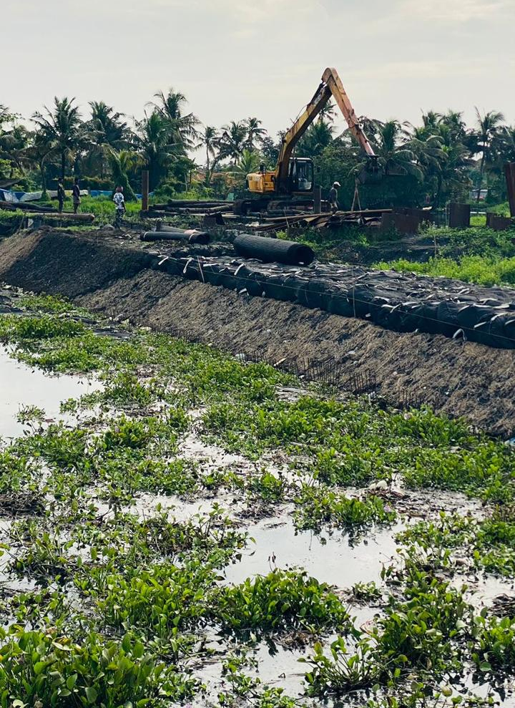
Construction in progress

Slide 59
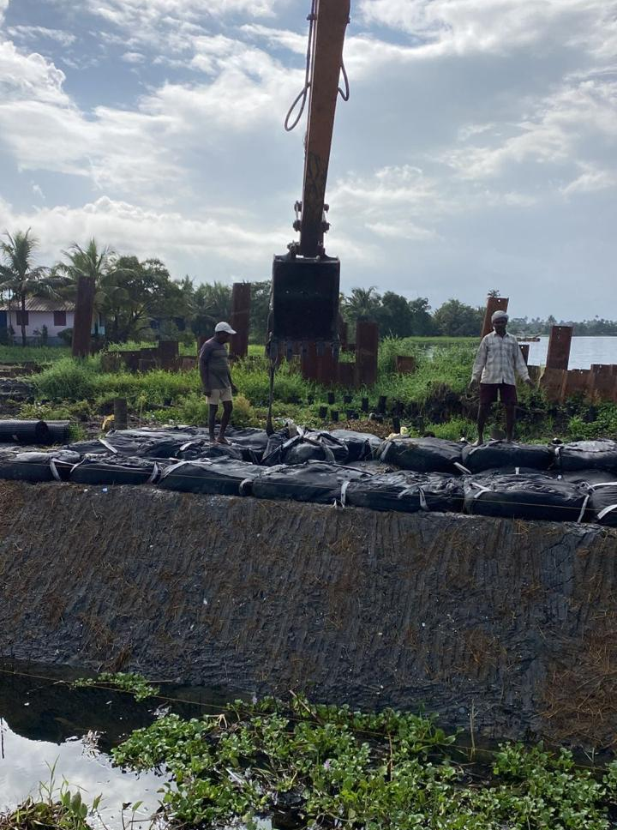
Construction in progress

Slide 60

Construction in progress

Slide 61

Construction in progress

Slide 62


Slide 63



Slide 64



Slide 65


Slide 66


Slide 67

Specifications

Slide 68
Questions are welcome
Thank you for your interest
Presented by:
Dr. Jayamohan.J
Joint Director
Lal Bahadur Shastri Centre for Science & Technology
Thiruvananthapuram

