Slide 1
EXPERIENCES WITH TROPICAL SOIL
DR K BALAN
Geotechnical Engineering Consultant
Former Professor in Civil Engineering
College of Engineering
Trivandrum

Slide 2
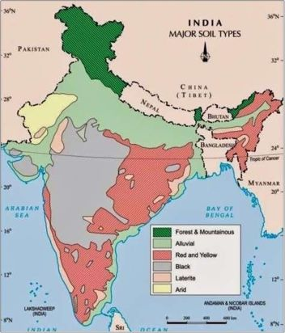

Slide 3
Laterite is a residual material left after in situ weathering of
parent rock under humid tropical conditions.
At least three different basic structural types in Kerala
Laterites with a continuous coherent skeleton, which can be
considered as a vesicular soft rock. The vesicules are usually
Filled with clay. The hardness and extent of vesicules are variable.
Referred as brickstone.
Latertites formed as a result of cementation of pre-existing
Materials like gravels, sands and pebbles by ferruginous matter.
Conglomerate.
3. Hard elements existing as free concretions or nodules
In an earthy matrix. Lateritic gravelly soil.

Slide 4
Gravelly soil extends to 60 cm
Hard to Medium Laterite extending upto 7 to 10 m
Soft Laterite/Kaolinitic clay
Disintegrated rock
Hard rock

Slide 5
At places, where laterite is exposed, it is very hard at the surface.
Some types of this hard laterite are very dense and darker in
colour, due to presence of iron.
They are known as Narickallu or Chenkallu
Laterite is met with at considerable depth, say 18 to 27 m
below the ground level (other than the three varieties), at
places like Ernakulam.
This lateritic hardpan is used to support end-bearing piles.

Slide 6
60 cm diameter pile resting at 8 m blow ground level in Trivandrum with its tip in a layer having SPT 40 can take over 100 tonnes.
SPT varies
For soft laterites 20 to 30
Hard laterites 100
Laterite having N value 30 shows
Angle of internal friction as 35 degrees and
Cohesion about 0.9 kg/cm2.
Average compressive strength of 15 cm cube was
1.79 kg/cm2

Slide 7
Theoretical Bearing capacity for a 30 cm plate was found
to be 400 t/m2.
Whereas the actual value was found to be 82 t/m2.
Settlement criterion should govern the design.

Slide 8
In General, the properties can be summarized as follows., though
It varies drastically whether the test is conducted on fresh
Samples or on samples air dried or oven dried.
Properties of the first two varieties
Property | Range of values | Remarks
Bulk density | 1.8 to 2.2 t/m3 | Upto 3.5 t/m3 for surface layers
Natural water content | 5 to 21%
Specific Gravity | 2.68 to 2.7
Void ratio | 0.5 to 0.6
Porosity | 36 to 38%
Grain size, Gravel | 46 to 59%
Sand | 26 to 37 %
Silt | 7 to 14%
Clay | 4 to 6%
% Swelling | Negligible

Slide 9
Property | Range of values | Remarks
Liquid Limit | 39 to 46%
Plasticity Index | 9 to 13 % | Sometimes NP
Compressive strength | 4.5 to 6.5 kg/cm2 | On 10 cm cube fresh
 | 9 to 11 kg/cm2 | On some samples
 | 14.5 kg/cm2 | Air dried
 | 19.5 kg/cm2 | Oven dried
Modulus of elasticity | 260kg/cm2 | UCC on 3.8x7.6 cm sample
 | 660 kg/cm2
%Absorption of water | 15 to 23%
Triaxial | Φ = 40 and C=0.8 kg/cm2 | 3.8 x 7.6 cm sample. Strain 0.6%

Slide 10
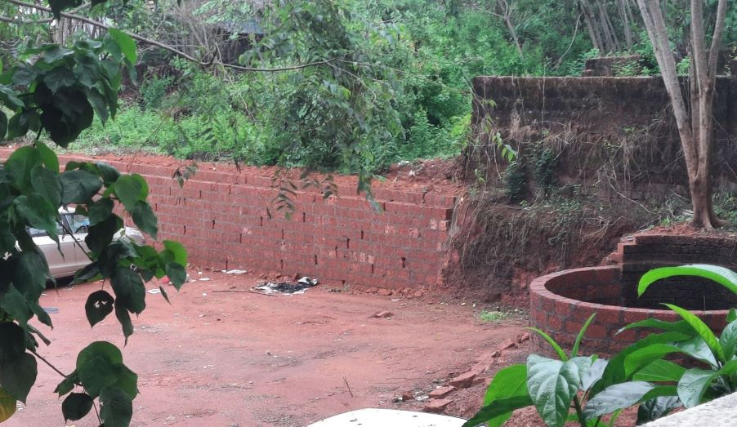

Slide 11
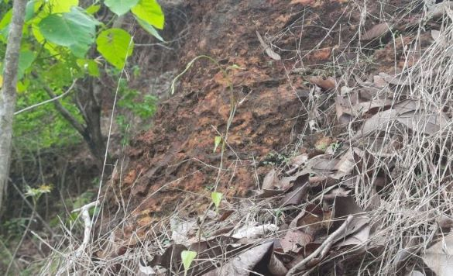

Slide 12
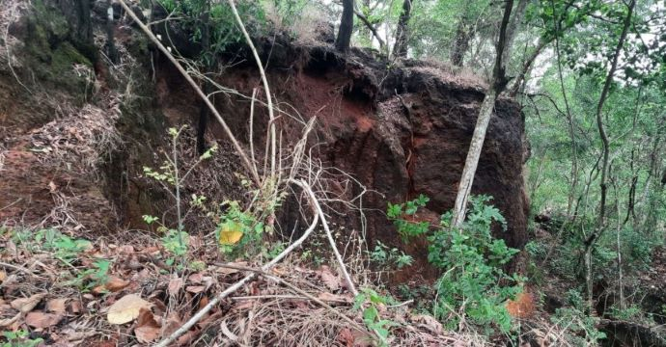

Slide 13
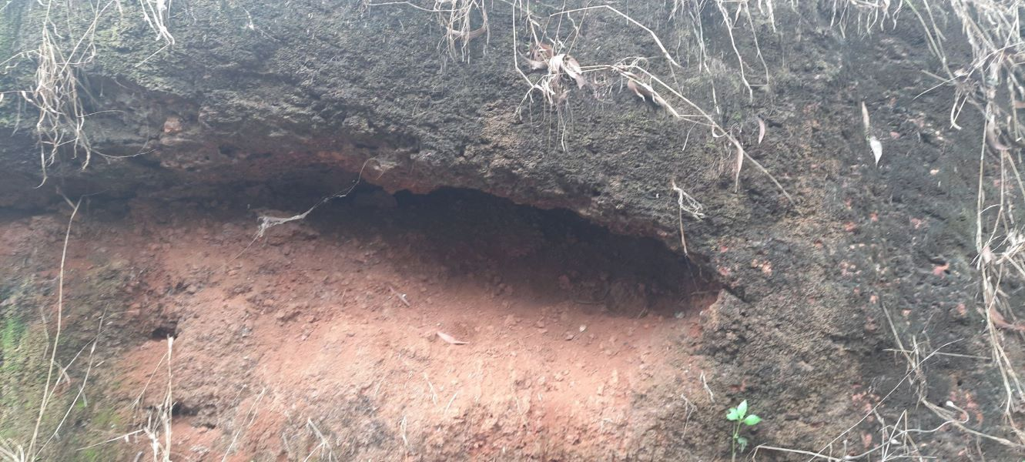

Slide 14
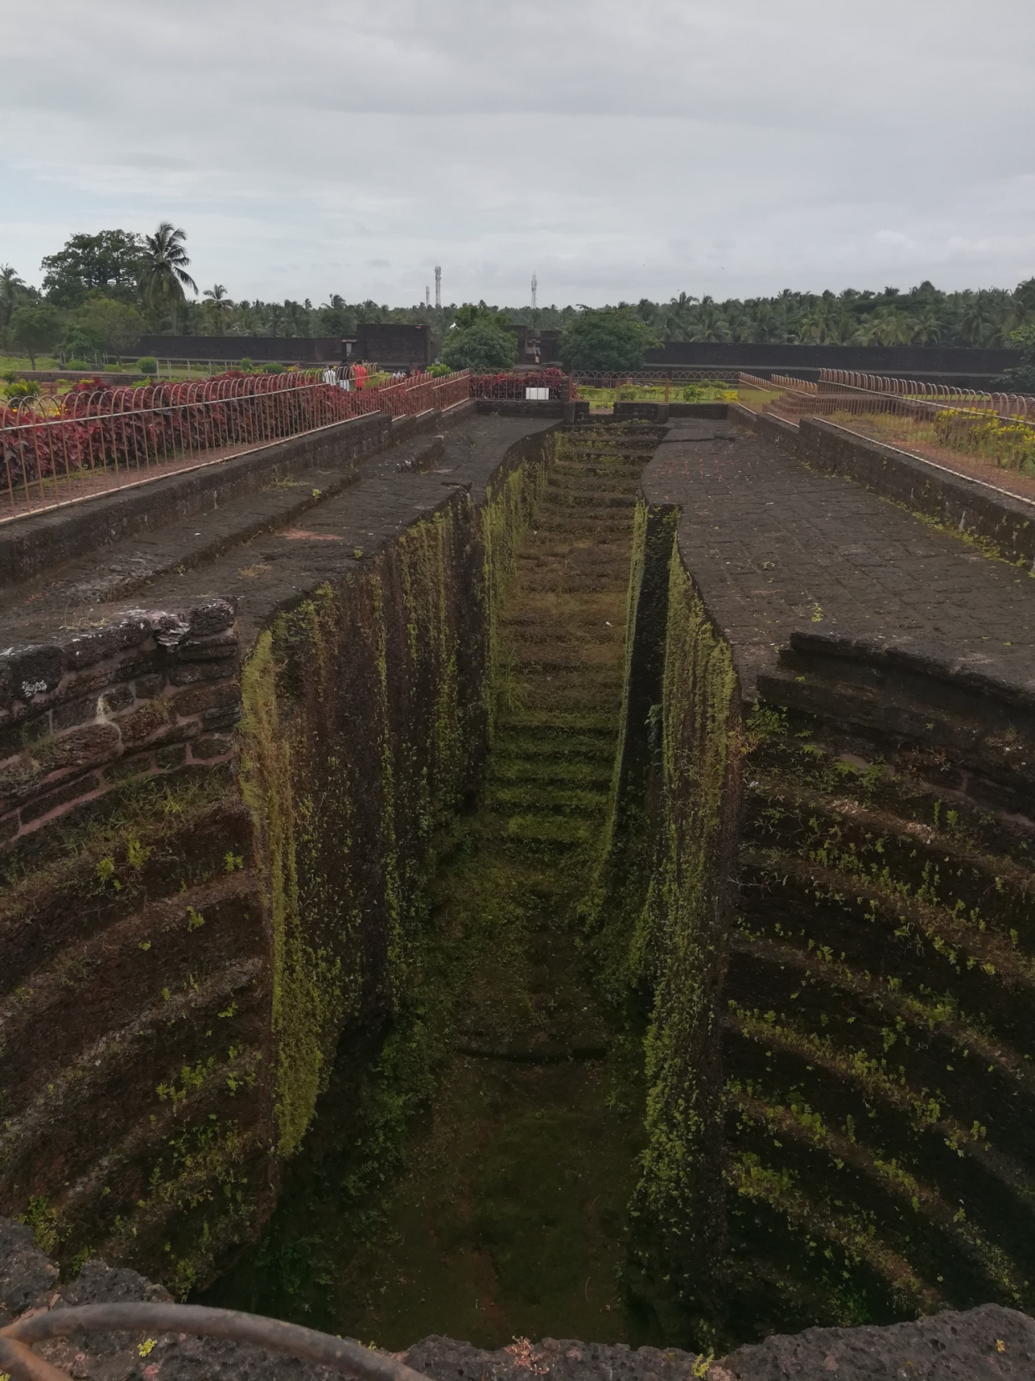
Bakel Fort

Slide 15
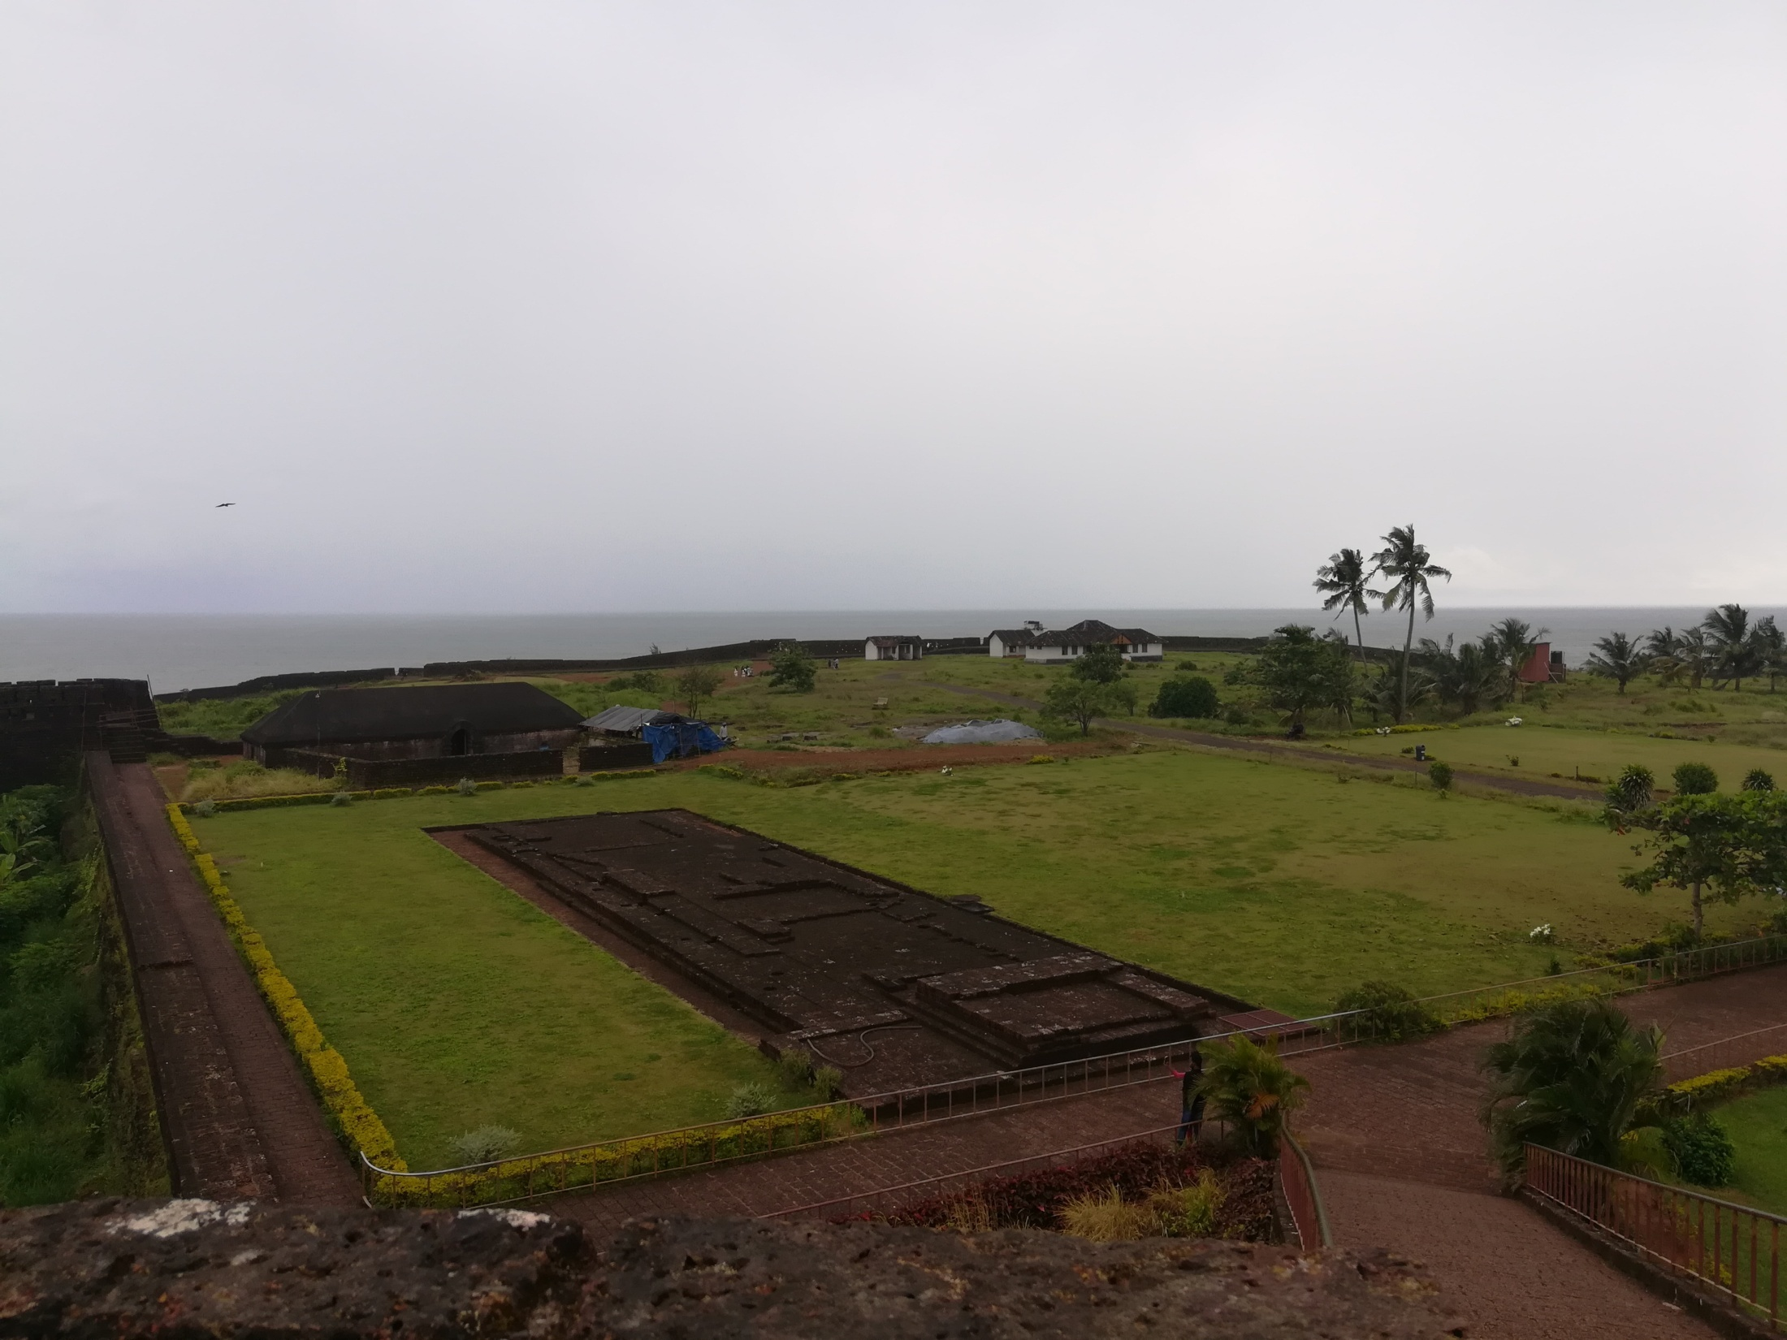

Slide 16
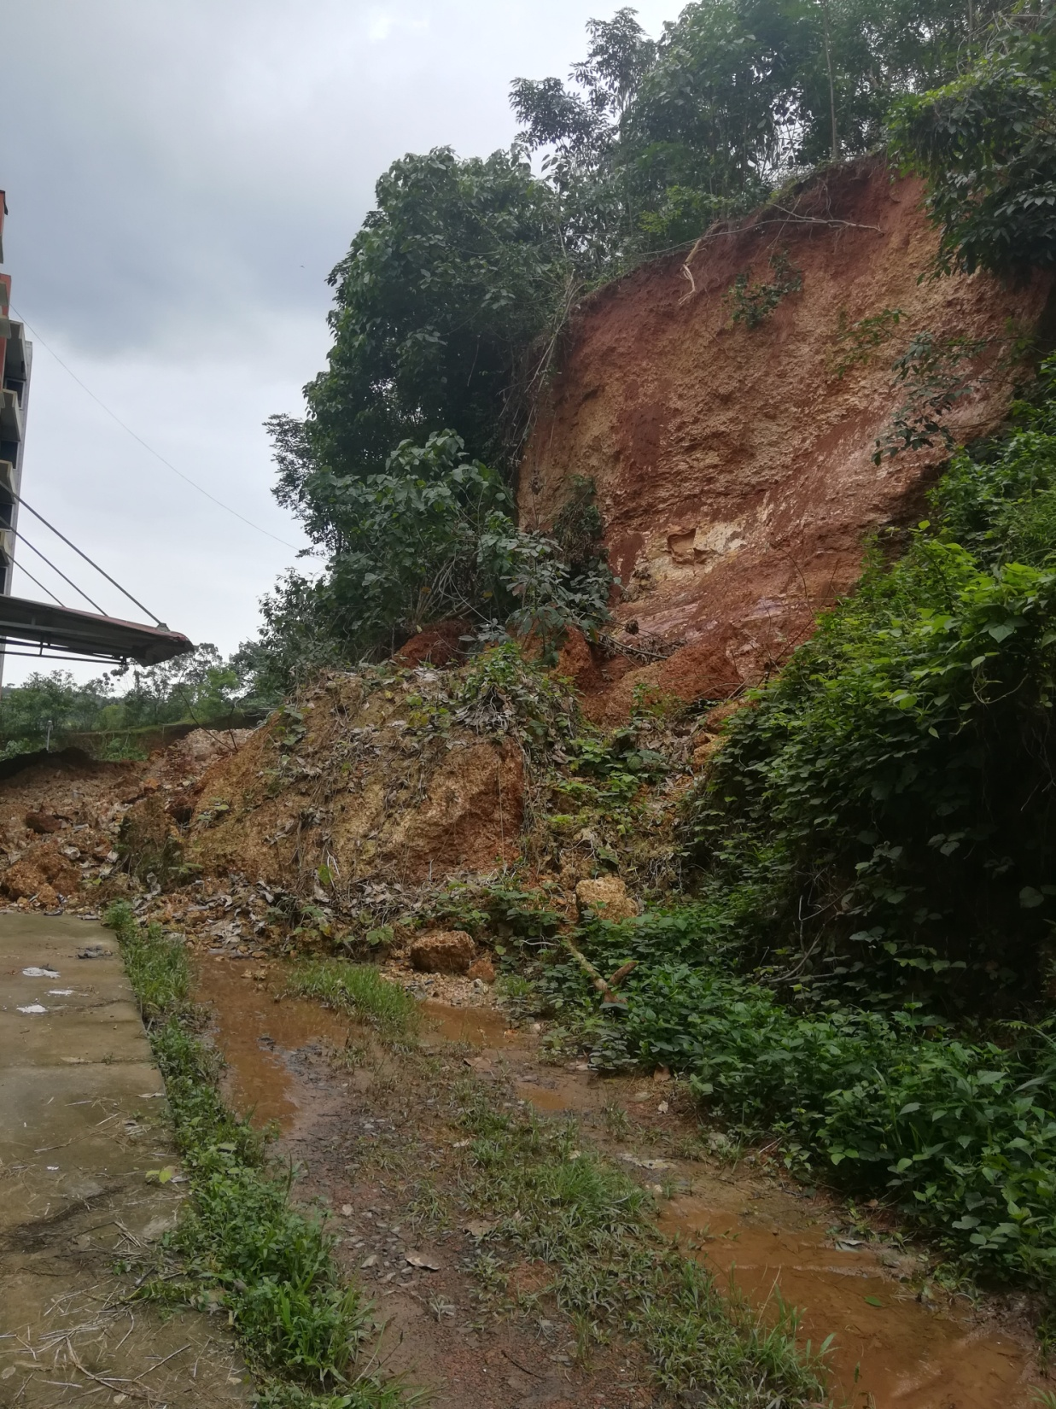

Slide 17
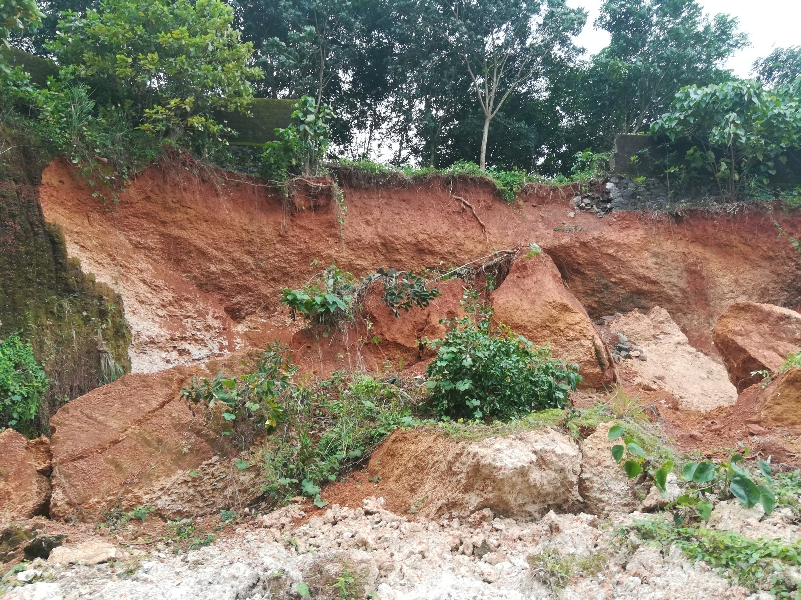
Aranmula, Pandalam

Slide 18

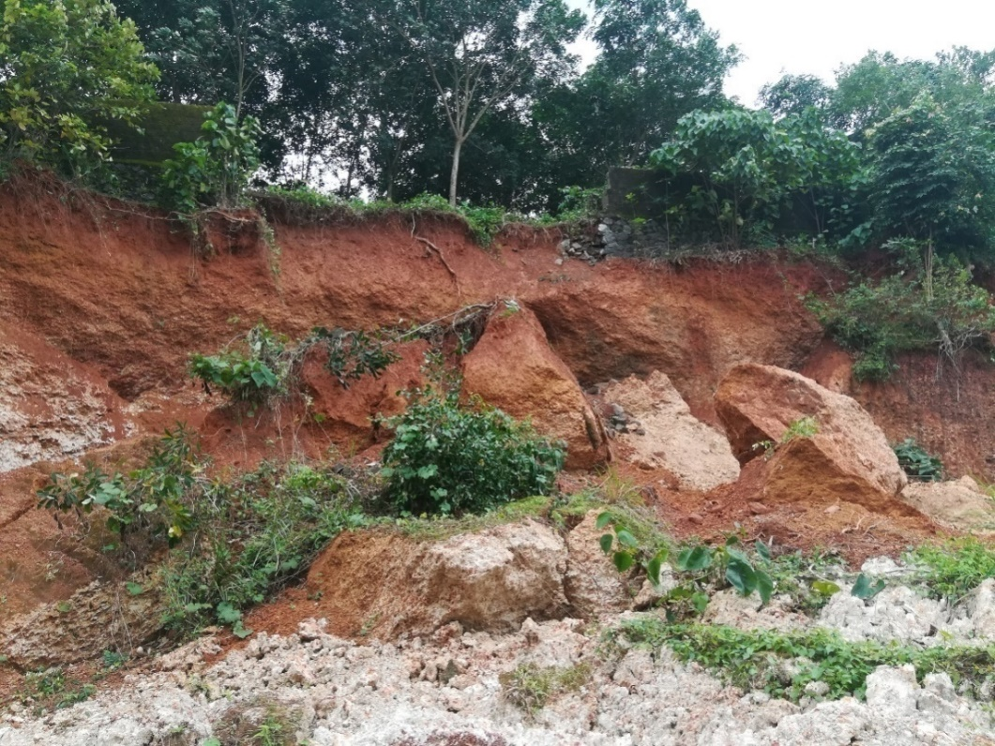
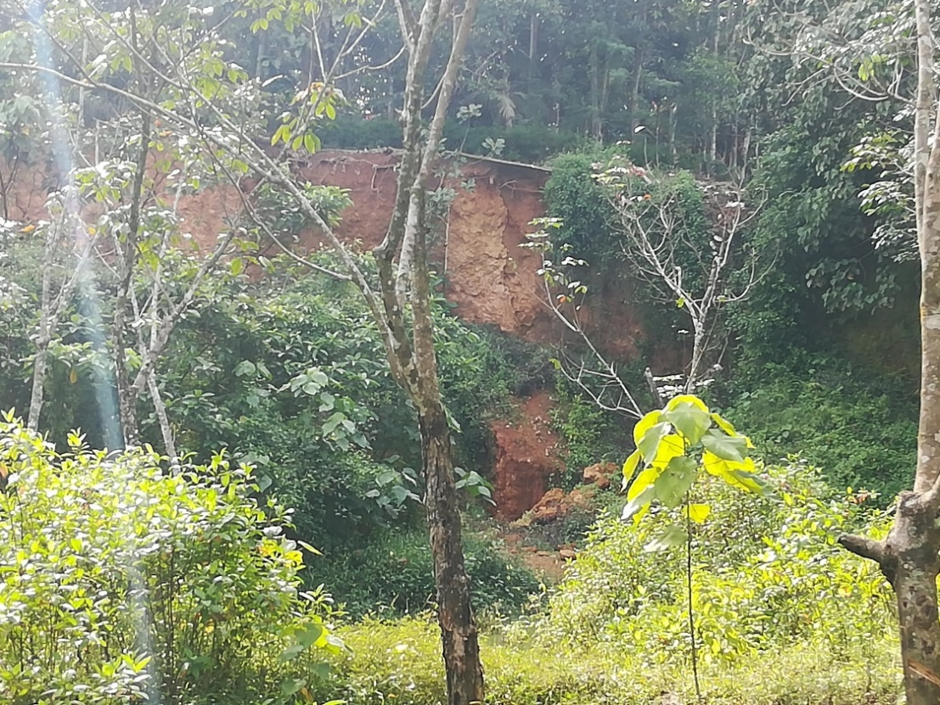

Slide 19
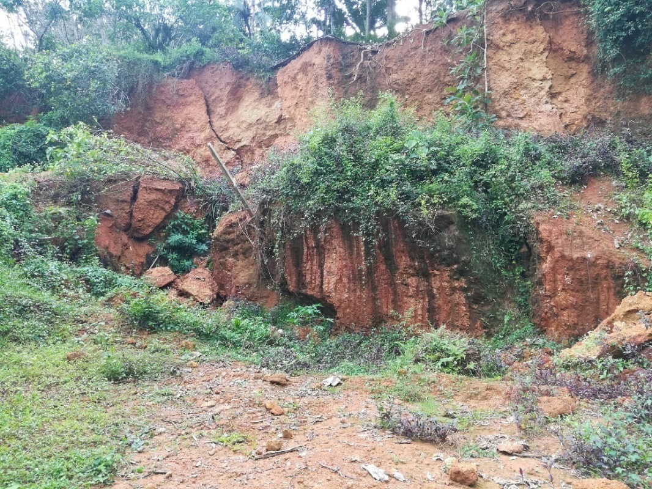
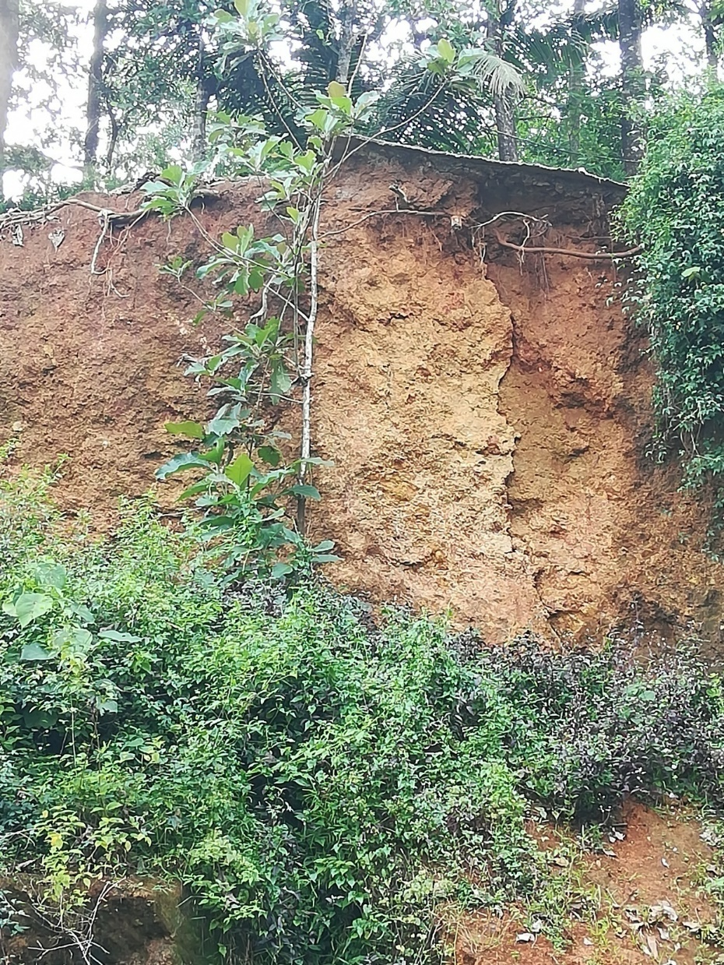
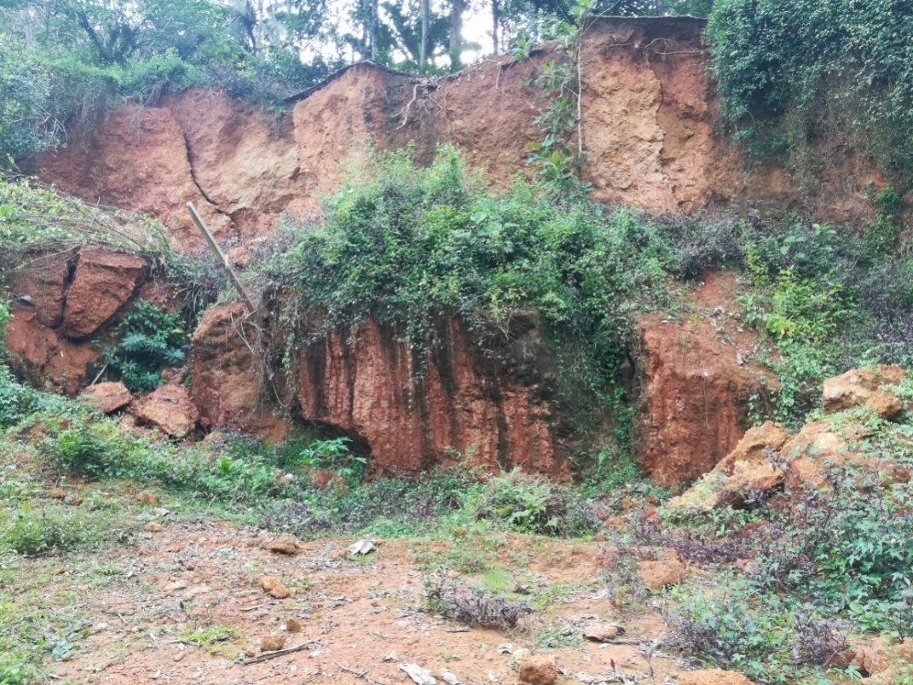

Slide 20
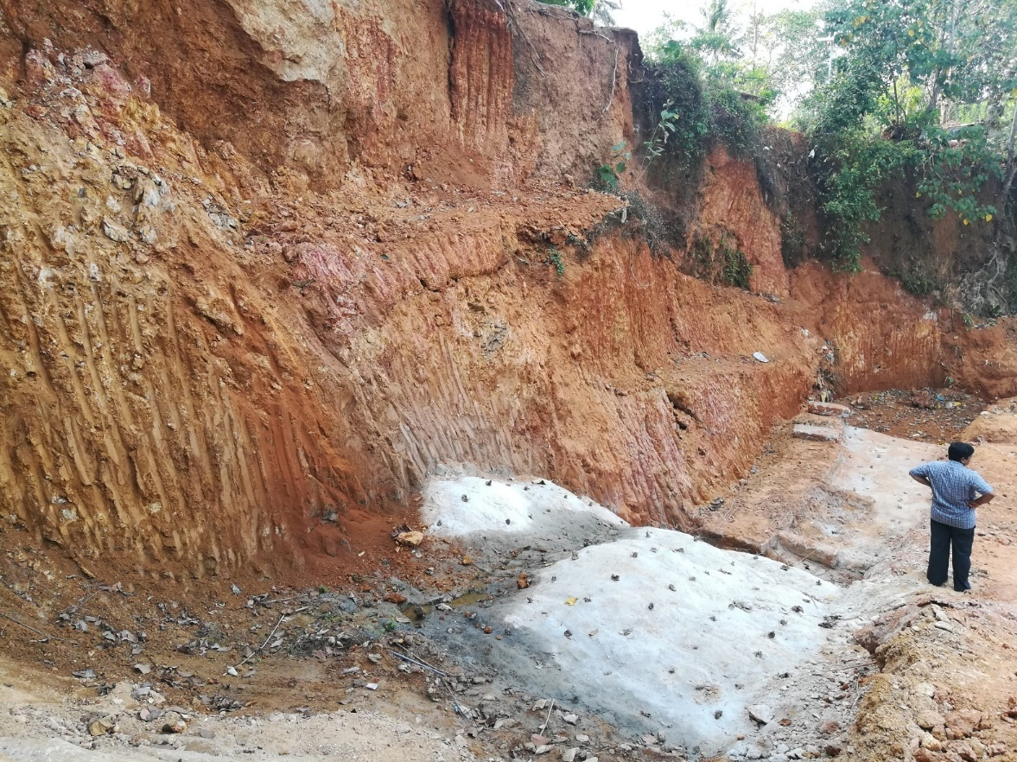
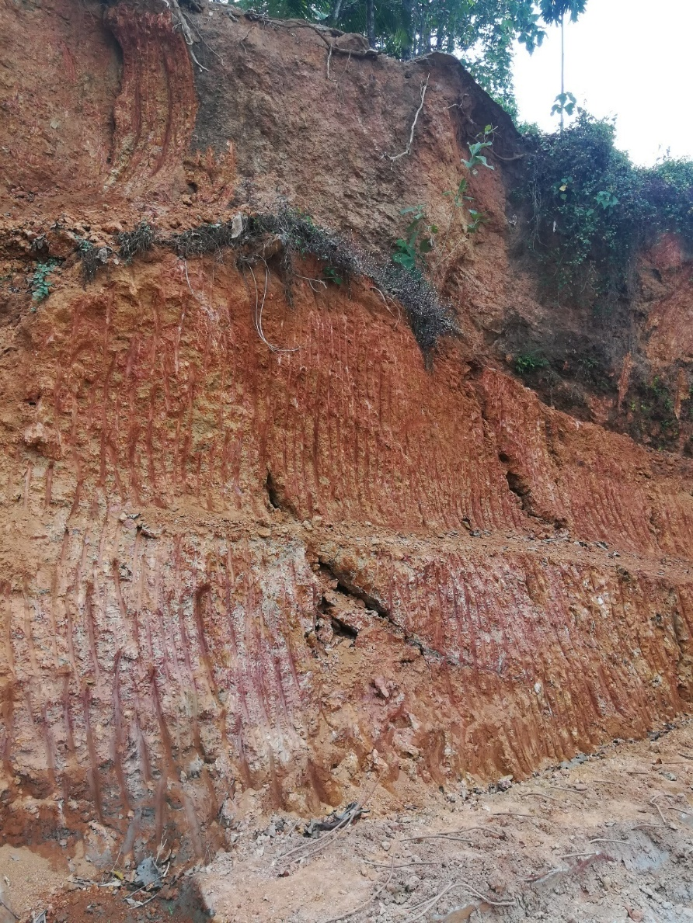

Slide 21
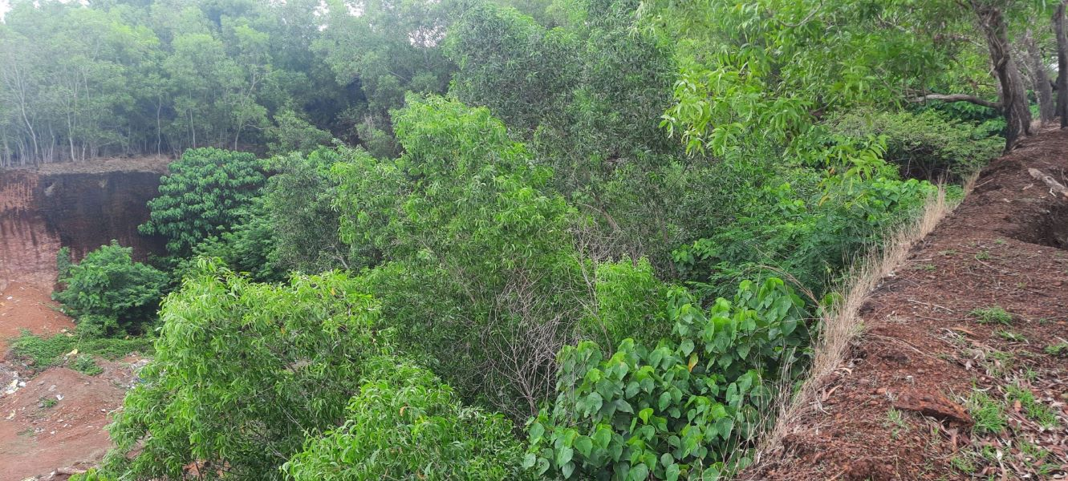
Kasargode

Slide 22
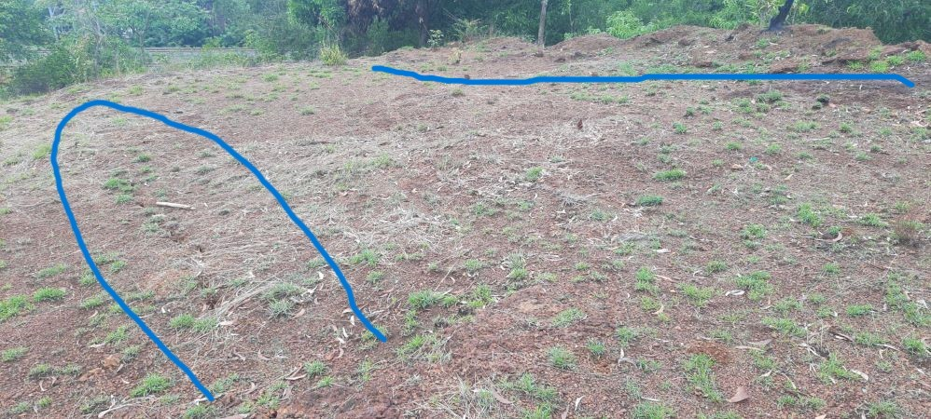

Slide 23
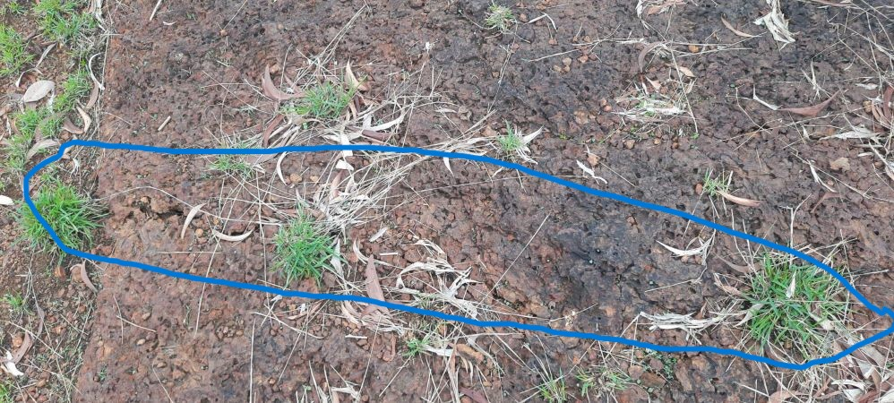

Slide 24
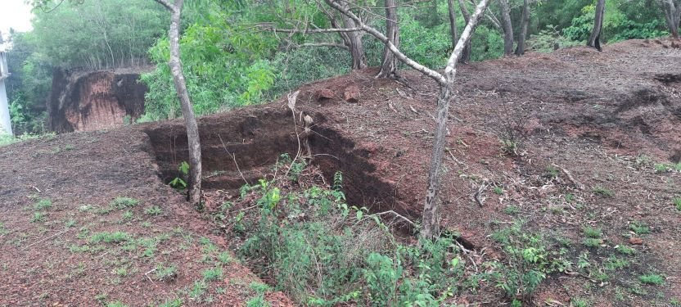

Slide 25
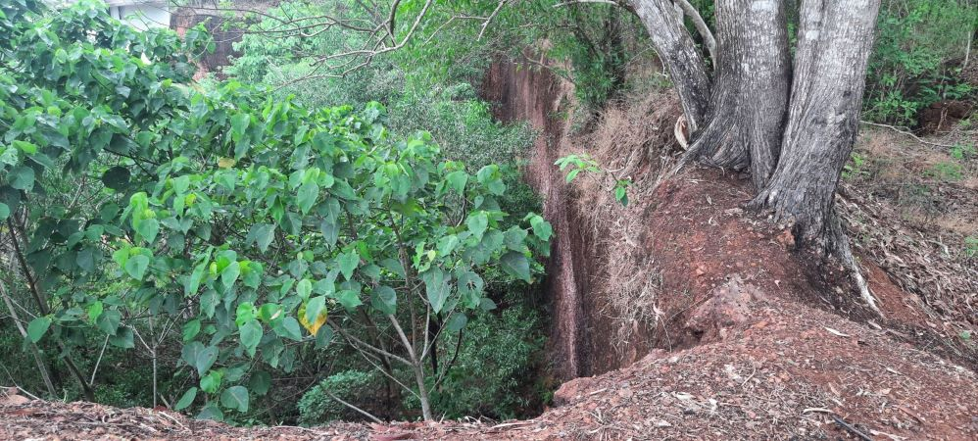

Slide 26
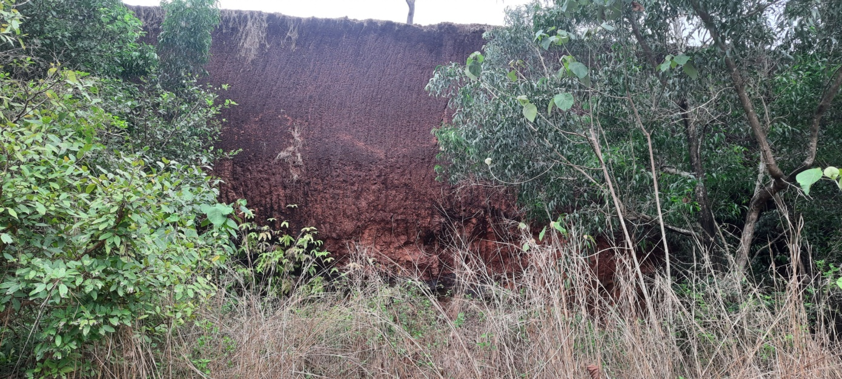

Slide 27
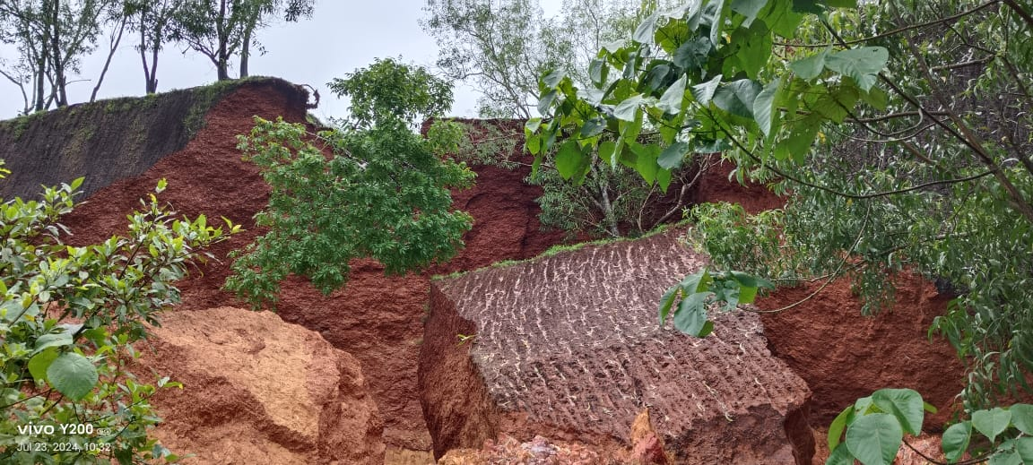

Slide 28
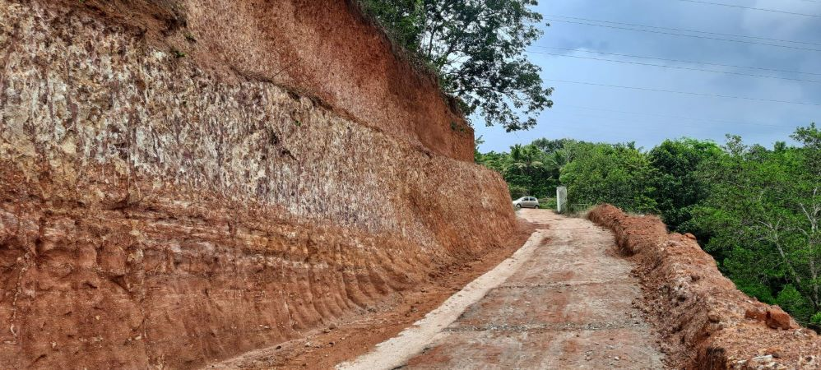
Cutting in Trivandrum

Slide 29
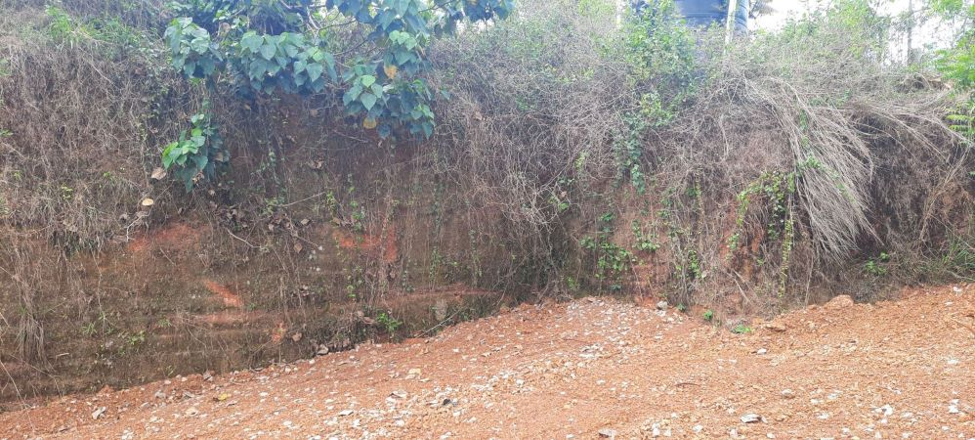

Slide 30
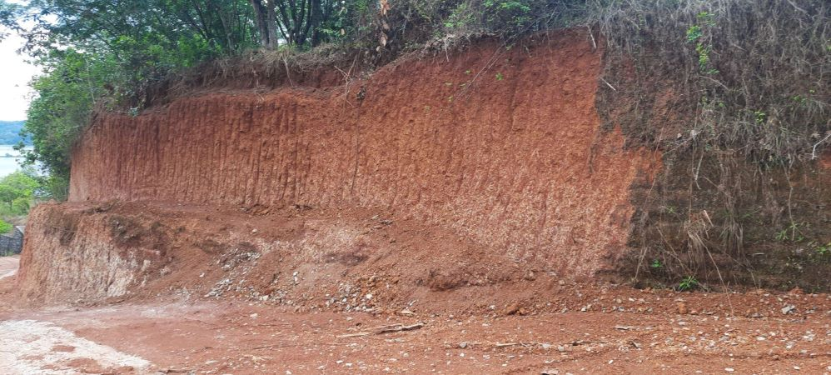

Slide 31
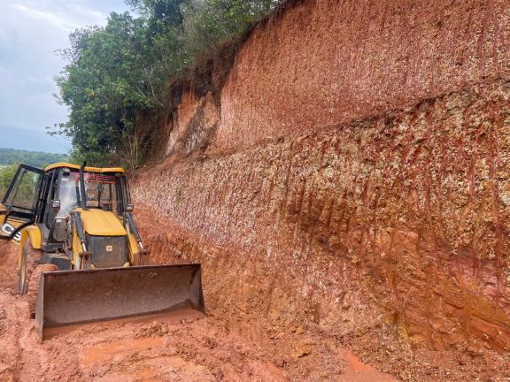
Cutting at Kollam

Slide 32
Comparison of cut surface
In laterite at Trivandrum
and Kollam

Slide 33
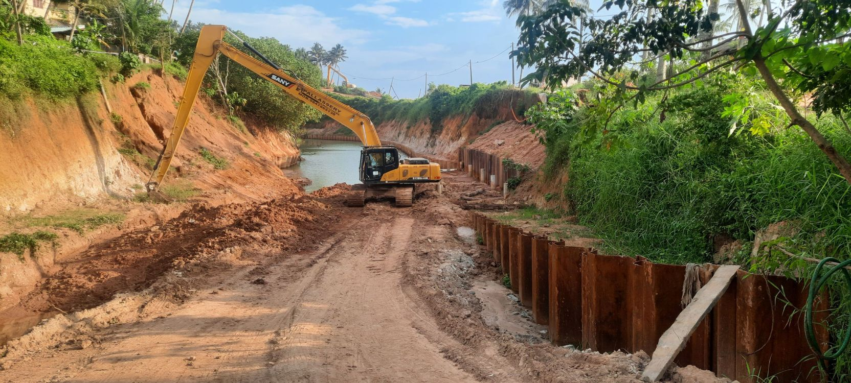
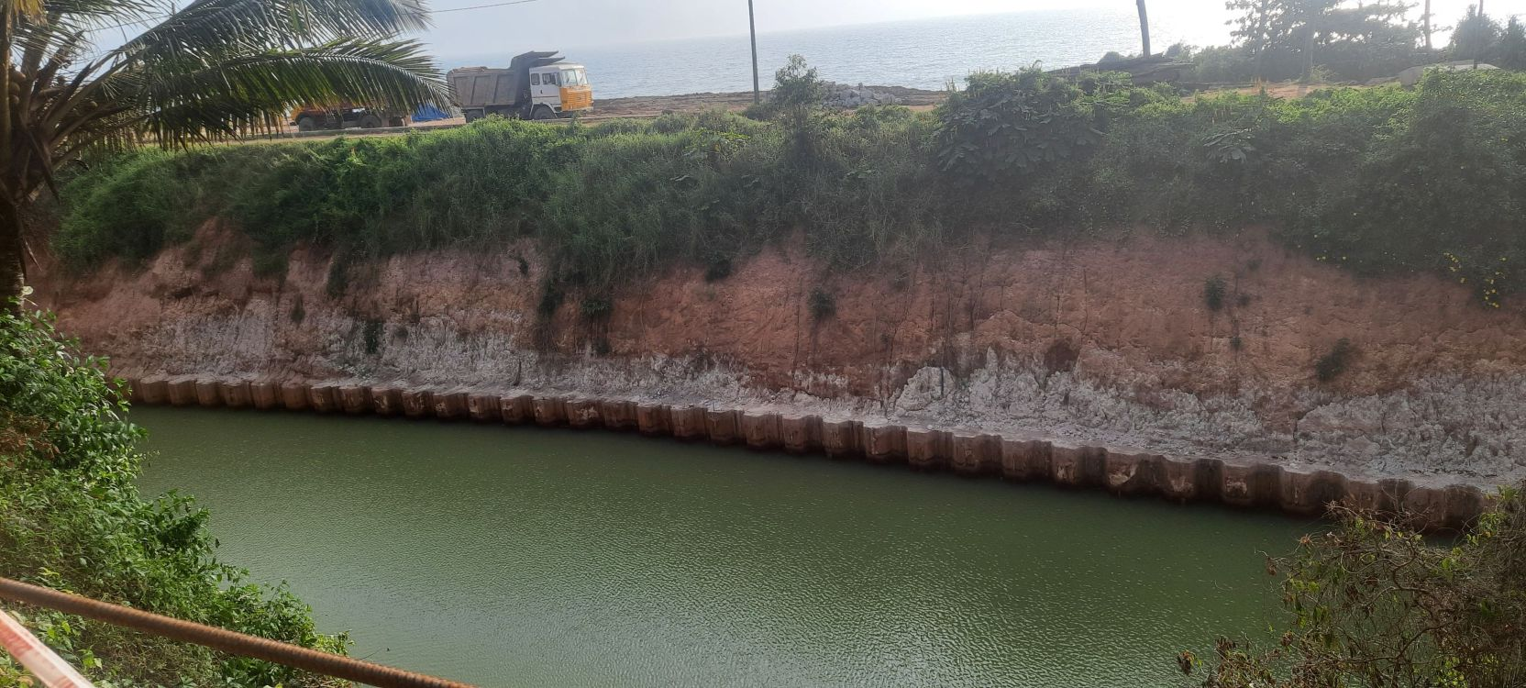

Slide 34
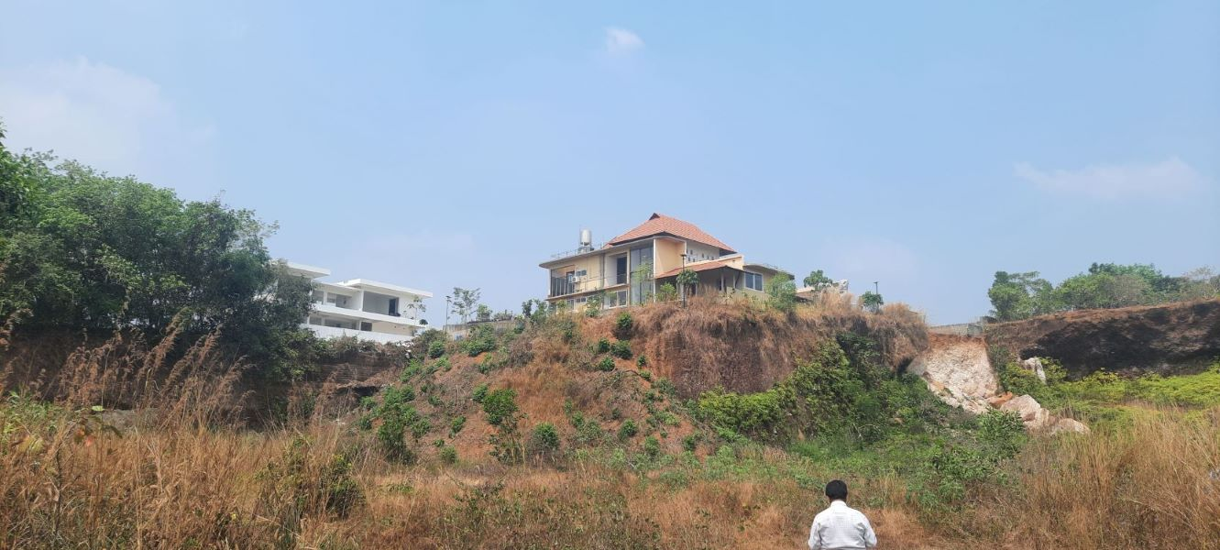
Cutting in Kakkanad, Ernakulam

Slide 35
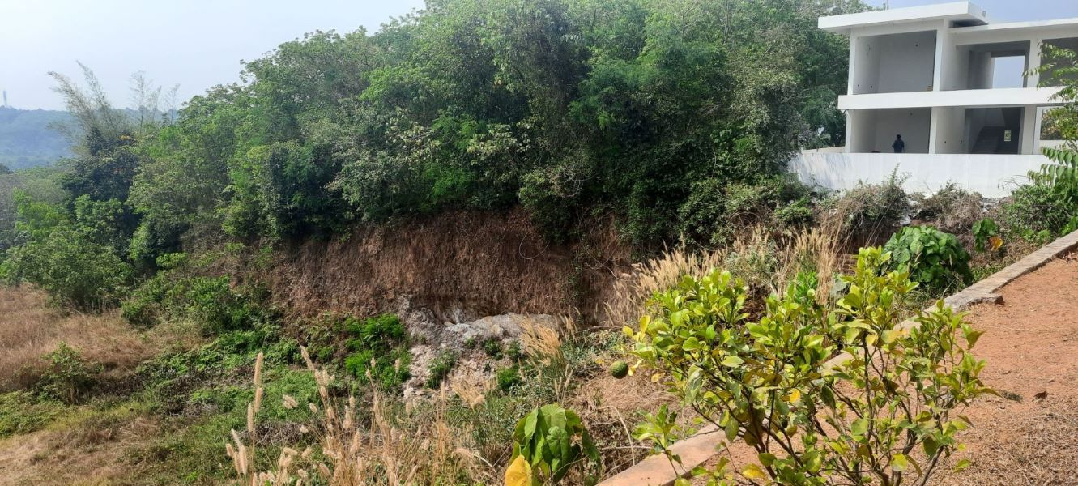

Slide 36
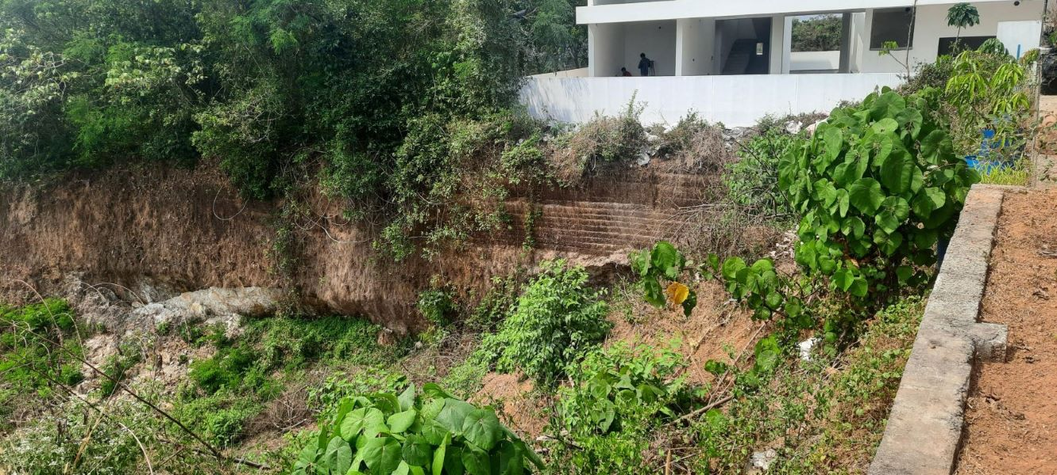

Slide 37
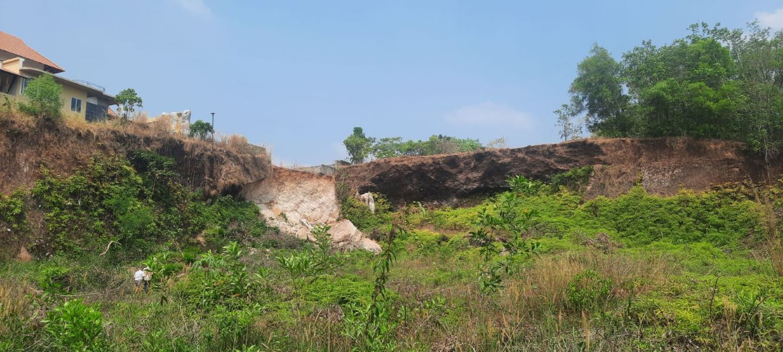

Slide 38
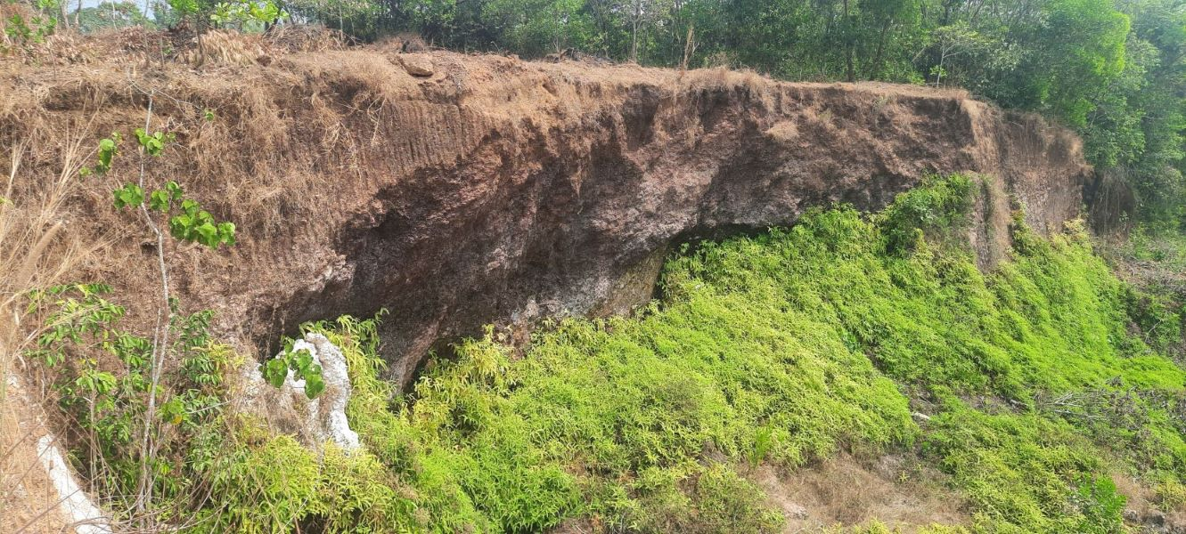

Slide 39
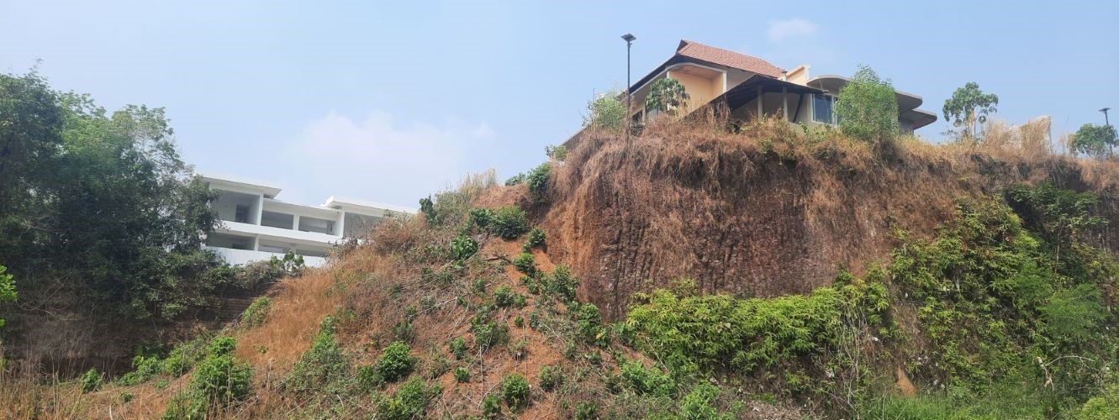

Slide 40
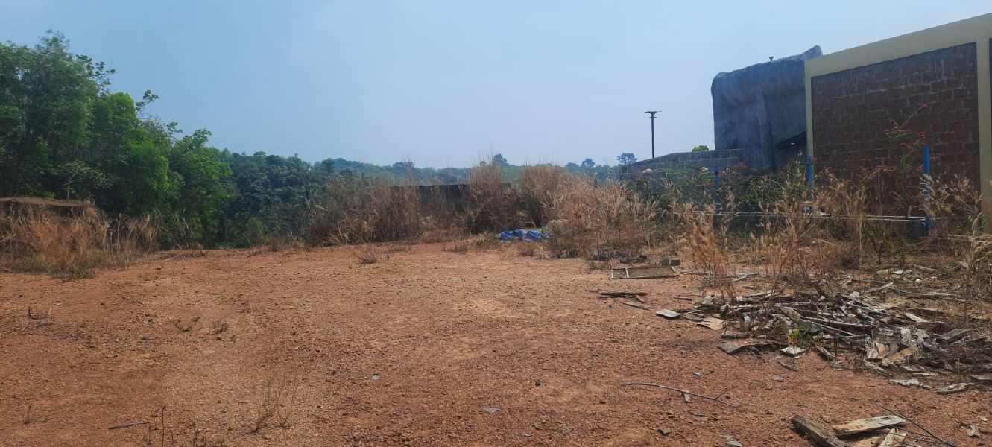

Slide 41
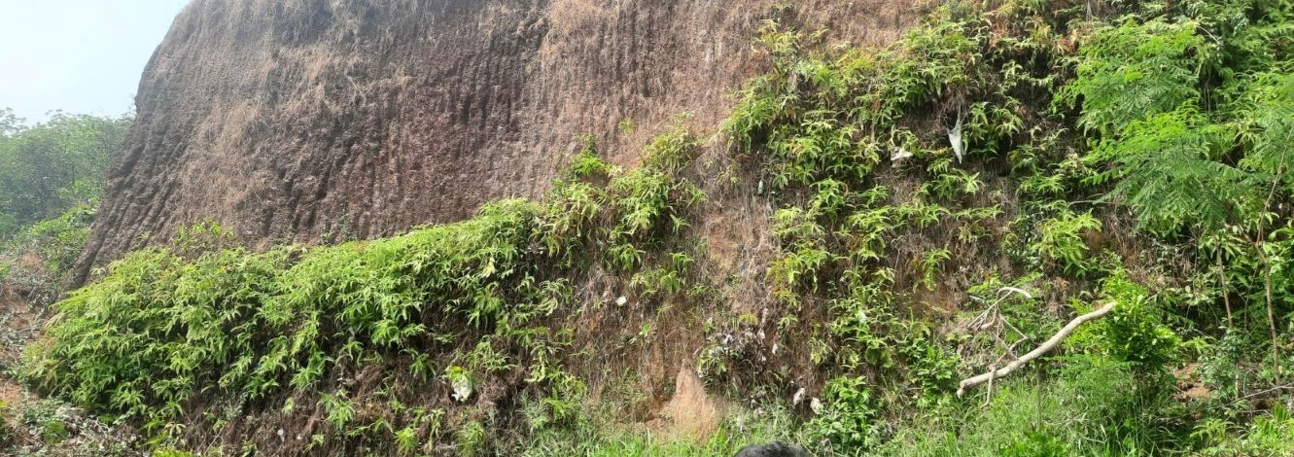

Slide 42
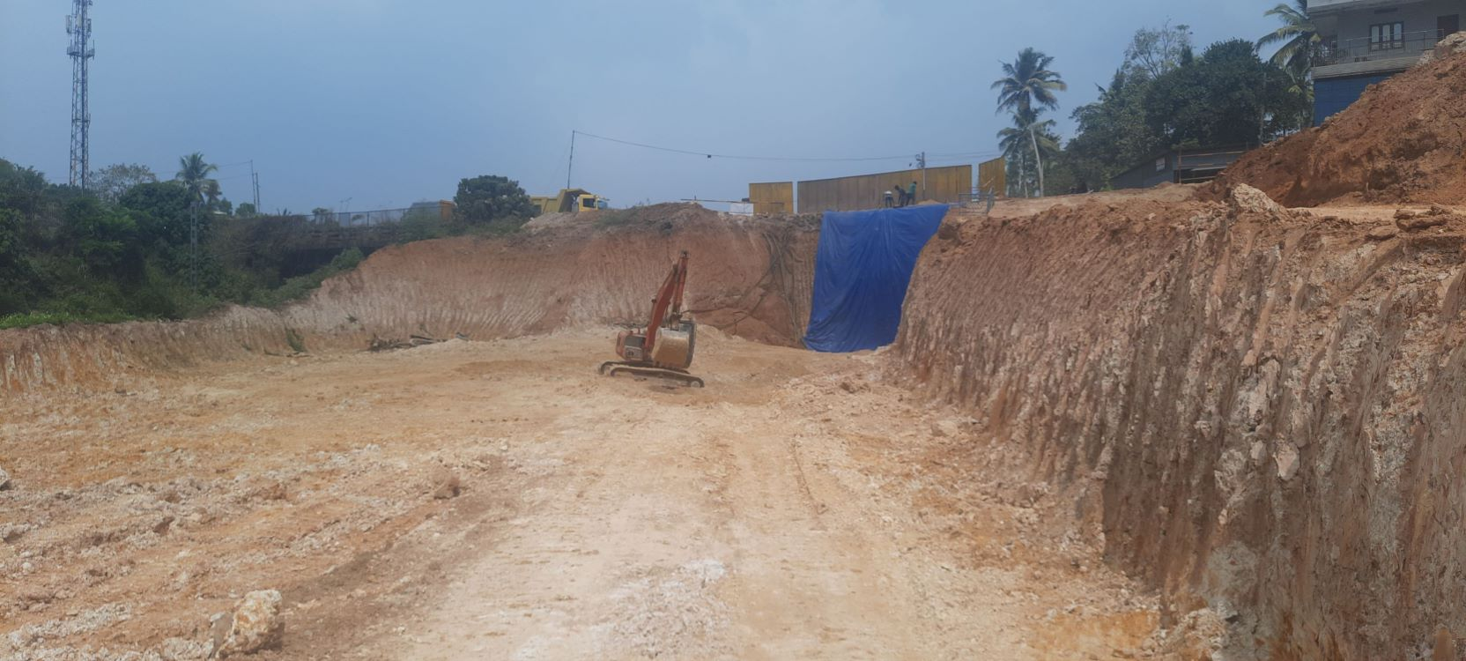
Cutting at Nemom, Trivandrum, Rail doubling project

Slide 43
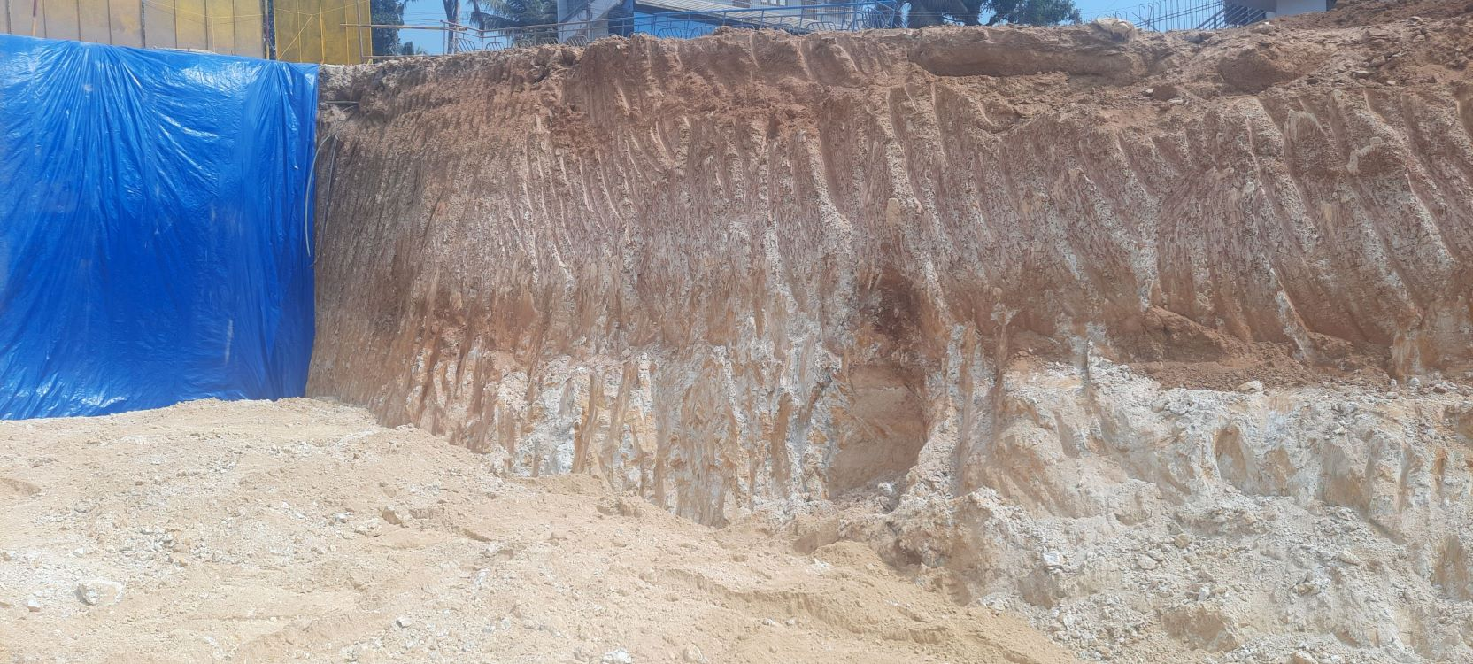

Slide 44
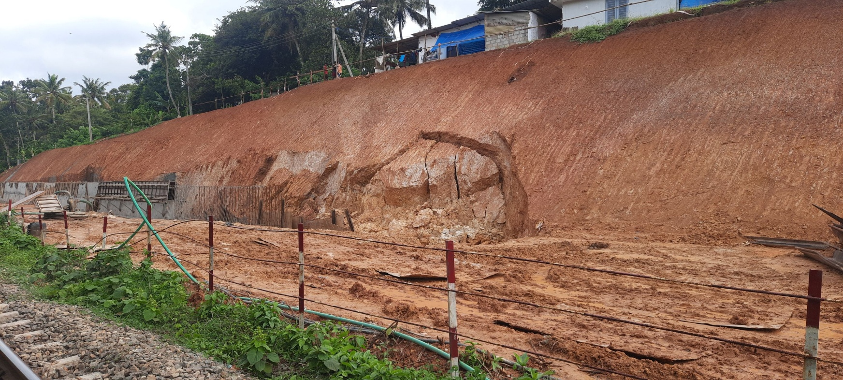
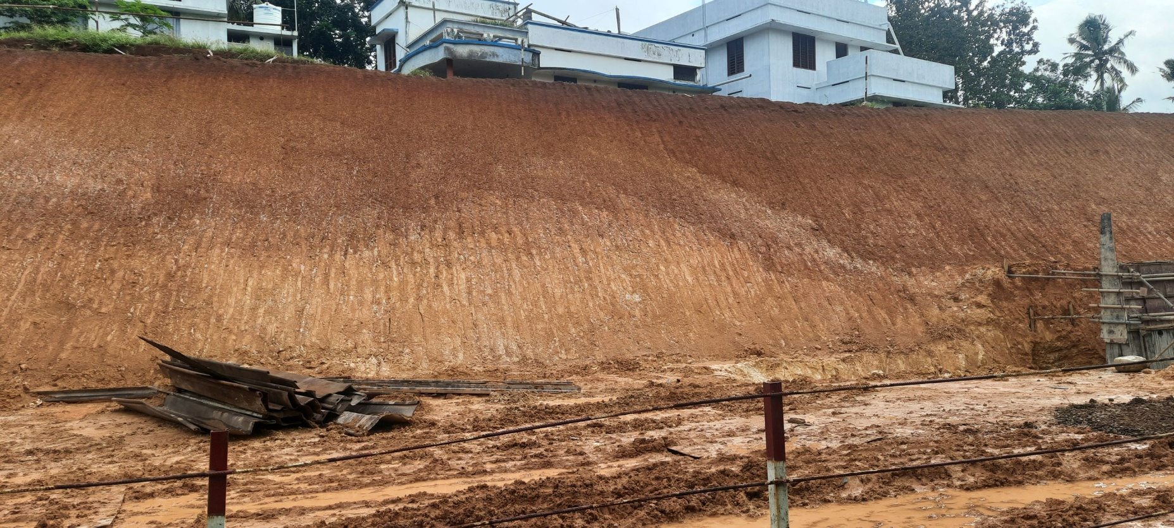

Slide 45
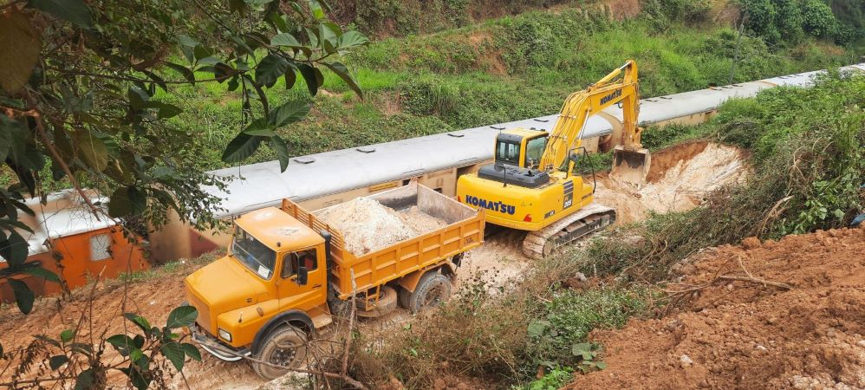
Railway cutting at Parassala

Slide 46
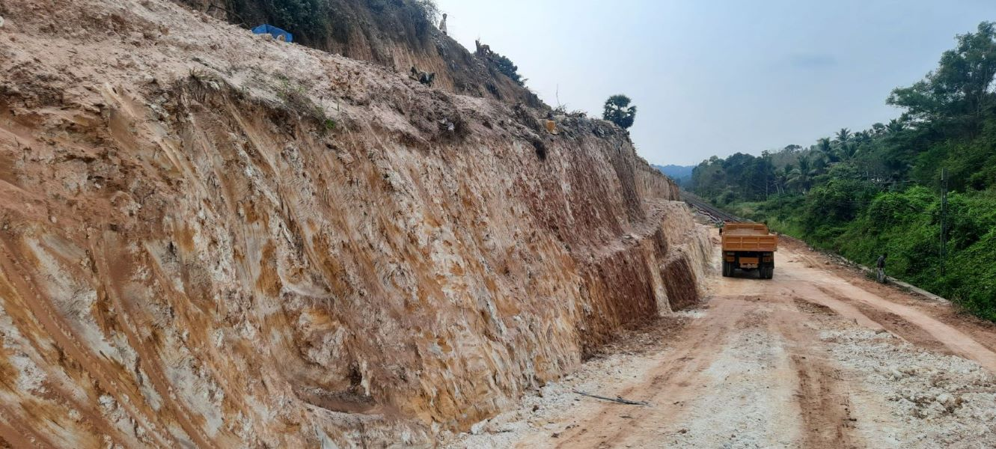

Slide 47
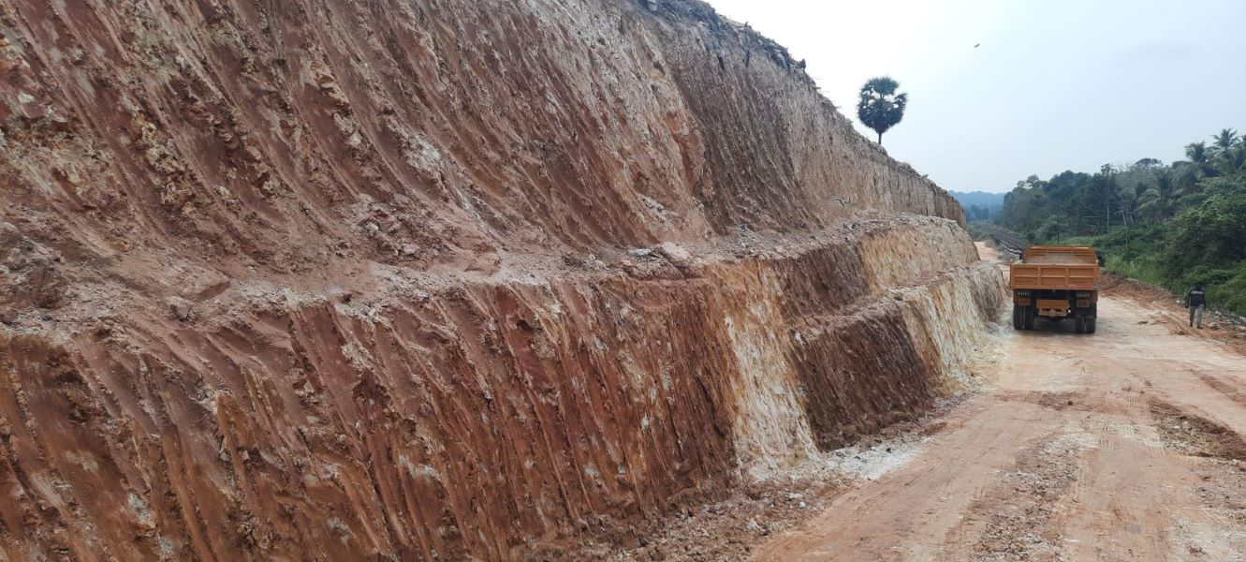

Slide 48
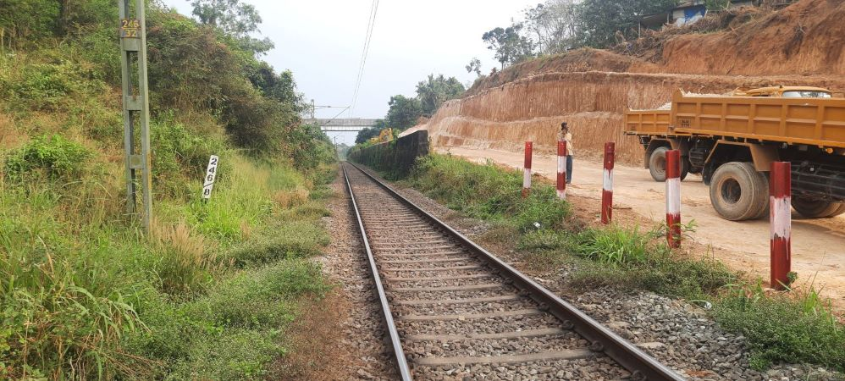

Slide 49
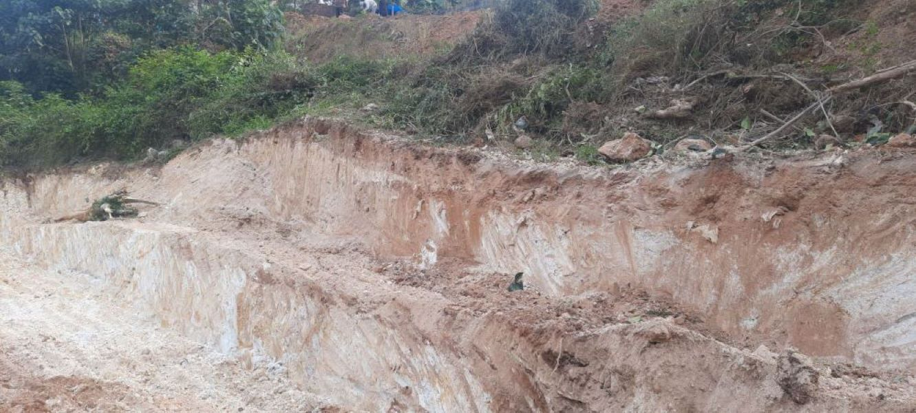

Slide 50
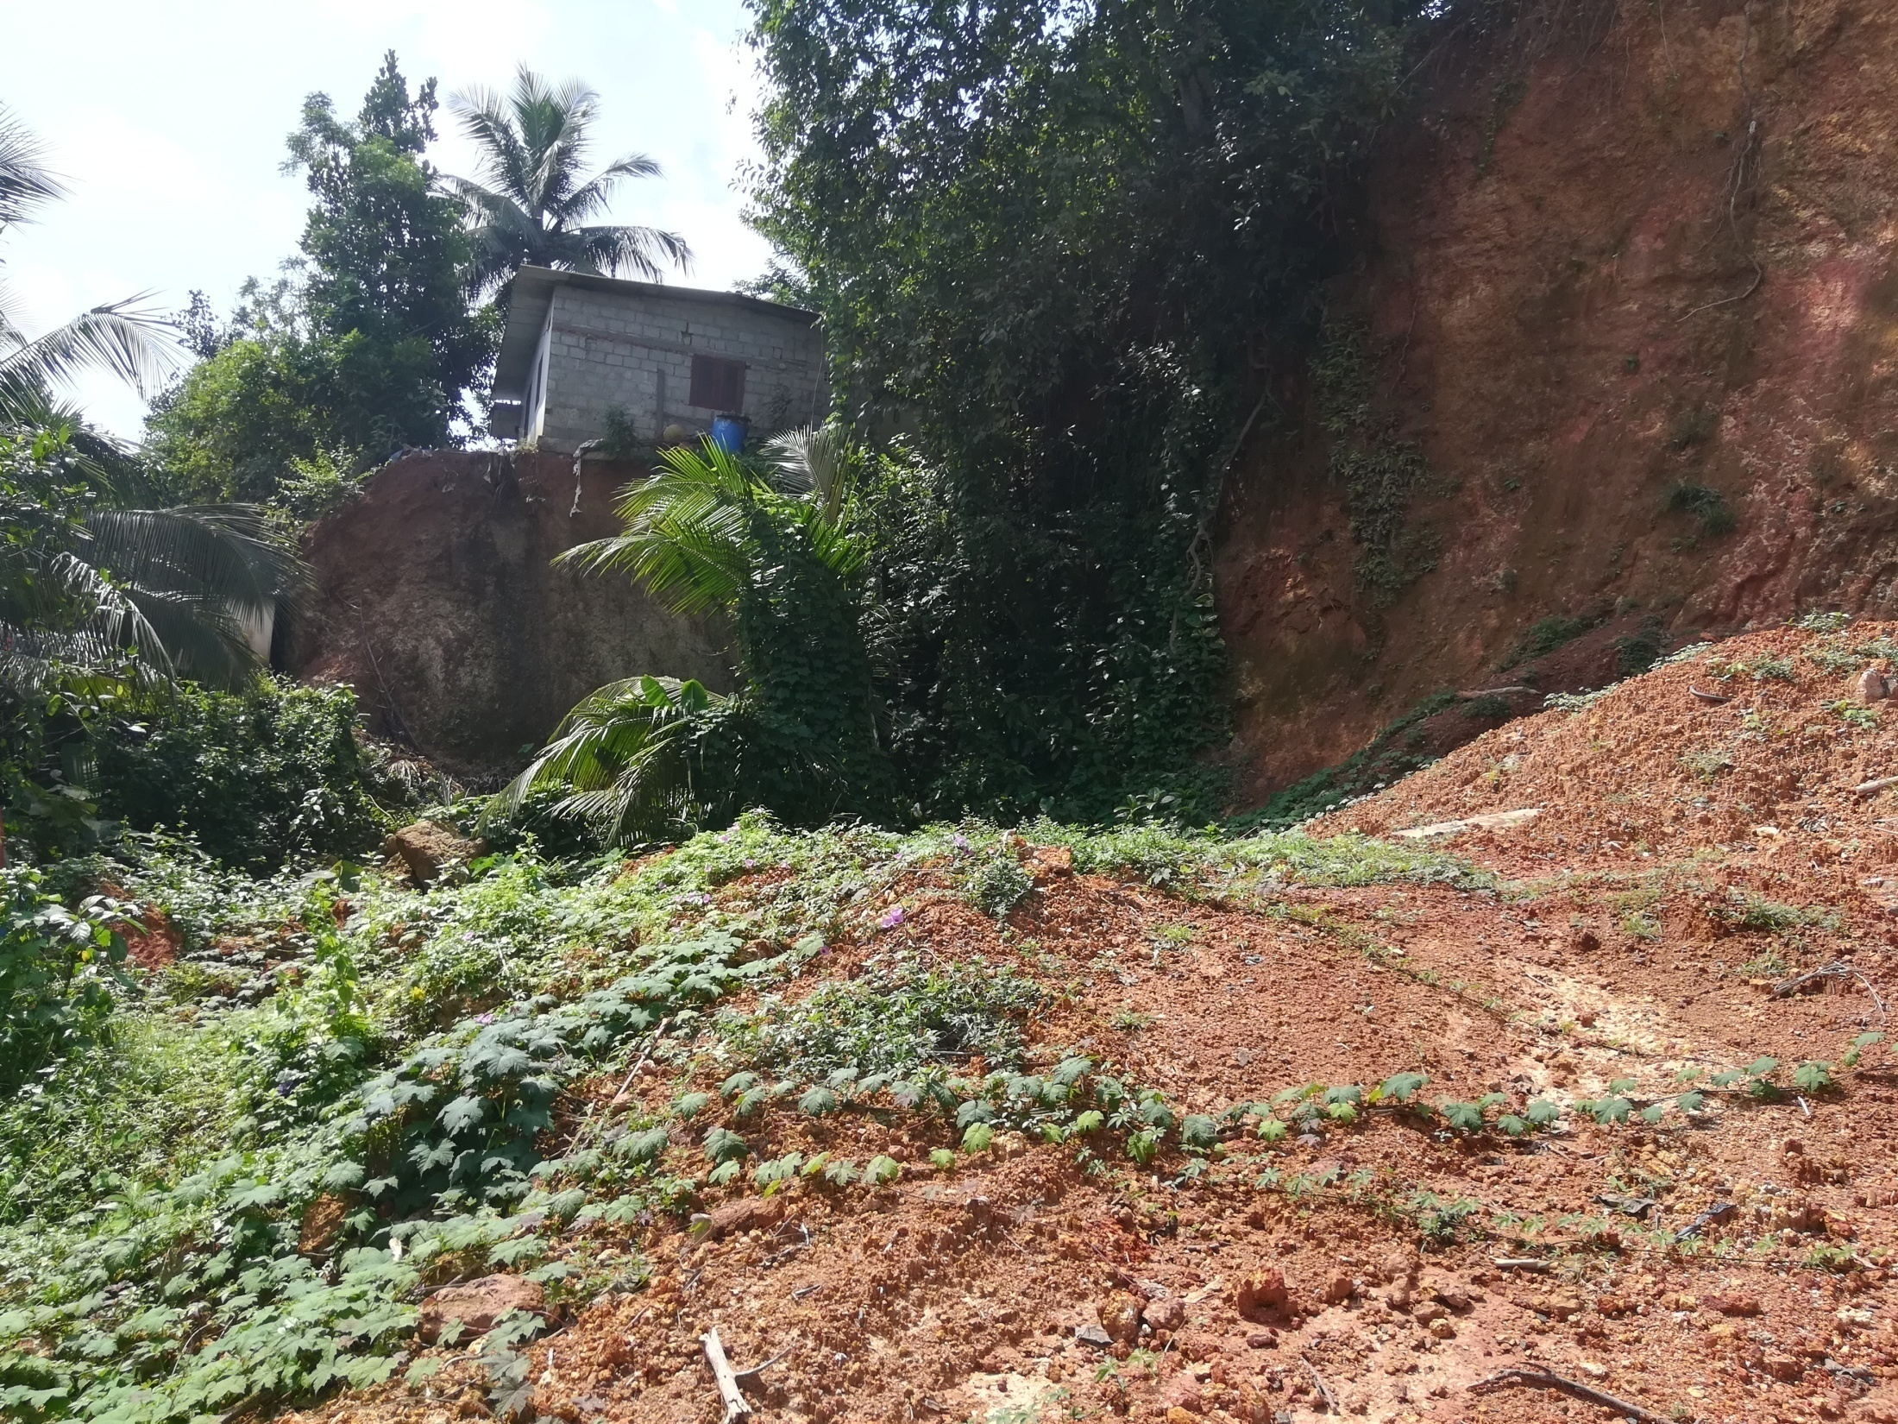
Kottayam

Slide 51
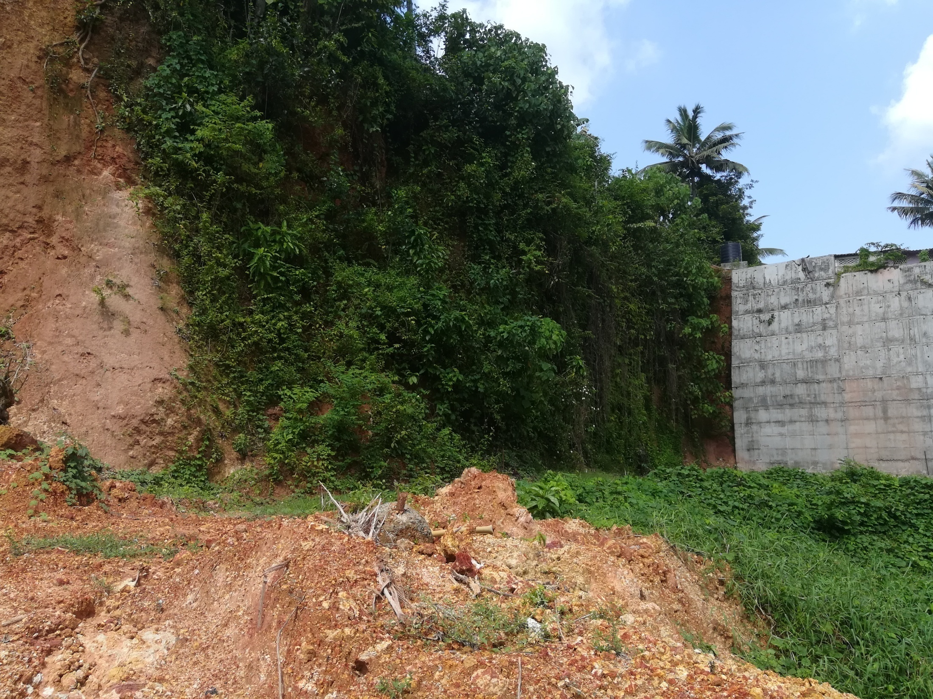

Slide 52
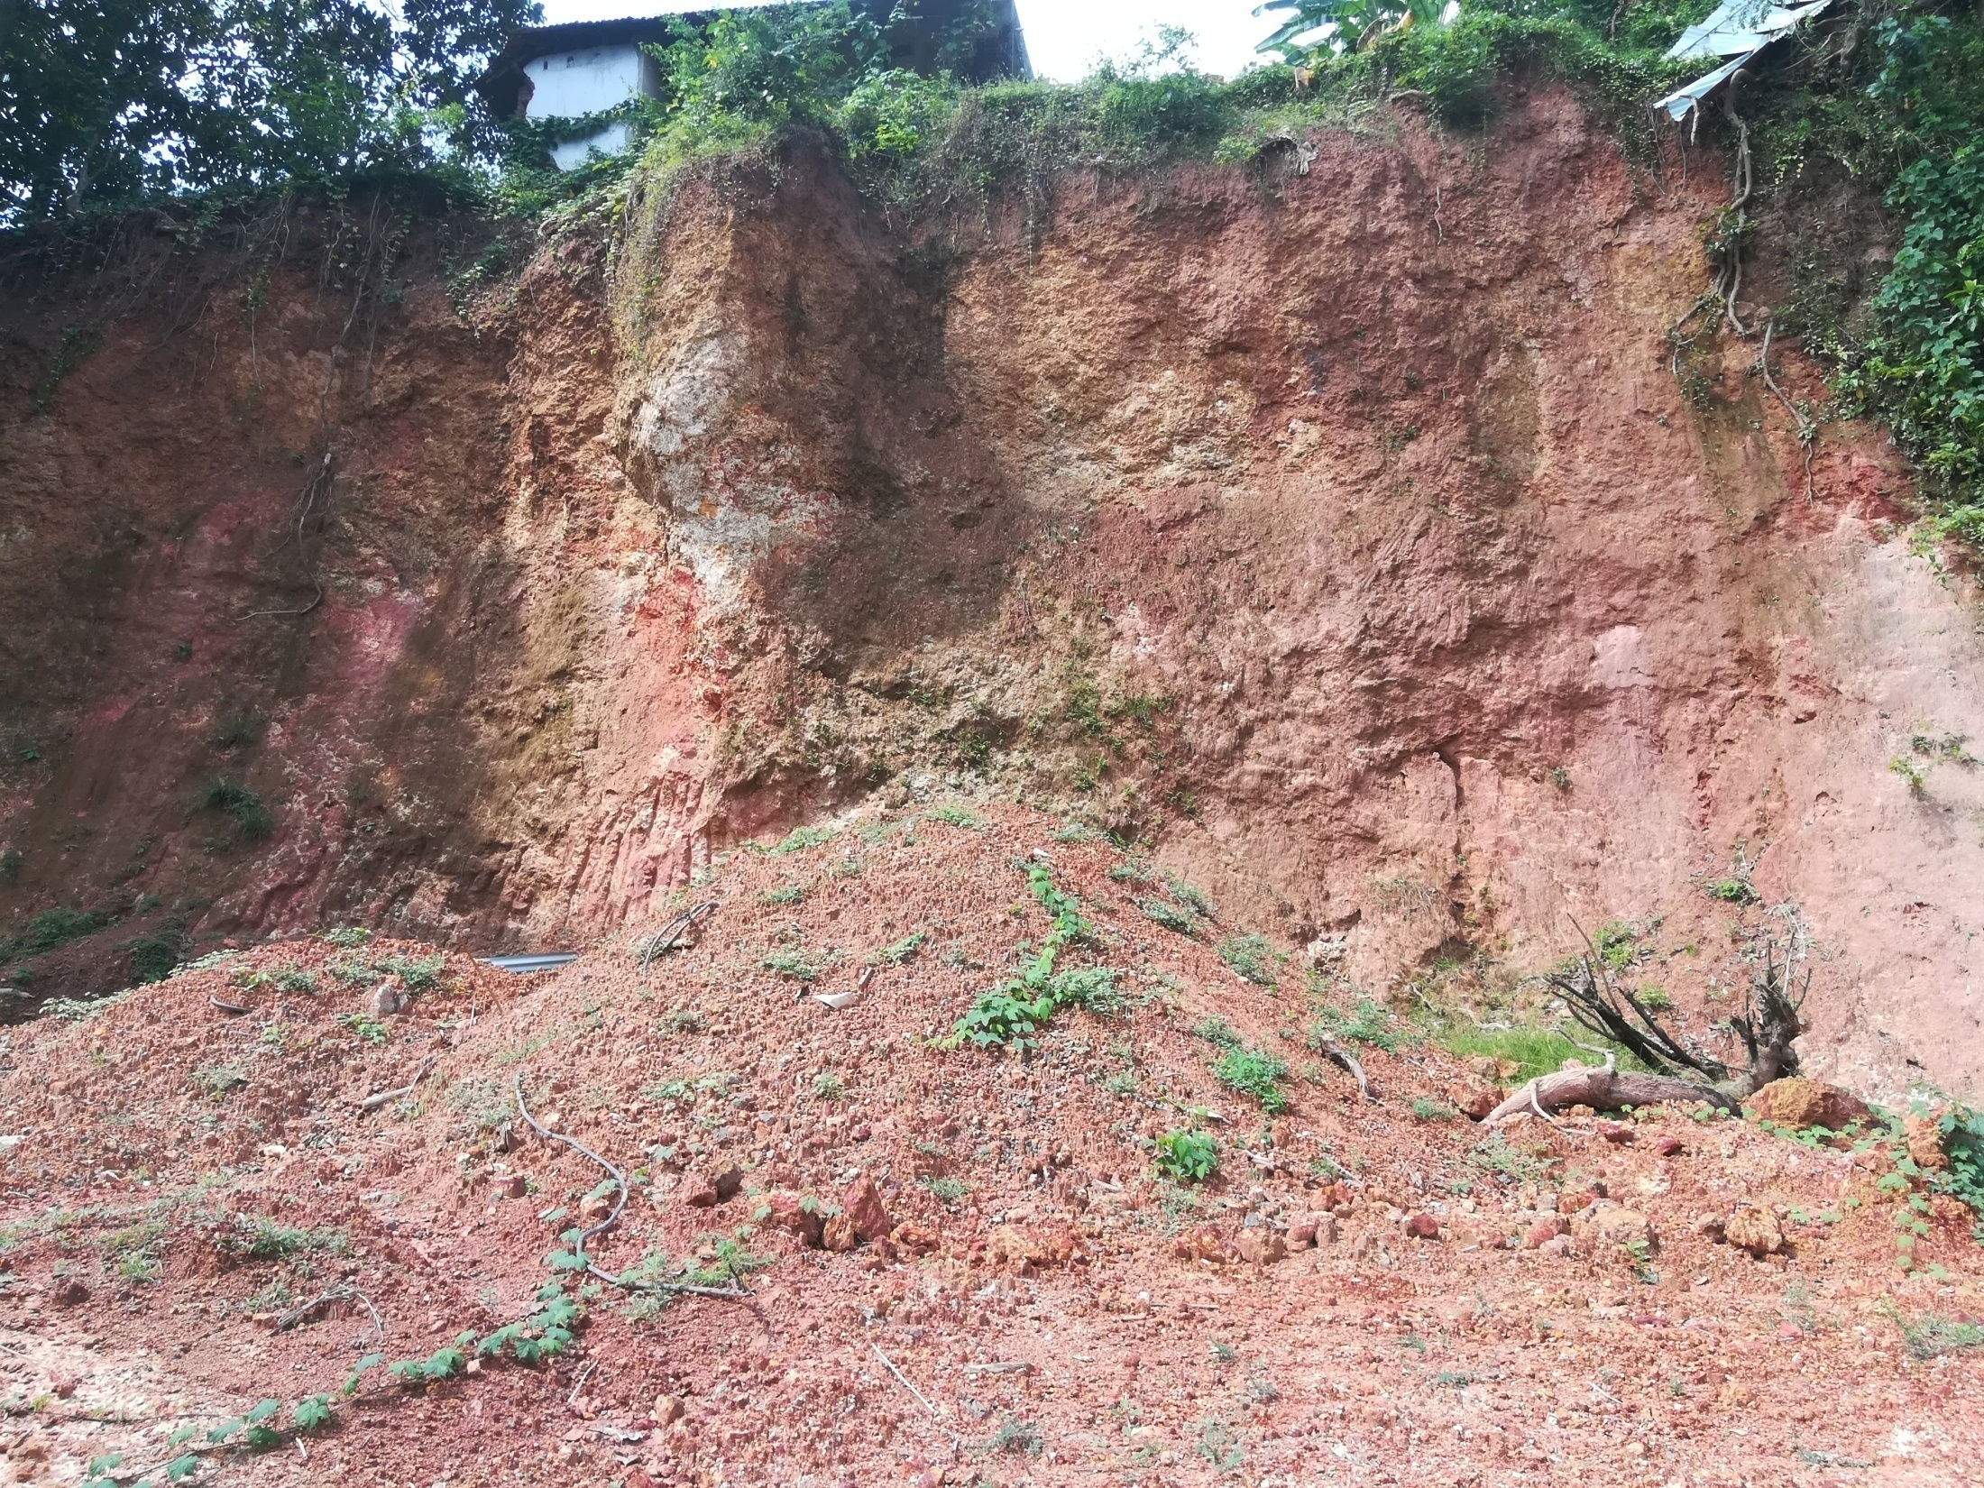

Slide 53
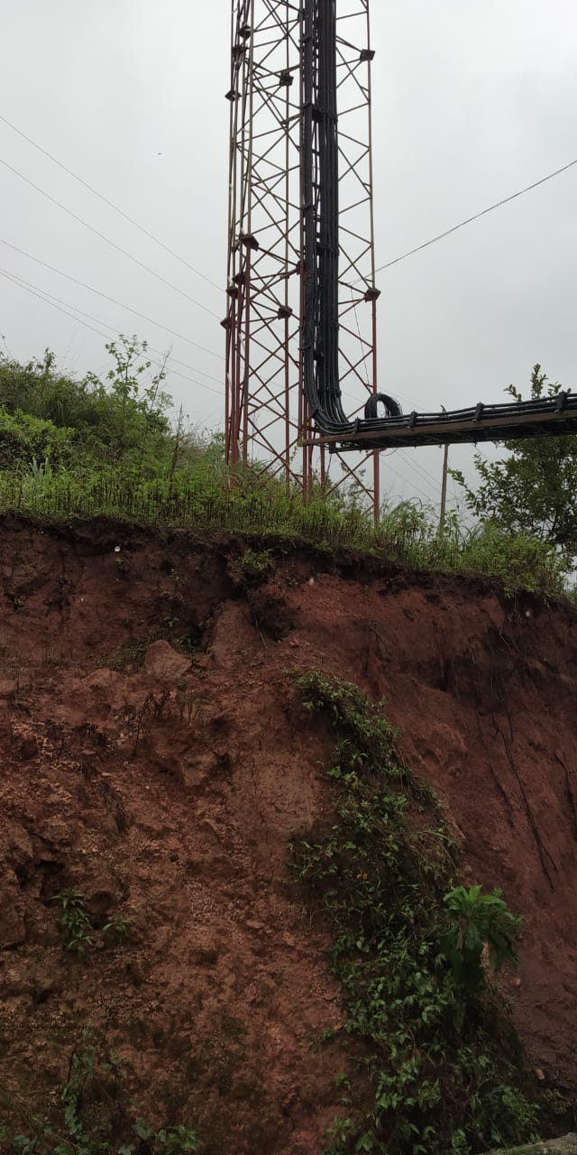


Slide 54


Slide 55


Slide 56


Slide 57


Slide 58


Slide 59


Slide 60


Slide 61


Slide 62


Slide 63



Slide 64


Slide 65


Slide 66


Slide 67



Slide 68


Slide 69


Slide 70


Slide 71


Slide 72


Slide 73


Slide 74


Slide 75


Slide 76
BH1
Existing House
BH4
BH3
BH2
BH2A
Rain water harvesting
WELL

Slide 77
Thank you

